Slide 1
Flights
DB PROJECT

Slide 2
Flight ticket

Slide 4
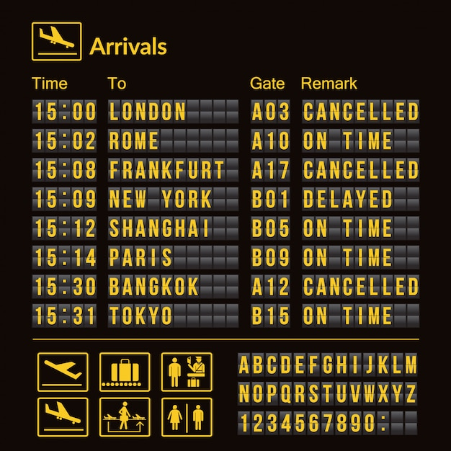
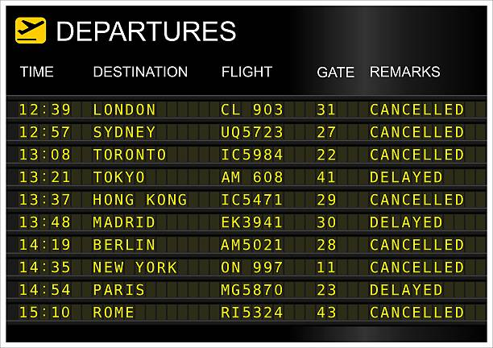
Airport boards

Slide 5
