Slide 1
Database
step-by-step creation of a simple databases

Slide 2

Specification of the problem
In our database, we want to manage information about recipes and its ingredients.
An example would be tea, which contains, for example, hot water, a dried mixture of tea leaves and optionally sugar.

Slide 3
Ingredients
We want to record the name of the ingredients. To simplify our task, we will not register anything else with them. To clearly distinguish the ingredients from each other, we choose a unique identifier in the form of a unique number.
id
unique value for each record
a positive integer
required value
name
text
required value

Slide 4
Recipe
We will also simplify the recipe itself. We will only record the name, the date of entering the recipe into the database and again a unique identifier.
id
unique value for each record
a positive integer
required value
name
text
required value
dttm
Date and time: YYYY-MM-DD HH:MM:SS
required value

Slide 5
Table with relationships
recipe
ingredient
id | name | dttm
1 | tea | 2023-09-10 14:00:00
2 | pancake | 2023-09-10 15:20:00
3 | chicken schnitzel | 2023-10-01 16:00:00
4 | cappuccino | 2023-10-15 08:00:00
id | name
1 | water
2 | tea leaves
3 | salt
4 | sugar
5 | flour
6 | pork
7 | egg
8 | milk
9 | chicken breast
We can visualize the data in tables.

Slide 6
Relationships between records
We record recipes and ingredients, but we do not link them together. It is not yet possible to determine what ingredients the tea is made from.
So, we must think about the relationship itself and what we expect from it.
Relationship properties:
Recipe must have at least one ingredient. There may be more.
An ingredient can be in more than one recipe. For example, milk can be in a pancake recipe as well as a milkshake.
From the relationship of the ingredient to the recipe, we should also know the quantity.

Slide 7
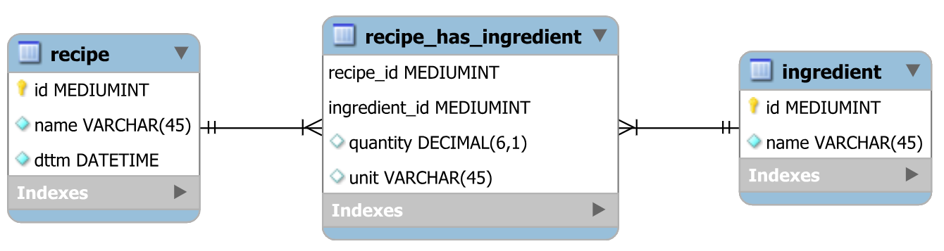
E-R diagram (MySQL Workbench)

Slide 8
Table again
recipe
ingredient
id | name | dttm
1 | tea | 2023-09-10 14:00:00
2 | pancake | 2023-09-10 15:20:00
3 | chicken schnitzel | 2023-10-01 16:00:00
4 | cappuccino | 2023-10-15 08:00:00
id | name
1 | water
2 | tea leaves
3 | salt
4 | sugar
5 | flour
6 | pork
7 | egg
8 | milk
9 | chicken breast
recipe_has_ingredient
recipe_id | ingredient_id | quantity | unit
1 | 1 | 250 | ml
1 | 2 | 3 | g
1 | 4 | 4 | g

Slide 9
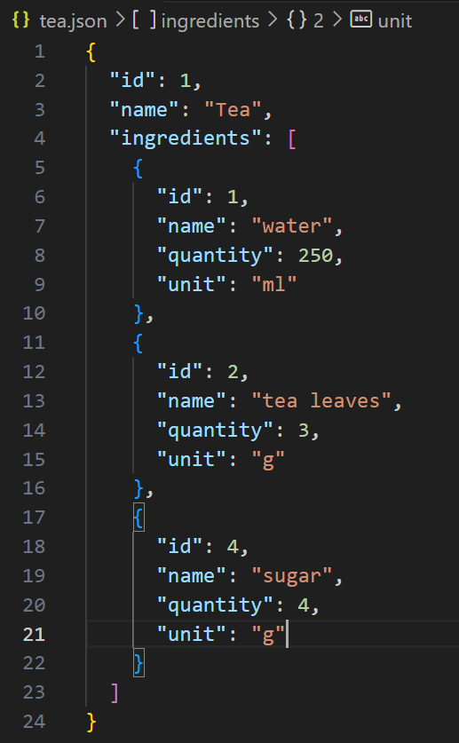
File formats
Databases also use special data file formats for data transfer:
JSON
XML
CSV

Slide 10
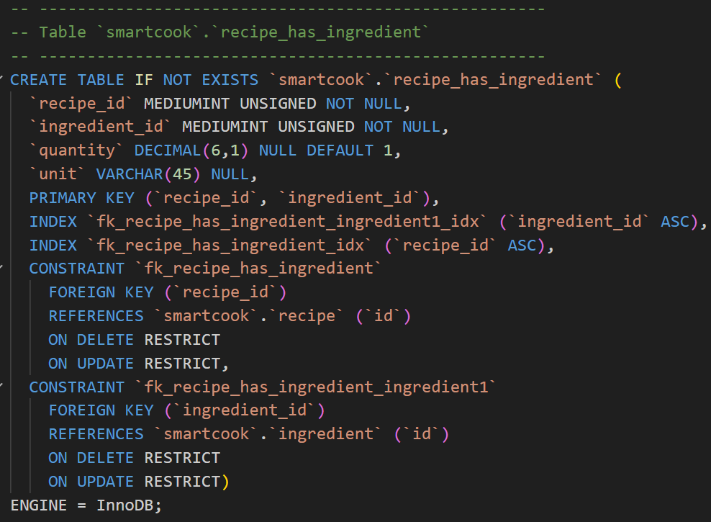
SQL

Slide 11
SQL
INSERT INTO ingredient VALUES (NULL, ‘sugar')
INSERT INTO ingredient(name) VALUES ('salt'), ('milk'), ('water')
UPDATE ingredient SET name=‘butter‘ WHERE id=4
DELETE FROM ingredient WHERE id=3

