Slide 1
Static web presentation
step-by-step creation of a simple website

Slide 2
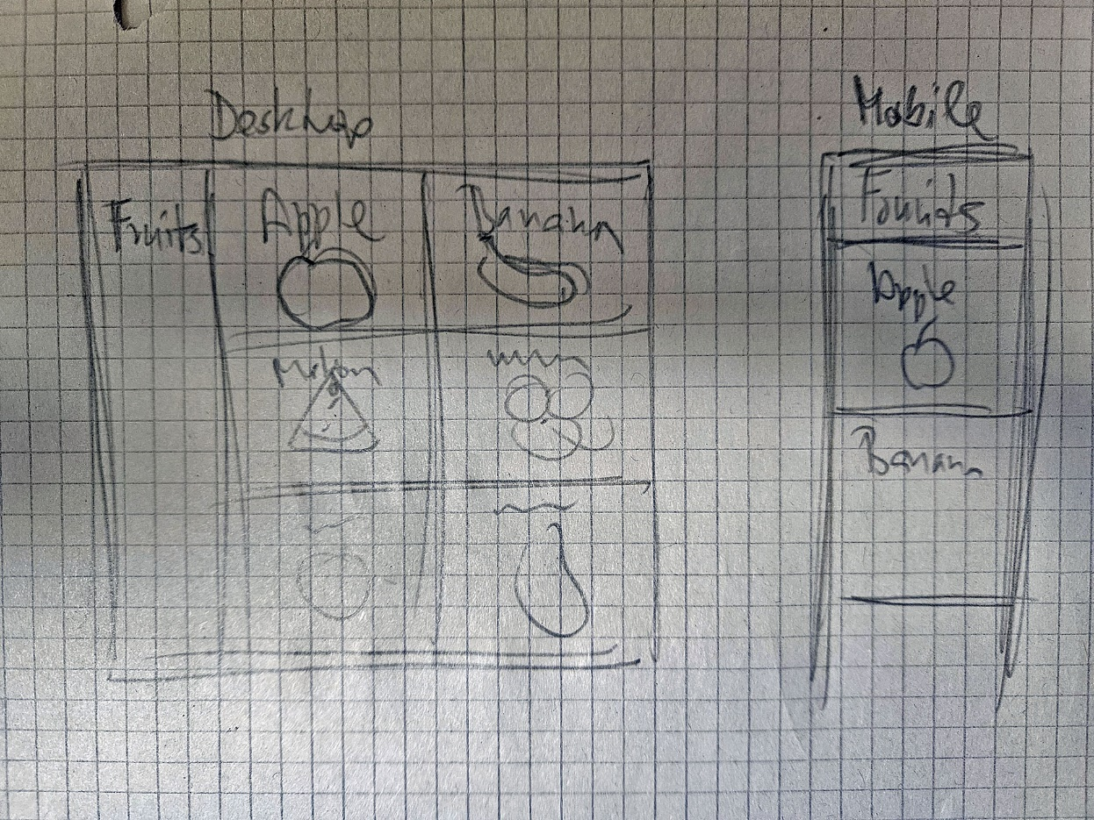
The concept
The first idea of the appearance of the website.

Slide 3
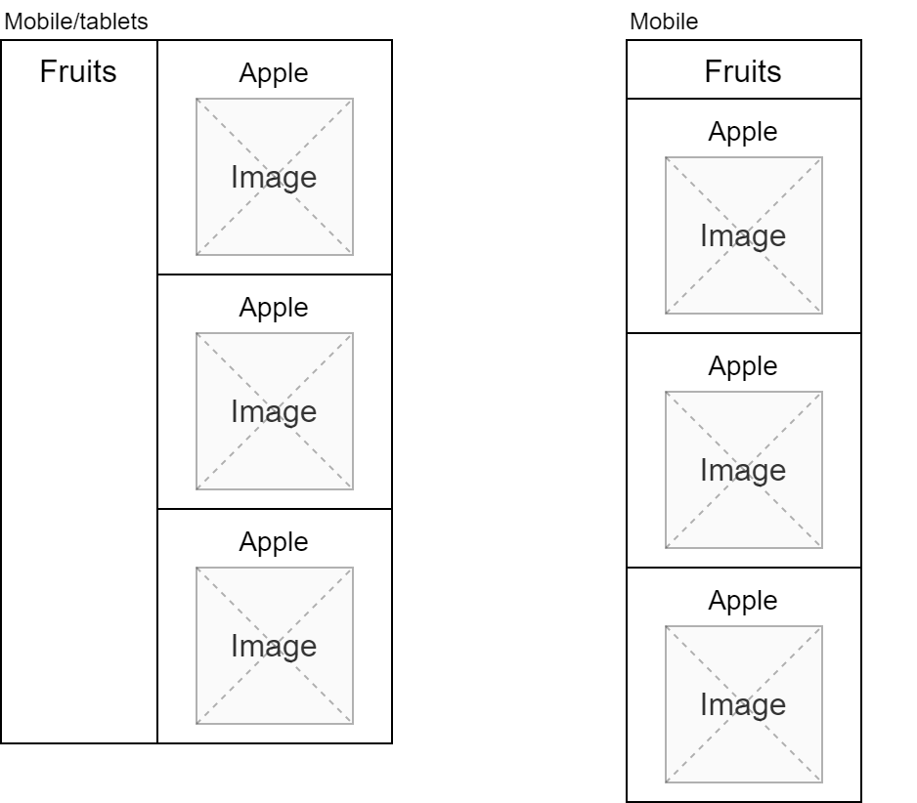
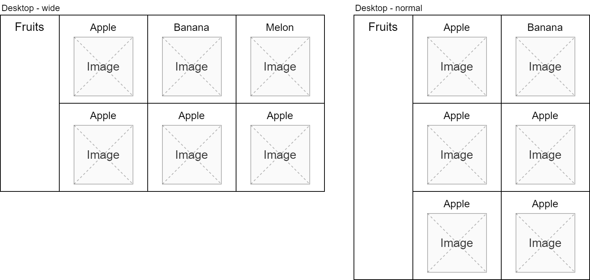
Wireframe
Desktop
Mobile

Slide 4
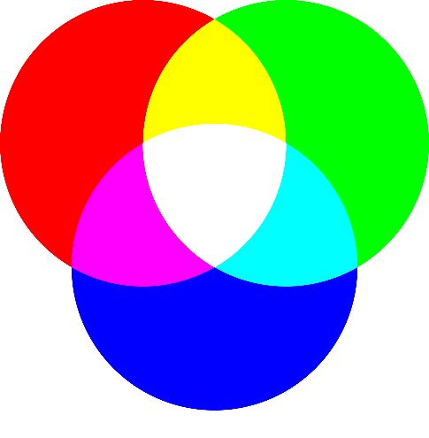
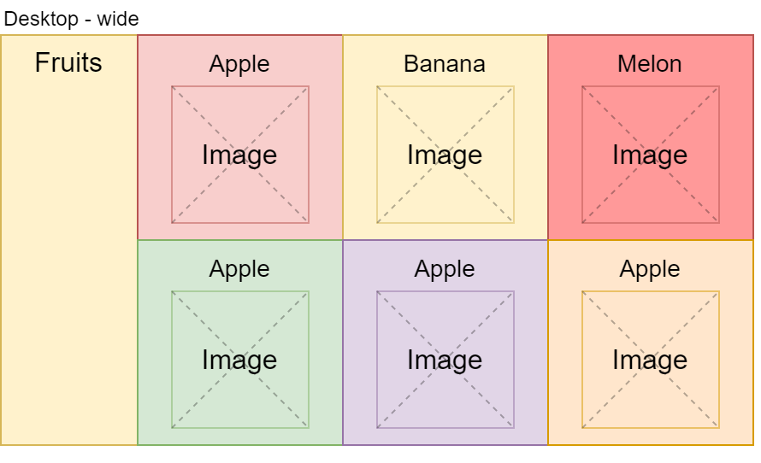
Colors
A basic idea about web color.
The colors will be according to the individual types of fruit. The color code itself is used from the images. Dark in the background, light in the foreground.

Slide 5
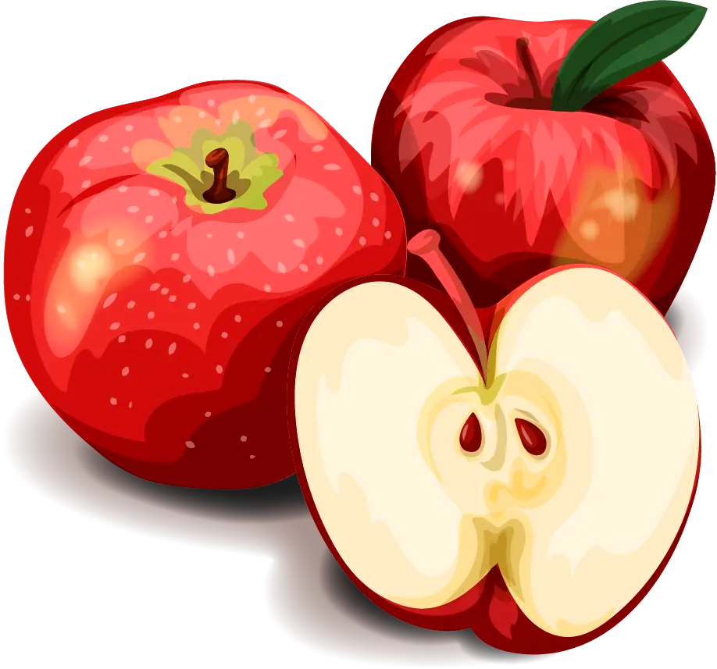
Images
Image file formats:
JPG
PNG
WEBP (used)
SVG
Source: https://www.freepik.com
https://www.freepik.com/free-vector/detailed-fruit-collection_13839306.htm
License: Free license (attribution is required)

Slide 6
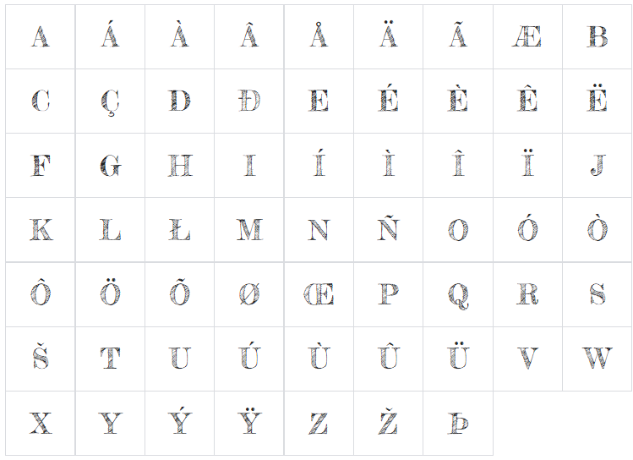
Font
We used the Fredericka the Great font for our website.
https://fonts.google.com/specimen/Fredericka+the+Great
These fonts are licensed under the Open Font License.
https://scripts.sil.org/cms/scripts/page.php?site_id=nrsi&id=OFL

Slide 7
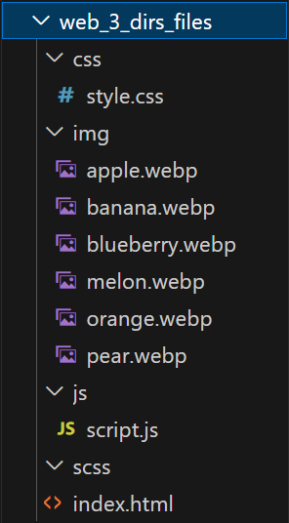
Website directory structure
A basic simple web presentation will contain images (webp) and source files for content(html), design(css, scss) and possibly website dynamics (js).
For this we will create a standard directory structure.

Slide 8
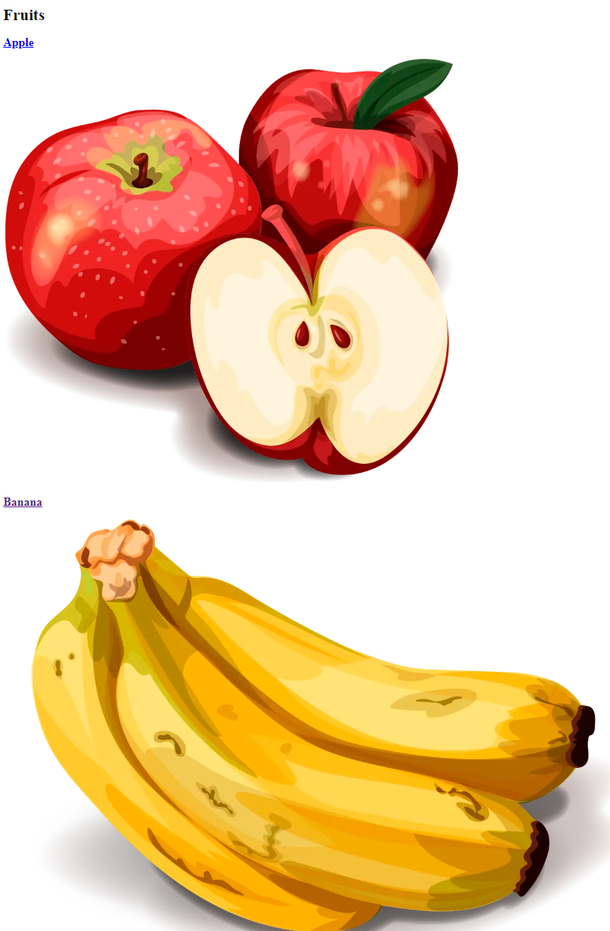
Content (HTML)
<!DOCTYPE html>
<html lang="en">
<head>
<meta charset="UTF-8" />
<title>Fruits</title>
</head>
<body>
…
</body>
</html>

Slide 9
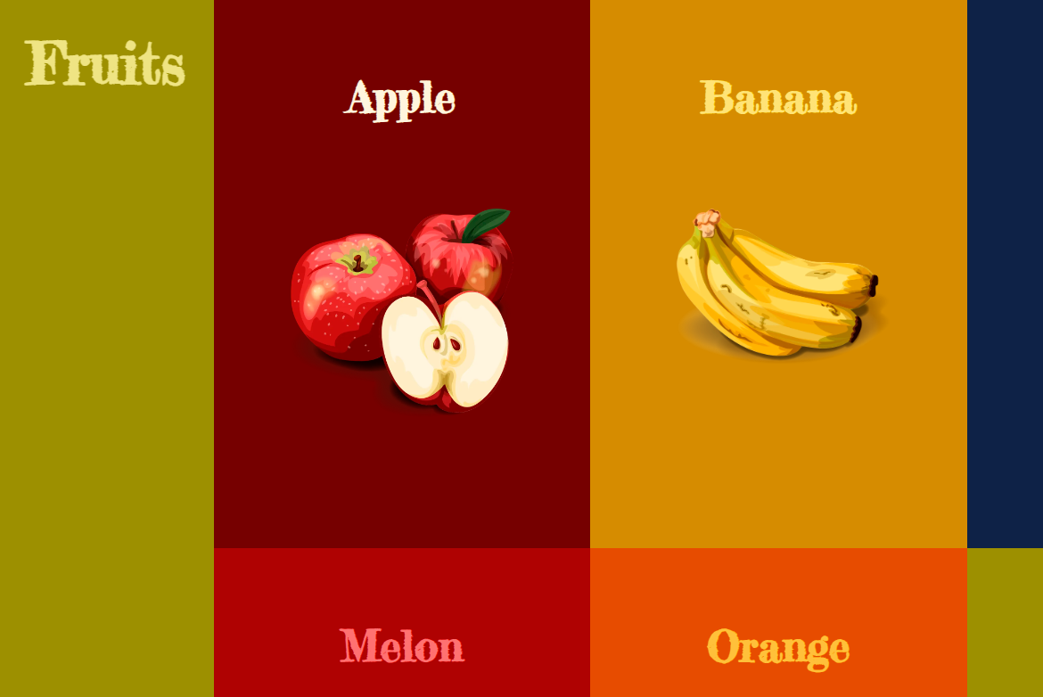
Design (CSS, SCSS)
* {
margin: 0;
padding: 0;
}
body {
font-family: "Fredericka the Great", cursive;
font-size: 16px;
font-weight: 400;
}
a {
text-decoration: none;
transition: all 500ms ease-in-out;
}

Slide 10
Hosting and domain
In order for a website to run on the Internet, it needs to be placed on a publicly accessible server (hosting) under a publicly accessible address (domain, URL).
URL:
https://www.smartcook.eu
https://www.smartcook-project.eu/workshop/web/

Slide 11
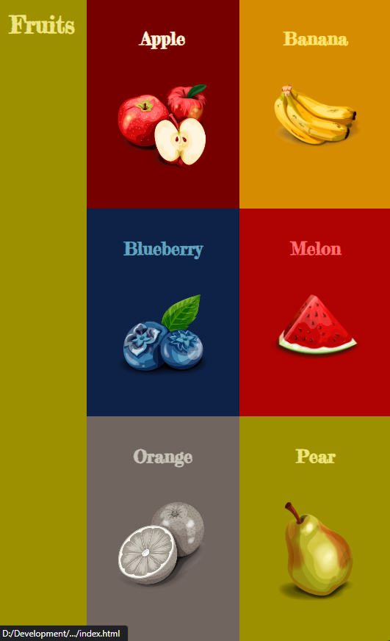
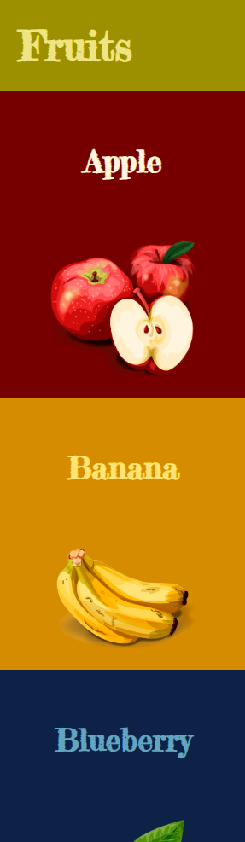
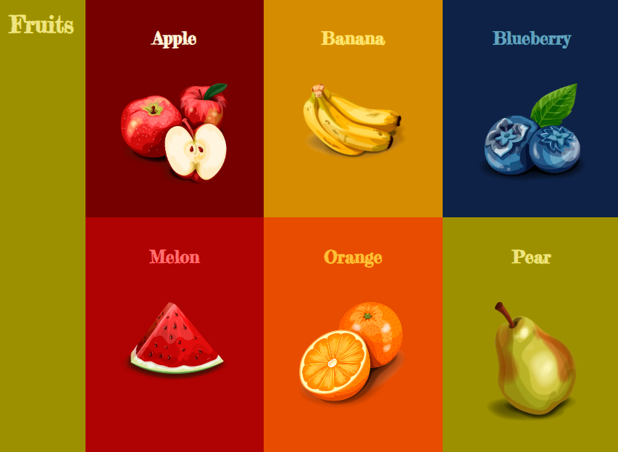
Result

Slide 12
Website as a Service
We can also create websites without knowledge of coding in HTML or CSS. We can use web services, such as wix or framer, in which we simply click on the website.

