Slide 1
MAVEN
Maven is a build automation tool used primarily for building and managing Java projects. It is a dependency tool, mainly, used in Selenium to
Update the jar files automatically.
Compile the automation code
Run the testng.xml.
Selenium WebDriver is best for browser automation. But, it is not efficient using it for testing and building a test framework. In order to overcome this, Maven is integrated with Selenium.

Slide 2
MAVEN
Integrating Maven with Selenium provides following benefits
Using pom.xml(Maven) you can configure dependencies needed for building, testing and running code.
Maven automatically downloads the necessary files from the repository while building the project.

Slide 3
MAVEN
To implement this concept, we should perform following steps
1)Convert java project into maven project. 2)Specify the dependency.
3)Execute the Maven Project

Slide 4
MAVEN
1)Convert java project into maven project.
Right click on the java project
Go to configure
Select convert to maven project
Click finish
It will generate a file with the name pom.xml inside the java project. It will also display pom.xml editor on the right side. Now the project is called Maven Java project.

Slide 5
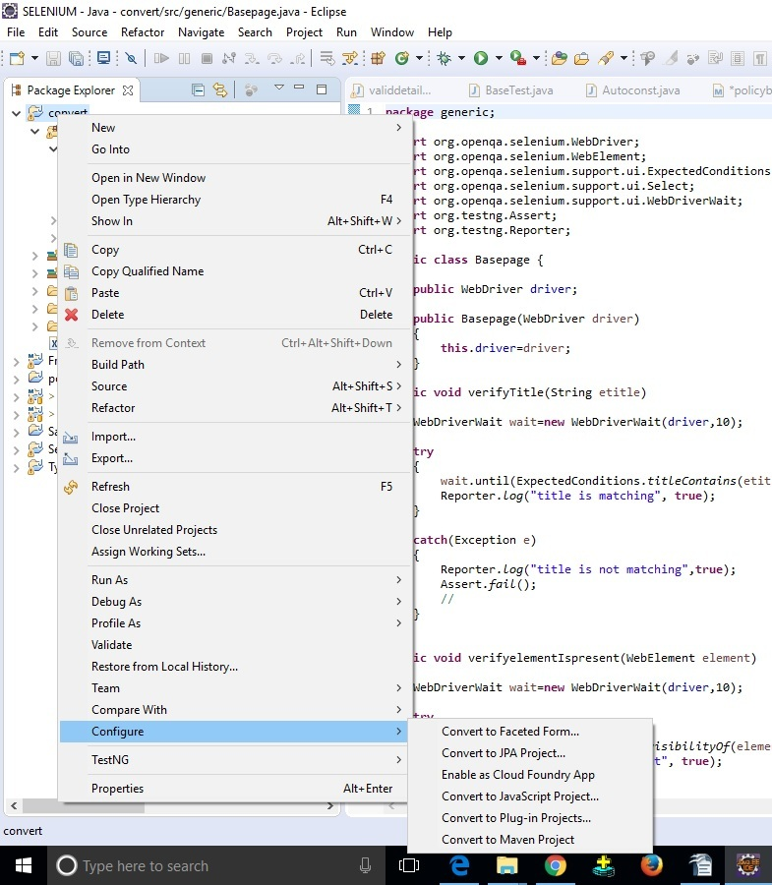
MAVEN

Slide 6
MAVEN
2)Specify the dependency.
Specifying which jar file to download and update is called as dependency.
Go to Dependencies Tab
Click on Add
Specify Group Id, Artifact Id & Version for each jar file
Click OK and Save.
Dependency to be added:
Selenium Dependency
TestNG Dependency
POI Dependency

Slide 7
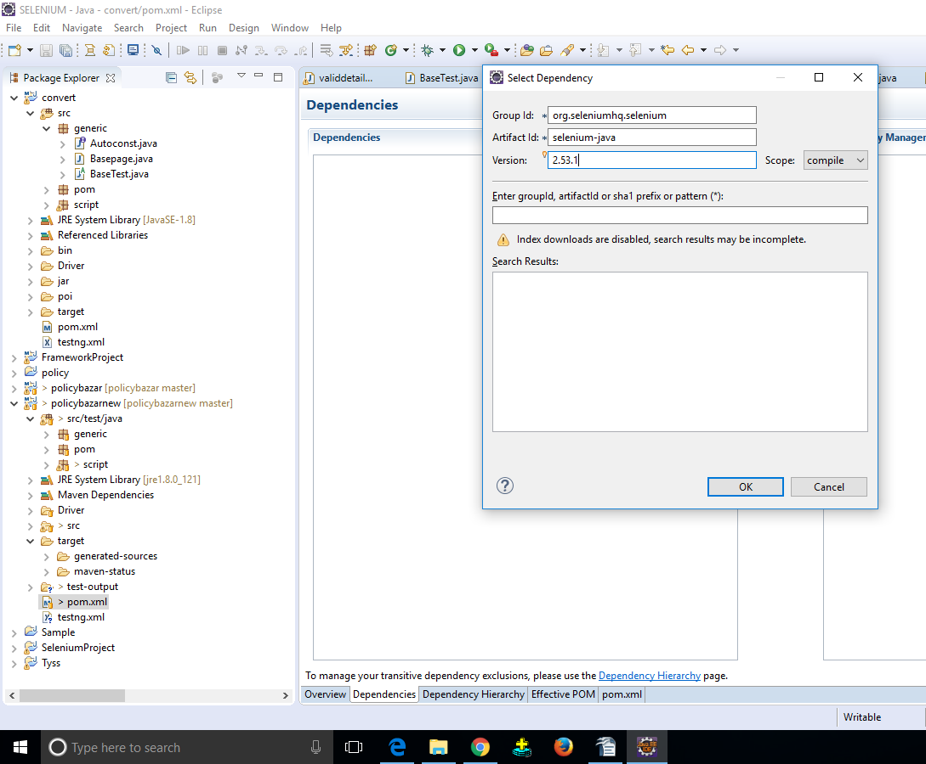
MAVEN

Slide 8
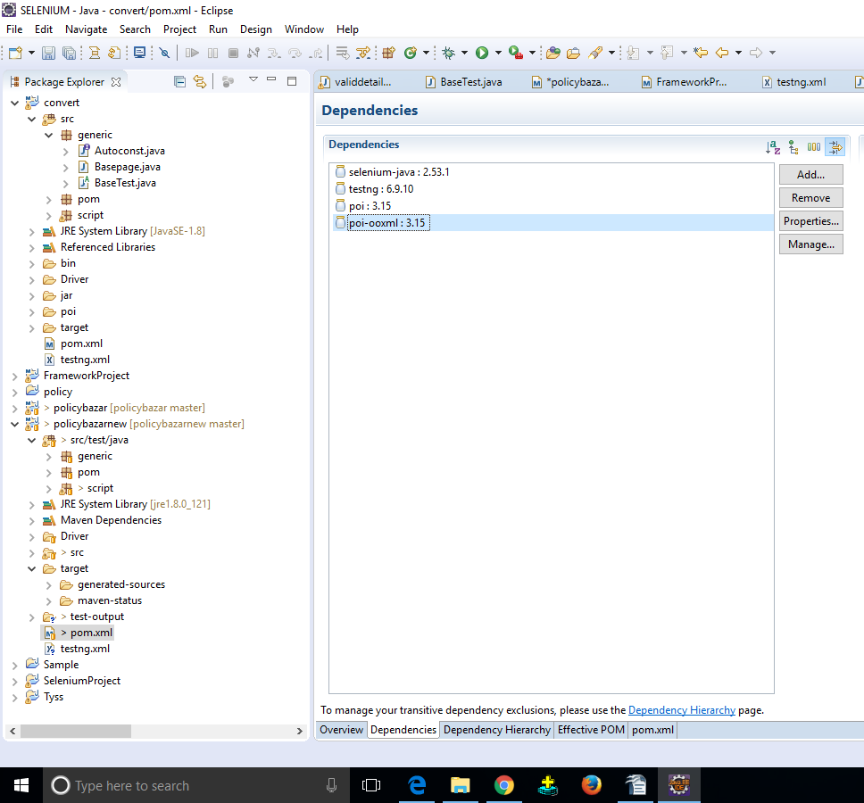

Slide 9
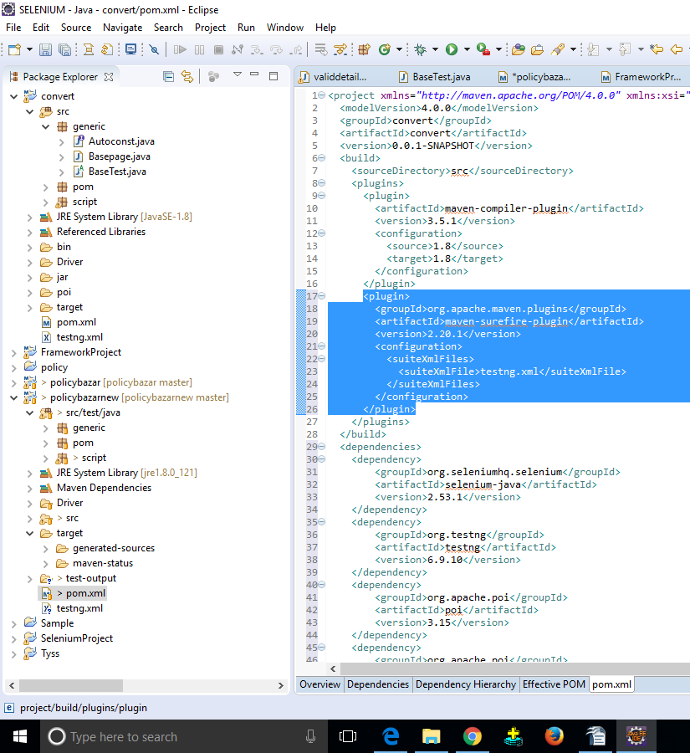

Slide 10
MAVEN
For Dependecies
https://mvnrepository.com/
For surefire plugin
http://maven.apache.org/surefire/maven-surefire-plugin/examples/testng.html

Slide 11
MAVEN
3)Execute the Maven Project
Right click on pom.xml
Go to Run As
Select Maven Test
After specifying the dependency, when we run pom.xml
It checks & updates the jar file.
It compiles the code using maven.compiler.plugin.
It executes testng.xml
In order to run testng.xml from pom.xml, we should use “surefire”plugin

Slide 12
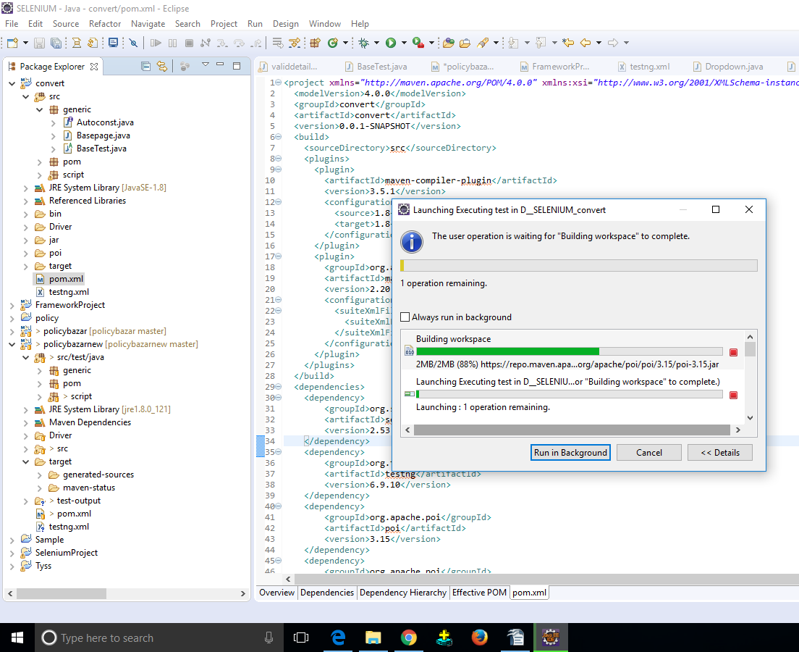

Slide 13
If we run the framework directly using testng.xml
1)It will not download any jar files.
2)It will executes the scripts using the jar files which are listed under Reference Libraries Folder.
3)After the execution, result will be generated in test-ouput folder.
If we run the frame work using pom.xml
1)It will download the latest jar files from the internet into .m2 repository. (“C:\Users\Administrator\.m2”)
2)It executes the script using the jar files which are listed under Maven Dependencies folder.
3)After the execution, result will be generated under target folder i.e., Java project//target/surefire-reports/emailable-report.html.
Using Maven, we cannot update driver executables such as chromdriver.exe

Slide 14
JENKINS
Jenkins is a continuous integration tool used to build and test software projects continuously making it easier to integrate changes to the project.
It supports building and testing virtually any project.
It is used by developers to automatically create and install the Build.
It is used by testers to execute the framework automatically whenever the new build is installed.

Slide 15
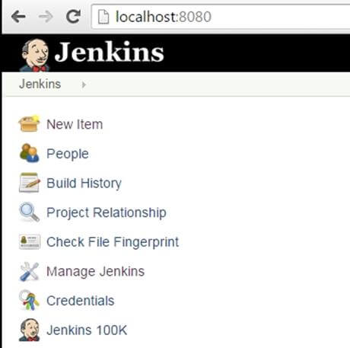
Install Jenkins:
a)Download jenkins-2.73.2 file from jenkins-ci.org website.
b)Unzip jenkins to specified folder and install exe file.
c)Once installation is done, navigate to the Jenkins Dashboard (http://localhost:8080 by default) in the browser window. It display Home page of the Jenkins.

Slide 16
JENKINS
To integrate the Automation Framework with Jenkins, we need following information from the development team
URL of the Jenkins
Username and password of the Jenkins
Project Name

Slide 17
JENKINS
Steps to Integrate:
Open the browser and enter the URL of Jenkins.
Enter username and password and click on Login.
Click on NewItem.
Specify the Automation Project Name.
Select Maven Project and click on OK.
Select “GIT” radio button.
Specify Git-Hub URI in the Repository URL.
Select the Check box “Build after other Projects are build”.
Specify the name of the project which is provided by Development Team in “Projects to Watch”.
Click on Save button.

Slide 18
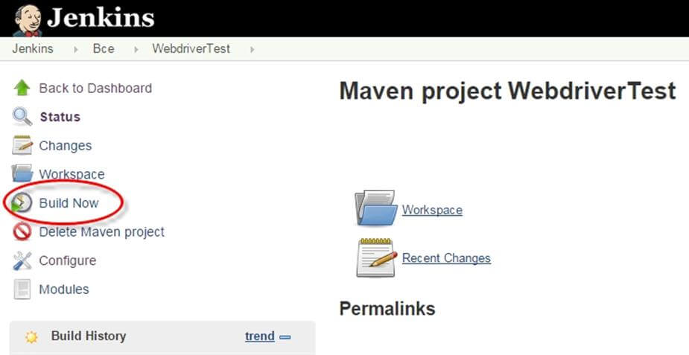

Slide 19
JENKINS
Phase 1(Development Project):
Download Latest Source code from SVN
Compile the development code
Compress the compiled code
Run Unit Scripts (WBT)
Install Build
Send Email Notification
Phase 2 (Automation Project):
Download AFW from GitHub
Run pom.xml
Update jar file
Compile Automation code
Run testng.xml

Slide 20
We click on BuildNow only once to check whether the framework is integrated properly with the Jenkins.
Everytime it automatically gets executed whenever developers starts the execution of their project.
testng.xml will create multiple threads depends on number of test blocks, and each thread will run the scripts on node system parallely and the results will be stored in Jenkins server.
To see the Result in Jenkins
Login into Jenkins.
Click on the Automation Project.
Click on the link present under Build_History, then click on Console-Output.

Slide 21
