Slide 1

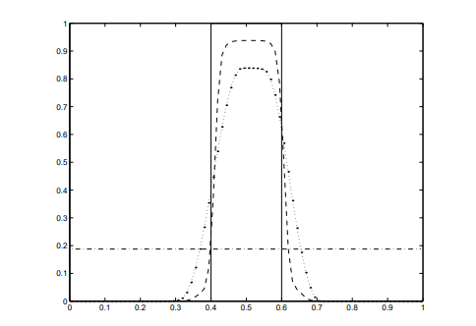
Notes:
Find the partial differential equation (u_t + u_x = 0) above and u (x, t) satisfying the following conditions. In other words, u value at a specific x is obtained at each timestep.
Initial condition: When t = 0, it has a value of u0,
Boundary condition: u (0, t_n) = u (1, t_ {n-1}). That is, the u value at x = 0 is equal to x = 1 (the last value) in the previous timestep.

Slide 2
Results and conclusions

Slide 3
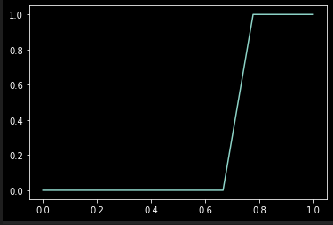
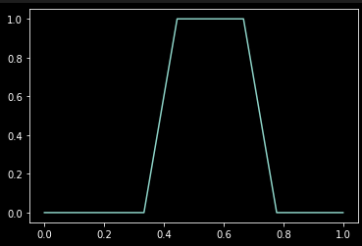
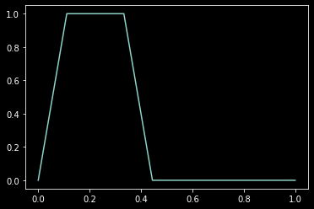
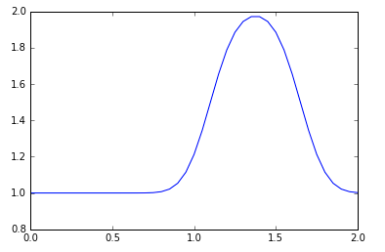
Simulation goals
1
like t = 0
When the initial value is given
Pulse like 1,2,3 next
Moving Simulation
t=0
2
3
As shown in the picture above by error - Pulse shape may be deformed

Slide 4
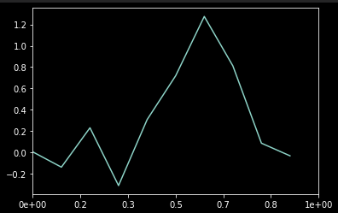
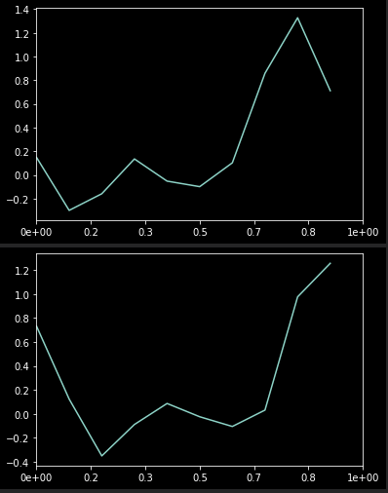
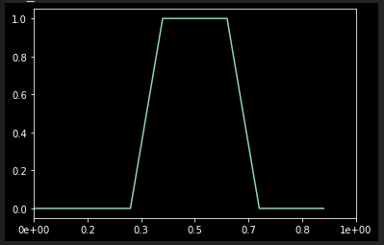
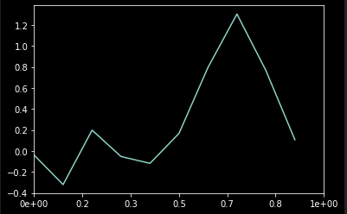
Simulation result
N_e = 10; dx = 0.1; dt = 0.005
1
3
t=0
2
4

Slide 5
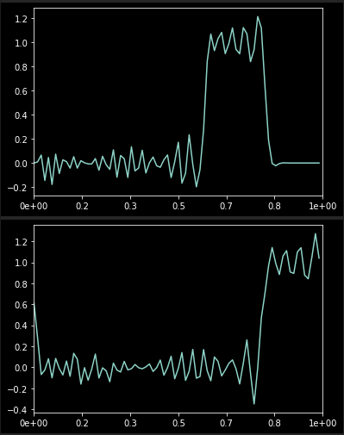
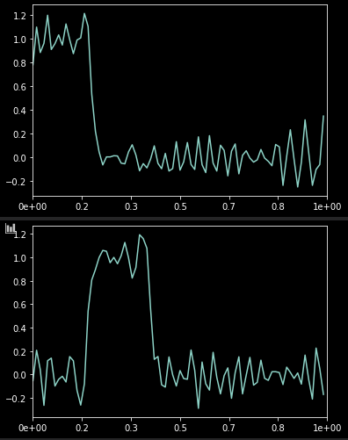
N_e = 80; dx =1/80; dt =0.0001; nt = 10000
1
1
3
3
t=0
2
2
4
4

Slide 6

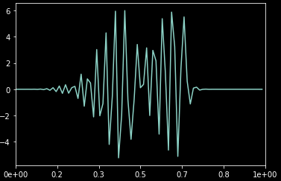
If dx is small enough, the result is good
The smaller the dx, the better the shape of the pulse is maintained
Smaller dx requires smaller dt (CFL condition)
(pulse decay if dt is not small enough)
If dt is small, increase nt for same time calculation
-> Increase calculation amount-> Increase calculation time
I use Euler method for the current time,
Expect to increase accuracy with Runge Kutta.

Slide 7
Discontinuous Galerkin Method Rationale

Slide 8




Discontinuous Galerkin Method
Goal: -> 를 is approximated by a function with a basis
The paper uses a Legendre polynomial
Method: f (x) is the actual function we want to find,
The difference between the approximate functions u (x) and f (x) is the error.
The goal is to find u (x) that minimizes the error.

Slide 9
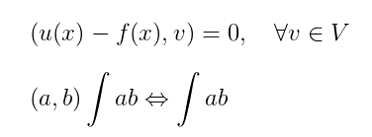


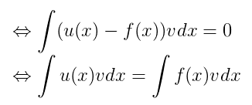
3. Minimizing errors
과 동치.
이므로,

Slide 10




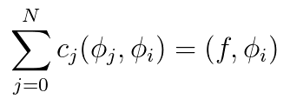
Since it must be established for all v, must also be established when v is the base.
therefore,
satisfies in finding

Slide 11


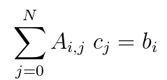

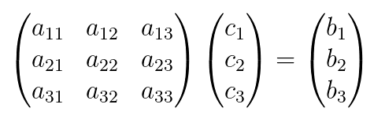
Define
Can be rewritten
Using matrix multiplication, Can be written as

Slide 12



we know the formula as Legendre Polynomial,
Since f is also a given formula, we know the expression.
therefore , can give the value of c through

Slide 13
Discontinuous Galerkin Method with time

Slide 14

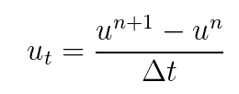

Time dependent

Slide 15
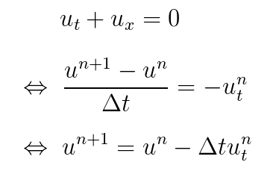
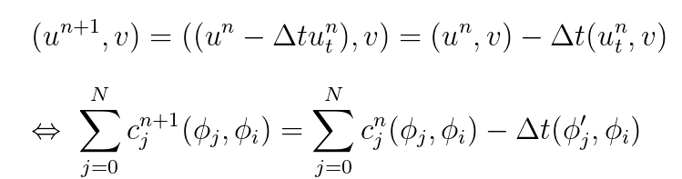
: known

Slide 16


Use to obtain
Compute a new c value for each timestep.
Boundary conditions are applied every timestep.
The value of cn + 1 at X = 0 = The value of cn at x = 1

Slide 17
Code

Slide 18
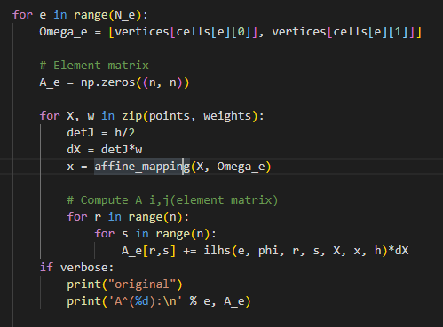
A does not change as time steps. Count it only once.

Slide 19
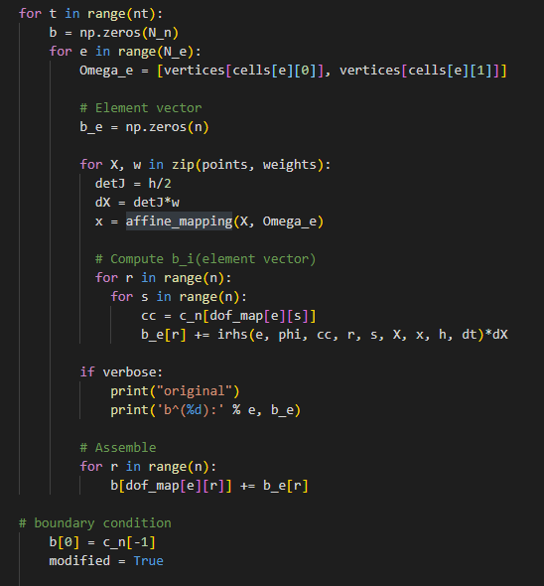
b is every timestep
Because c_n changes, we calculate new.
Apply a periodic boundary condition

Slide 20

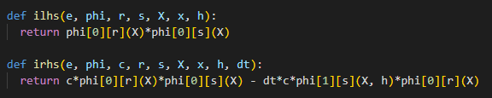
Compute new c at the end of Timestep
Update c_n to c.
lhs: A_i, j expression
rhs: b_i expression

