Slide 1
6502 Simulator

Slide 2
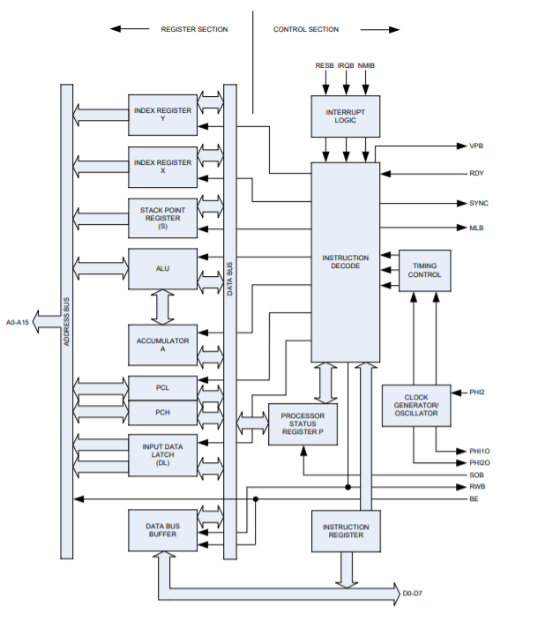
Notes:
8-bit data bus 16-bit address bus provides access to 65,536 bytes of memory space 8-bit ALU, Accum45ulator, Stack Pointer, Index Registers, Processor Status Register 16-bit Program Counter 70 instructions 16 addressing modes 212 Operation Codes (OpCodes) Vector Pull (VPB) output indicates when interrupt vectors are being addressed WAit-for-Interrupt (WAI) and SToP (STP) instructions reduce power consumption, decrease interrupt latency and provide synchronization with external events Variable length instruction set provides for lower power and smaller code optimization over fixed length instruction set processors Fully static circuitry Wide operating voltage range, 1.8+/- 5%, 2.5+/- 5%, 3.0+/- 5%, 3.3+/- 10%, 5.0+/- 5% specified Low Power consumption, 150uA@1MHz

Slide 3
3 Main Parts
Reading the manuals
Discussing Implementation.
Learning Web Assembly
Building the model
EDUCATION
Research
WORK

Slide 4
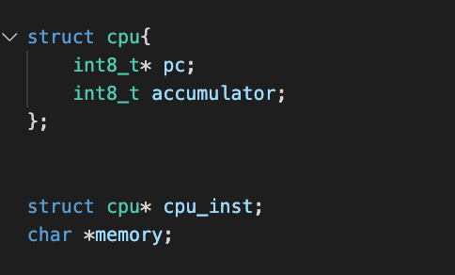

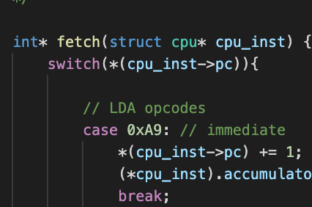
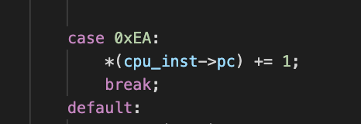
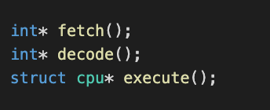
1

Slide 5
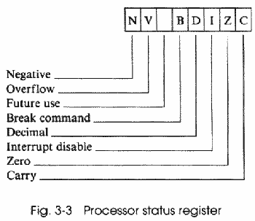
Education
Addressing modes
Immediate
Absolute
Zero-Page
etc..
Registers
Processor status register
Called the flag register

Slide 6
Future Implementations
What’s next?
Finish up 6502 to allow users to send instructions and programs into memory
Design an interactive UI that shows you how different parts of the machine are working as it is executing
Use WebAssembly and JavaScript to deploy application to the web

Slide 7
THANKS!
Any questions?

