Slide 1

KOLScope
Influencer intelligence for the next generation of marketing teams.
Multi-platform KOL analytics · Sub-second lookups · Built for agencies
Founded by Busyra Oryza · Proton Media Indonesia
Pre-Seed Round · $300K · Confidential

Slide 2
KOLScope
02 / 13
by Proton Media
Problem
THE PROBLEM
KOL research is slow, expensive, and outdated before it ships.
▸ 78% of marketers say finding the right KOL is their #1 challenge
▸ Manual research: 2-4 hours per creator, scattered across platforms
▸ Agency KOL reports cost $500-2,000 per profile
▸ Data is stale by the time the report reaches the client
▸ No way to benchmark against peers at scale
2-4 hrs
per creator profile, manually
$1,000+
per agency KOL report
KOL research is broken — slow, expensive, and outdated before it is delivered.

Slide 3
KOLScope
03 / 13
by Proton Media
Solution
OUR SOLUTION
One URL. Ten seconds. Every KOL, benchmarked.
▸ Paste a TikTok or Instagram URL → get full analytics in seconds
▸ Engagement rate, average views, recent post performance
▸ Multi-platform: TikTok + Instagram today, YouTube next
▸ 3-month cache = consistent data, instant repeat lookups
▸ Discovery: browse every previously analyzed profile in one place
▸ Copy-to-clipboard for Sheets · CSV export · API access (Enterprise)
⚡
Instant lookup
< 10 sec end-to-end
🎯
Multi-platform
TikTok · Instagram · YouTube (soon)
💾
3-month cache
Repeat lookups are instant
📊
Discovery view
Browse + filter all profiles
📋
Sheets-ready
Copy & CSV export built in
API access
Best of all worlds: speed of software, depth of an agency, price of a tool.
🔌
For enterprise workflows

Slide 4
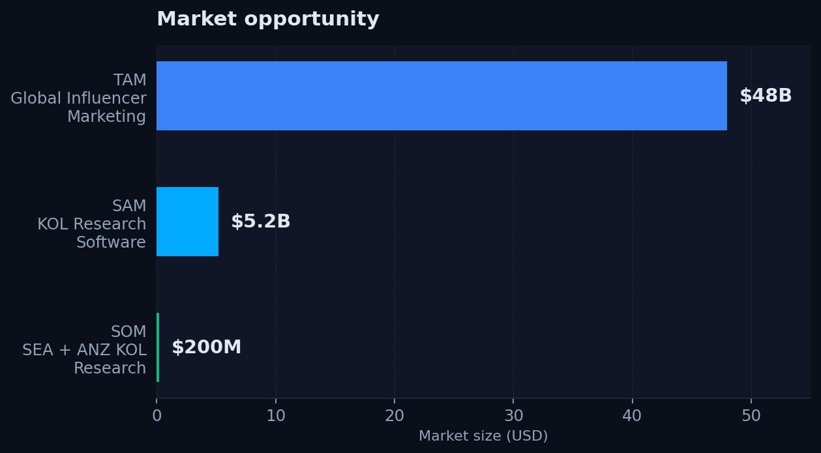
KOLScope
04 / 13
by Proton Media
Market
MARKET OPPORTUNITY
$48B industry with no dominant SaaS in Southeast Asia.
Bottom-up SAM
50,000
marketing agencies in SEA + ANZ
$4,000/yr
avg tool spend per agency (bottom-up)
= $200M SAM
Sources: Influencer Marketing Hub 2025 · Statista · internal estimates

Slide 5
KOLScope
05 / 13
by Proton Media
Product
PRODUCT
Built, deployed, and working today — not a mockup.
Live at kol-research.protonmedia.co.id
Tech stack
▸ Single-URL lookup → 6 metric cards + recent content table
▸ Discovery view with search, filter, sort, pagination
▸ CSV export · Copy-to-clipboard for Google Sheets
▸ Multi-scraper fallback: Scrapfly primary, Apify backup
▸ Built on Vercel + Supabase Postgres (3-month cache)
▸ API-ready for enterprise integration
Next.js 16
Frontend + API routes
Vercel
Hosting + serverless
Supabase
Postgres + REST API
Scrapfly
Primary scraper (XHR interception)
Apify
Fallback scraper
TypeScript
Type-safe end-to-end
From zero to live in 30 days. Real users, real data, real product.

Slide 6
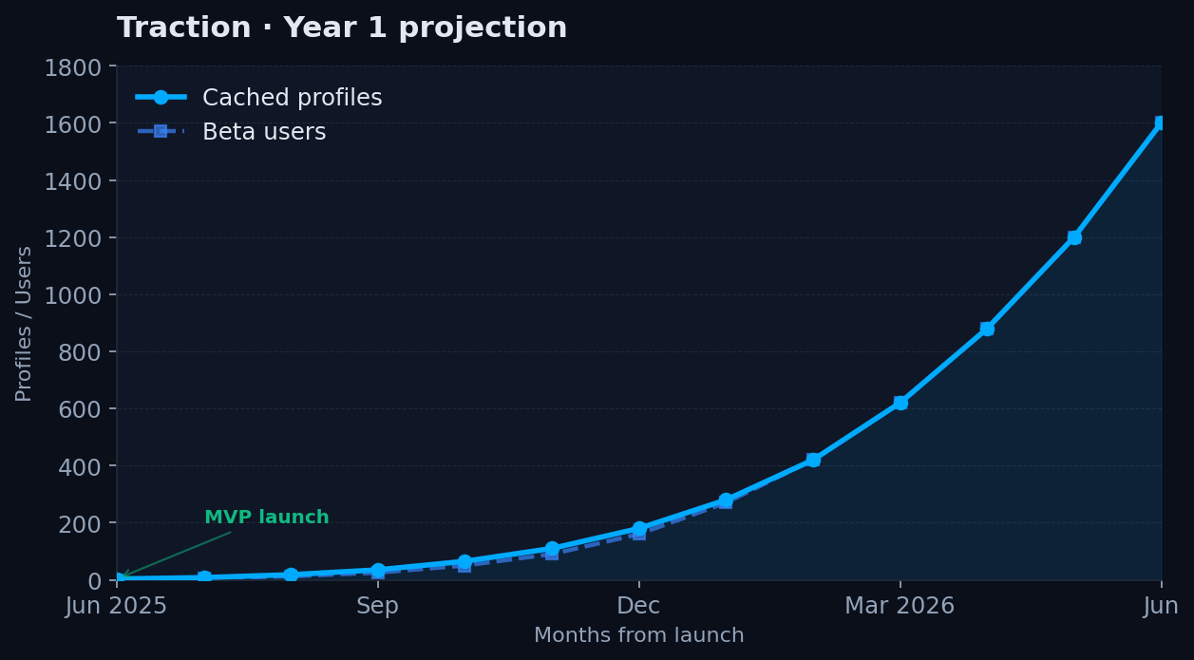
KOLScope
06 / 13
by Proton Media
Traction
TRACTION
MVP launched June 2025. Building from a real client base.
Milestones · Year 1
✓
MVP shipped
June 2025
✓
Live at custom domain
kol-research.protonmedia.co.id
✓
Internal adoption
Proton Media team daily use
◐
3 design partners
LOIs in progress
◯
Public launch
Q3 2025
◯
200 paid customers
Q4 2026
200+
< $1
3-month
brand clients at Proton Media
monthly infra cost today
data cache (TTV)

Slide 7
KOLScope
07 / 13
by Proton Media
Business Model
BUSINESS MODEL
Self-serve SaaS. Land with free, expand with teams.
MOST POPULAR
Free
Agency
Enterprise
Pro
$0
$199
$999+
$49
forever
per month
per month
per month
✓
10 lookups / month
✓
Unlimited lookups
✓
API access
✓
1 platform
✓
200 lookups / month
✓
5 team seats
✓
White-label option
✓
Public data only
✓
TikTok + Instagram
✓
Bulk export
✓
Unlimited seats
✓
CSV export
✓
Sheets integration
✓
SLA + onboarding
✓
Discovery view
✓
Priority support
✓
Custom scrapers
✓
Email support
Lead generation
Solo marketers
Target segment · 60% of revenue
High-margin · 10% of revenue
Target mix Y3: 30% Pro · 60% Agency · 10% Enterprise · Gross margin: 75% (API costs scale with usage)

Slide 8
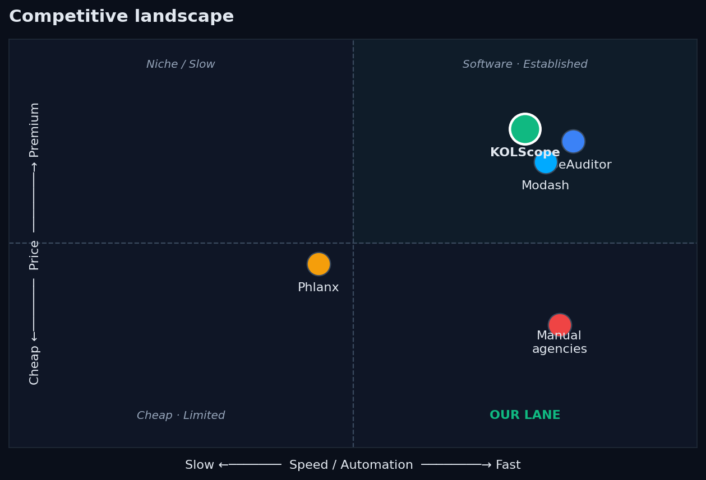
KOLScope
08 / 13
by Proton Media
Competition
COMPETITIVE LANDSCAPE
Faster than agencies, cheaper than incumbents, multi-platform from day one.
Our unfair advantages
Multi-platform from day 1
TikTok + Instagram; YouTube next
Built by a working agency
Real client needs drive the roadmap
SEA market expertise
Proton Media already serves 200+ brands
Cost structure
Self-serve SaaS, no analyst labor
Speed
API-driven, not human-driven

Slide 9
KOLScope
09 / 13
by Proton Media
Team
TEAM
Domain expertise, distribution, and product velocity.
Busyra Oryza
Next hires (with $300K raise)
BO
Founder & CEO
→
Senior Full-Stack Engineer
Proton Media Indonesia
Next.js · Postgres · Scrapers
→
Growth Marketer
Content · SEO · Paid acquisition
→
Account Executive
Enterprise sales · SEA + ANZ
• 5+ years in growth marketing & KOL operations • Built Proton Media into a 200+ client agency • Direct line to Indonesia's top brands & creators • Hands-on builder: shipped KOLScope MVP solo in 30 days
Advisors (in formation)
Target: 2-3 advisors with: • Ex-HypeAuditor / Modash / creator-economy founder • SEA VC partner with KOL/marketing portfolio • Senior eng leader from scraper/data infrastructure
We are not just building a tool — we are building it for the market we already serve.

Slide 10
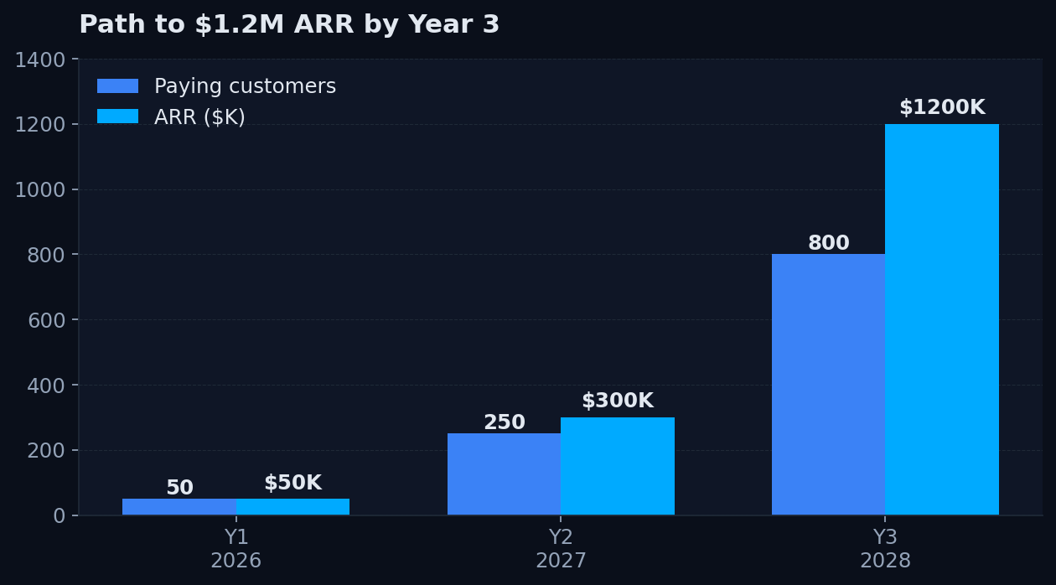
KOLScope
10 / 13
by Proton Media
Financials
FINANCIALS
Path to $1.2M ARR by Year 3 with 75% gross margin.
Key assumptions
Pricing
$49 Pro · $199 Agency · $999+ Enterprise
Conversion
8% free → paid (industry avg)
Gross margin
75% (API costs scale linearly)
Churn
< 5% monthly (sticky workflow tool)
Team cost
$25K/mo fully loaded at 4 FTE
Runway
18 months on $300K raise
Unit economics: $99 blended ARPU · $25 CAC · 4-month payback

Slide 11
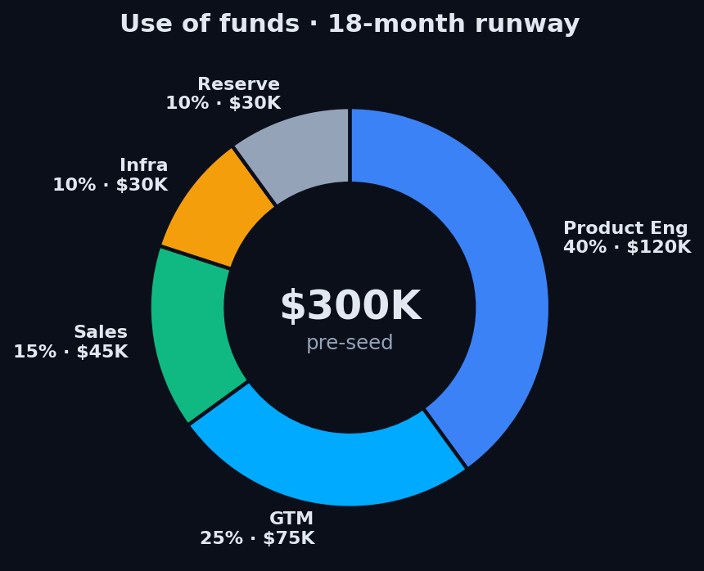
KOLScope
11 / 13
by Proton Media
Use of Funds
USE OF FUNDS
Funded to hit $300K ARR, 200 customers, and Series A metrics.
$300K · 18-month runway
Product Engineering
$120K
2 senior engineers · 18 months
40%
Go-to-Market
$75K
Growth marketer · content · paid
25%
Sales
$45K
1 AE for enterprise accounts
15%
Infrastructure
$30K
API costs · hosting · tools
10%
Reserve
$30K
3-month contingency buffer
10%
Milestones: 200 paying customers · $300K ARR · 3 platforms · 4-person team

Slide 12
KOLScope
12 / 13
by Proton Media
The Ask
THE ASK
$300,000
pre-seed · SAFE or priced · 18-month runway
Q2 2026
Q4 2026
Q2 2027
MVP+ live
Product-market fit
Series A ready
TikTok + Instagram · 50 beta users · 3 design partners
200 paying customers · $300K ARR · 5+ NPS
$1M ARR run-rate · 3 platforms · 4-person team
Join us in building the dominant KOL intelligence platform in Southeast Asia.

Slide 13
KOLScope
13 / 13
by Proton Media
Appendix
APPENDIX
Additional context, technical details, and references.
Customer testimonials
Technical architecture
Pricing comparison
Data sources
• (3 design-partner quotes — to be filled in after Q3 beta)
• Next.js 16 + TypeScript on Vercel
• HypeAuditor: $168/mo single platform
• Influencer Marketing Hub 2025 report
• 5+ agency case studies planned for Y1
• Supabase Postgres for profile cache + content
• Modash: $99/mo creator search
• Statista Influencer Marketing Forecast
• Net Promoter Score target: >40 by Q4
• Scrapfly XHR interception for TikTok
• Phlanx: free tier, $39 ER-only
• HubSpot State of Marketing 2024
• Apify fallback for rate-limit recovery
• KOLScope Pro: $49/mo multi-platform
• eMarketer SEA Digital Ad Spend
• 3-month TTL cache, ~75% hit rate at scale
• KOLScope Agency: $199 vs $400+
• Internal Proton Media client data
Contact: busyra@protonmedia.co.id · kol-research.protonmedia.co.id

