Slide 1
Ham Radio Communications via Satellite
A great way to DX with a technicians license

Slide 2
Some of the Satellites
Most use either a 70 cm uplink with 2 meter downlink or vice versa
ISS –
Downlink – 145.80 mhz. Also has SSTV downlink 145.800 mhz
Uplink 437.80 mhz
Saudisat (Oscar 50) – PL TONE 67.0 hz and arming PL Tone 74.4 for 2 seconds
Downlink – 145.80 mhz
Uplink 145.85 mhz
Fox 1A (AO-85)
Downlink – 145.980 mhz
Uplink 435.172 mhz (not as planned may be temp difference)
LilacSat-2 (CAS-3H) – Active Mon, Wed and Fri
Downlink – 437.200 mhz
Uplink 144.350 mhz

Slide 3
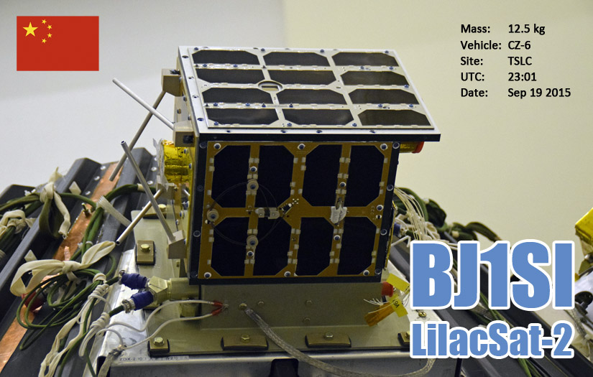
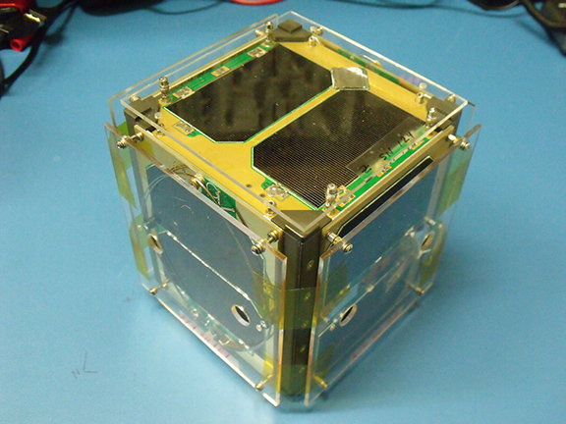
LilacSat and Fox 1-A (Cubesats)

Slide 4
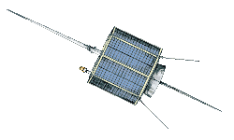
Oscar 7 (AO-7)
Oscar 7
Downlink – 29.4 to 29.5 mhz
Uplink 145.850-950 mhz
Stopped working in the 90’s but in the 2000’s was found to be operating again
Recently used to connect Arkansas with Brazil

Slide 5
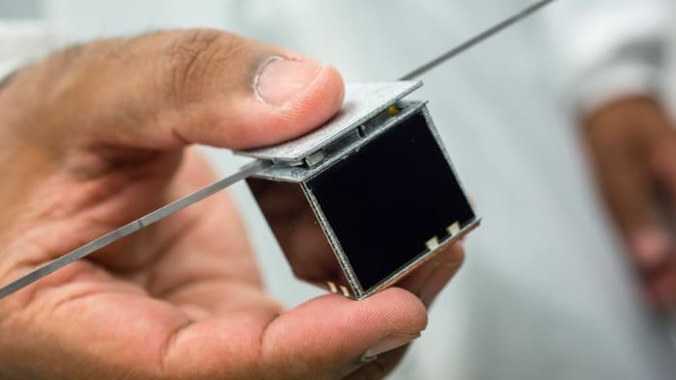
Proof of concept CubeSat
Cubesat is 10 cm^3
Most have very short life spans and are research projects for University (2-4 weeks, then fall out of orbit)
Some Cubsats are 2 X or 3 times bigger. Processors are Arduino derivations or some have recently used cell phones for entire package
New up and coming are Femtosats

Slide 6
What is needed to communicate via satellites?
Antenna
I am using an Arrow Antenna that is used specifically for satellite contacting
Most recommend that the antenna is not tightly tuned
Dual band, possible duplexer
One or Two radios (full duplex)
Tried one multiple times but too much to point and track at the same time – Two radios work better if one person is uplink the other downlink and calling numbers while one tracks
Also, preprogram the radios for easier Doppler compensation

Slide 7
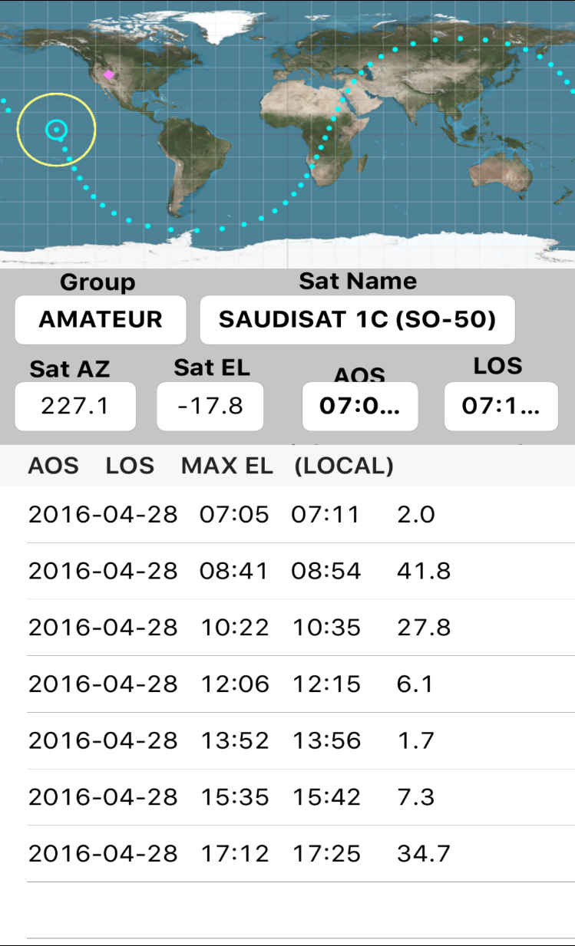
A tracking program
I use a simple tracking program that I got for free on Iphone
Other free options with AM-SAT or other online programs
Use a compass to help determine North, adjust a little for True North
Find Azimuth. Due North will always be 0 and due south 180

Slide 8
Hitting a satellite
You will first know when you are on the satellite because static almost comes to an end – silence, or voices if it is the weekend
May need to adjust for Doppler
Most contacts are very quick, just call sign and grid
Polarity is almost never an issue, no idea why..
https://youtu.be/zQPD2ok8b4A

Slide 9
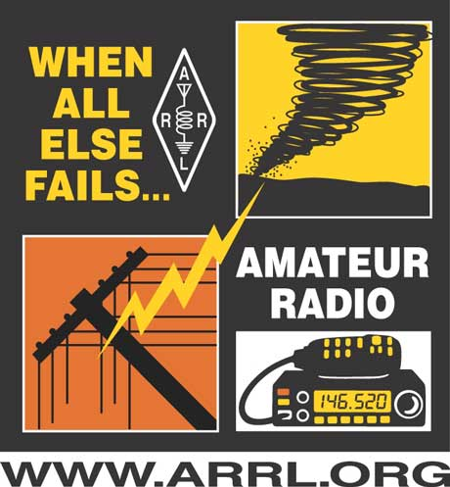
How can this be used in an emergency
Distance communication for those who do not have HF rig
Can be run on handheld battery power
Open discussion….

Slide 10
Additions to the tracking side
Some type of elevation and azimuth system….
Possible electronic tracking, but need to find code for determining the pass of the satellite
Add a shelf for more hands free and ability to hold more items
Biggest problem from doing indoors is tracking and the location of my house

Slide 11
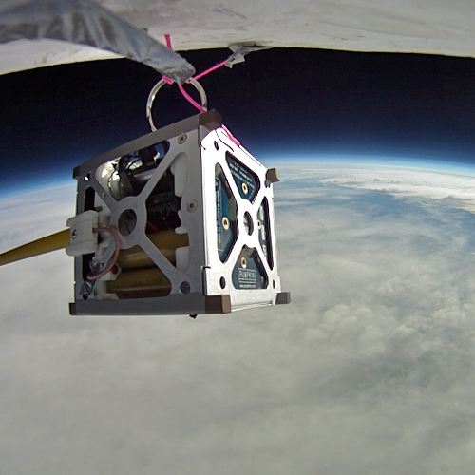
Additional Satellite …Hobbies… - SATNOGS
SATNOGS – Non-profit that links satellite tracking stations around the world
Build a tracking system and connect to your computer
Researchers now have access to their satellite data
Plans for tracking station is online as well as sourcecode

Slide 12


