Slide 1
Software Defined Radio
What is SDR?
Types of SDR
Fun with SDR

Slide 2
SDR
First let me acknowledge where I learned my information.
Grundig radio manual led me to SDR
Began reading
The hobbyist guide to RTL – SDR (Book and Blog)
All your RF’z are belong to me – DEF CON 21
Balint Seeber - https://www.youtube.com/watch?v=ZuNOD3XWp4A

Slide 3
What is cheap SDR?
SDR has been around for 30 years
It’s all about math!! Currently analog circuits do the process, but small computers can now do the processing.
Chip is the RTL2832U and a special debugging mode can allow it to be used for SDR.
A combination of the dongle and software allow me to see tons of different frequencies

Slide 4
What can be done with SDR
Listen to unencrypted Police / First responders
Listen to air traffic controllers
Decode ACARS (Aircraft computer communications)
Scan commercial trunked radios
Decode unencrypted digital voice communications (P25)
POCSAG / FLEX pagers
Ham bands above 100 MHz (Settings claim you can go lower)
FM radio
Boats / aircraft
Decode ham APRS packets
Watch analog TV (not USA)
Use spectrum analyzer

Slide 5
More with SDR
Radio Astronomy
NOAA and Meteor M weather satellites
Listen to Unencrypted Military communications
Decode FM RDS information
Satellites and the ISS
Decode CW / PSK / RTTY / SSTV

Slide 6
What do you need?
Free software
Antenna and cabling
DUAL CORE OR BETTER COMPUTER!! Will not work with older computers.
Dongle or card
SDR dongle – About $21
FunCube – Price varies
Hack RF - $399
Ettus Research products – Universal Software Radio Peripheral - $$$$
AirSpy – about $299

Slide 7
What modifications can you do?
LNA to improve reception
Add up converter to receive HF bands (0-30) MHz
Preselected filters to reduce out of band interference.

Slide 8
What are specs?
Manufacturer claims 22-2200 MHz
Actually about 100 MHz – 1000 MHz, but could possibly be user error.
3.2 MHz max bandwidth
75 ohm input impedance (because most are built for TV hardware)

Slide 9
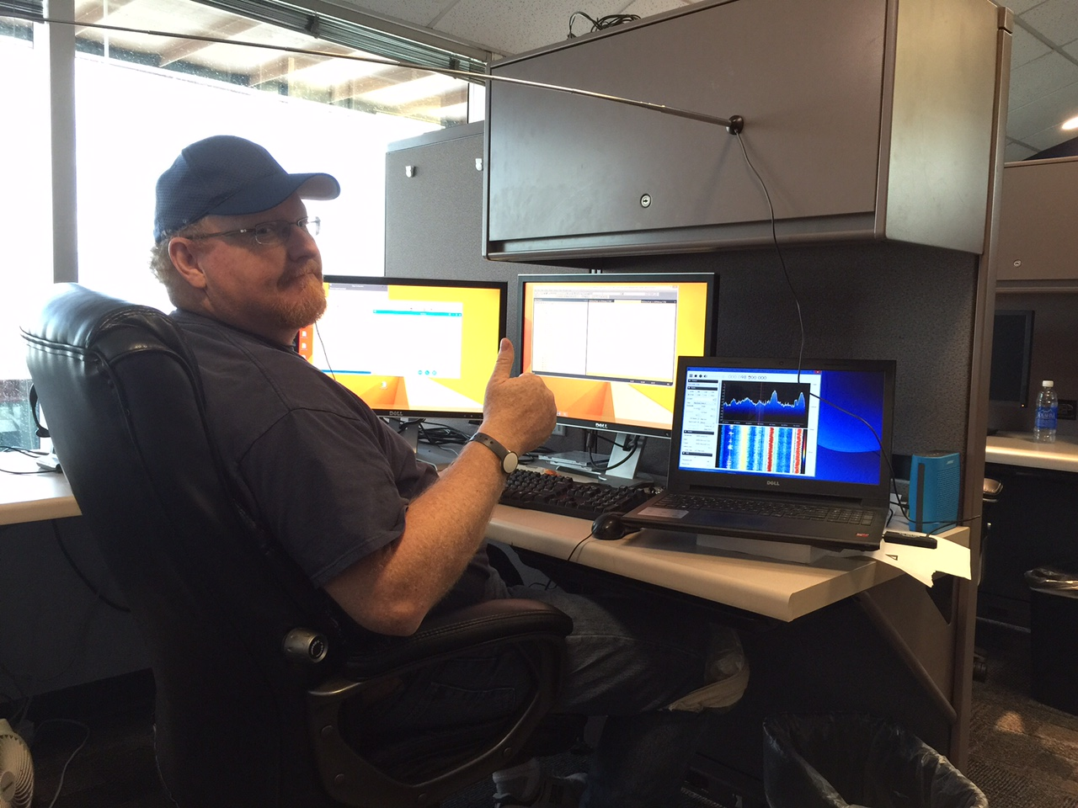
SDR is fun!! So fun I am actually playing around at work and not troubleshooting software

Slide 10
HD Radio
HD radio is on FM radios and is a ‘square wave’ carrier signal on the upper or lower sidebands.
Example of HD radio (Hardware and an app)
What does it sound like and look like on a spectrum analyzer
Lets look at FM on SDR

Slide 11
Lets look at aviation channels
Pilot to ground
Ground to pilot
Automated runway information
ACARS – We will get to this later

Slide 12
Ham 2 meter and 70 cm
Use spectrum analyzer to identify which frequencies are being used
What do frequencies look like
Play around
One problem we have had is if too close to a transmitting radio it causes cross band interference.

Slide 13
What else have we found
800 MHz – 900 MHz used by lots of first responders. Also possibly 400 – 500 MHz
900 MHz has some broadcast stations
Playing around is a blast!!
Trunked stations are a little hard to follow, but with 2 dongles and free software you can track.
SIGINT can be an affordable hobby

Slide 14
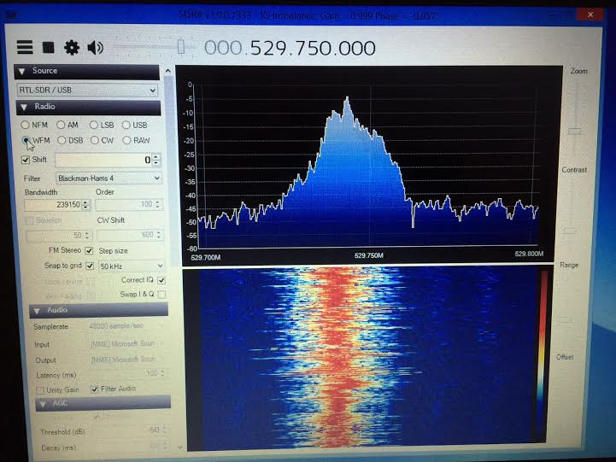
Spanish Television?

Slide 15
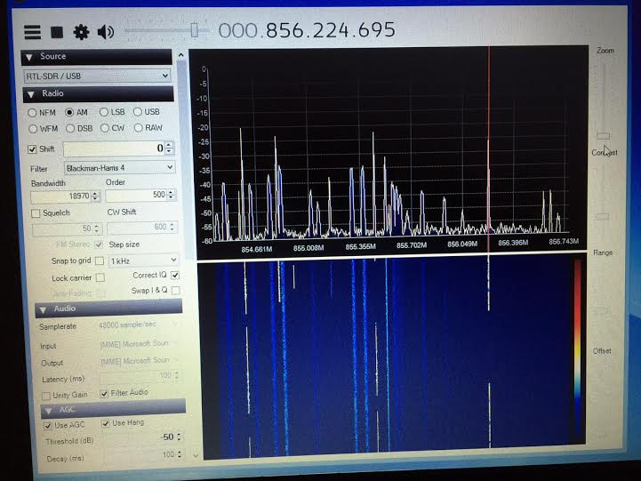
Lots of trunked radios in this area

Slide 16
What else?
Anything that has RF can be seen, looked at / hacked
NFC devices, and toll transmitters / tags
Parking meters are a mesh network
Key fobs for remote open / start
Wireless devices in the 433 MHz range (doorbells, thermostats, appliances)
Spoofing of FM radio RDS signals (fake traffic was sent to prototype receivers)
Used to set up mini cell network
Studies 2011 University of Pennsylvania show P25 has about 30 minutes unencrypted traffic daily. More the week following encrypt key changes
Only gov agency to not have ANY unencrypted traffic?

Slide 17
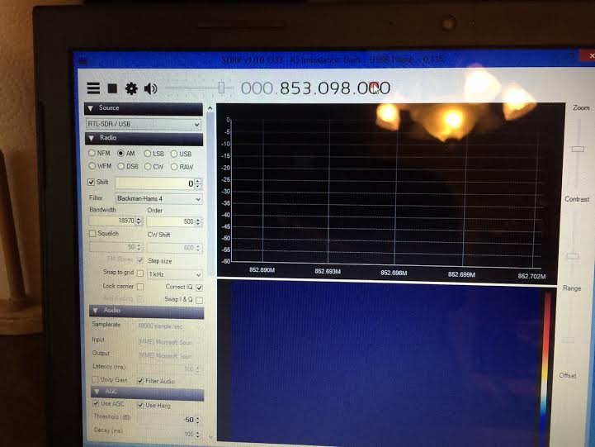
Lets look at trunked stations

Slide 18
GNU Radio
GNU Radio is a free & open-source software development toolkit that provides signal processing blocks to implement software radios. It can be used with readily-available low-cost external RF hardware to create software-defined radios, or without hardware in a simulation-like environment. It is widely used in hobbyist, academic and commercial environments to support both wireless communications research and real-world radio systems.
Gnuradio.org has links to downloads, tutorials, etc.
YouTube has a few basic GNU radio tutorials, but most start with the assumption you have used the toolkit before and know the drag and drop boxes.
GNU radio is your ability to build transmitting SDR
Lets watch GNU building blocks - https://www.youtube.com/watch?v=KWeY2yqwVA0

Slide 19
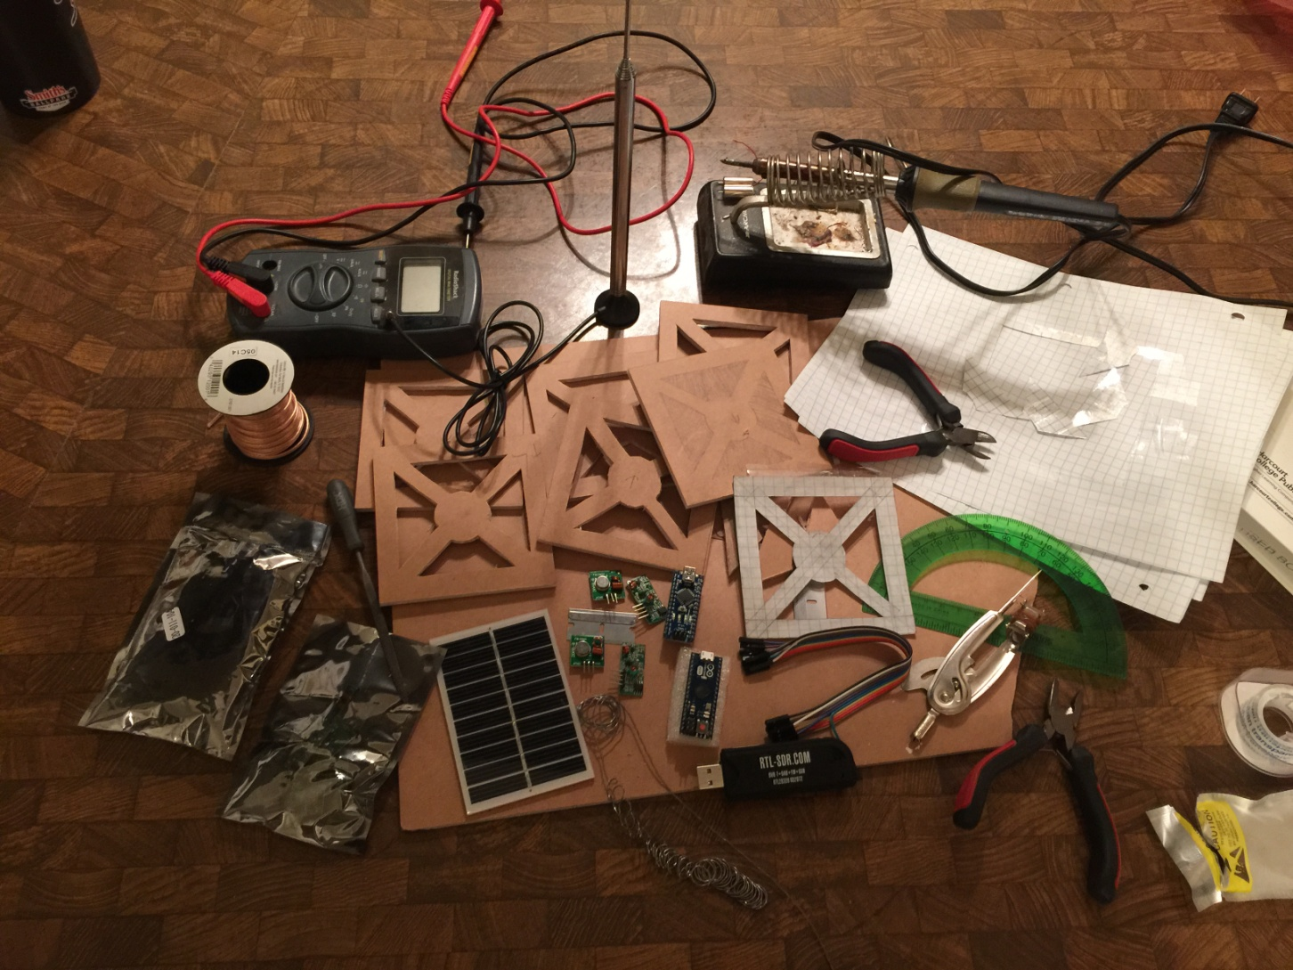
My next presentation?

Slide 20
Next presentation
Satellite communications for hams
Cubesat prototype
Actually talk over satellite
Also go back and cover ACARS for aviation – I will be traveling in a plane and hope to get some great SDR info!

