Slide 1
Taylorsville HAMnet
FT8 & JS8Call Digital Modes
Elisabeth Barry
KJ7MEB
August 2019

Slide 2
Agenda
What
Why
How
Demo

Slide 3
What & Why
What are FT8, FT4, JS8Call?
weak signal modes
FT4 (contesting), signals 10 dB weaker than RTTY, much less bandwidth
Why
Solar minimums
Bands are NOT dead
Fun, Rag chew, eComms,Contesting
Notes:
More about fun...

Slide 4
Facebook “Fun”
“The last time I got up at 4:45a somebody was paying me... This morning I got up at 4:45 to work the grey line on 40 with FT8. My XYL thinks I'm nuts.
My first week on FT8: 141 QSOs, 12 Countries, 5 Continents ... with a dipole ... barefoot ... 50 watts.

Slide 5
Background
WSJT-x
Joe Taylor K1JT/Steven Franke, others
open source, several digital modes
JS8Call: Jordan Sherer
Common across both
weak signal modes
regular s/w enhancements

Slide 6
Getting Started
How
Time sync
USB Sound card or RigBla$ter
Software WSJT-x and JS8Call
Google is your Friend

Slide 7
Helpful Software
Time:
TimeSyncTool.com, BktTimeSync (GPS)
Meinberg, Dimension4
Mobile: hamalert.org/about
pskReporter.info
Logging: Integrates with N3FJP & JT-Alert
Notes:
Let’s look at some sample QSOs before I demo

Slide 8
FT*, JS8Call & more...
Documentation is fantastic!
JS8Call: js8call.com
Many digital modes: WSJT-x
FLDigi (PSK, RTTY, more)
Tips: bit.ly/FT8OP (Gary ZL2iFB)
Jed Petrovich AD7KG RMDC presentations
JS8 QSO Parties 2nd Saturdays
RigPi - Remote WSJT-x, SSB and more!
Help? KJ7MEB @ gMail
Notes:
Let’s see what WSJT-x looks like...

Slide 9
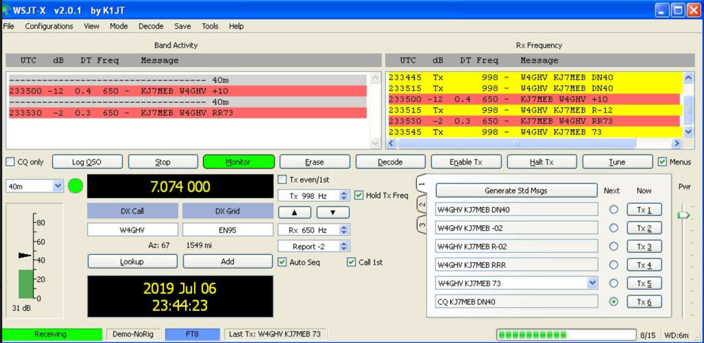

Slide 10
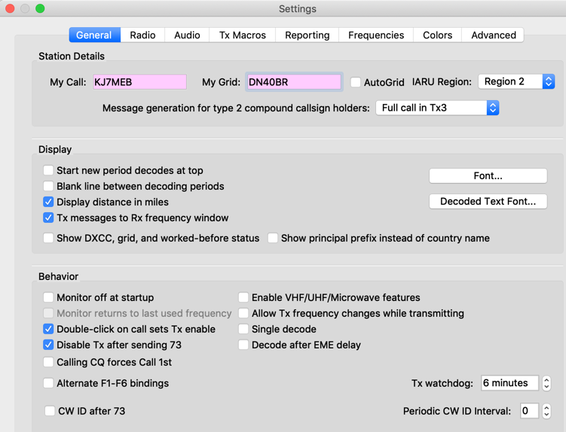
Setup
Notes:
But what if I want to say more than pre-canned messages?

Slide 11
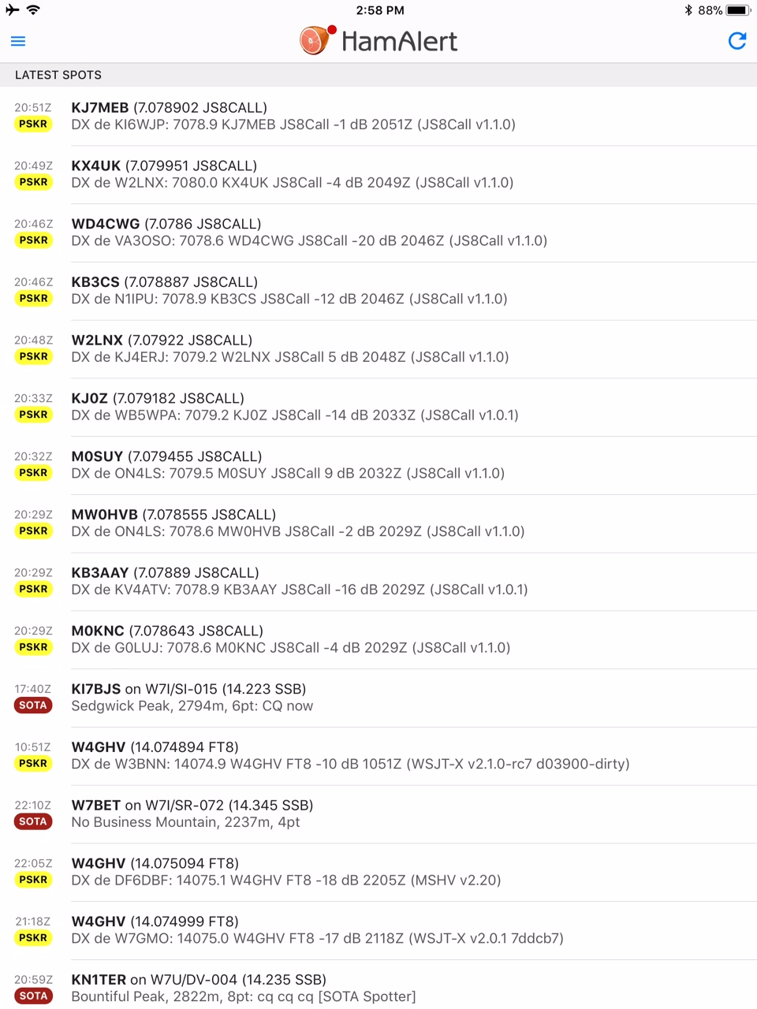
Where are Signals?
Did I make it out?

Slide 12
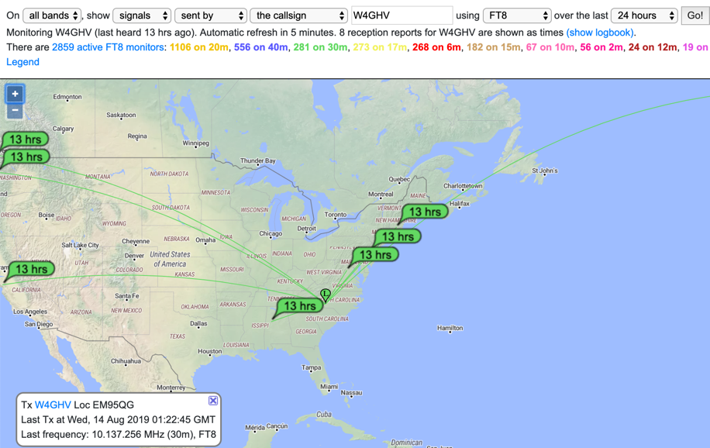
pskReporter
Notes:
But what if I want to say more than pre-canned messages?

Slide 13
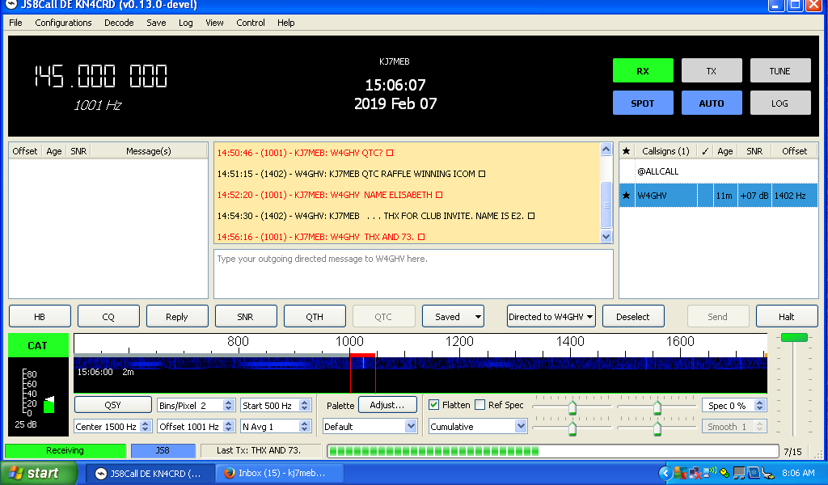
J
S
8
C
A
L
L

Slide 14
Demo
Notes:
Show of hands, FT8 or JS8?

Slide 15
Q&A

