Slide 1
Bloom Filters and Hyperloglog

Slide 2


Hello!
We are
Debaditya Sen
Ritesh Bucha
Department of Computer Engineering, SRMIST, KTR, Chennai
Department of Computer Engineering, SRMIST, KTR, Chennai
https://bucharitesh.in

Slide 3
TerMINOLOGY
Probabilistic Data Structure
A NO is a NO, but a yes might not be a yes.
Probabilistic data structures are a group of data structures that are extremely useful for big data and streaming applications. These data structures use hash functions to randomize and compactly represent a set of items
Cardinality
The term "cardinality" is used to mean the number of distinct elements in a data stream with repeated elements. However in the theory of multisets the term refers to the sum of multiplicities of each member of a multiset.

Slide 4
OBJECTIVE

Slide 5
Bloom Filter
Security has always been a major concern for networked systems administrators and users. Many approaches have been proposed to achieve the various security goals. In these approaches, a variety of techniques and data structures have been used to address the security concerns in an efficient manner. On the other hand, there are typically umpteen numbers of data items that need to be stored, queried and updated in the network environment. Therefore, the fact is concluded that space and time are two important factors that should be taken into consideration by the security approaches, especially in the specific networks, such as sensor networks, which suffer from severe limitations. A probabilistic data structure that has been widely utilized in this field is Bloom filter (BF), which was introduced by Burton Bloom in 1970. BF is a simple, memory- and time-efficient randomized data structure for succinctly representing a set of elements and supporting set membership queries. These properties of BF make it very attractive to be utilized for many security applications. In recent years, BFs and their variants have been widely used in networking applications, such as resource routing, security, and web caching. This paper provides a survey on the applications of BFs in the field of network security. Note that we only focus on the idea behind the approaches without discussing implementation details. It should be noted, however, that our goal of making this survey is not providing an exact classification of security attacks for different networks. But we intend to review where BFs and their variants have been used to improve the efficiency of the different security schemes.

Slide 6
Hyperloglog
Denial of service (DoS) attacks are one of the most important issues in network security. They aim to make a server resource unavailable by either damaging data or software or flooding the network with a huge amount of traffic. Thus, the server becomes unreachable by legitimate users, causing a significant financial loss in some cases. Port scan is a particular DoS attack that aims to discover available services on the targeted system. It essentially consists of sending an IP packet to each port and analysing the response to the connection attempts. Definitions found in the literature are enable to provide an absolute quantitative definition of port scan. The attack is rather defined by a comparison to the standard behaviour. The attacker can discover not only available ports (or services) but also more relevant information about the victim such as its operating system, services owners, and the authentication method. Once the system vulnerabilities are identified, a future attack can be launched, engendering important damages. Various port scanning techniques have been developed and are very simple to install in order to launch serious port scan attacks. Nmap [2] is the most known port scan method. It was proposed by Fyodor in 2009. Zmap is a faster scanning method developed by Durumeric et al. in 2013. It can scan the IPv4 address space in less than 45 min using a single machine. The memory size required by this kind of approach is proportional to the number of flows, which is clearly unscalable and not adapted to the current very high-bit traffic carried by very high-speed links. To overcome this problem, it is necessary to dispense accurate statistics and to generate estimates which require less memory and are based on a faster processing. In this context, some recent probabilistic methods based on Bloom filters have been proposed. A Bloom filter is an efficient data structure of a limited size that guarantees fast processing, thanks to the use of hash functions.

Slide 7
Introduction
Bloom Filter & Hyperloglog

Slide 8
Bloom Filter
Bloom Filter is a probabilistic data structure which is used to search an element within a large set of elements in constant time that is O(K) where K is the number of hash functions being used in Bloom Filter. This is useful in cases where:
The data to be searched is large
The memory available on the system is limited/ low
Bloom Filter is memory efficient than a Hash Map with the same performance. The only thing to note is that this is a probabilistic data structure so for a small number of cases, it may give wrong results (which can be limited).

Slide 9
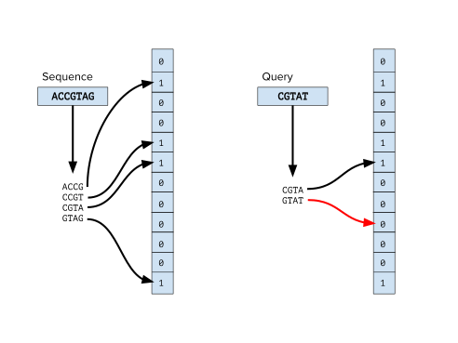
Bloom Filter

Slide 10
Hyperloglog
HyperLogLog is an algorithm for the count-distinct problem, approximating the number of distinct elements in a multiset. Calculating the exact cardinality of a multiset requires an amount of memory proportional to the cardinality, which is impractical for very large data sets.
The basis of the HyperLogLog algorithm is the observation that the cardinality of a multiset of uniformly distributed random numbers can be estimated by calculating the maximum number of leading zeros in the binary representation of each number in the set. If the maximum number of leading zeros observed is n, an estimate for the number of distinct elements in the set is 2n

Slide 11
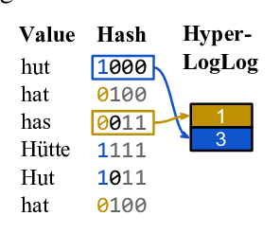
Hyperloglog

Slide 12
Advantages

Slide 13
Bloom Filter
The Time Complexity associated with Bloom Filter Data Structure is O(k) during Insertion and Search Operation where k is the number of hash function that have been implemented.
The Space Complexity associated with Bloom Filter Data Structure is O(m) where m is the Size of the Array.
While a hash table uses only one hash function, Bloom Filter uses multiple Hash Functions to avoid collisions.

Slide 14
Hyperloglog
It allows us to estimate unique items within a large dataset by recording the longest sequence of zeroes within that set.
This ends up creating an incredible advantage over keeping track of each and every element in the set. It is an incredibly efficient way to count unique values, with relatively high accuracy

Slide 15
DISADVANTAGES

Slide 16
Bloom Filter
Hyper loglog
Unlike other Data Structures, Deletion Operations is not possible in the Bloom Filter because if we delete one element we might end up deleting some other elements also, since hashing is used to clear the bits at the indexes where the elements are stored
Besides the obvious false positive potential, the bloom filter can only report yes or no. It can't suggest alternatives for items that might be close to being spelled correctly. A bloom filter has no memory of which bits were set by which items so a yes or no answer is the best we can get with even a yes answer not being correct in some circumstances.
Only provides estimated count.

Slide 17
Enhancements

Slide 18
Bloom Filter
A cuckoo filter is a space-efficient probabilistic data structure that is used to test whether an element is a member of a set, like a Bloom filter does. False positive matches are possible, but false negatives are not – in other words, a query returns either "possibly in set" or "definitely not in set". A cuckoo filter can also delete existing items, which is not supported by Bloom filters. In addition, for applications that store many items and target moderately low false positive rates, cuckoo filters can achieve lower space overhead than space-optimized Bloom filters.

Slide 19
Hyperloglog
HLL++ is based on HyperLogLog; HLL++ more accurately estimates the number of distinct values in very large and small data streams.
The HyperLogLog++ algorithm proposes several improvements in the HyperLogLog algorithm to reduce memory requirements and increase accuracy in some ranges of cardinalities:
64-bit hash function is used instead of the 32 bits used in the original paper. This reduces the hash collisions for large cardinalities allowing to remove the large range correction.
Some bias is found for small cardinalities when switching from linear counting to the HLL counting. An empirical bias correction is proposed to mitigate the problem.
A sparse representation of the registers is proposed to reduce memory requirements for small cardinalities, which can be later transformed to a dense representation if the cardinality grows.

Slide 20
Our contribution, PRE-PROCESSING & TECHNIQUES

Slide 21
OUR CONTRIBUTION
We implemented the working of bloom filter in an intuitive way and represented the structure and its mechanism of storing and searching data in a visually compelling manner.
Since Hyperloglog is used and effective for a very large continuous stream of data, it wasn’t feasible for us to implement it in a miniature project.
https://bloomfilter.bucharitesh.in/ (IMPLEMENTATION)

Slide 22
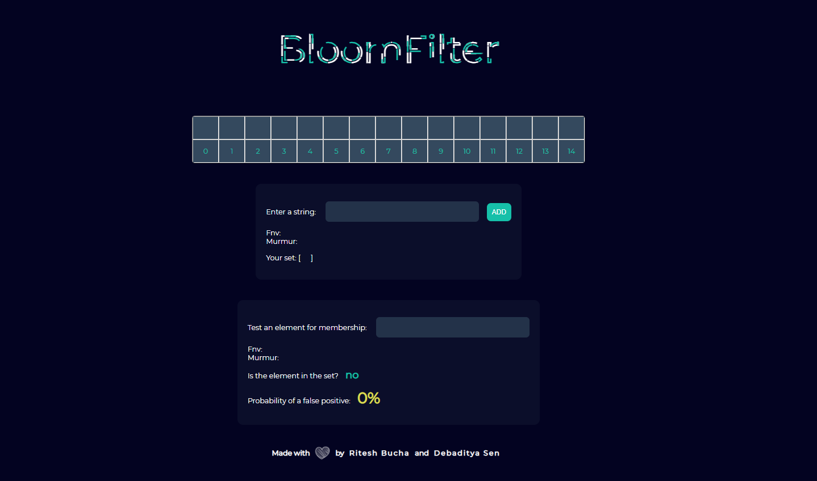

Slide 23
PRE-PROCESSING
It is not Applicable for Our Project.

Slide 24
TECHNIQUES
Bloom Filter
Bloom filters use superimposed hash transforms to provide a probabilistic membership test. The only types of errors are false positives (non-members being reported as members). Non-members are typically detected quickly (requiring only two probes in the optimal case).
Hyperloglog
In the HyperLogLog algorithm, a hash function is applied to each element in the original multiset to obtain a multiset of uniformly distributed random numbers with the same cardinality as the original multiset.

Slide 25
Applications

Slide 26
Bloom Filter
Medium uses bloom filters for recommending post to users by filtering post which have been seen by user.
Quora implemented a shared bloom filter in the feed backend to filter out stories that people have seen before.
The Google Chrome web browser used to use a Bloom filter to identify malicious URLs
Google BigTable, Apache HBase and Apache Cassandra, and PostgreSql use Bloom filters to reduce the disk lookups for non-existent rows or columns

Slide 27
Hyperloglog
Hyperloglog is a space-efficient algorithm for accurate cardinality estimations. Nowadays a lot of data products use it, including Redis, AWS Redshift, and Druid. Redis’s implementation of HLL uses at most 12Kb of memory to estimate the cardinality of practically any set.
If you are a fan of Bitcoin mining, you may find this somewhat familiar. Essentially, Bitcoin mining increases its difficulty by increasing the required number of consecutive leading 0’s in hashes, which means that you have to try a larger number of times to get lucky.

Slide 28
Thanks!

