Slide 1





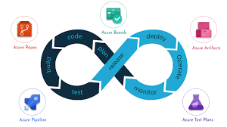
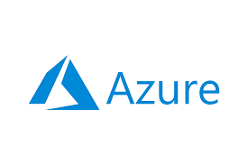



Kubernetes

Slide 2
Kubernetes
What is Kubernetes?
Kubernetes is Orchestration engine and Open-source platform to manage Containerized applications.
Responsibilities are included containers deployment, scale up and scale down containers & container load balancer
Its developed by Google and now it managing by CNCF(Cloud Native Computing Foundation)
Kubernetes v 1.0 was released in July 2015
Latest release is v 1.24
Kubernetes Features
Automated Scheduler: Kubernetes provides advanced scheduler to launch container on cluster nodes based on their resource requirements and other constraints, while not sacrificing availability.
Self Healing Capabilities: Kubernetes allows to replaces and reschedules containers when nodes die.It also kills containers that don't respond to user-defined health check and doesn't advertsie them to clients until they are ready to serve.
Automated rollouts & rollback: Kubernetes rolls out changes to the application or its configuration while monitoring application health to ensure it doesn't kill all your instances at the same time. If something goes wrong,with kubernetes you can rollback the change.

Slide 3
Kubernetes
Kubernetes Features
Horizontal Scaling & Load balancing: kubernetes can scale up and scale down the application as per the requirements with a simple command using a UI or automatically based on CPU usage.
Service Discovery & load Balancing: with kubernetes, there is no need to worry about networking and communication because kubernetes will automatically assign IP addresses to containers and a single DNS name for a set of containers, that can load balance traffic inside the cluster. Containers get their own IP so you can put a set of containers behind a signle DNS name for load balancing.
Storage Orchestration: Wth Kubernetes, you can mount the storage system of your choice.You cna either opt for local storage or choose a public cloud provider such as GCP or AWS or perhaps use a shared network storage system such as NFS,iSCSI etc.

Slide 4
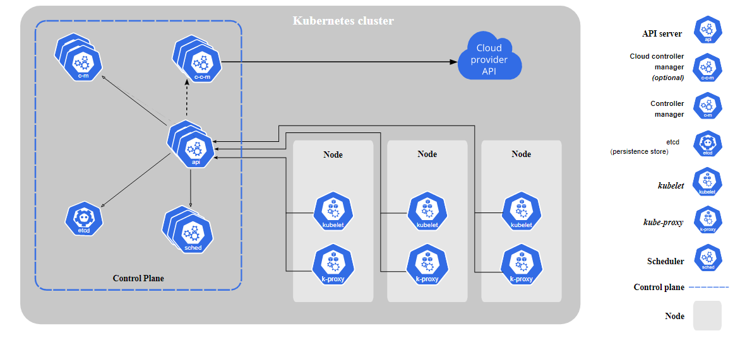
Kubernetes
Kubernetes Architecture

Slide 5
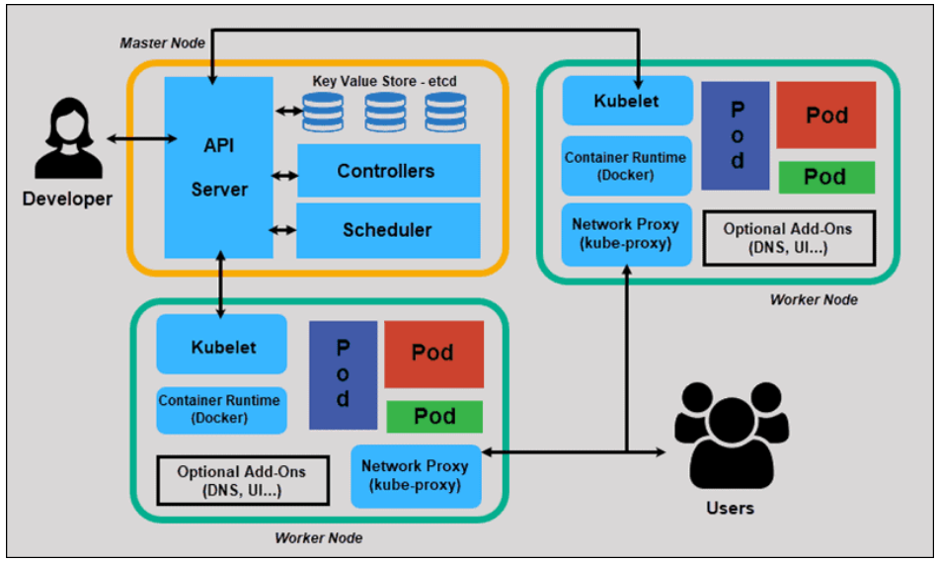
Kubernetes
Kubernetes Architecture

Slide 6
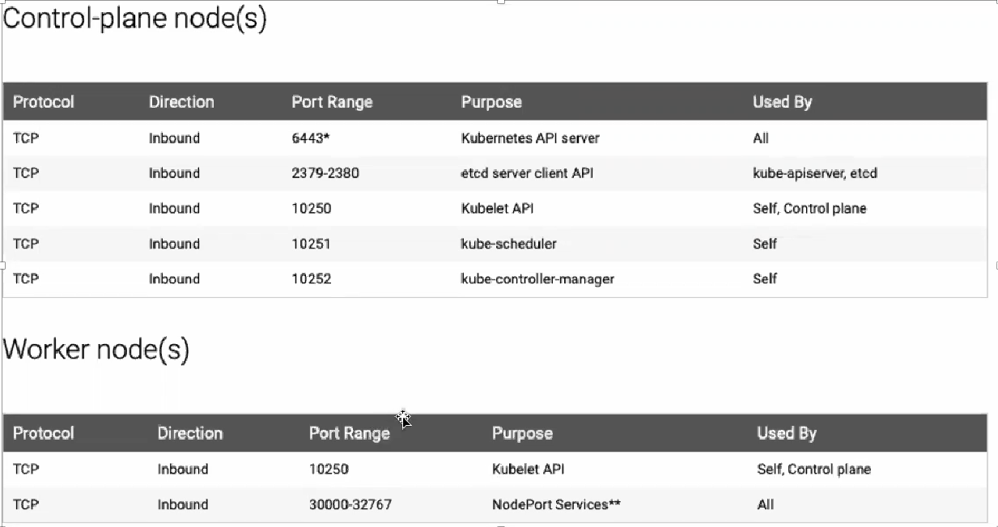
Kubernetes
Kubernetes cluster default ports

Slide 7
Kubernetes
Manifest files
The manifest is a specification of a Kubernetes API object in JSON or YAML format
A manifest specifies the desired state of an object that Kubernetes will maintain when you apply the manifest. Each configuration file can contain multiple manifests.
When we define manifest files contains below four fields
apiVersion: apps/v1
kind: Deployment
metadata:
...
spec:
...

Slide 8
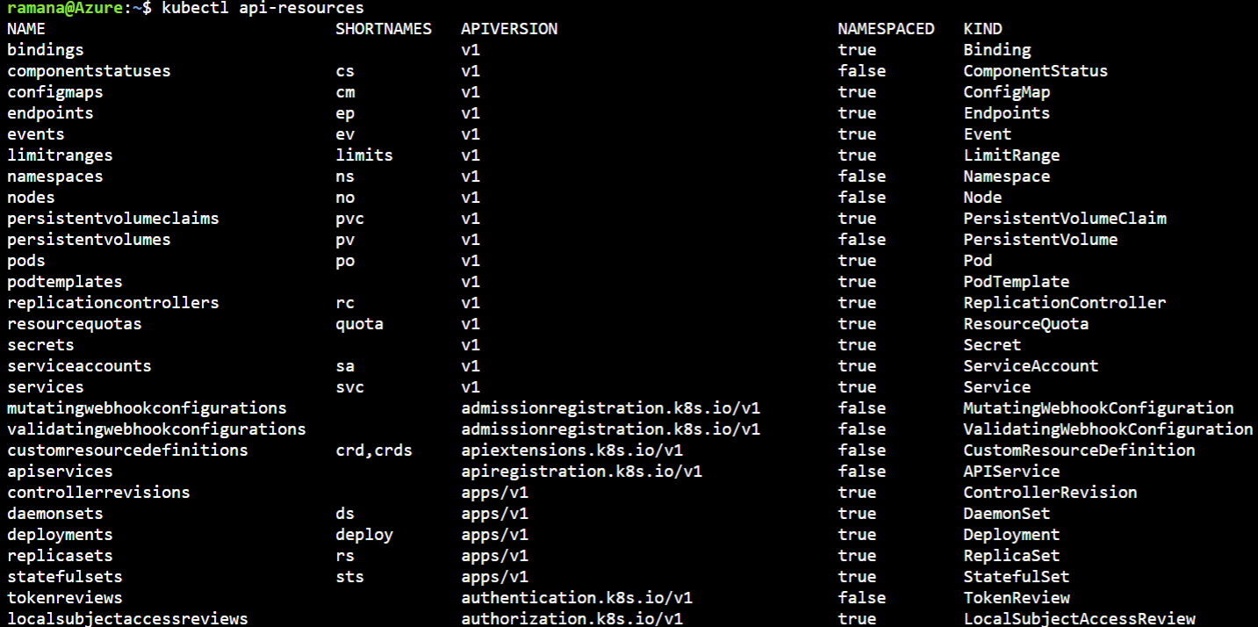
Kubernetes
Kubectl commands
To get the list of api versions for all kubernetes objects
Kubectl api-version
To get the list of api resources in kubernetes cluster
Kubectl api-resources

Slide 9
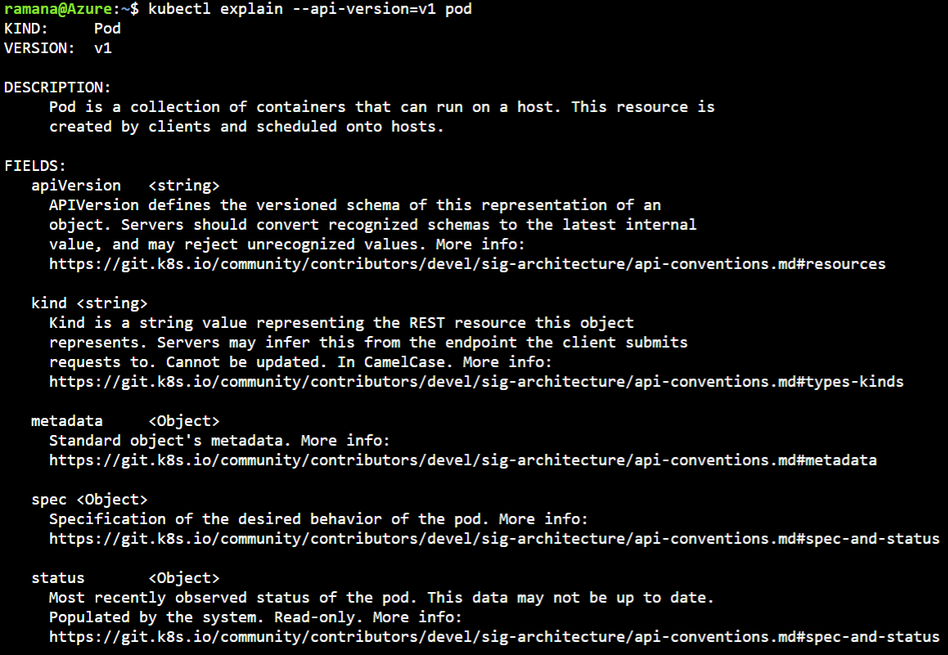
Kubernetes
Kubectl commands
To get the detailed information about the kubernetes api version
kubectl explain --api-version=<api-version> <resource-type>
Example for pod type:

Slide 10
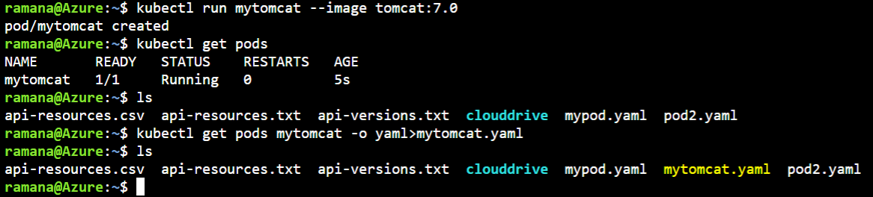
Kubernetes
Kubectl commands
To validate the manifest file run below command
kubectl apply –f <manifestfile>.yaml –dry-run=client
To create kubernetes objects using manifest files
kubectl apply –f <manifestfile>.yaml
To save kubectl objects in yaml file
kubectl get <k8s-object type> <objectname> -o yaml> <filename>.yaml
Example:

Slide 11
Kubernetes
POD
Pods are the smallest deployable units of computing that you can create and manage in Kubernetes
Pod always runs on Node.
In Kubernetes cluster, a pod represents a running process.
Inside a pod, you can have one or more containers. Those containers all shares
Unique network IP, storage, network and nay other specification applied
to the pod.
apiVersion: v1
kind: Pod
metadata:
name: nginx
spec:
containers:
- name: nginx
image: nginx:1.14.2
ports:
- containerPort: 80
Command
Kubectl apply –f pod.yaml

Slide 12
Kubernetes
Replication controller
A ReplicationController ensures that a specified number of pod replicas are running at any one time.
In other words, a ReplicationController makes sure that a pod or a homogeneous set of pods is always up and available
A replication Controller is a structure that enables you to easily create multiple pods,then make sure that number of pods alwasys exists. If a pod does crash, the replication controller reaplaces it.
Replication contollers and PODs are associcated with labels.
Creating "RC" with count of 1 ensure that a POD is always available
apiVersion: v1
kind: ReplicationController
metadata:
name: nginx
spec:
replicas: 3
selector:
app: nginx
template:
metadata:
name: nginx
labels:
app: nginx
spec:
containers:
- name: nginx
image: nginx
ports:
- containerPort: 80

Slide 13
Kubernetes
ReplicaSet
Replica set, also termed as rs in short, is almost same as the replication controller is, only with a single difference.
The replica set are also known as next generation replication controller. The only difference between replica set and replication controller is the selector types.
The replication controller supports equality based selectors whereas the replica set supports equality based as well as set based selectors.
Equality based Selectors
Equality based selectors allow filtering by label keys and values. Matching objects must satisfy all of the specified label constraints, though they may have additional labels as well.
Three operators used in set based equality based selectors are = , == , !=. The first two represent equality (and are simply synonyms), while the latter represents inequality.
For example, if we provide the following selectors:
env = prod
tier != frontend
Set Based Selectors
Unlike Equality based, Set-based label selectors allow filtering keys according to a set of values.
Three kinds of operators used in set-based selectors are in , notin, exists(only the key identifier).
For example, if we provide the following selectors:
env in (prod, qa)
tier notin (frontend, backend)

Slide 14
Kubernetes
Replica Set
apiVersion: apps/v1
kind: ReplicaSet
metadata:
name: frontend
labels:
app: guestbook
tier: frontend
spec: # modify replicas according to your case
replicas: 3
selector:
matchLabels:
tier: frontend
template:
metadata:
labels:
tier: frontend
spec:
containers:
- name: php-redis
image: gcr.io/google_samples/gb-frontend:v3

Slide 15
Kubernetes
Deployment
A Deployment provides declarative updates for Pods and ReplicaSets
Use Case
The following are typical use cases for Deployments:
Create a Deployment to rollout a ReplicaSet. The ReplicaSet creates Pods in the background. Check the status of the rollout to see if it succeeds or not.
Declare the new state of the Pods by updating the PodTemplateSpec of the Deployment. A new ReplicaSet is created and the Deployment manages moving the Pods from the old ReplicaSet to the new one at a controlled rate. Each new ReplicaSet updates the revision of the Deployment.
Rollback to an earlier Deployment revision if the current state of the Deployment is not stable. Each rollback updates the revision of the Deployment.
Scale up the Deployment to facilitate more load.
Pause the rollout of a Deployment to apply multiple fixes to its PodTemplateSpec and then resume it to start a new rollout.
Use the status of the Deployment as an indicator that a rollout has stuck.
Clean up older ReplicaSets that you don't need anymore

Slide 16
Kubernetes
apiVersion: apps/v1
kind: Deployment
metadata:
name: nginx-deployment
labels:
app: nginx
spec:
replicas: 3
selector:
matchLabels:
app: nginx
template:
metadata:
labels:
app: nginx
spec:
containers:
- name: nginx
image: nginx:1.14.2
ports:
- containerPort: 80
Deployment

Slide 17
Kubernetes
DaemonSet
A DaemonSet ensures that all (or some) Nodes run a copy of a Pod. As nodes are added to the cluster, Pods are added to them. As nodes are removed from the cluster, those Pods are garbage collected. Deleting a DaemonSet will clean up the Pods it created.
Some typical uses of a DaemonSet are:
running a cluster storage daemon on every node
running a logs collection daemon on every node
running a node monitoring daemon on every node
In a simple case, one DaemonSet, covering all nodes, would be used for each type of daemon. A more complex setup might use multiple DaemonSets for a single type of daemon, but with different flags and/or different memory and cpu requests for different hardware types.

Slide 18
apiVersion: apps/v1
kind: DaemonSet
metadata:
name: fluentd-elasticsearch
namespace: kube-system
labels:
k8s-app: fluentd-logging
spec:
selector:
matchLabels:
name: fluentd-elasticsearch
template:
metadata:
labels:
name: fluentd-elasticsearch
spec:
tolerations:
# these tolerations are to have the daemonset runnable on control plane nodes # remove them if your control plane nodes should not run pods
- key: node-role.kubernetes.io/control-plane
operator: Exists
effect: NoSchedule
- key: node-role.kubernetes.io/master
operator: Exists
effect: NoSchedule
containers:
- name: fluentd-elasticsearch
image: quay.io/fluentd_elasticsearch/fluentd:v2.5.2
resources:
limits:
memory: 200Mi
requests:
cpu: 100m
memory: 200Mi
volumeMounts:
- name: varlog
mountPath: /var/log
- name: varlibdockercontainers
mountPath: /var/lib/docker/containers
readOnly: true
terminationGracePeriodSeconds: 30
volumes:
- name: varlog
hostPath:
path: /var/log
- name: varlibdockercontainers
hostPath:
path: /var/lib/docker/containers
Kubernetes
DaemonSet

Slide 19
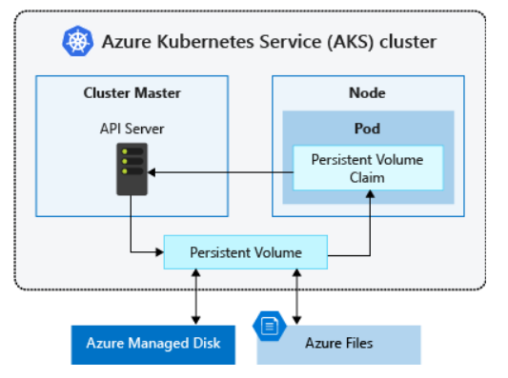
Kubernetes
Volumes
Volume Plugin | Internal Provisioner | Config Example
AWSElasticBlockStore | ✓ | AWS EBS
AzureFile | ✓ | Azure File
AzureDisk | ✓ | Azure Disk
CephFS | - | -
Cinder | ✓ | OpenStack Cinder
FC | - | -
FlexVolume | - | -
Flocker | ✓ | -
GCEPersistentDisk | ✓ | GCE PD
Glusterfs | ✓ | Glusterfs
iSCSI | - | -
Quobyte | ✓ | Quobyte
NFS | - | NFS
RBD | ✓ | Ceph RBD
VsphereVolume | ✓ | vSphere
PortworxVolume | ✓ | Portworx Volume
ScaleIO | ✓ | ScaleIO
StorageOS | ✓ | StorageOS
Local | - | Local

Slide 20
Kubernetes
Advanced Scheduling
Labels and Selector
nodeSelector is the simplest recommended form of node selection constraint. You can add the nodeSelector field to your Pod specification and
specify the node labels you want the target node to have. Kubernetes only schedules the Pod onto nodes that have each of the labels you specify.
apiVersion: v1
kind: Pod
metadata:
name: nginx
labels:
env: test
spec:
containers:
- name: nginx
image: nginx
imagePullPolicy: IfNotPresent
nodeSelector:
disktype: ssd #<labels of node>
# to list the labels of nodes
kubectl get nodes --show-labels
#To create a label for nodes
kubectl label nodes <your-node-name> disktype=ssd

Slide 21
Kubernetes
Advanced Scheduling
Affinity and Anti-Affinity
nodeSelector is the simplest way to constrain Pods to nodes with specific labels. Affinity and anti-affinity expands the types of constraints you can define.
Some of the benefits of affinity and anti-affinity include:
The affinity/anti-affinity language is more expressive. nodeSelector only selects nodes with all the specified labels.
Affinity/anti-affinity gives you more control over the selection logic.
You can indicate that a rule is soft or preferred, so that the scheduler still schedules the Pod even if it can't find a matching node.
You can constrain a Pod using labels on other Pods running on the node (or other topological domain), instead of just node labels,
which allows you to define rules for which Pods can be co-located on a node.
The affinity feature consists of two types of affinity:
Node affinity functions like the nodeSelector field but is more expressive and allows you to specify soft rules.
Inter-pod affinity/anti-affinity allows you to constrain Pods against labels on other Pods.
There are two types of node affinity:
requiredDuringSchedulingIgnoredDuringExecution: The scheduler can't schedule the Pod unless the rule is met.
This functions like nodeSelector, but with a more expressive syntax.
preferredDuringSchedulingIgnoredDuringExecution: The scheduler tries to find a node that meets the rule.
If a matching node is not available, the scheduler still schedules the Pod.

Slide 22
Kubernetes
Advanced Scheduling
Taints and Tolerations
apiVersion: v1
kind: Pod
metadata:
name: nginx
labels:
env: test
spec:
containers:
- name: nginx
image: nginx
imagePullPolicy: IfNotPresent
tolerations:
- key: "example-key"
operator: "Exists"
effect: "NoSchedule"
Taints are the opposite -- they allow a node to repel a set of pods.
Tolerations are applied to pods. Tolerations allow the scheduler to schedule pods with matching taints. Tolerations allow scheduling but don't guarantee scheduling: the scheduler also evaluates other parameters as part of its function.
Taints and tolerations work together to ensure that pods are not scheduled onto inappropriate nodes. One or more taints are applied to a node; this marks that the node should not accept any pods that do not tolerate the taints

Slide 23
Thank you…!!!

