Slide 1

SCP
scp stands for "secure copy.",
Scp (Secure Copy) is a command line tool to copy or transfer files across hosts.
If you are familiar with using the cp command on your local machine, scp is easy to understand. Both commands require a source and a destination filesystem location for the copy operation; the big difference is that with scp, one or both of the locations are on a remote system.

Slide 2
It uses the same kind of security mechanism like the ssh program. Infact it uses an ssh connection in the background to perform the file transfer
scp refers both to the "protocol" that defines how secure copy should work and the "program" (command) which is installed as a part of OpenSSH suite of tools.

Slide 3
Installing scp
Scp is generally installed by default on most linux distros as a part of openssh packages.
On ubuntu/debian for example, the openssh-client package provides the scp program.
Execute the following command to check whether scp in installed or not
dpkg -L openssh-client | grep scp
If scp installed we get the following outpit
/usr/bin/scp
/usr/share/man/man1/scp.1.gz

Slide 4
If not installed then install openssh-client
sudo apt-get install openssh-client

Slide 5
SCP Syntax
scp source_file_path destination_file_path
Depending on the host, the file path should include the full host address, port number, username and password along with the directory path.
While dealing with remote machine we need to enter remote machine password when prompted

Slide 6
File transfer from local machine to remote machine
scp local_filename remotemachine_hostname@ip_address:/remotemachine_localdirectory
ex:
scp filename.c gaian@192.168.23.200:/home/gaian/
This command copies file filename.c from local machine to remote machine /home/gaian directory

Slide 7
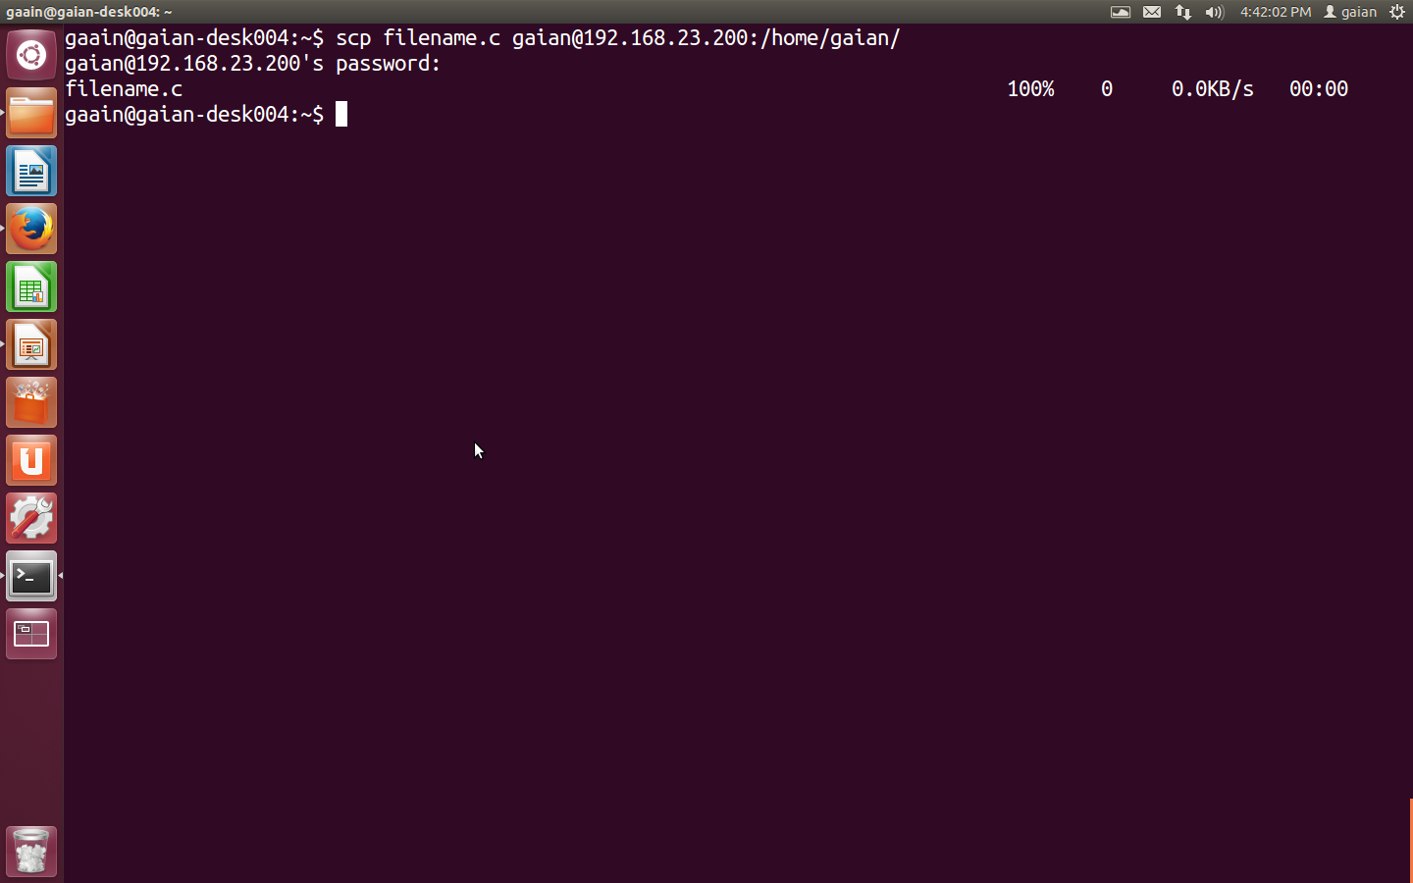

Slide 8
File copy from remote machine to local machine
scp remotemachine_hostname@ip_address:/file_path local_path
Ex:
scp gaian@192.168.23.200:/home/gaian/xml.c .
This command copies file xml.c from remote machine to present directory(.),if we want to copy the file to another directory specify that path
Ex
scp gaian@192.168.23.200:/home/gaian/xml.c /localdirecroty_path

Slide 9
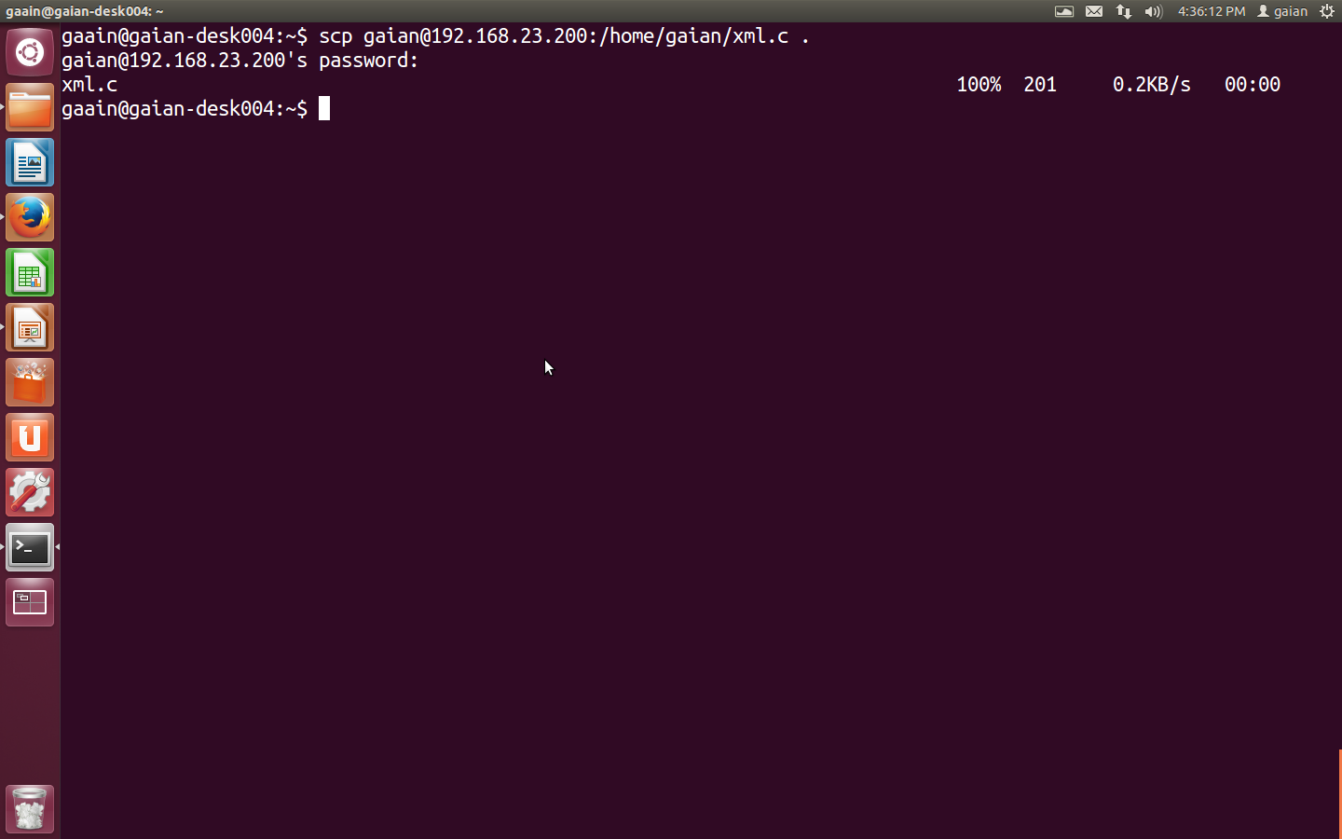

Slide 10
Copying multiple files from local to remote machine
scp filename1 filename2 filename3 remotemachine_hostname@ip_address:/remotemachine_localdirectory
ex:
scp filename.c filename2.c filename3.txt gaian@192.168.23.200:/home/gaian/
This command copies files filename.c filename2.c filename3.txt from local machine to remote machine /home/gaian directory

Slide 11
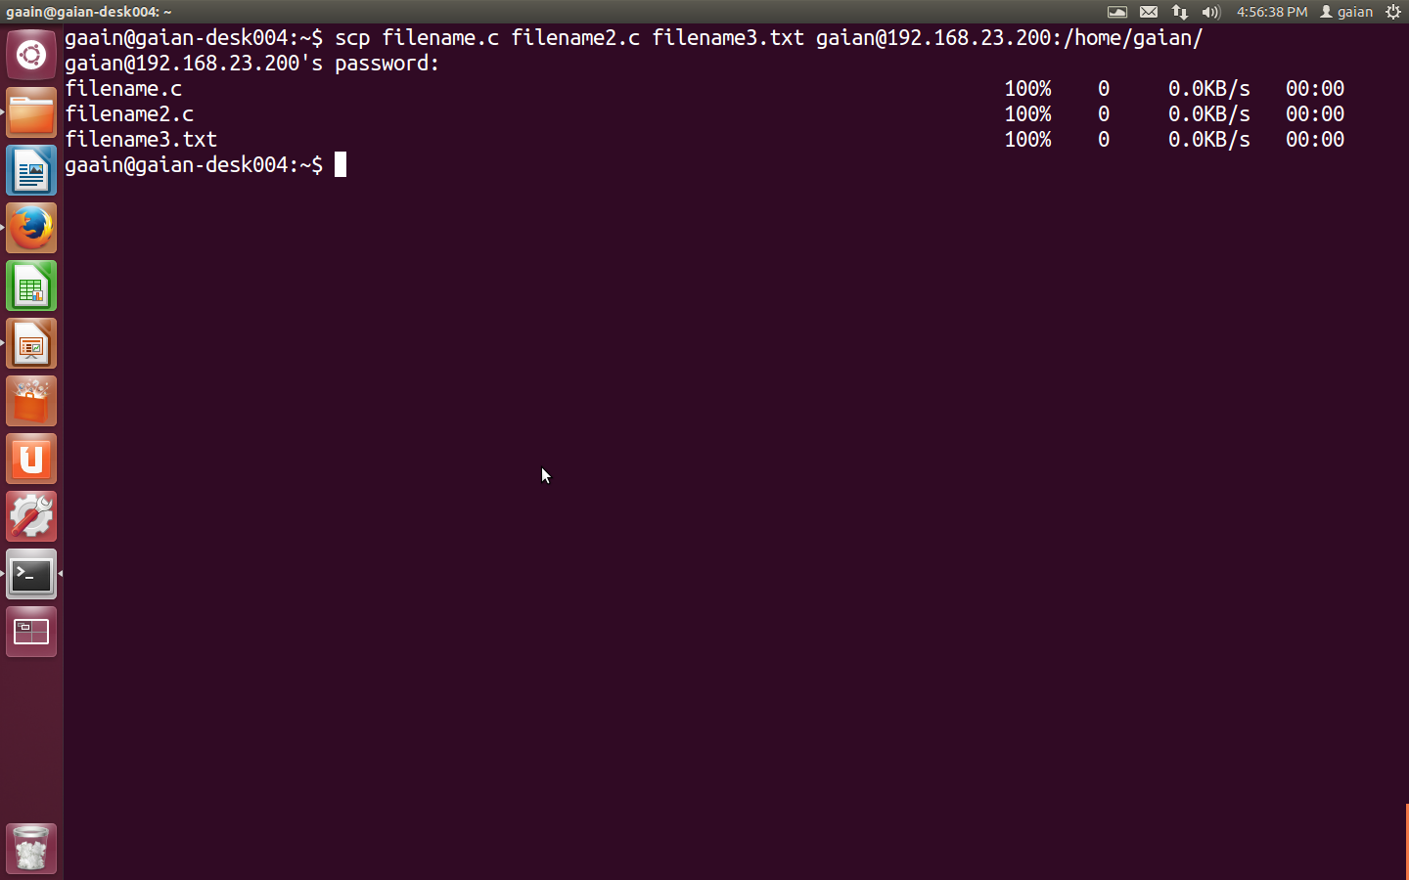

Slide 12
Copying multiple files from remote machine to local machine
scp remotemachine_hostname@ip_address:/\{file1,file2,file3,file4\} local_path
scp gaian@192.168.23.200:/home/gaian/\{filename.c,filename2.c,filename3.txt\} .

Slide 13
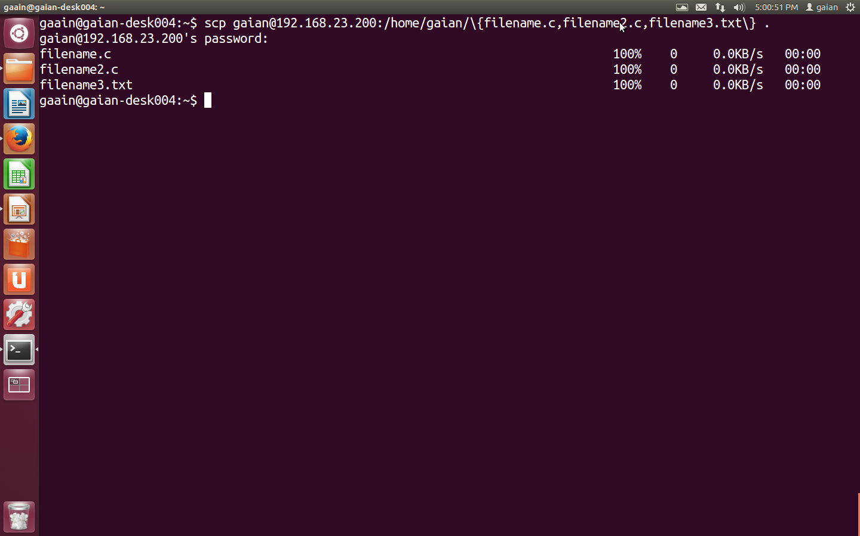

Slide 14
Copying Local directory to Remote machine
scp -r Directory_name remotemachine_hostname@ip_address:/remotemachine_localdirectory
Ex
scp -r TestDirectory/ gaian@192.168.23.200:/home/gaian
Here the directory and the files in the directory TestDirectory are copied to /home/gaian directory of remote machine

Slide 15
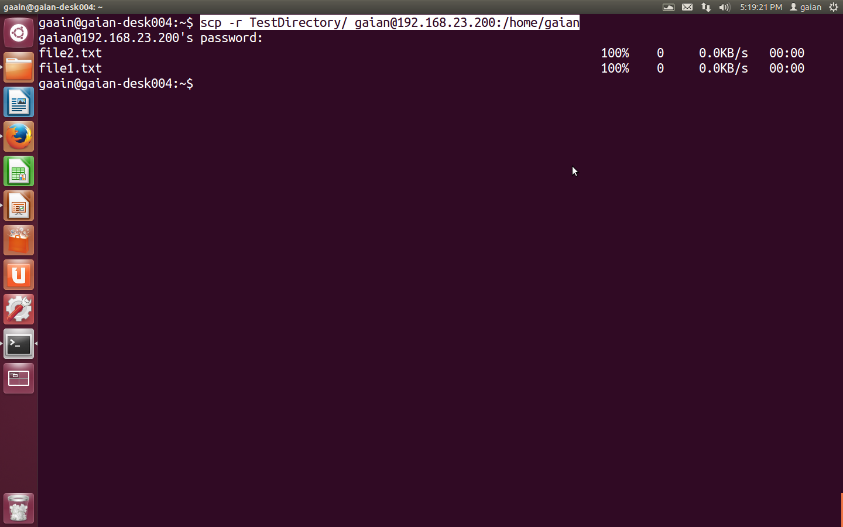

Slide 16
Copy file from local machine to remote machine using port
scp -P port_number file_name remotemachine_hostname@ip_address:/remotemachine_localdirectory
Ex
scp -P 12345 filename.c gaian@192.168.23.200:.

Slide 17
File transfer between two remote machines
sudo scp -3 host1@ipaddress:/filename_path host2@ip_address:/destination_path
Ex
sudo scp -3 gaian@192.168.23.200:/home/gaian/xml.c gaian@192.168.23.208:.
This command copies xml.c file located in /home/gaian directory of gaian@192.168.23.200 to home directiry(.) of gaian@192.168.23.208 machine

Slide 18
