Slide 1

Multimedia Streaming

Slide 2
Application Classes
Typically sensitive to delay, but can sometimes tolerate packet loss (would cause glitches that can be concealed somewhat)
Data contains audio and video content (“continuous media”), three classes of applications:
Streaming
Unidirectional Real-Time
Interactive Real-Time

Slide 3
Streaming:
Streaming or media streaming is a technique for transferring data so that it can be processed as a steady and continuous stream
Clients request audio/video files from servers and pipeline reception over the network and display

Slide 4
Interactive: user can control operation (similar to VCR: pause, resume, fast forward, rewind, etc.)
Delay: from client request until display start can be 1 to 10 seconds

Slide 5
Unidirectional Real-Time:
similar to existing TV and radio stations, but delivery on the network
Non-interactive, just listen/view
Interactive Real-Time :
Phone conversation or video conference
More stringent delay requirement than Streaming and Unidirectional because of real-time nature
Video: < 150 msec acceptable
Audio: < 150 msec good, <400 msec acceptable

Slide 6
Helper Applications
Displays content, which is typically requested via a Web browser; typical functions:
Decompression
Jitter removal
Error correction: use redundant packets to be used for reconstruction of original stream
GUI for user control
Examples:
RealPlayer
Adobe Flash Player
Windows Media Player
QuickTime
DivX Web Player

Slide 7
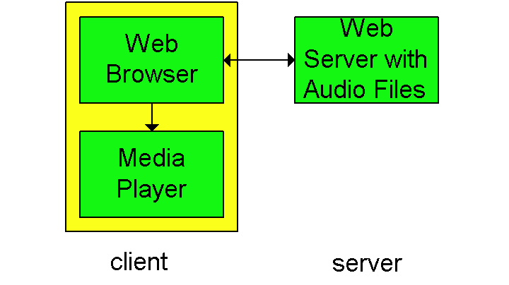
First Generation: HTTP Download
A simple architecture is to have the Browser request the object(s) and after their reception pass them to the player
for display
No pipelining

Slide 8
Alternative: set up connection between server and player; player takes over
Web browser requests and receives a Meta File
(a file describing the object) instead of receiving the file itself;
Browser launches the appropriate Player and passes it the Meta File;
Player sets up a TCP connection with Web Server and downloads or streams the file

Slide 9
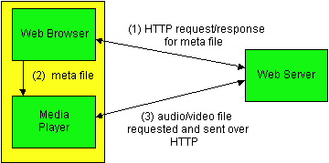
Meta file requests

Slide 10
HTTP Progressive Download
With helper application doing the download, playback can start immediately...
Or after sufficient bytes are buffered
Sender sends at maximum possible rate under TCP; retransmit when error is encountered; Player uses a much larger buffer to smooth delivery rate of TCP
HTTP connection keeps data flowing as fast as possible to user's local buffer
May download lots of extra data if you do not watch the video
TCP file transfer can use more bandwidth than necessary

Slide 11
Mismatch between whole file transfer and stop/start/seek playback controls.
However: use file range requests to seek to video position
Next, we'll see an approach that streams data into a buffer using only the bit rate of the video

Slide 12
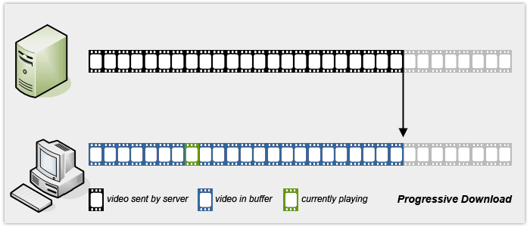

Slide 13
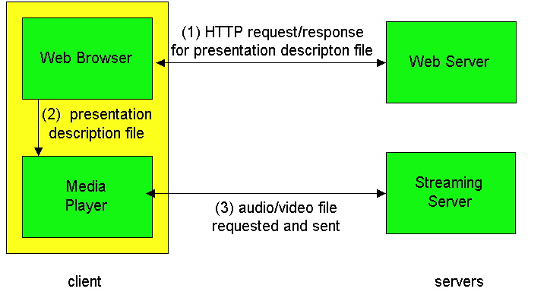
2nd Generation:
Real-Time Streaming
This gets us around HTTP, allows a choice of UDP vs. TCP and the application layer protocol can be better tailored to Streaming; many enhancements options are possible

Slide 14
Real Time Streaming Protocol (RTSP)
For user to control display: rewind, fast forward, pause, resume, etc…
Out-of-band protocol (uses two connections, one for control messages (Port 554) and one for media stream)
RFC 2326 permits use of either TCP or UDP for the control messages connection, sometimes called the RTSP Channel
As before, meta file is communicated to web browser which then launches the Player; Player sets up an RTSP connection for control messages in addition to the connection for the streaming media

Slide 15
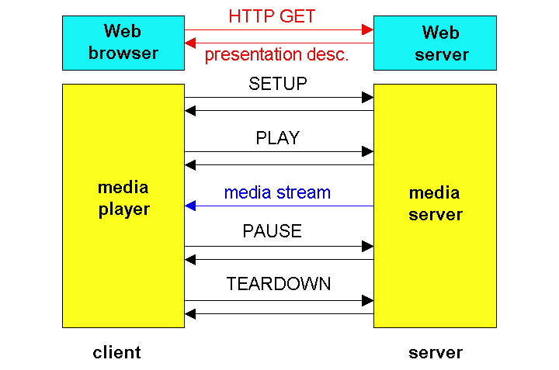
RTSP Operation

Slide 16
RTSP Exchange Example
C: SETUP rtsp://audio.example.com/xena/audio RTSP/1.0
Transport: rtp/udp; compression; port=3056; mode=PLAY
S: RTSP/1.0 200 1 OK
Session 4231
C: PLAY rtsp://audio.example.com/xena/audio.en/lofi RTSP/1.0
Session: 4231
Range: npt=0 (npt = normal play time)
C: PAUSE rtsp://audio.example.com/xena/audio.en/lofi RTSP/1.0
Session: 4231
Range: npt=37
C: TEARDOWN rtsp://audio.example.com/xena/audio.en/lofi RTSP/1.0
Session: 4231
S: 200 3 OK

Slide 17
RTSP Media Stream
Stateful Server keeps track of client's state
Client issues Play, Pause, ..., Close
Steady stream of packets
UDP - lower latency
TCP - may get through more firewalls, reliable

Slide 18
RTMP - Real-Time Messaging Protocol
Proprietary Adobe protocol
Runs over TCP
Manages audio, video, and other
Multiplex multiple streams over TCP connection

Slide 19
Drawbacks of RTSP, RTMP
Web downloads are typically cheaper than streaming services offered by CDNs and hosting providers
Streaming often blocked by routers
UDP itself often blocked by firewalls
HTTP delivery can use ordinary proxies and caches
Conclusion: rather than adapt Internet to streaming, adapt media delivery to the Internet

Slide 20
3rd Generation: HTTP Streaming
Other terms for similar concepts: Adaptive Streaming, Smooth Streaming, HTTP Chunking
Probably most important is return to stateless server and TCP basis of 1st generation
Actually a series of small progressive downloads of chunks
No standard protocol. Typically HTTP to download series of small files.
Apple HLS: HTTP Live Streaming
Microsoft IIS Smooth Streaming: part of Silverlight
Adobe: Flash Dynamic Streaming
DASH: Dynamic Adaptive Streaming over HTTP
Chunks begin with keyframe so independent of other chunks
Playing chunks in sequence gives seamless video
Hybrid of streaming and progressive download:
Stream-like: sequence of small chunks requested/delivered as needed
Progressive download-like: HTTP transfer mechanism, stateless servers

Slide 21
HTTP Streaming
Adaptation:
Encode video at different levels of quality/bandwidth
Client can adapt by requesting different sized chunks
Chunks of different bit rates must be synchronized: All encodings have the same chunk boundaries and all chunks start with keyframes, so you can make smooth splices to chunks of higher or lower bit rates
Evaluation:
+ Easy to deploy: it's just HTTP, caches/proxies/CDN all work
+ Fast startup by downloading lowest quality/smallest chunk
+ Bitrate switching is seamless
- Many small files
Chunks can be
Independent files -- many files to manage for one movie
Stored in single file container -- client or server must be able to access chunks, e.g. using range requests from client.

Slide 22
Advantages of Streaming
It reduces the download time
It provide seady stream
Slower systems takes advantages of streaming technology
Provide service on demand

Slide 23
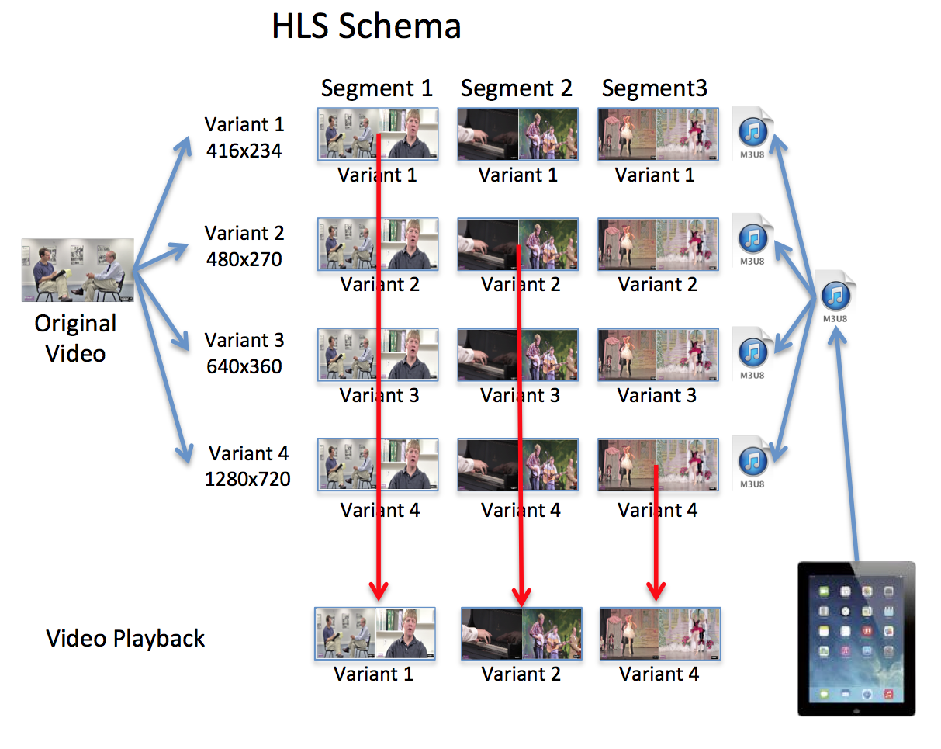
HLS Schema

Slide 24
Applications that utilizing Streaming techonology
Video streaming
IP telephony
Video conferencing
Interactive games
Distance learning

