Slide 1
Codec
a codec is a method for encoding and decoding data and more specifically, a protocol for compressing data, especially video. Selecting the right codec can depend on several factors. Target file size, output quality, and delivery method all factor in. Currently h.264 is the predominant codec on the web.

Slide 2

Video Codecs

Slide 3
Container
a container is what holds the grouping of compressed video as defined by the codec. A container is also referred to as a format. The container takes care of packaging, transport, and presentation. The container is usually represented by a file extension. For example the MPEG4 container is usually represented by a .mp4 file type

Slide 4
Different Video Formats

Slide 5
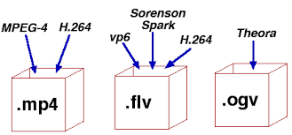
Video Container

