Slide 1
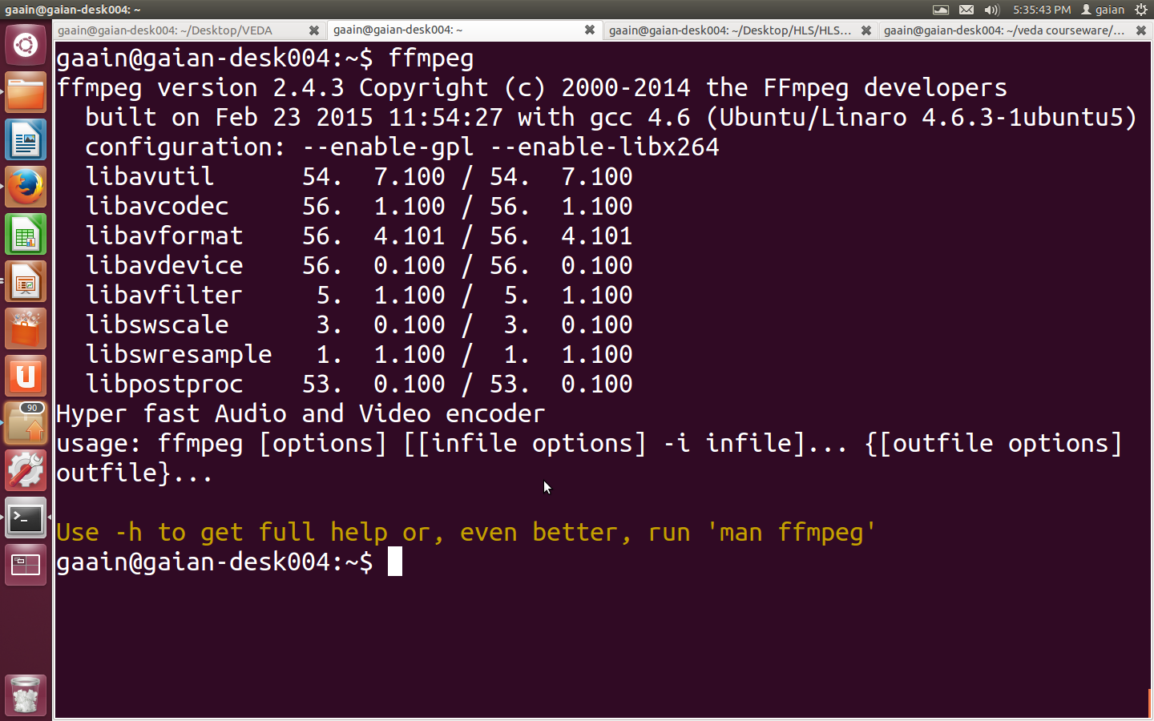
ffmpeg commands

Slide 2
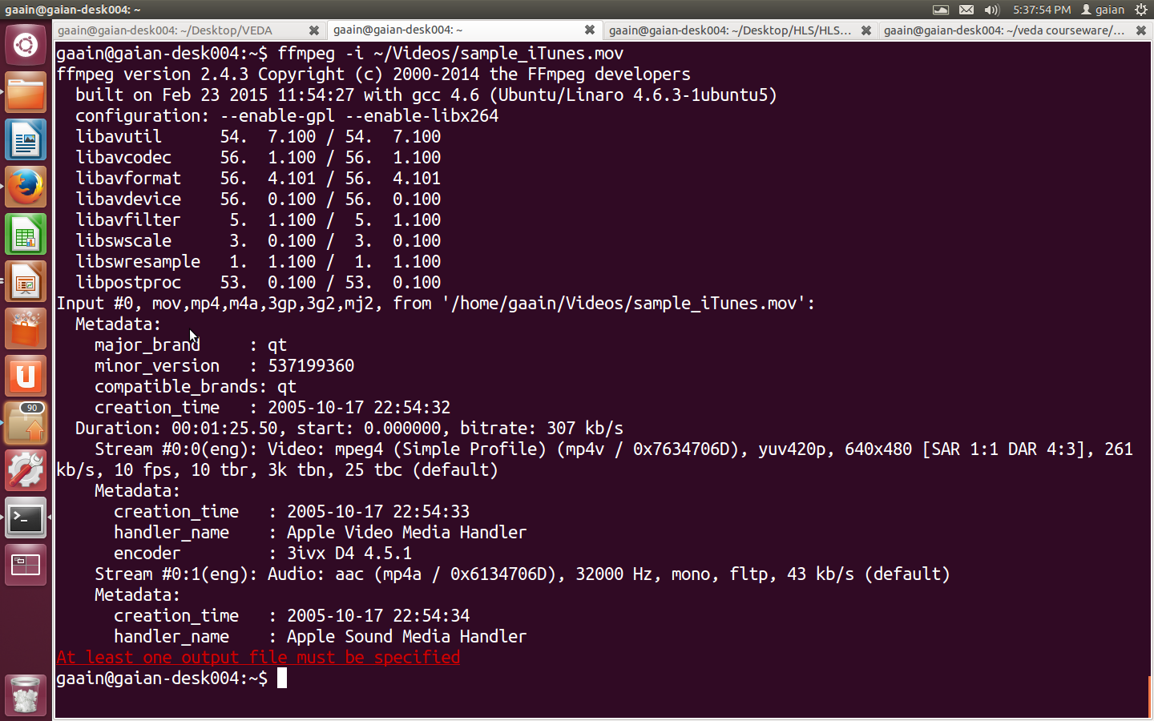

Slide 3
ffmpeg command to convert video into images
ffmpeg -i video.mpg image%d.jpg

