Slide 1

GoldenMate Transforming Elderly Care
By Bucilă Mihai, Călăuz Răzvan and Chelaru Laurențiu

Slide 2
Table of Contents
The Problem
Our Solution
Business Opportunity
Competitive Comparison
User Persona
Key Features
Technical Overview
Future Enhancements
Business Model
Conclusion
Proposed Value and Benefits

Slide 3
The Problem: Challenges in Elderly Care
Loneliness Impact: Nearly 50% of elderly adults report chronic loneliness, significantly affecting mental and physical health outcomes.
Health Management: Approximately 80% of older adults have at least one chronic condition, highlighting a pressing need for effective management solutions.
Tech Adaptation Challenges: Over 60% of seniors struggle with technology, necessitating user-friendly solutions tailored to their unique needs.

Slide 4
Our Solution: GoldenMate
Mission Statement: GoldenMate aims to enrich elderly lives by fostering connections and simplifying health management through innovation.
AI-Powered Companionship: The app utilizes AI to provide tailored companionship, addressing loneliness and enhancing emotional well-being among seniors.
User-Centric Design: GoldenMate features an intuitive interface, specifically crafted for seniors, ensuring ease of use and accessibility.

Slide 5
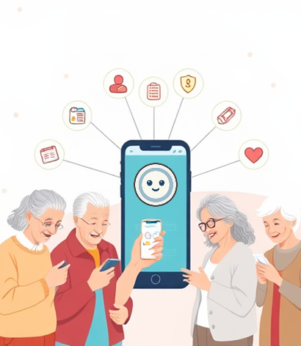
Business Opportunity
Elderly Care Market Growth: The elderly care market is projected to experience unprecedented expansion, driven by demographic shifts and increased demand.
AI Companion Demand: There is a significant rising demand for AI companions, as they provide emotional support and reduce social isolation.
Remote Health Monitoring: Innovative remote health monitoring solutions are increasingly vital, facilitating continuous care and promoting independence in seniors.

Slide 6

Competitive Comparison
Distinctive Feature Set: GoldenMate combines health tracking, companionship, and AI integration, offering a holistic approach to elderly care.
Companionship vs. Coaching: Unlike CeliaTeCuida, GoldenMate prioritizes emotional connectivity alongside health monitoring for comprehensive support.
User Experience Edge: GoldenMate's interface surpasses Medisafe’s design by incorporating social interaction elements enhancing user engagement.

Slide 7

User Persona
Target User Persona: GoldenMate primarily caters to elderly adults in small towns with specific health and social needs.
Hobbies and Engagement: Users often enjoy gardening and family interactions, requiring connectivity for social involvement and well-being.
Need for Independence: These older adults prioritize independence while needing reliable resources for effective health management and support.

Slide 8
Business Model
Subscription Features Overview: The subscription model includes health monitoring, voice communication, sentiment tracking, and engaging minigames designed for seniors.
Future Enhancements: Plans include additional cognitive games, enhanced AI features, and integration with wearable health technology for improved care.
User Engagement Strategy: Focused on increasing user interaction through personalized experiences, reinforcing retention and promoting healthier lifestyle choices.

Slide 9
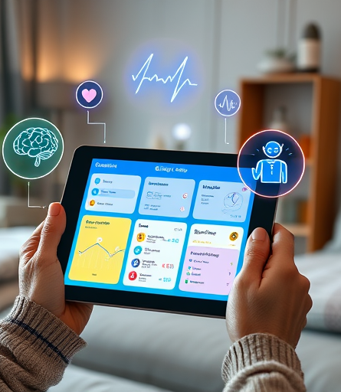
Future Enhancements
Wearable Device Integration: Future iterations of GoldenMate will enhance user experience through seamless integration with wearable health devices.
Health Data Sharing Options: Users will benefit from functionalities that allow secure, real-time sharing of health data with family members.
Social Networking Platform: Development of a tailored social networking platform for seniors aims to promote engagement and community connection.

Slide 10
Conclusion
Vision Recap: GoldenMate envisions improved elderly well-being through enhanced health management and social connectivity for users.
Core Benefits: The app fosters emotional support, promotes independence, and empowers seniors to manage their health effectively.
Potential Impact: GoldenMate aims to revolutionize elderly care by intertwining technology with compassionate support, ensuring holistic living.

