Slide 1
IA32 (AKA Pentium) Instructions
representation/encoding/decoding

Slide 2

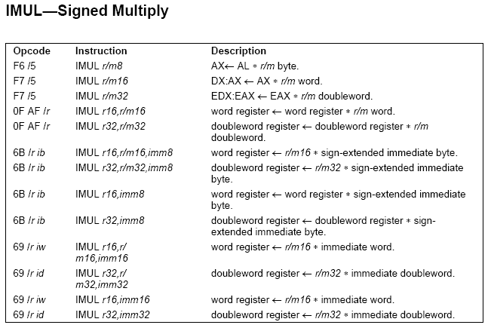
How are instructions (opcodes and operands) represented (as numbers)?

Slide 3
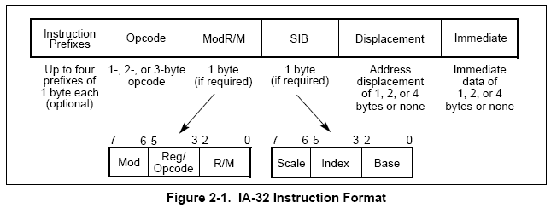
General IA32 instruction format

Slide 4
PREFIXES

Slide 5
Instruction prefixes

Slide 6
Instruction prefixes – 4 groups
Group 1
  lock (f0h)
  repeat (f2h, f3h)
Group 2
  segment override (2eh, 36h, 3eh, 26h, 64h, 65h)
  branch hints (2eh, 3eh)
Group 3
  operand-size override prefix (66h)
Group 4
  address-size override prefix (67h)

Slide 7
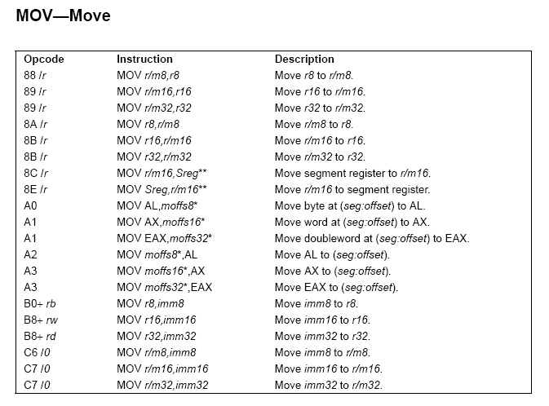
Ex. Group 3 prefix
(operand-size override, 66h)
“The operand-size override prefix allows a program to switch between 16- and 32-bit operand sizes. Either size can be the default; use of the prefix selects the non-default size.”
Ex. Note that both 16- and 32-bit moves below are both B8!

Slide 8
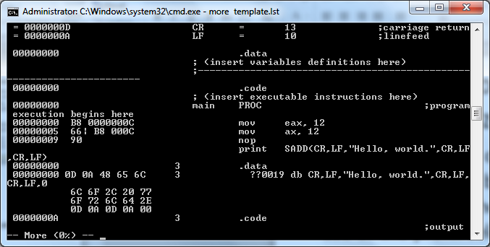
Ex. Using prefix to distinguish between 16- and 32-bit moves.
prefix (66h)

Slide 9
OPCODES AND OPERANDS

Slide 10
How are instructions (opcodes and operands) represented (as numbers)?
3 different types (plus immediate).

Slide 11
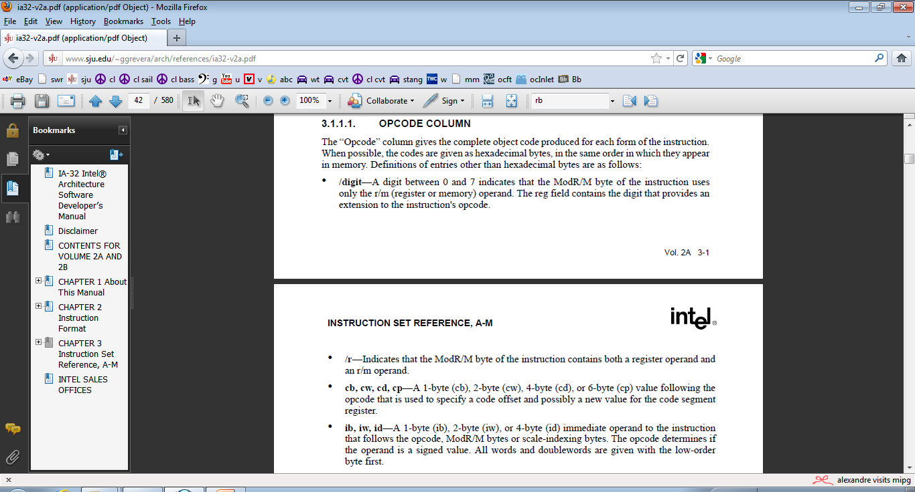
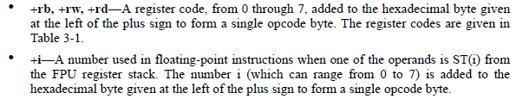
type 2
type 3
imm
type 1

Slide 12
Type 1

Slide 13
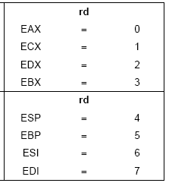
00000000 .code ;insert executable instructions below
00000000 main PROC ;program execution begins here
00000000 B8 00000001 mov eax, 1 ;set regs values
00000005 BB 00000002 mov ebx, 2
0000000A B9 00000003 mov ecx, 3
0000000F BA 00000004 mov edx, 4
00000014 BE 00000005 mov esi, 5
00000019 BF 00000006 mov edi, 6

Slide 14
00000000 .code ;insert executable instructions below
00000000 main PROC ;program execution begins here
00000000 B8 00000001 mov eax, 1 ;set regs values
00000005 BB 00000002 mov ebx, 2
0000000A B9 00000003 mov ecx, 3
0000000F BA 00000004 mov edx, 4
00000014 BE 00000005 mov esi, 5
00000019 BF 00000006 mov edi, 6

Slide 15
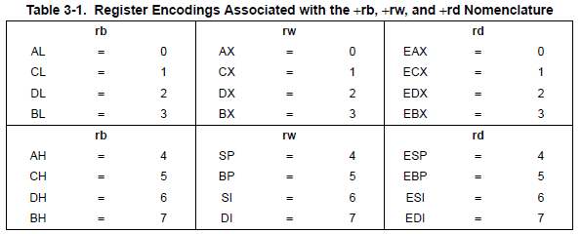

Slide 16
REMAINING TYPES
Using ModR/M and SIB bytes

Slide 17
ModR/M and SIB bytes

Slide 18
Instruction representation / encoding / decoding
ModR/M: Many instructions that refer to an operand in memory have an addressing-form specifier byte (called the ModR/M byte) following the primary opcode. The ModR/M byte contains three fields of information.

Slide 19
Instruction representation / encoding / decoding
ModR/M: Many instructions that refer to an operand in memory have an addressing-form specifier byte (called the ModR/M byte) following the primary opcode. The ModR/M byte contains three fields of information:
  The Mod field (2 bits) combines with the R/M field (3 bit) to form 2⁵=32 possible values: eight registers and 24 addressing modes.
  The Reg/Opcode field (3 bits) specifies either a register number or three more bits of opcode information.
  The R/M field (3 bits) can specify a register as an operand or it can be combined with the Mod field to encode an addressing mode.

Slide 20
Instruction representation / encoding / decoding
ModR/M: Many instructions that refer to an operand in memory have an addressing-form specifier byte (called the ModR/M byte) following the primary opcode. The ModR/M byte contains three fields of information:
  The Mod field (2 bits) combines with the R/M field (3 bit) to form 2⁵=32 possible values: eight registers and 24 addressing modes.
  The Reg/Opcode field (3 bits) specifies either a register number or three more bits of opcode information.
  The R/M field (3 bits) can specify a register as an operand or it can be combined with the Mod field to encode an addressing mode.

Slide 21
Instruction representation / encoding / decoding
ModR/M: Many instructions that refer to an operand in memory have an addressing-form specifier byte (called the ModR/M byte) following the primary opcode. The ModR/M byte contains three fields of information:
  The Mod field (2 bits) combines with the R/M field (3 bit) to form 2⁵=32 possible values: eight registers and 24 addressing modes.
  The Reg/Opcode field (3 bits) specifies either a register number or three more bits of opcode information.
  The R/M field (3 bits) can specify a register as an operand or it can be combined with the Mod field to encode an addressing mode.

Slide 22
Instruction representation / encoding / decoding
SIB: (optional) Certain encodings of the ModR/M byte require a second addressing byte (the SIB byte). The base-plus-index and scale-plus-index forms of 32-bit addressing require the SIB byte. The SIB byte includes the following fields:
  The Scale field specifies the scale factor.
  The Index field specifies the register number of the index register.
  The Base field specifies the register number of the base register.

Slide 23
TYPE 2

Slide 24
Instruction representation / encoding / decoding
Type 2. Opcodes followed by /digit
  The Reg/Opcode field contains the digit that provides an extension to the instruction's opcode. A digit between 0 and 7 indicates that the ModR/M byte of the instruction uses only the R/M (register or memory) operand (SIB, Disp, Imm are not used).
  (Mod is the addressing mode. For plain register, it is always 11.)
X
X
X
X

Slide 25
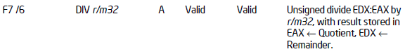
Instruction representation / encoding /decoding
Type 2: Example of opcodes followed by /digit:
div ecx

Slide 26
Instruction representation / encoding /decoding
Type 2: Example of opcodes followed by /digit:
div ecx
Step1: From vol 2a, we see that div esi is div r/m32, which is encoded as F7 /6. So the first byte (Opcode) is F7 (indicating div), and the second byte is a ModR/M byte in format /6.

Slide 27
Instruction representation / encoding /decoding
Type 2: Example of opcodes followed by /digit:
div ecx
Step1: From vol 2a, we see that div esi is div r/m32, which is encoded as F7 /6. So the first byte (Opcode) is F7 (indicating div), and the second byte is a ModR/M byte in format /6.
Step 2: From table 2-2 (top),
  we see that /6 is 110 (or we already knew that),
  the two Mod bits for plain old register are 11 (left bottom),
  and the three R/M bits for ecx are 001.
  So putting all that together in one byte is 11 110 001 (1111 0001) or F1.
So div ecx is encoded as two bytes: F7 F1.

Slide 28
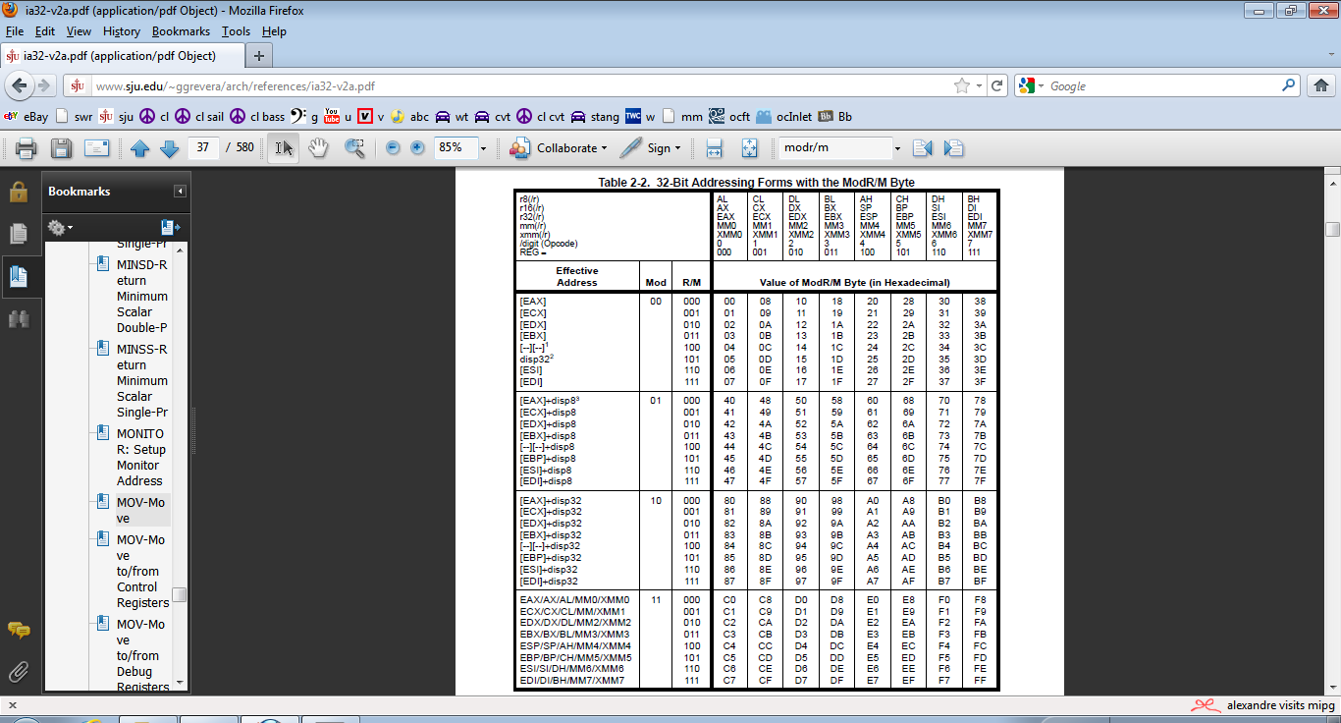

Slide 29
TYPE 3

Slide 30
Instruction representation / encoding / decoding
Type 3. Opcodes followed by /r
  /r—Indicates that the ModR/M byte of the instruction contains both a register operand and an R/M operand.

Slide 31
Instruction representation / encoding / decoding
Type 3: Example of /r: imul ecx, 12
How is this encoded? Answer: 6B C9 0C

Slide 32
Instruction representation / encoding / decoding
Type 3: Example of /r: imul ecx, 12
How is this encoded? Answer: 6B C9 0C

Slide 33
Instruction representation / encoding / decoding
Type 3: Example of /r: imul ecx, 12
How is this encoded? Answer: 6B C9 0C

Slide 34
Instruction representation / encoding / decoding
Type 3: Example of /r: imul ecx, 12
How is this encoded? Answer: 6B C9 0C
C9 = 11 001 001. From table 2-2, we see that:
  Mod = 11 (operand in reg (lower left))
  Reg/Opcode = 001 (/r for ecx (top))
  R/M = 001 (specify ecx (lower left))
X
X
X

Slide 36
PHEW!

