Slide 1
Ultrasonic LED strip
Kasper Buckbee
Ben Cunningham
Justas Lukosiunas
Notes:
Introduce ourselves here

Slide 2
Contents
Arduino
Arduino IDE
LEDs
Ultrasonic sensor
Complete system
Your tasks

Slide 3
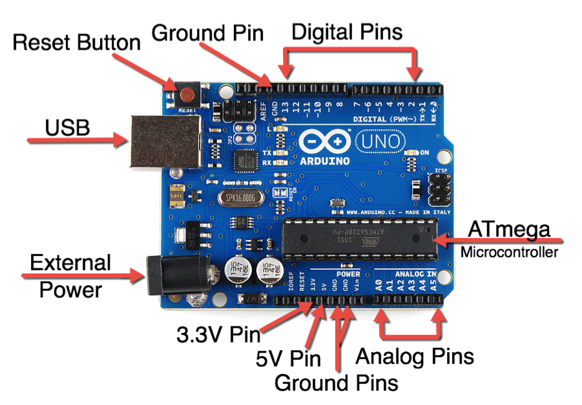
Arduino
Notes:
The Arduino is a small computer (microcontroller) that can be programmed to connect and control various electronic parts. The Arduino has a number of pins that can be set as either input, which means they can receive data from items such as switches, buttons and sensors, or output, which means they send data to control items such as motors, lights and buzzers.

Slide 4
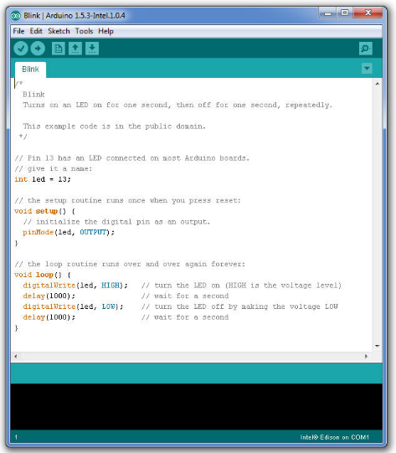
Arduino IDE
void setup () – a function for initial configuration, executed only once
void loop () – a function for the main behaviour, executed continuously
Notes:
The Arduino board is controlled by software written in the Integrated Development Environment (IDE).
Key buttons (from left to right):
- Verify – checks code for errors and compiles
- Upload to board
- Create new sketch
- Open existing sketch
- Save sketch
- Serial Monitor

Slide 5
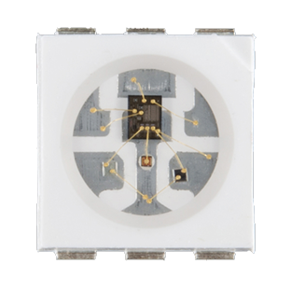
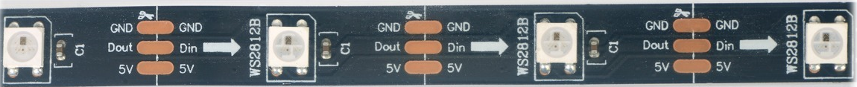
LEDs
These LEDs are made out of 3 mini LEDs and a chip which controls them.
The 3 different LEDs are Red, Green and Blue, which, when together can produce any colour.
They are connected in a strip and by using just one control pin can be individually addressed

Slide 6
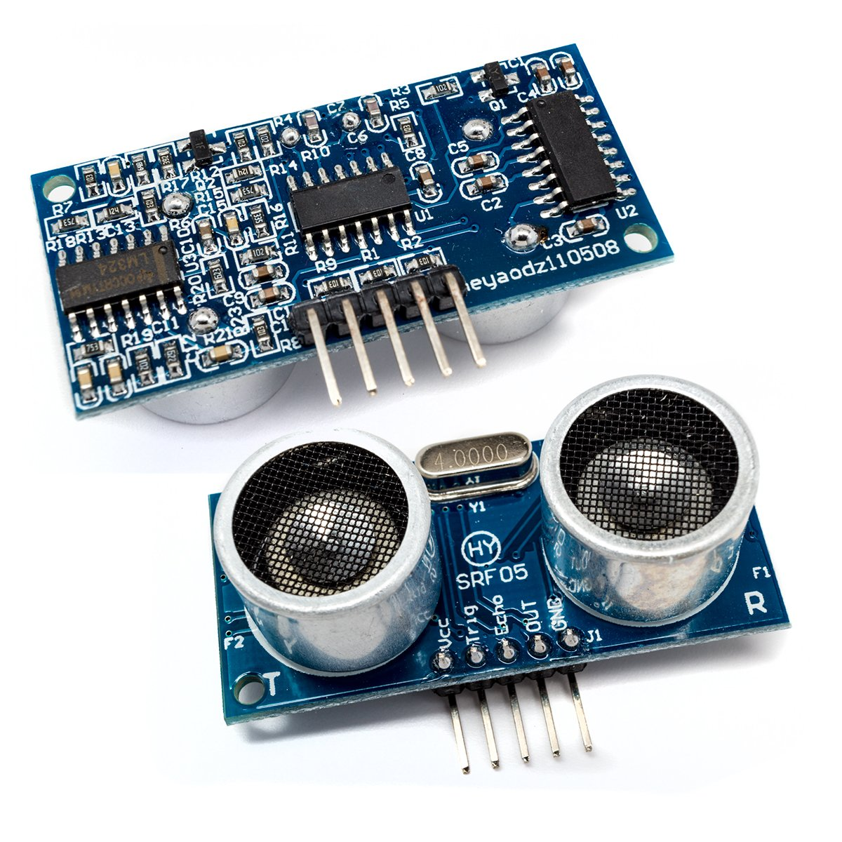
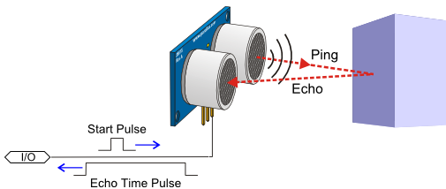
Ultrasonic sensor
This device emits sound waves at 40 kHz and records the reflections
Its output is the time taken for the signal to come back
Can you derive the distance?
Notes:
It emits an ultrasound at 40 000 Hz which travels through the air and if there is an object or obstacle on its path It will bounce back to the module.
In order to generate the ultrasound you need to set the Trig on a High State for 10 µs. That will send out an 8 cycle sonic burst which will travel at the speed sound and it will be received in the Echo pin. The Echo pin will output the time in microseconds the sound wave traveled.
Knowing the travel time and the speed of the sound, can you calculate the distance?

Slide 7
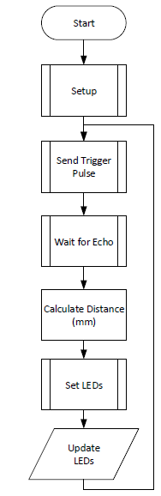
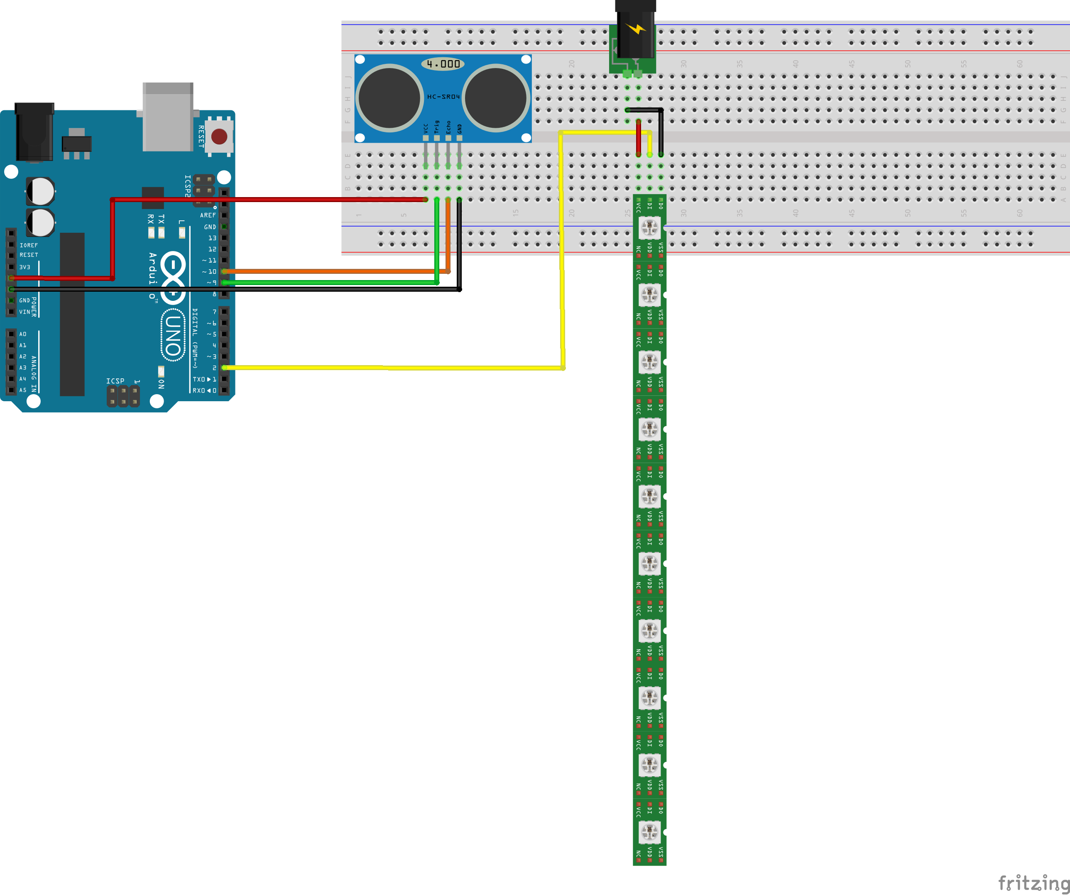

Complete system
Power adapter
Notes:
The complete circuit will be able to light up the strip of LEDs as you will move your hand (or, better, a hard-and-flat-surfaced object) in front of the Ultrasonic sensor.

Slide 8
Your tasks
Building up the complete system in a few steps:
Light up the strip of LEDs
Configure the Ultrasonic sensor to output distance readings to the Serial Monitor
Connect the LEDs with the Ultrasonic sensor to complete the system
Each of these tasks will involve setting up the hardware and completing the provided code templates.
The work will be carried out in pairs
If in doubt, ask away!

Slide 9


