Slide 1
Group 1 Rutabah Khan Junghyun Son Joseph Grantham

Slide 2
Austin Animal Shelter Analysis of dogs at AAS. What types of breeds are coming into the shelter and how long do they stay. What breeds are getting adopted and where animals are found around the city of Austin. The data will be coming from a Kaggle dataset found here: https://www.kaggle.com/aaronschlegel/austin-animal-center-shelter-intakes-and-outcomes Austin Animal Center Austin, Texas is the largest No Kill community in the nation, and home to the Austin Animal Center. We provide shelter to more than 16,000 animals each year and animal protection and pet resource services to all of Austin and Travis County. The Austin Animal Center is an open-intake facility where lost and surrendered animals from all of Travis County in need of shelter are accepted regardless of age, health, species or breed. The goal of the Austin Animal Center is to place all adoptable animals in forever homes.

Slide 3
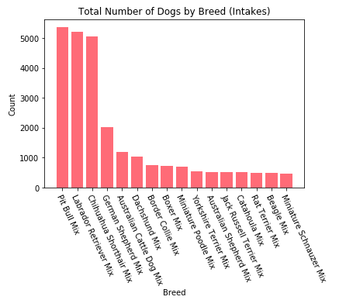
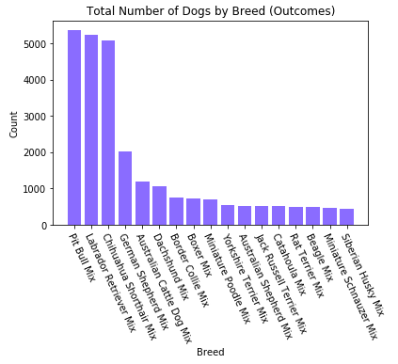
Intake/Outake by Breeds Pit Bulls are the largest breed that are coming into the shelter. Followed by Labs and Chihuahua.

Slide 4
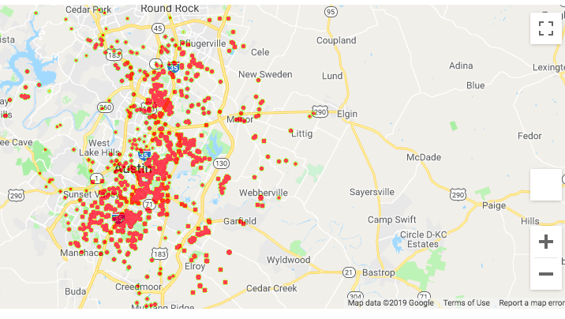
Intake by location created by the google maps API

Slide 5
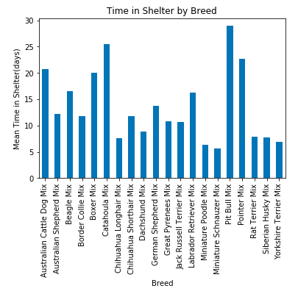
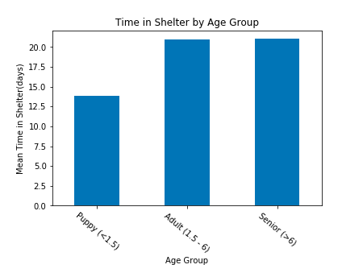
Time spent in shelter

Slide 6
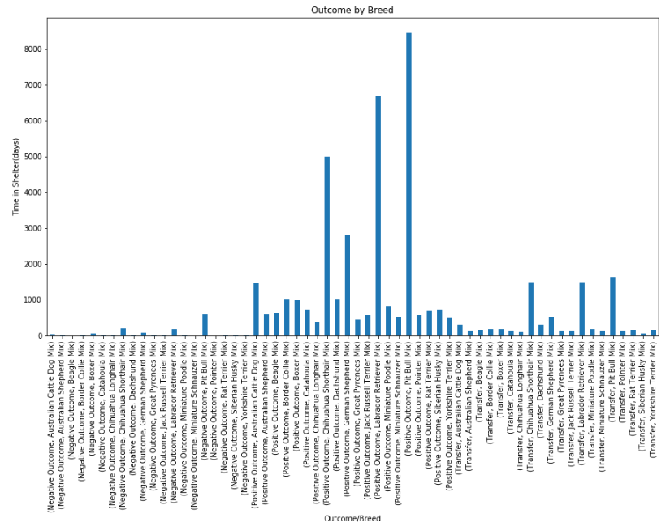

Slide 7
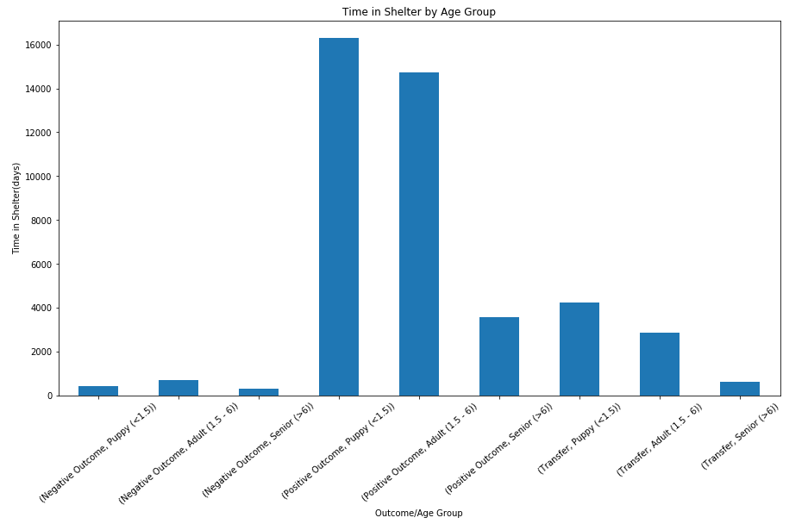

Slide 8
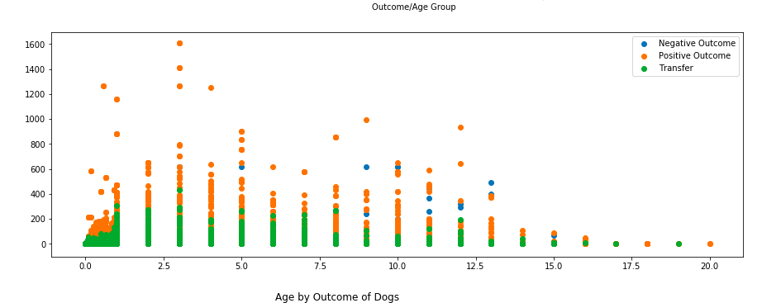
Scatter of Ages of outcome mostly positive and/or tranfered

Slide 9
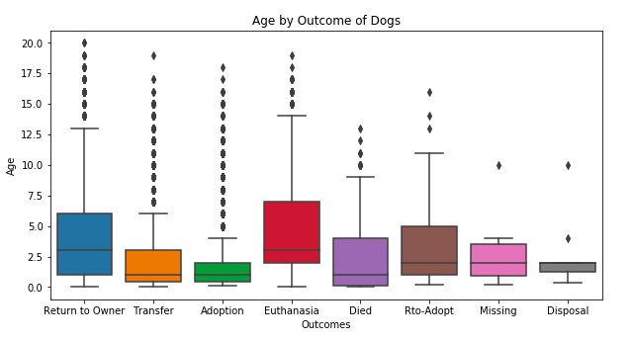
Boxplot of Ages of dogs by their outcome type in shelter

Slide 10
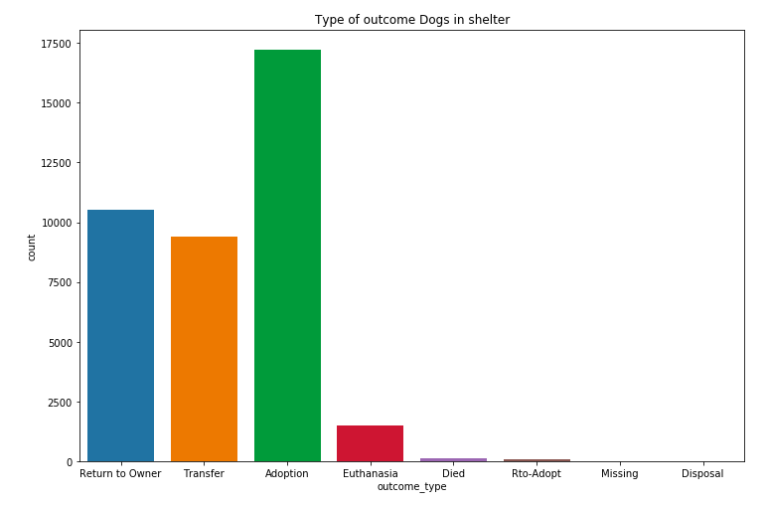
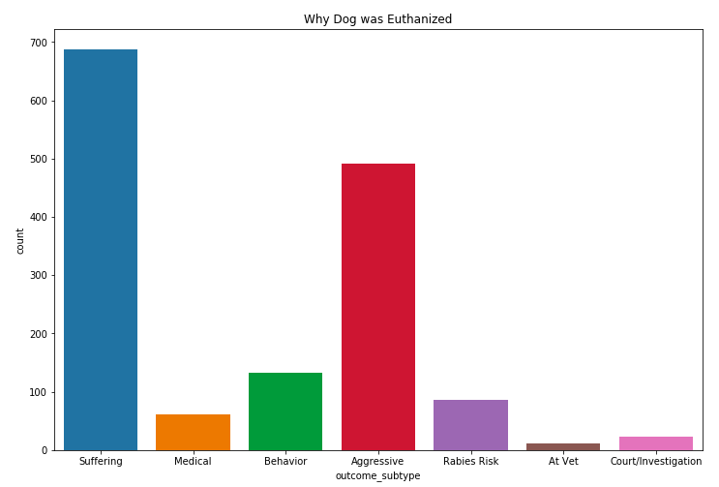
Euthanizing Details

Slide 11
Conclusion
Pit bulls are the highest amount of breed that are coming into the shelter system. They are the most euthanized breed as well, with the conclusion of being aggressive.
Puppies are the most adopted and the have the shortest stay at the shelter.
7.89% of dogs are to be euthanized
20% of lost dogs are returned to owner
30% of dogs are transferred to another facility or partner shelters

