Slide 1
Introduction to Electron Energy Distribution Fuction (EEDF)

Slide 2
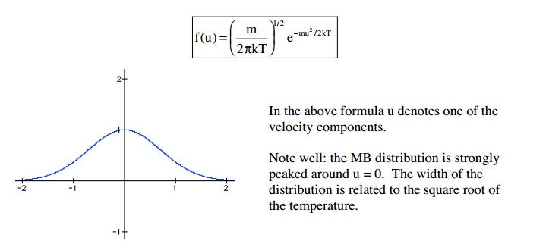
definition of temperature
The averge kinetic energy of a particle is
Maxwell velocity distribution
The width of the distribution is called TEMPERATURE.
The higher the temperature, the higher the particle energy.

Slide 3
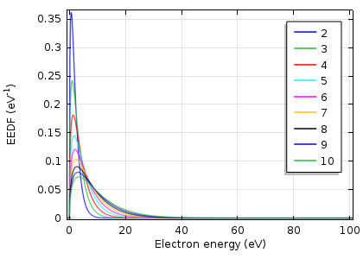
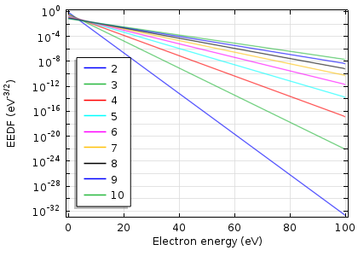
Maxwellian EEDF
In log scale, the Maxwellian distribution appears as a linear function.

Slide 4
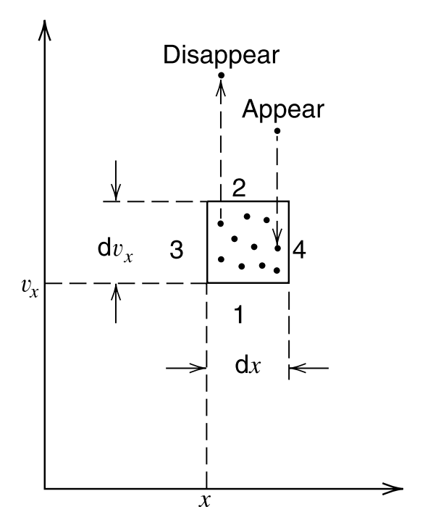
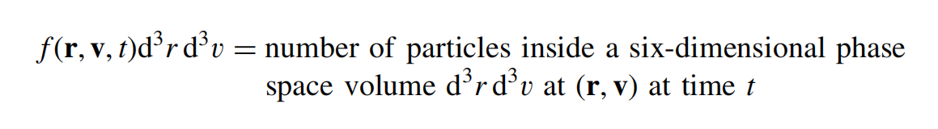
boltzmann's Equation
For a given species, we introduce a distribution function f(r, v, t) in the six dimensional phase space (r, v) of particle positions and velocities, with the interpretation that
Collisionles Boltzmann Eq. or Vlasov Eq.

Slide 5
fluid description of motion
is the distribution fuction within phase space
is the density
is the average velocity. In a symmetric system,
is the flux

Slide 6
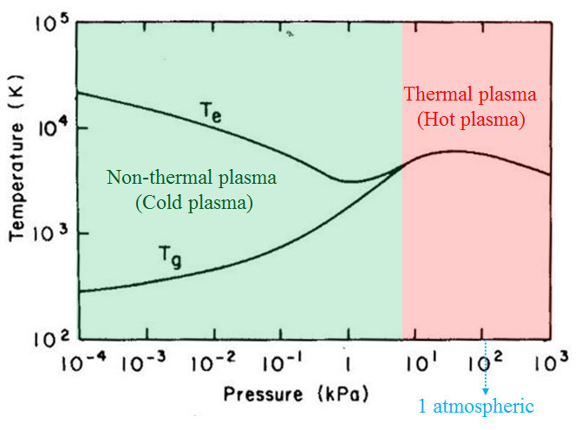
plasma temperature - non-equilibrium
T_{e} is usually high, in 2 - 15 eV. (2 eV ≈ 15,000 K ≈ 600 km/s ≈ 1.3e6 mph
Electrons respond to instantaneous RF field and accelerated.
T_{ion} is usually 300 - 400 K in bulk and up to 50,000 K within the sheath.
Ions respond to average RF field.
Ions are accelerated only within the sheath.
T_{gas}, 300 - 600 K
Neutrals are heated through momentum transfer, reaction heating, etc.

Slide 7
distribution
Electron distribution | Ion distribution
T_{e} ≈ 30,000 K, <v_{e}> ≈ 10⁶ m/s » V_{drift} | T_{ion} ≈ 500 K, <v_{ion}> ≈ 500 m/s « V_{drift}
V_{ion} drift
V_{e} drift
V_{e} thermal
V_{ion} thermal

Slide 8
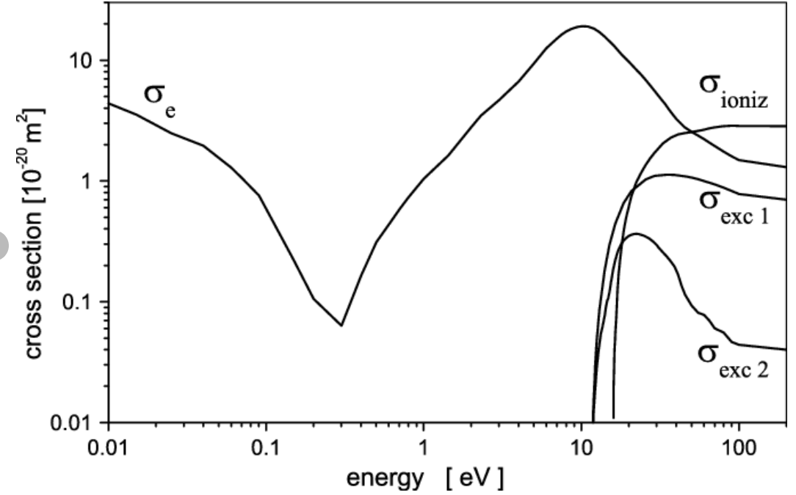
Argon cross section
Cross section and distribution functoin are all energy dependent.
Ar
EEDF
Reaction rate coefficient
For Maxwellian energy distribution, <T_{e}> can be used for rate coefficient
Foe non-Maxwellian energy distribution, f(ε) needs to be solved instead of <T_{e}>
Collision threshold

Slide 9
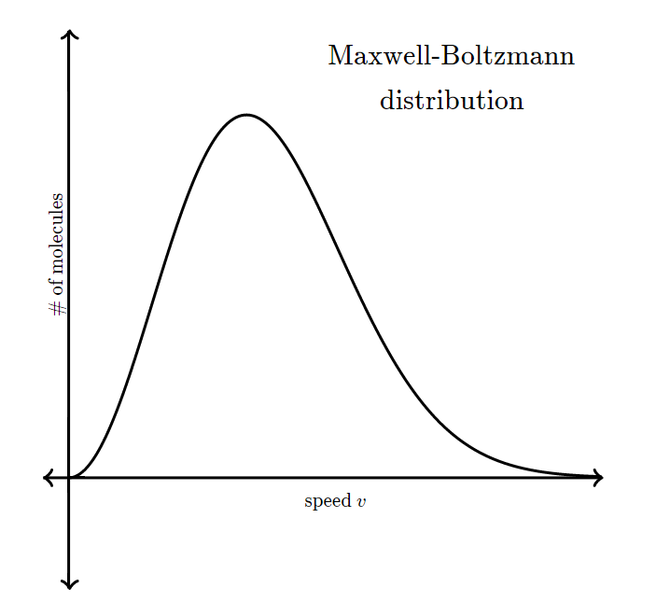
EEDF and collisions in cl₂ discharges
Only a small fraction of the plasma electron have enough ε to ionize gas and sustain the discharge.
ε(diss) << ε(ioniz) a high number of plasma electron have enough ε to dissociate molecule but not enough to ionize the gas.
Generally speaking, low energy processes are favored.

Slide 10
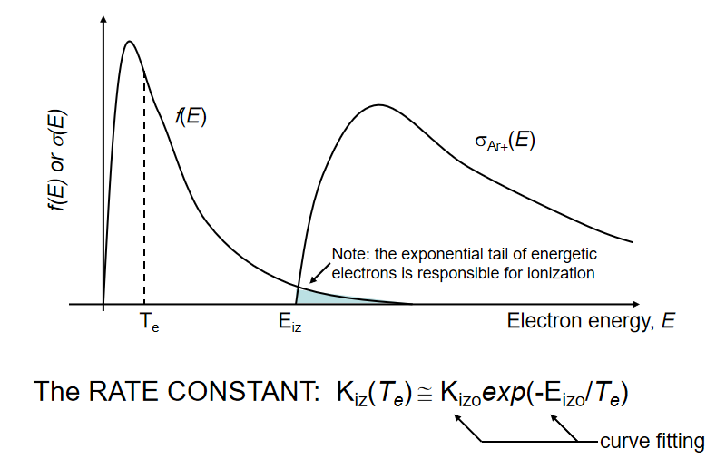
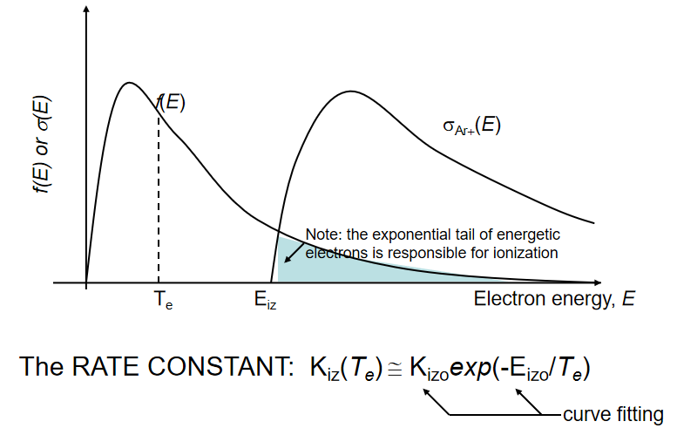
Reaction cross section and EEDF
In idea gas, electrons follow maxwellian distribution. However, in plasma high-energy electrons are populated.
Cross section is energy dependent.

Slide 11
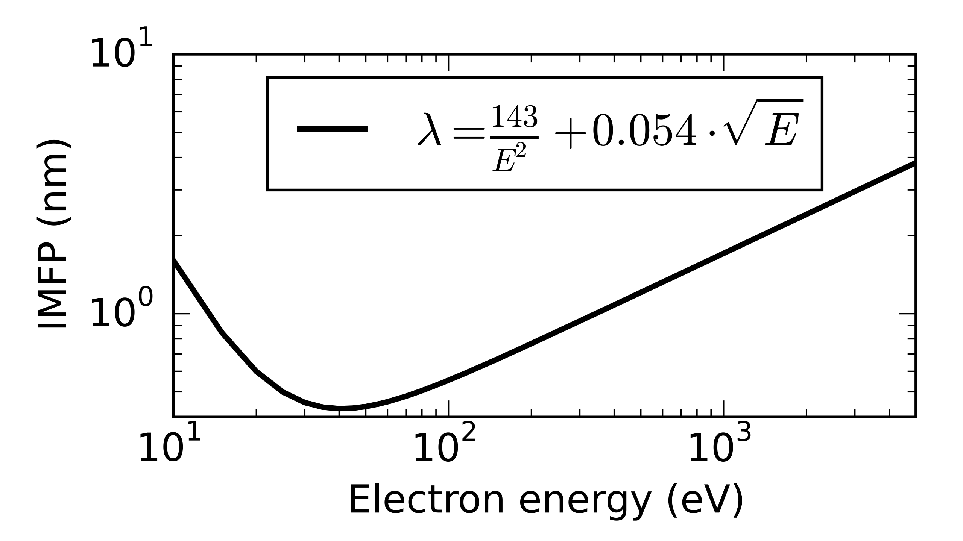
Energy dependent MFP
High cross section results shorter mean free path.
In general, “very hot” (>100 eV) electrons have larger mean free path.
“hot” electrons - above ionization threshold; “very hot” electrons - much higher energy.

Slide 12
Elastic cllision - Only momentum collision
E-field is applied
Energy Increases
Probability
Probability
Probability
“Very hot” electrons increases even more
Energy
Energy
Energy
In elastic collision regime, “very hot” electrons gains more energy than normal electrons
The tail of EEDF is lifted.

Slide 13
inelastic collision - ionization, etc.
E-field is applied
Energy Increases
Probability
Probability
Probability
“hot” electrons lose more energy
Energy
Energy
Energy
In inelastic collision regime, “hot” electrons lose more energy due to ionzation, excitation, etc.
The tail of EEDF is pressed.

Slide 14
Local Field Approximation
Local field approximation (LFA) which relies on the parametrization of the rates of some local, bulk property of the plasma such as the local E/N.
EEDF is locally equilibrium, not affected by its neighbors, requring sufficient collisions. Fluxin and fluxout cancel each other.
E - energy gain; N - energy loss.
λ - 1/σN
Mean free path for electrons < cell size, no matter of energy

Slide 15
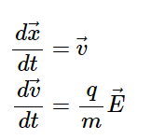
Local Field Approximation
Assume initial velocity distribution as Maxwellian
Integrate Newton's equation (only in velocity space) with applied E-field
Launch particles following the initial distribution
E-field is external and fixed.
Collect particles to plot the EEDF
Update velocity due to energy change
Calculate collision probability

Slide 16
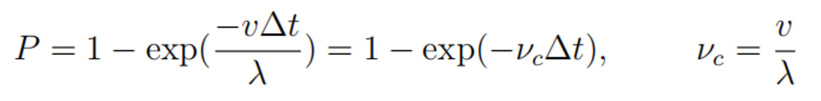
Collision
Collision: Yes or Not?
Collision: Yes or Not?
Collision: Yes or Not?
Collision
In physcis, collison occurs during the movement.
Computationally, collision is decoupled from the velocity and position integration, in which there is no collision occuring within between. Collision is applied at a fixed, constant point in the timestep.
The collision probability is given by,
P = v_{c}∆t, when v_{c}∆t <<1. λ can be a function of v, although not sensitive.
This technique limits the simulation to a maximum single collision within a timestep. For a higher collision rate, it results in a breaking down of timestep into smaller segments.

Slide 17
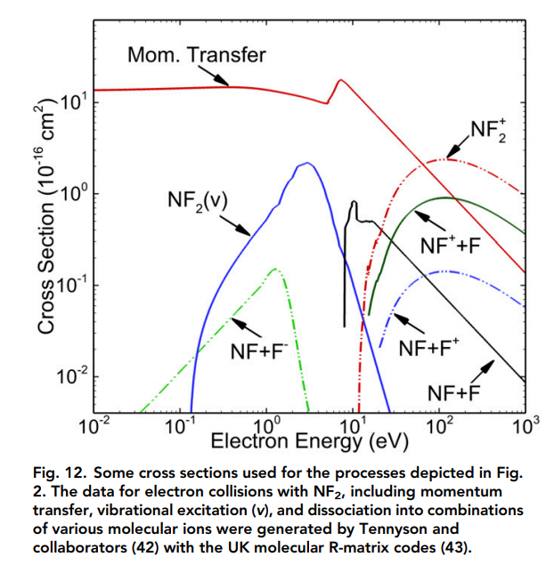
Difficulties
In order to resolve the EEDF “tail”, the number of launched particles need to be huge.
Detailed cross section data is needed. Mixed gases can be complex.
Monte Carlo simulation is in general not efficient.
Probability
Energy
Only Accounts for < 1%

