Slide 1
State Sponsored Cyber Warfare
By Joshua Shilts

Slide 2
What is State Sponsor Cyberwarfare?
Come from a government military
Highly skilled and educated engineers
Working in teams
Develop or enhance cyber attack methodologies.
Military scale operation

Slide 3
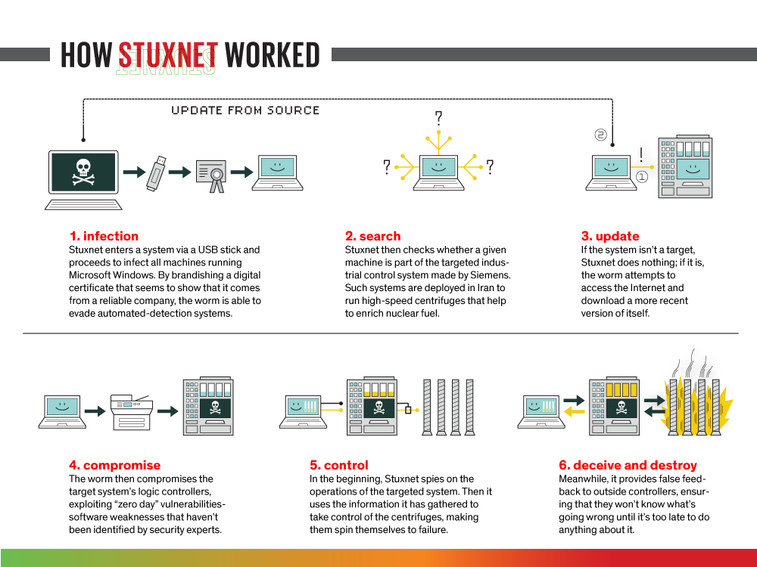
The First State Sponsored Attack
First attack was Stuxnet virus
Virus type called a worm
Standalone computer program replicates and infects

Slide 4
Infected at least 14 industrial sites
Inhibit ability to enrich Uranium
Created from United States and or Israel

Slide 5
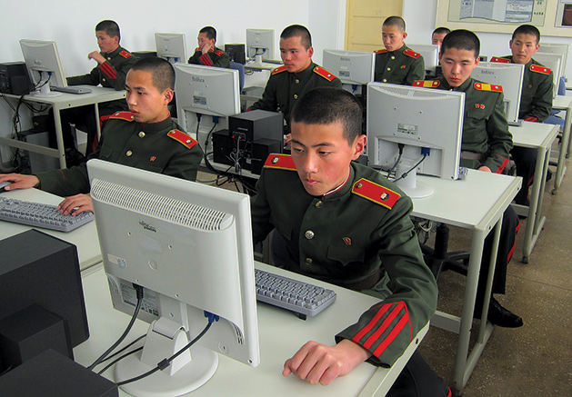
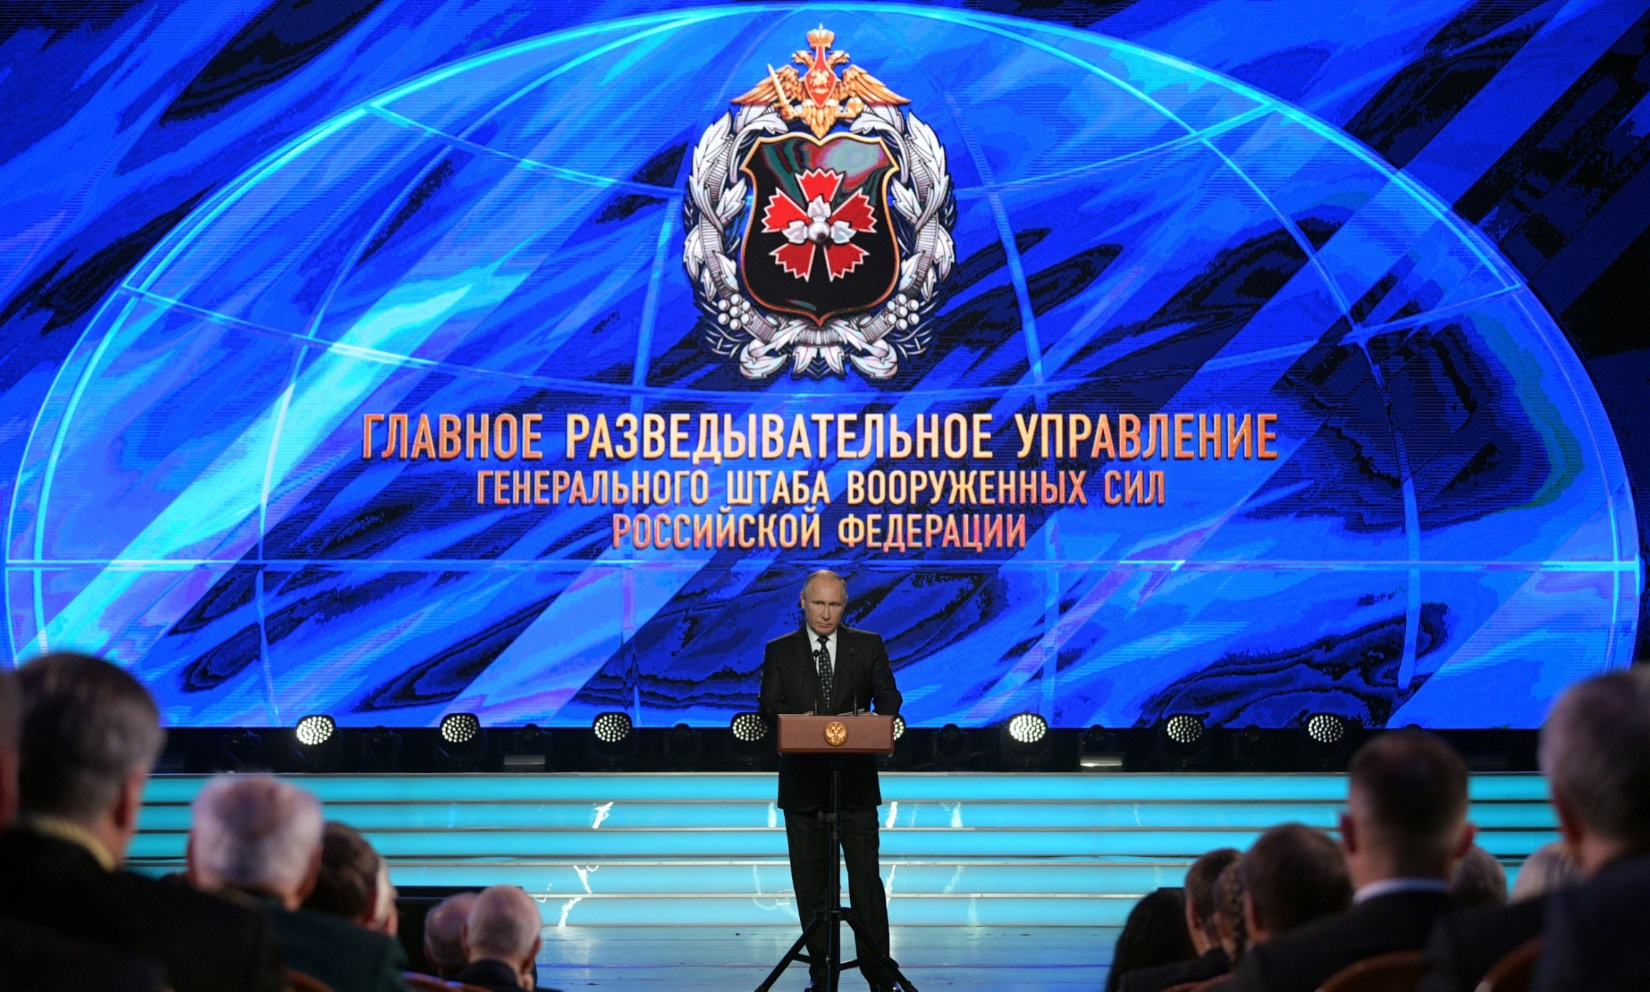
Contemporary State Sponsor Attacks
North Koreas Bureau 121
Russia’s GRU
Main Intelligence Directorate

Slide 6
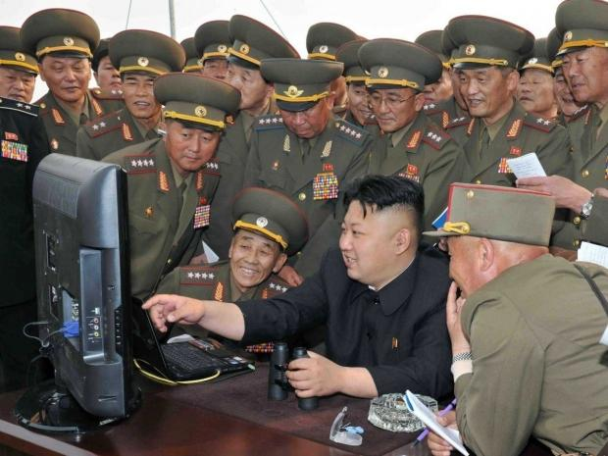
What is Bureau 121
North Korea’s cyber-attack elite
Unit run by North Korean military
Established in the late 90
Believed to number around 6000
Recruits picked and trained at 17

Slide 7
Stationed in Belarus, China, India, and Russia
Launch attacks outside of the country
Most notable group is the Lasuraus group

Slide 8
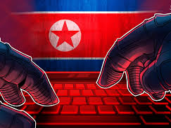
What Have They Done?
Responsible for 2014 Sony pictures hack
Employees locked out
Content released online
Cost over 35 million to repair
WannaCry Ransomware
Hit around 230,00 computers globally
Affected thousands of NHS hospitals

Slide 9
Caused 4 billion dollars in damage globally
Have requestioned 1.75 billion
From countries and crypto currency heists
Stole credentials bit coin
Funnel money though banks

Slide 10
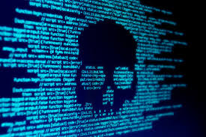
What is the GRU?
Means Main intelligence Directorate
Russian military intelligence Agency
Intelligence for Russian president and government
Considered an elite unit of military

Slide 11
Responsible offensive and defensive security
Utilize illegal spies
Work without diplomatic cover
Live under an assumed identity

Slide 12
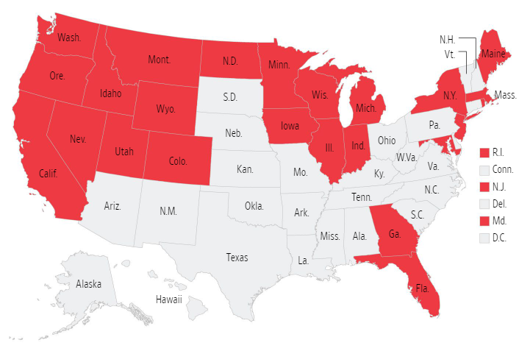
When Russia Hacked the Power Grid
Oregon construction company was hacked
15-person company
Lacked adequate Cyber Defense
Worked on utilities under a government contract

Slide 13
Worked their way up supply chain
Using fake and tainted documents
Acquired network credentials
Slipped through remote portals
Compromised power grid in 24 states.
Including Massachusetts

Slide 14
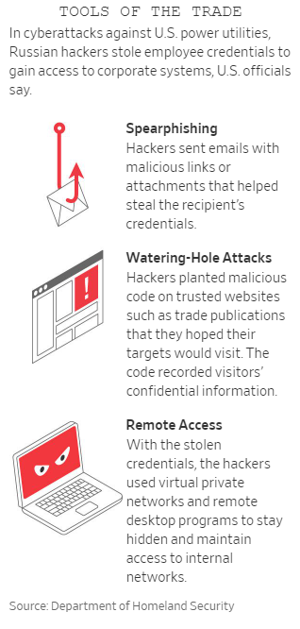
The Early Warning Signs
In 2016 Intelligence officials first noticed
Realized campaign to hack the power grid
A small company found malicious file
File used to launch attacks

Slide 15
A water hole attack
Russian hackers stalked their victims
Pounced at the right time
Then steal credentials
Virtual private networks and remote desktops
Not all Russian malware has been removed
Unable to detect

Slide 16
Conclusion
Not Safe
North Korea impacts question

