Slide 1

Ticket Booking App Project
Archana, Durga, Carrie, Hooi,

Slide 2



Ticket Booking App Project
Task 1: App Wireframes
Task 2: Implement your Wireframes using HTML & CSS
Task 3: Task Form Inputs Validation

Slide 3
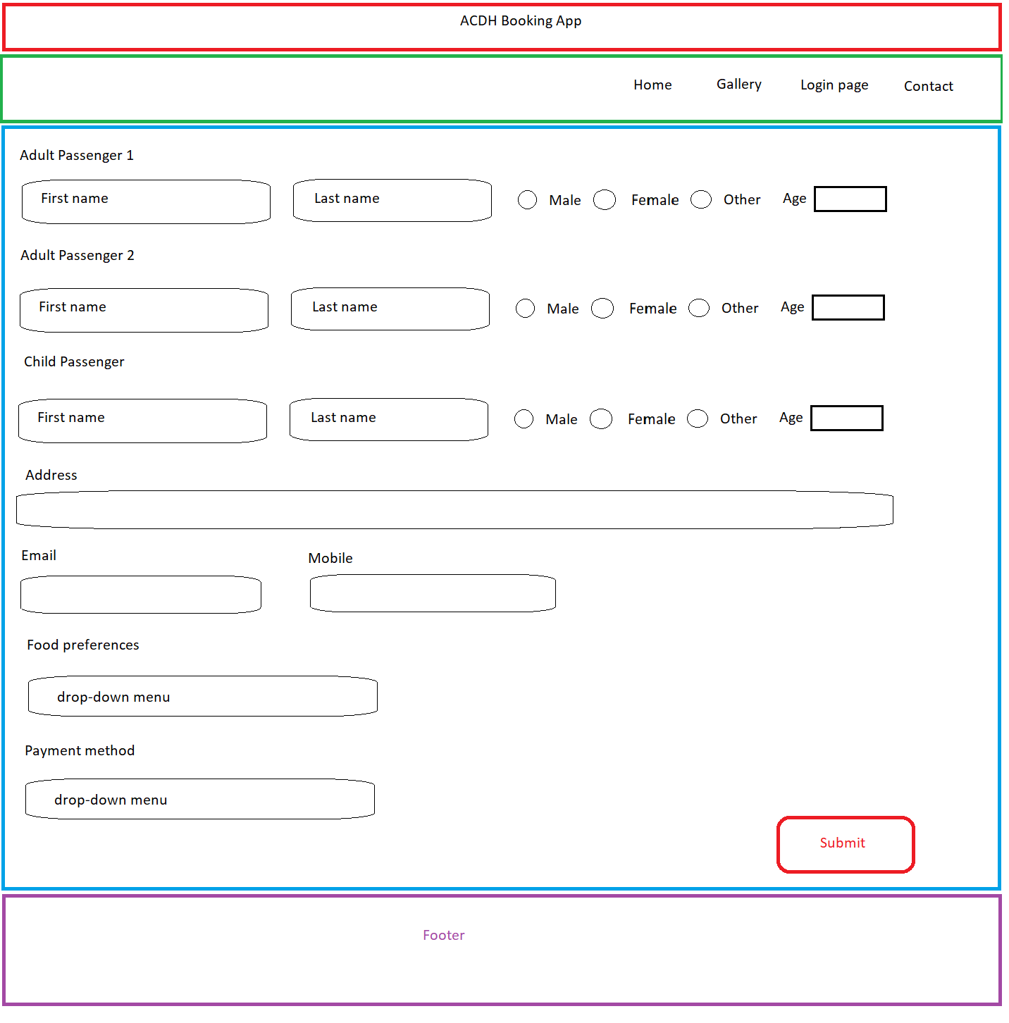
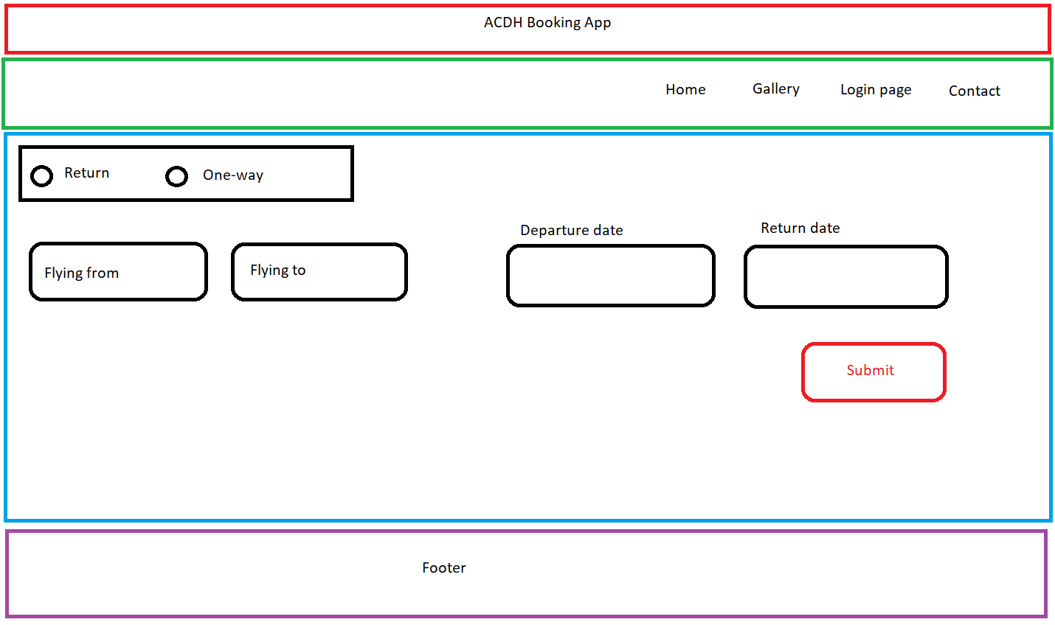
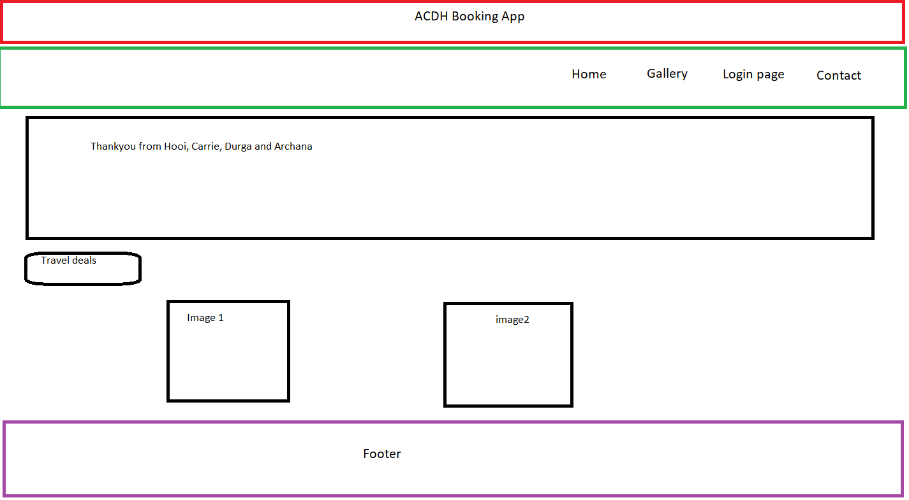
Task 1: App Wireframes

Slide 4
Task 2: Implement Wireframes using HTML & CSS

Slide 5
Task 3: Form Inputs Validation

Slide 6

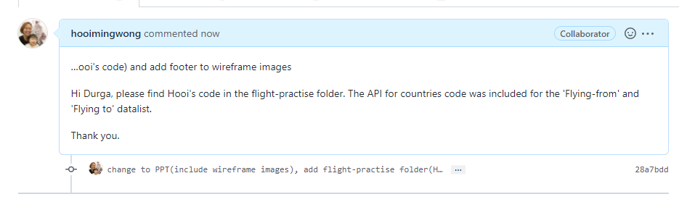
Workflow / Teamwork

Slide 7
Thank you
Archana, Durga, Carrie, Hooi,

