Slide 1
Intro to Machine Learning with Scikit-Learn
Hailey K Buckingham
Sr. Data Scientist
Cylance, Inc.

Slide 2
WhoAMI
Hailey Buckingham
Sr Data Scientist, Cylance Inc
hailey.k.buckingham@gmail.com
Twitter: @HKBuckingam

Slide 3
Talk Outline
Data as Vectors and Labels
Supervised Learning
Unsupervised Learning
Data Processing (time allowing)

Slide 4
Data As Vectors
How machine learning tools (like scikit-learn) expect to see data

Slide 5
What are Vectors
Vectors are also called arrays, lists, series, etc…
A vector represents all the information you know about a particular example of data.
For example, if our data is about fruit, we might know the following about each fruit:
Weight
Color
Water Content
Diameter

Slide 6
What Are Vectors
Fruit | Weight (g) | Color | Water Content (%) | Diameter (mm)
1 | 75 | 1 | 86 | 72
2 | 130 | 2 | 87 | 64
3 | 175 | 2 | 89 | 70
4 | 2.5 | 3 | 84 | 10
5 | 9000 | 4 | 92 | 320
Each row of this table is a single vector.
Each vector represents one example.
Note that colors have been turned into numbers. Here, we’ve used the following:
Red = 1
Orange = 2
Blue = 3
Green = 4
This is a vector

Slide 7
What Are Labels
Fruit | Weight (g) | Color | Water Content (%) | Diameter (mm)
1 | 75 | 1 | 86 | 72
2 | 130 | 2 | 87 | 64
3 | 175 | 2 | 89 | 70
4 | 2.5 | 3 | 84 | 10
5 | 9000 | 4 | 92 | 320
Label
Apple
Orange
Peach
Blueberry
Watermelon
Labels are what we want each of our examples to be called.
This is especially important for supervised learning

Slide 8
Supervised Learning
Learning from Examples

Slide 9
What is Supervised Learning?
Supervised Learning describes tasks where:
You have a set of example cases
You have labels for each example
You wish to produce a function that can predict a label, given an example
You’d like your function to work even for new examples that haven’t yet been seen.
Often used for Classification and Regression

Slide 10
Examples of Classification
From labeled example images,
learn to classify new images
From examples of spam emails,
learn to classify new emails as spam
From examples of someone’s voice commands,
Learn to respond to those commands properly
From examples of malware files,
Learn to classify new files as malware

Slide 11
Classification Models
Logistic Regressions
Support Vector Machines (SVM)
Random Forest Classifiers
Neural Networks
Many others

Slide 12
Classification in scikit-learn
There a lot of classification algorithms available in scikit-learn, but they all have the same basic interface:
Instantiation
Training
Prediction

Slide 13
Classification in scikit-learn
Instantiating a Classification Object
Steps:
Import the appropriate module
Call the constructor, with any desired parameters:
from sklearn.ensemble import RandomForestClassifier
my_classifier = RandomForestClassifier(n_trees=25)
All parameters are optional. Sometimes the defaults are okay, but usually you’ll want to read up on what they each do

Slide 14
Classification in scikit-learn
Training (Fitting) Your Classifier
Steps
Get your data array (X) in vector form, and your labels (y).
A numpy array, pandas dataframe/series, or scipy.sparse array are good choices for your data
Regular python lists also work
Call the .fit() method
my_classifier.fit(X=x_array, y=labels)
Here, the variable ‘x_array’ has our examples, in vector form. The variable ‘labels’ are the true classifications for each of our examples

Slide 15
Classification in scikit-learn
Prediction
Steps
Get a new example (also in vector form)
Call the .predict() method
predictions = my_classifier.predict(X=new_records)
Here, the variable ‘new_records’ should be vectors, just like our training examples. Note that we don’t need labels! This time, we’re asking the classifier to give us the labels.

Slide 16
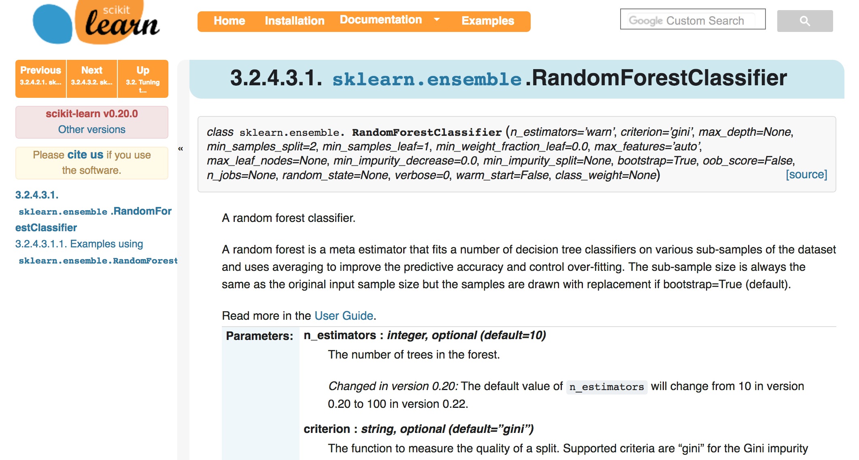
When In Doubt, Hit the Web!

Slide 17
Our Example
Dataset
URLs
Some URLs are labeled ‘good’, and lead to normal websites
Some URLs are labeled ‘bad’, and lead to malicious websites
Classification Question
Can we build a classification function which can predict whether a URL likely leads to a good website or a bad one.
The machine learning algorithm will need to learn from the labeled examples we have.

Slide 18
Our Example
See code

Slide 19
Unsupervised Learning
Finding order and structure in our data

Slide 20
What is Unsupervised Learning?
Unsupervised learning techniques seek to find structure in our data
Often used to identify groups within our data
Often relies on metrics of similarity

Slide 21
Clustering Algorithms
K-Means
DBSCAN
HDBSCAN
Agglomerative Clustering
Many Others

Slide 22
Clustering in Scikit-learn
In scikit-learn, clustering is similar to classification:
Steps
Import the appropriate module
Instantiate a clustering object
Call the clustering object’s .fit() method
Call the .predict() method to get what “cluster id” each sample belongs to
(Alternatively, call the .fit_predict() method to get cluster id’s in one step)

Slide 23
Clustering in Scikit-Learn
from sklearn.clustering import DBSCAN
my_clustering_obj = DBSCAN()
my_clustering_obj.fit(X=vector_data)
cluster_ids = my_clustering.fit_predict(X=vector_data)
The ’cluster_ids’ variable will now hold an array with the same number of rows as ‘vector_data’. However, instead of a vector in each row, it’ll have a single integer, or cluster ID. Rows with the same ID, have been ‘clustered’ together.

Slide 24
Our Example
Dataset
Same URL dataset, but this time we’ll start with the vectors themselves
Clustering Questions
Are their groups of similar URLs in our dataset?
How many groups?
What are in the groups?

Slide 25
Our Example
See code

Slide 26
Data Processing
Wrangling and Mangling Our Data

Slide 27
Data Processing
Scikit-learn provides a number of methods to help turn raw data into usable vectors.
You can do tasks such as:
Scaling
Normalizing
Encoding categorical variables into numbers (like we did with colors)
Binning
Support for custom transformation

Slide 28
Data Processing
Text data can also be processed
Bag-of-words
Ngrams
TFIDF (Term-frequency, Inverse Document Frequency)
Tokenization
Support for custom tokenizers, etc..

Slide 29
Data Processing
Also check out
FeatureUnions – allow you to join many tokenizers and vectorizers together, to build one larger vectorization object
Pipelines – Allow you to build all your vectorization and classification objects into one, which can highly simplify later calling.
Just call .fit() and .predict() on your pipeline object, and all the steps you defined will run cleanly in sequence

Slide 30
Thanks!

