Slide 1
Data Archiving
Beth Boettner
IPR Methods Workshop
November 5th, 2020

Slide 2
Outline
The Data Life Cycle
Why Archive Data?
How to Archive Data
Data Repositories
Data Preparation
Metadata
Confidentiality
Depositing data
Resources

Slide 3
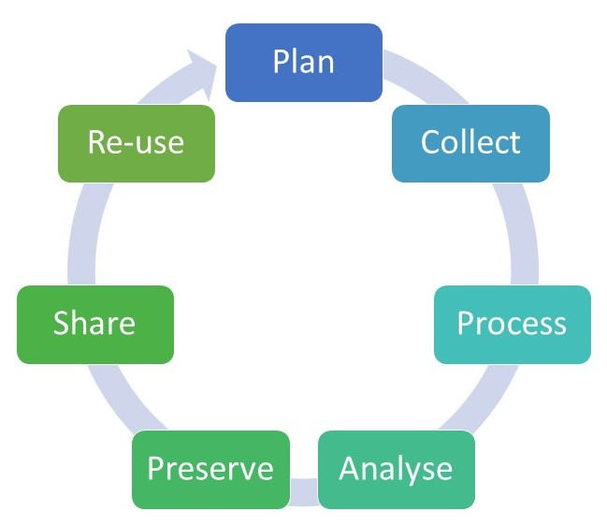
The Data Life Cycle

Slide 4
Why archive data?
Data collection is hard. Spare someone else having to duplicate your efforts.
Transparency, replication, and extensions of primary analyses
Meeting funders requirements to share data
Meet journal requirements to share analytic files and/or code from specific papers
Preserves data for future users, regardless of changes in technology, software

Slide 5

How: Choosing a data repository
If you don’t already have something in mind, Re3data.org provides catalog of data repositories by discipline/type of data
2,500 repositories across many disciplines

Slide 6

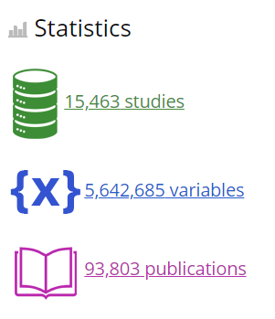
Most well-known and largest in social sciences
Deposit data collection files at no cost
Also much access at no cost-OSU is a member
Files are curated by ICPSR staff
Checking for potentially problematic identifying information, necessary data cleaning
Track usage statistics and citations
ICPSR provides data user support so you don’t have to
Options for restricted data protections
Online data analysis if data is not restricted access

Slide 7



ICPSR Archives
ICPSR has a series of sub-archives dedicated ot certain topics, which are often supported by various granting agencies, but the main ICPSR search shows results from all archives

Slide 8

Self-publishing option that is great for analytic files or smaller projects
Immediate publication with DOI/persistent url
Up to 2BG storage
Not curated/checked by ICPSR
Catalogued in main ICPSR search so high visibility
Can include links to related publications

Slide 9
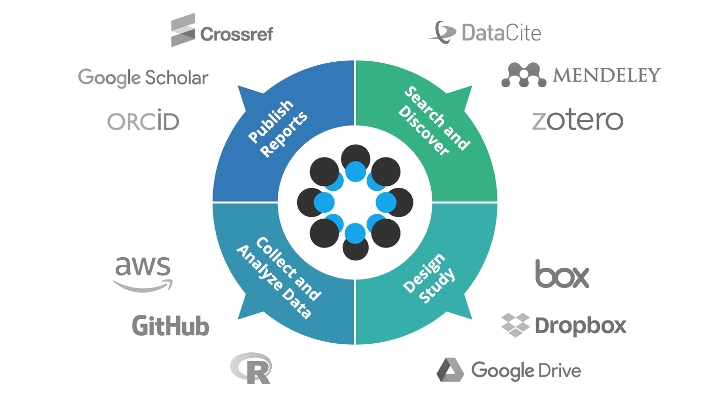
Open Science Framework (OSF.io)
Collaboration tool that also provides ability to give access to public
Self-managed
Post code, data collection protocols, working papers, and data (or whatever else you want)
Offers pre-registration of planned analyses and hypotheses

Slide 10
How: Data Preparation Overview
ICPSR has a fantastic guide on their website that you can download as a PDF
PLAN AHEAD! Planning for data sharing can save many headaches later, so weave it into your:
grant data management plan
IRB protocol and consent documents
data collection methods

Slide 11


How: Data Management Plan
Grant Data Management Plan
NIH already requires data management/sharing plan that include how data will be shared for large grants over $500,000
NSF also requires a data management/sharing plan
NIH just announced new expanded policy for all grants with larger focus on compliance that goes into effect in Jan 2023, so plan for it now
New NIH policy also discusses costs for data sharing. Plan for these costs in your grant budgets!

Slide 12
How: Consent forms
Make sure language alerts participants to potential sharing, and how you will protect privacy even when sharing outside original investigators
Both OSU IRB and ICPSR have suggestions on their websites
Not clear: “Only the research team will have access to information that identifies you”
Better: “Any personal information that could identify you will be removed or changed before files are shared with other researchers or results are made public.”

Slide 13
If your consent forms use “bad” language
You can overcome it! Just takes more work & have to jump through more hoops with IRB
Request a waiver of consent for data sharing, if you can detail all the protections that will remain in place to keep risk of disclosure at a minimum

Slide 14
How: Data Prep
Data file structure:
Do you have multiple types of respondents or types of data collected? do you have many sections of survey questions?
Data integrity during collection/data entry:
cross-platform identifiers if data collected across different modes or systems or levels in a hierarchical structure
Checking for valid vs. out of range responses
Setting up system for file/variable naming conventions and missing values
Numeric, question numbers, prefix/suffix systems

Slide 15
AHDC Naming Conventions
Part | Value | Code
1. Wave | Wave 1 | W1
 | Wave 2 | W2
 | Wave 3 | W3
 | Covid Wave 1 | C1
 | Covid Wave 2 | C2
 | Wave 4 | W4
2. Reporter | Caregiver | CG
 | Youth | Y
3. Survey Section | Tobacco and Alcohol | TA
 | Done Things | DT
4. Question Number | Numbered within section | #, 1-X
Variable : Wave + Reporter + Survey Section + Question #
w3yTA1 – Wave 3 youth tobacco & alcohol question 1
(Have you tried cigarettes since last interview?)

Slide 16
How: About Metadata
ICPSR uses an XML system to make Data Documentation Initiative (DDI) compliant codebooks
In other words: make it human and machine readable for easy searching on any aspect (variable name, survey question text, value labels) that is more helpful than a PDF with handwritten codes on it that isn’t searchable

Slide 17
How: Metadata Creation
ICPSR will take your codebooks and make DDI metadata, but there are also programs in R and other commercial tools to generate it
R packages: Codebook, ddionrails
Other software: Nesstar (free), Colectica (paid)
If you don’t create your own metadata, providing a uniform, structured codebook in a Word doc is the best alternative, including:
integrated question text
value labels
skip patterns – Who got this question/answered it
Missing values – don’t know vs. refuse vs. not applicable

Slide 18
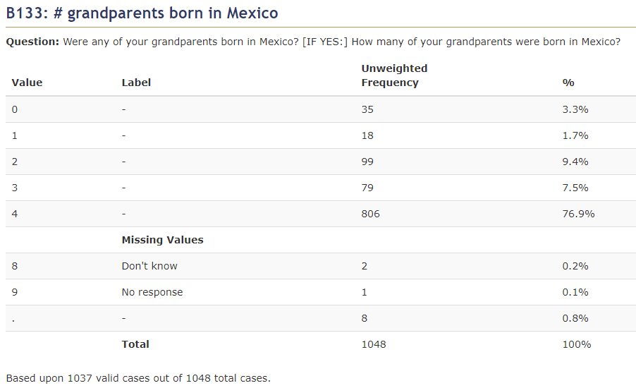
Border Contraceptive Access Study, El Paso, Texas 2005-2008 (ICPSR 32561) Principal Investigator(s): Joseph E. Potter, University of Texas-Austin; Kristine Hopkins, University of Texas-Austin; Jon Amastae, University of Texas-El Paso; Daniel Grossman, Ibis Reproductive Health-San Francisco

Slide 19
How: Confidentiality Issues
Two kinds of identifiers
Direct
Names, addresses, social security numbers
Indirect – together or in combination with other information could be used to identify participant
Geographic identifiers
Exact dates (birth/death/marriage)
Detailed income, organizational memberships, occupational titles
If using ICPSR, they will check for direct and potentially indirect identifiers that are of concern when processing the deposited data

Slide 20
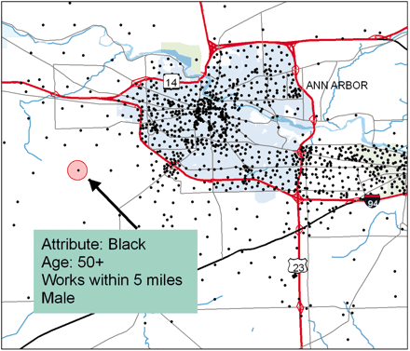
Example: VanWey et al. PNAS 2005
Even if displayed information is not enough to identify a person (county of residence, age, race, gender, distance to work)
– IF able to link to other outside data, could lead to identification quickly

Slide 21
Disclosure Risk Limitation
Remove direct identifiers and problematic indirect identifiers that can’t be mitigated
Potential changes to consider for indirect identifiers:
Top-coding or collapsing categories (ex: make children’s ages in months or only give month/year)
Only give higher level geospatial identifiers (no lower than state or region) or spatially jigger the coordinates within a distance
Remove write-in text responses – make categories if needed
Provide only a random sample of the cases (ex: Add Health public use data is a random sample of the full study)

Slide 22
What if the utility of the data requires confidential information?
If direct and indirect identifiers cannot be removed or adjusted without affecting the significance of the data, consider a restricted dataset
ICPSR and other repositories can hold two versions, one for public access and one for restricted access
Restricted access requires the researcher to apply to use the data and have a plan for keeping the data confidential

Slide 23
Accessing Restricted Data
ICPSR has multiple methods:
Secure download: lowest level of security, requires local IRB approval and a data use agreement between ICPSR and user’s institution
Virtual data enclave: data stays on servers at ICPSR, accessed remotely, with disclosure review of output before it can be removed
Physical Data enclave: user must go to Ann Arbor to work, disclosure review of output before it can be removed

Slide 24
Depositing Data: What to submit to ICPSR
Data file(s) in almost any format (SPSS, Stata, SAS)
Data files(s): One big file or multiple files by subject level/section?
Include variable labels, value labels, missing codes
Any contextual files like Census data or shapefiles
Derived/computed variables
Survey Weights

Slide 25
What to Submit
Documentation in DDI/XML or in Word Doc
Codebooks / variable names, values
Missing codes and skip patterns
Description / User Guide
Study summary: design and methods, sampling procedures
Procedures used for generating data and cleaning
How derived variables are computed (ex. scales, imputed income)

Slide 26
Resources
ICPSR’s Guide to Depositing Data
https://www.icpsr.umich.edu/web/pages/deposit/guide/
NICHD has an R03 funding mechanism specifically designed for archiving child health and human development data sets
https://grants.nih.gov/grants/guide/pa-files/PAR-20-064.html

Slide 28
National Neighborhood Crime Study, 2000 (Peterson and Krivo)
Variable Naming Conventions:
the prefix "t_" represents census tract-level
the prefix "c_" represent city-level (i.e., census place)
the prefix "m_" represent metropolitan-level (i.e., MSA or PMSA)
Variable names with no prefix represent aspects of geographic location that apply to all three levels.
T_murder, C_murder, M_murder

