Slide 1
Novel Human-Computer Interaction
Final Year Project
Andrew McGlynn

Slide 2
Project Overview
Three Prototype Applications

Slide 3
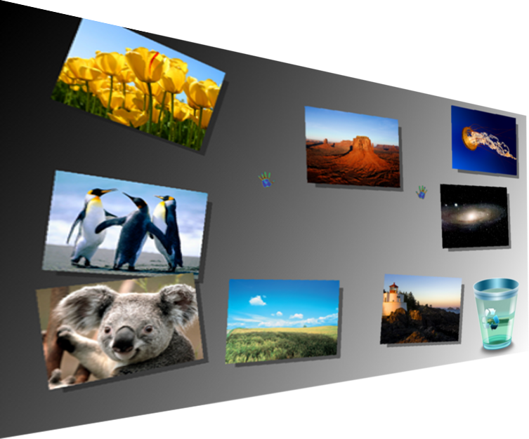
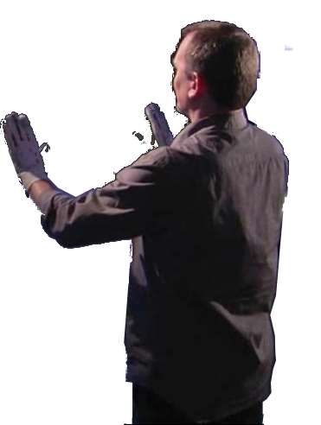
Photo Application
Gesture recognition
Sun SPOT gloves
Move, resize, rotate and delete images with hand gestures
Login authorised from database

Slide 4
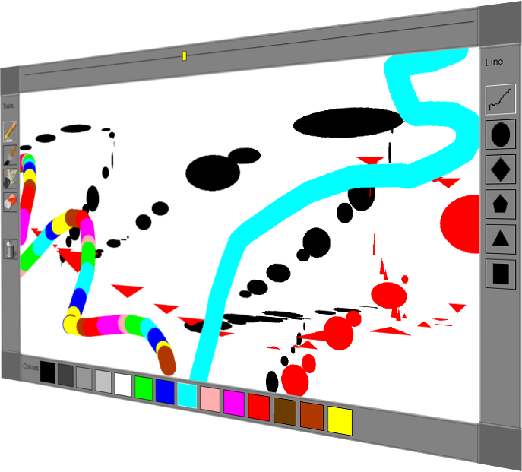
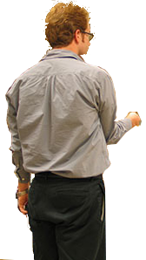
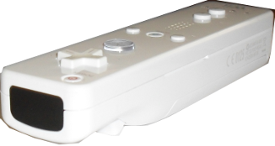
Drawing Application
Wii Remote & Light-brush
Draw Pictures with light-brush
Motion Detection

Slide 5
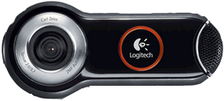
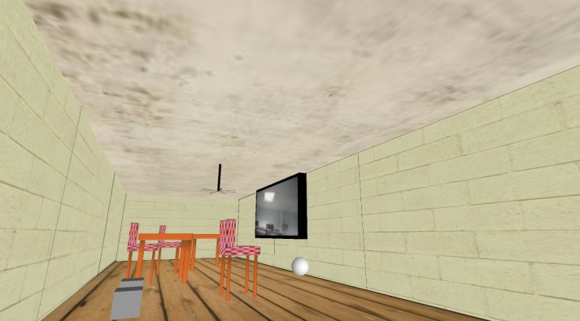

3D Virtual Room
Face detection
Webcam
Look around the virtual room

Slide 6
Technologies Used
Java
Sun SPOT
  IEEE 802.15.4
Wii Hardware
  Bluetooth
Webcam
Processing
MySQL Database

Slide 7
Thank You

Slide 8
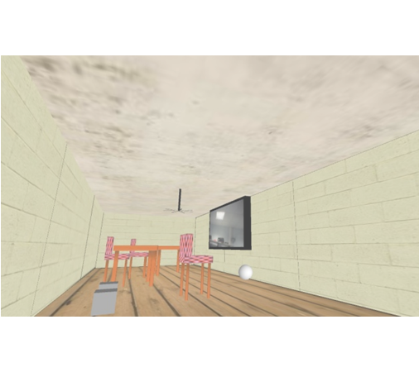

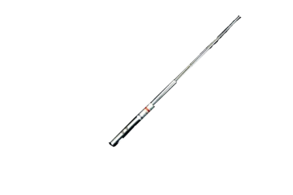

Webcam face recognition
enables dynamic virtual room viewing
Bachelor of Engineering in Digital
& Software Systems Engineering
Andrew McGlynn 2010
Manipulate an image album
using custom built wireless
gloves and hand gestures
Paint pictures using the
Wii Remote and a specially
developed light-brush

