Slide 1




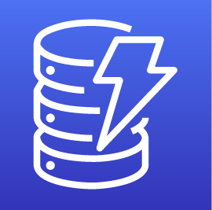






My Zappi Architecture
eu-west-1
myenergi APIs
Global S3 bucket
With Cloudfront distribution
APIs
Scheduler
Alexa-to-lwa-users-lookup
API requests
From Angular
www.myzappiunofficial.com
Invoke target
devices
API requests
schedule
myzappi
myzappi-login
sqs-handler
schedule-details
session
My Zappi (unofficial)
Skill invocation
tariff
Reminder
zappi-login-creds
encrypt/
decrypt
myZappiApiKey
encrypt/
decrypt
Token &
User APIs
My Zappi (unofficial)

