Slide 1

FIRST FAULTS GUI
Historical Alarm Analysis & Reporting Platform
Benoit Goethals · Tom Van de Vyver
ArcelorMittal · 2025 – 2026
10-minute project presentation

Slide 2
Agenda
What we'll cover in 10 minutes
01 Project description & problem statement
02 Goals & success criteria
03 Team & responsibilities
04 Working style & methodology
05 Architecture
06 Key features walkthrough
07 Progress timeline
08 What's next

Slide 3
Project Description
What problem are we solving?
The Problem
Our Solution
› CIMPLICITY logs thousands of alarms per day on the ArcelorMittal production line
› Existing tools only show real-time alarms — no historical analysis
› Engineers cannot easily see which faults are trending upward
› Finding the root cause of interlock chains is manual and time-consuming
› No automated reporting or PDF exports for shift handover
› Python / Flask web app served through IIS — no new login required
› Interactive dashboard: 6 charts + heatmap from historical SQL Server data
› Recursive interlock chain tracer: find the root fault in seconds
› Weekly fault snapshots for long-term trend & regression detection
› One-click PDF export for both the dashboard and the interlock tree
› Sub-second queries via optimised SQL Server TVFs and indexes

Slide 4
Why This Project?
The reasons that triggered First Faults
1
Database hit its ceiling
2
No tool for technicians
The existing database wasn't performant enough — asking for larger time ranges of data was slow or returned nothing at all.
Maintenance engineers had no dedicated application — only the raw, real-time CIMPLICITY alarms with no history.
3
Fault finding was hard
4
No line-fault analysis
Tracing a stop back to its first fault through nested interlock chains was manual, slow and error-prone.
There was no way to analyse line faults over time — no trends, no top-risers, no week-over-week comparison.
5
No historical reporting
6
Reactive, not proactive
Nothing supported shift handover or documentation — no PDF exports or stored snapshots to look back on.
Without trend visibility, maintenance stayed reactive — climbing faults went unnoticed until they caused a breakdown.

Slide 5
Basic Circuits
Series enable-chains (vrijgaveketens) behind every drive
What is a basic circuit?
Why it matters for First Faults
› A basic circuit (basisschakeling) is a SERIES chain of conditions — AND logic
› The drive is only enabled (Vrijgave) when EVERY condition in the chain is true
› One broken link breaks the whole chain → the machine stops
› Each link is itself a basic circuit, so chains nest many levels deep
› A single stop can hide behind dozens of nested conditions
› Operators must find which link failed first — the 'first fault'
› Tracing this by hand across PLCs is slow and error-prone
› First Faults reconstructs the chain automatically and points to the root cause
AND-logic in series — one failed link (red) stops the whole drive
No current reduction
Position OK
Drives released
No e-stop
VRIJGAVE

Slide 6
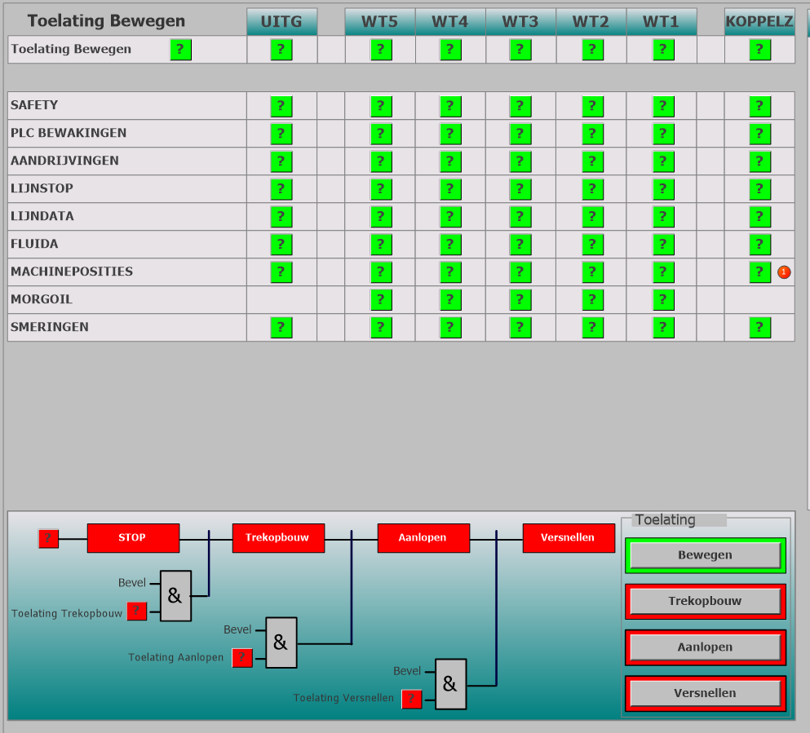
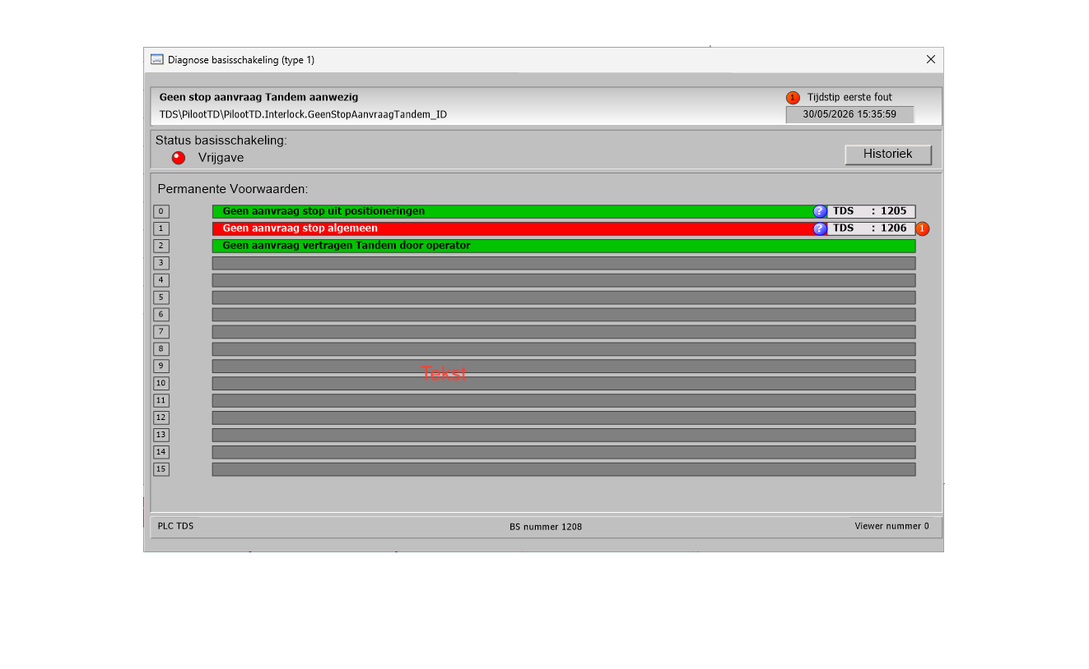
How the Operator Sees It
The overview screen flags the first fault
Overview — status per drive (WT1–WT5); the red marker flags the first fault
Clicking the fault opens its diagnostic window — the start of the chain
From the big picture, the operator drills into the first fault →

Slide 7
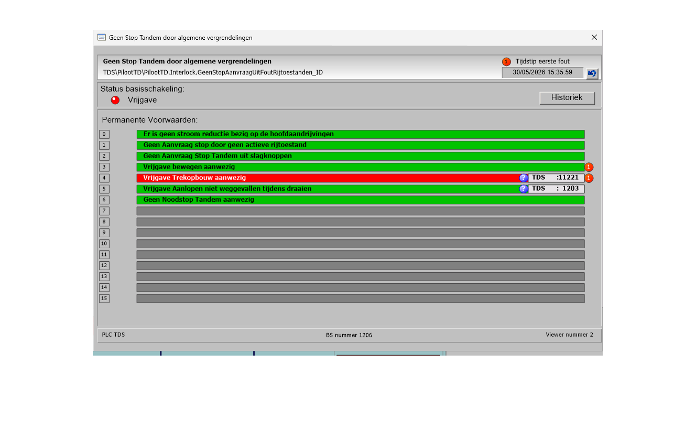
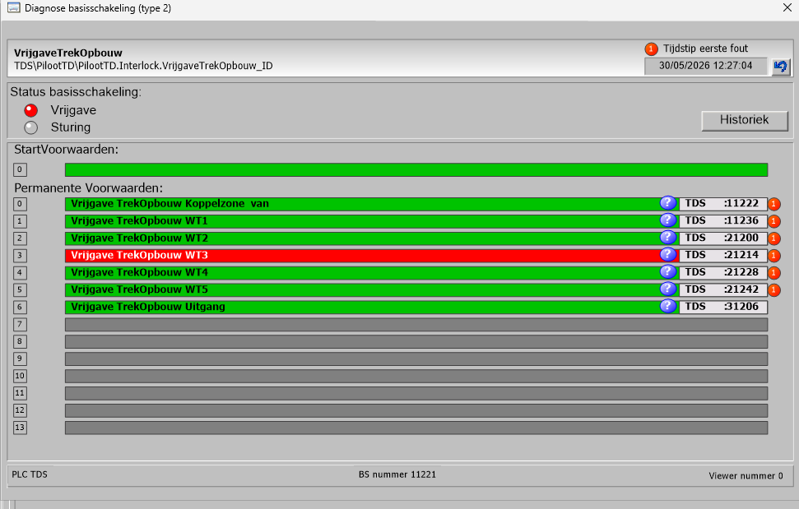
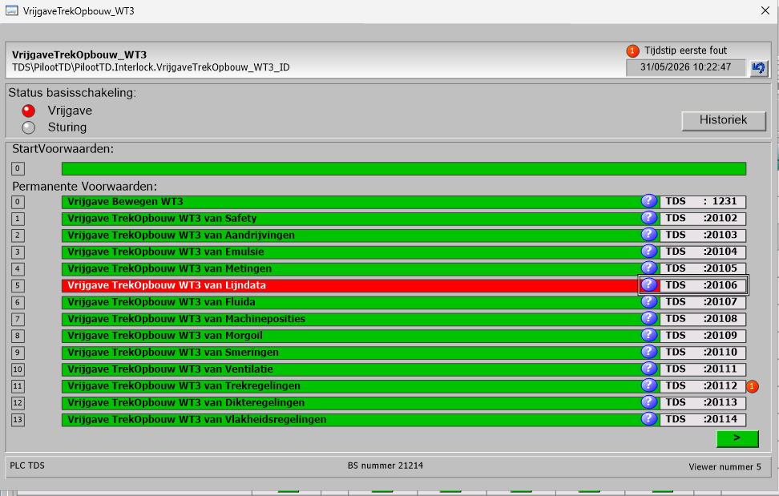
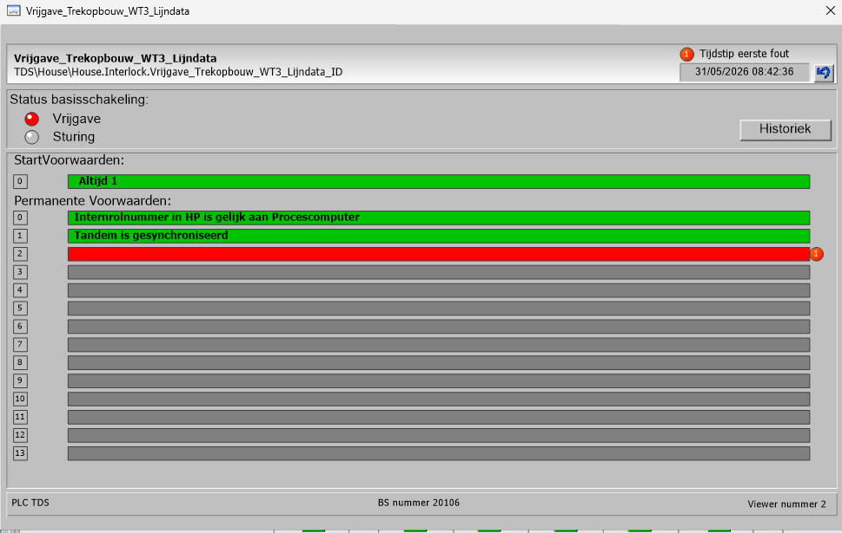
Following the Fault Chain
Drill down red bar → red bar, until the very first fault
1
Drill path
1
Tandem stop request
2
BS 1208
↓
3
2
General interlocks
BS 1206
4
↓
3
Enable Trek-opbouw
BS 11221
5
↓
4
Drive WT3
BS 21214
↓
5
Line data (Lijndata)
BS 20106
Each red bar opens its own sub-circuit — the operator follows the red thread down to the root fault.

Slide 8
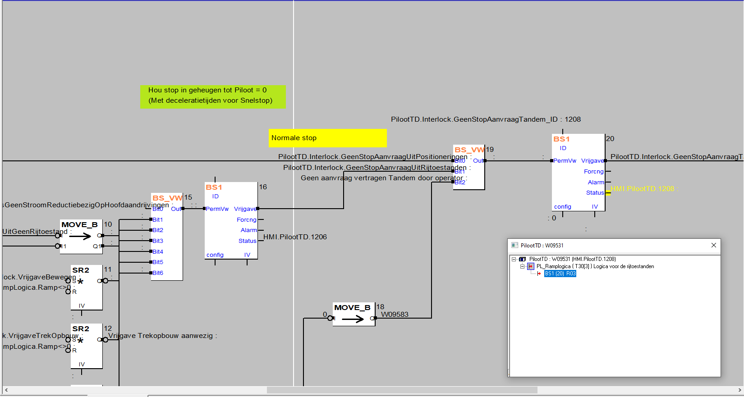
How the PLC Programmer Sees It
The same chain as PLC function-block logic
From bars to blocks
· Same enable-chain, now as function-block logic
· Each BS1 / BS_VW block = one basic circuit
· PermVw in → Vrijgave out, daisy-chained left → right
· The green/red bars the operator sees are these block states
· First Faults reads this structure straight from the PLC database
PLC programming environment — PilootTD rijtoestanden-logica

Slide 9
Goals & Success Criteria
What does 'done' look like?
DONE
DB connection via SQLAlchemy + pyodbc (SQL Server)
DONE
Interlock chain tracing with recursive SQL function
DONE
Diagrams dashboard: faults/hour, MTBF, top risers, heatmap …
DONE
Collapsible interlock tree table with server-side filters
DONE
PDF export — dashboard (6 charts) and interlock tree
DONE
Weekly fault snapshots + historical reference-date picker
DONE
Query performance: from ~8 s to < 1 s
WIP
Scheduled daily snapshot runs + automated weekly email report
WIP
Final IIS deployment + user acceptance test (target: July 2026)
LATER
Role-based access (read-only vs. admin configuration)
LATER
Configurable alert thresholds with Teams/email notification

Slide 10
Team & Responsibilities
Benoit Goethals
Tom Van de Vyver
· Frontend — UI design, Jinja2 templates, Bootstrap 5 layout
· Visualisations — Plotly charts (bar, pie, heatmap)
· Flask routes, Blueprint structure, form handling
· PDF export — DiagramPdfService, Kaleido + ReportLab
· JavaScript: collapsible tree, async PDF download, global spinner
· Documentation: README, CHANGELOG, PROJECT_PROGRESS, architecture docs
· Performance: query rewrites and DB index tuning
· Backend — database design and normalisation
· SQL Server: TVFs, stored procedures, views, indexes
· SQLAlchemy ORM models and repository layer
· InterlockService: root-cause chain analysis engine
· Snapshot system: weekly fault snapshots + backfill scripts
· MailService: SMTP-based automated email reports
· DB migration scripts and validation tooling

Slide 11
Working Style & Methodology
Git Flow
Agile Iterations
Quality Practices
Tooling
· main → Develop → feature branches
· Pull requests for every feature (50+ PRs merged)
· Branch names follow GitHub issue numbers
· No direct commits to Develop
· Short cycles: build → test → review → merge
· Priorities shift based on user feedback from engineers
· Weekly sync between Benoit and Tom
· Progress reported monthly to stakeholders
· SQLAlchemy 2.0 compliance enforced throughout
· SOLID principles applied to service layer
· Logging added at service boundaries for traceability
· SQL scripts tested in isolation before integration
· PyCharm (IDE) · GitHub (versioning & PRs)
· Flask dev server for local testing
· IIS as production run environment
· Plotly + Kaleido for chart-to-PNG rendering

Slide 12
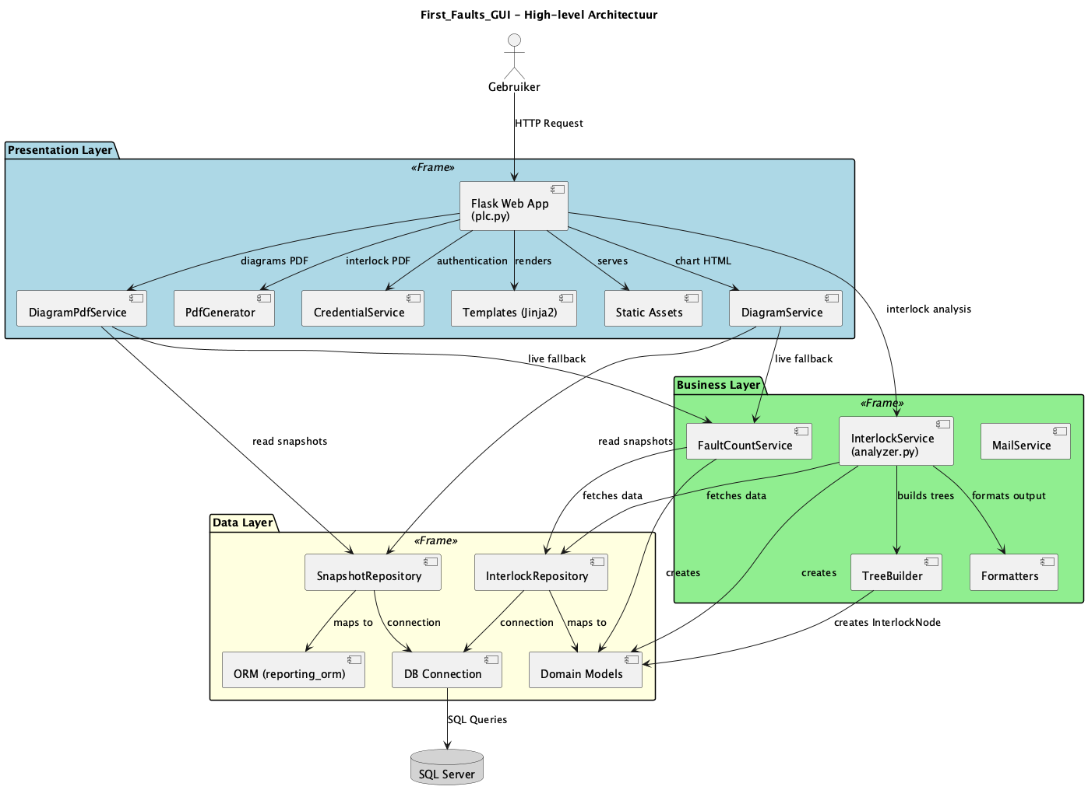
Architecture
Three-tier Flask application on IIS
Presentation layer Flask Blueprints · Jinja2 templates · Bootstrap 5
Business layer InterlockService · FaultCountService
Data layer SQLAlchemy ORM · SnapshotRepository · DB_Connection
Database SQL Server via pyodbc · TVFs · Views · Indexes
Export ReportLab PDF · Plotly + Kaleido PNG
Auth IIS Windows Authentication — no custom login
Config TOML config file loaded at startup
SQL Server → Repository → Service → Template → Browser

Slide 13
Key Features
What the application delivers
Diagrams Dashboard
Interlock Tree
PDF Exports
Snapshot & Reporting
/plc/diagrams
/plc/table-tree
/plc/diagrams-pdf & table-tree PDF
run_daily_snapshot.py
· Faults per hour (bar chart)
· Faults per PLC — pie chart
· Top risers (week-over-week climbing faults)
· MTBF per PLC
· Top 10 climbing faults
· Repeat offenders (max occurrences per hour)
· Heatmap: hour × day per selected PLC
· Historical week/month picker via reference date
· Recursive fault-chain tracer in SQL
· Filters: Target BSID, Top N, PLC, time range, condition mnemonic
· Collapsible tree rows — expand/collapse per node
· POST-redirect-GET pattern prevents double-submit
· Server-side validation with flash messages
· All 6 dashboard charts → PNG (Kaleido) → landscape PDF (ReportLab)
· Interlock tree exported as formatted PDF table
· Async download via fetch — no page reload
· Global loading spinner shown during generation
· Weekly fault count snapshots stored in DB
· Backfill support across multiple production databases
· Long-term regression view: compare trends over months
· MailService ready for automated weekly email delivery

Slide 14
Progress Timeline
November 2025 → May 2026
Phase 1 — Setup & PoC
Nov 2025
Flask app · Blueprint routing · Plotly charts · Tree table · IIS auth
Phase 2 — Interlock Engine
Nov–Dec 2025
SQLAlchemy ORM · Recursive SQL chain tracer · PDF export · Snapshots · MailService
Phase 3 — Stability
Feb 2026
InterlockService rename · SQL views · Migration validation tooling
Phase 4 — Dashboard & Performance
Apr 2026
6-chart dashboard · DiagramPdfService · Reference-date picker · 8 s → < 1 s query time · DB indexes
Now — Polish
May 2026
Pie chart on home · Subtree toggle refactor · PDF null-fix · Documentation

Slide 15
What's Next
Road to MVP — 11 June 2026
Before MVP (June 11)
Post-MVP Ambitions
› Schedule daily snapshot runs (Windows Task Scheduler / IIS)
› Wire MailService to automated weekly PDF email
› Final IIS deployment on production server
› User acceptance test with ArcelorMittal engineers
› About & Contact pages with real contact details
› End-to-end test pass: all pages, filters, PDF downloads
› Role-based access: read-only vs. admin
› Configurable alert thresholds with email/Teams notifications
› Extended heatmap: drill-down to individual fault codes
› Promote ML fault prediction to production
› Multi-site support (multiple CIMPLICITY instances)
› REST API so other tools can query fault trends
Thank you for your attention — questions welcome
Benoit Goethals · Tom Van de Vyver | ArcelorMittal · 2025–2026

