Slide 1
Trees
CS 240 Spring 19

Slide 2
Binary Search Trees

Slide 3
Problems with Sequences
What are some limitations of sequences?
searching
O(n):
length of the list
sorting
best case: n logn

Slide 4
A Better ADT
Vectors make working with arrays easier, but no real performance improvements
Linked list improves the array
using nodes gives us memory flexibility, but sacrifices random access
How can we improve?
What if we add additional node pointers to each node
we can divide the problem in half

Slide 5
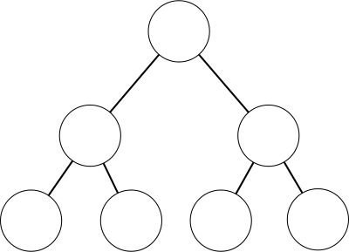
A Tree is a Linked List
If we add 1 additional ‘next’ pointer, we have a logarithmic traversal time
CRUD is much faster, but the data structure is more complex
Problem: we now need to know what ‘path’ to take
Different kinds of trees are all solving this problem of what ‘path’ to take to find your data

Slide 6
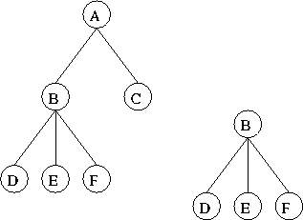
The Tree ADT
Definition:
A finite set of nodes such that one node is designated as the root. All other nodes are partitioned into sets, each of which is a tree.

Slide 7
Terminology
Root node
The ‘top’-most node in the tree
Branch
the connection to a child node that may or may not contain a subtree
Subtree
subnode that contains subnodes

Slide 8
Properties of a Tree
max # of leaves
all nodes that do not have branches
max # of nodes
all nodes in the tree
Height for a tree
path depth
The number of branches between the current node and the farthest leaf
max depth
The number of branches between the root node and and the farthest leaf
A Binary Node
Data
left node pointer
right node pointer

Slide 9
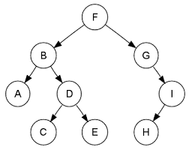
Parents and Children
Parent Node
The immediate predecessor node in the tree structure
Child Node
the immediate following node in the tree structure
Parent Node to A
Child Node to I

Slide 10
Height
A tree’s depth is the number of ‘steps’ to get to a leaf
Only count branches, not nodes
What is the depth of A? H?
A tree’s height is based on its maximum depth
What is the tree’s height?

Slide 11
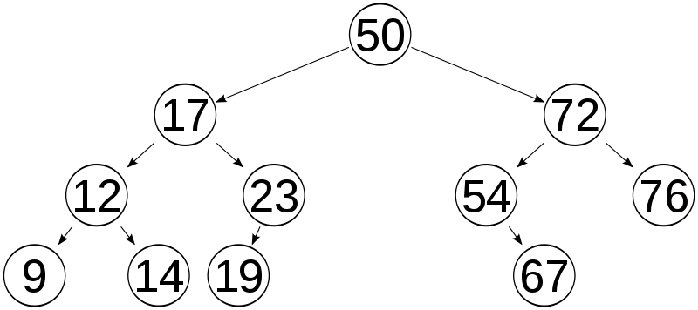
Binary Search Tree

Slide 12
Binary Search Tree
Binary Search tree is one of many different kinds of Tree Data Structures
Each node has two branches
Branches may point to another node, or NULL
all data in every node of the left subtree are less than the data in the node
all data in every node of the right subtree are greater than the data in the node
All data in a BST is unique

Slide 13
Implementation
Array
You can use an array to implement your tree
left child index = 2*(Parent Index)+1
right child index = 2*(Parent Index)+2
parent index = (Child Index-1)/2 (truncate)
Pros:
Constant time Access
Cons:
Complexity
Array Max Size must be known
Linked
a linked list using structs and pointers
a data field
a left child field with a pointer to a node
a right child field with a pointer to a node
a parent field with a pointer to the parent node
Pros:
Dynamic Memory size
Cons:
Complexity
Linked Traversal

Slide 14
The BST ADT
Made up of two structs:
Tree
Node * root
Node
Node * left
Node * right
Data * data
Node * parent (optional, but recommended)

Slide 15
Nested Classes
A nested class is declared inside another enclosing class.
A nested class is a member object and has the same access rights as any other member.
Member objects of an enclosing class don’t have any special access to member object of a nested class
the usual access rules (public, private) are enforced

Slide 16
Nested Class Example
class Enclosing {
private:
int x;
class Nested {
int y;
void nestedFun(Enclosing *e) {
std::cout<<e->x; // works fine: nested class can access
}
}; // declaration Nested class ends here
}; // declaration Enclosing class ends here

Slide 17
BST’s use recursion
Recursion is the process of a function calling itself to perform iteration
Basically, using the stack as your loop
Why use recursion
Simplifies code greatly
Why not use recursion?
Uses more memory
Can be very slow

Slide 18
Recursion has two parts
Recursion requires two parts within the recursive function:
A base case that defines an atomic object
an end to the recursion.
A recursive step that defines how objects can be modified, reduced, or combined to produce another object closer to the atomic object
Recursion Rules
Every recursive method must have a base case -- a condition under which no recursive call is made -- to prevent infinite recursion.
Every recursive method must make progress toward the base case to prevent infinite recursions

Slide 19
Tree Traversal
Traversal, whether for insertion, deletion, or read, is much simpler with recursion
A method is recursive if it can call itself directly or indirectly
A function, foo(), is indirectly recursive if it calls, bar() which in turn calls foo()

Slide 20
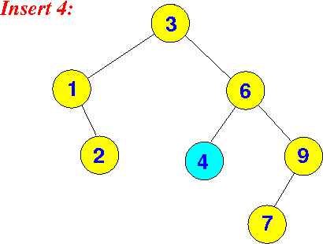
Recursive Insert
Recursive insert
Check if value is greater than or less than the value in the current node
If greater, go right, check again
If less, go left, check again
If null, add a leaf to the tree
if equal, NOOP

Slide 21
Inserting a node into an existing tree
Operations:
Use recursion to traverse through the tree
Insert node as a leaf
What information do you need?
Data inserted
current node visited
with access to child nodes

Slide 22
Insert (pseudocode)
insert(node, data){
if (data < node.data)
if(node.left == NULL)
addLeaf(node, data);
else
insert(node.left, data)
else if (data > node.data)
if(node.right == NULL)
addLeaf(node, data);
else
insert (node.right, data)
*must handle special case where tree is empty

Slide 23
Problems
How to choose the root node?
What happens if you choose a bad root node?
Becomes a linked list
Insertion (with a well chosen root)
Best Case?
O(1)
Worst Case?
O(logn)
Notes:
Constant time best case is property of heap

Slide 24
Recursive Read
Almost identical to insert
Requires a return statement
Reference or pointer
Check if value is greater than or less than the value in the current node
If greater, go right, check again
If less, go left, check again
If equal, return data
If null, error message

Slide 25
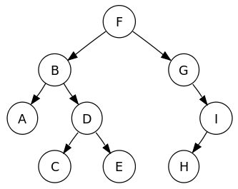
Read (pseudocode)
read(node, data){
if(data == node.data) return node.data
else if (data < node.data)
if(node.left == NULL)
print(“value not found”);
else
return read(node.left, data)
else if (data > node.data)
if(node.right == NULL)
print(“value not found”);
else
return read (node.right, data)
*must handle special case where tree is empty

Slide 26
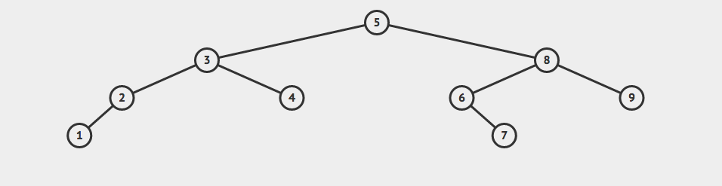
Classwork
Trees
find(Node[7],7)
find(Node[6],7)
find(Node[6],7)
find(Node[8],7)
find(Node[8],7)
find(Node[8],7)
find(Node[5],7)
find(Node[5],7)
find(Node[5],7)
find(Node[5],7)

Slide 27
Delete
Basic Deletion process
Remove the pointer(s) to the node
Non-leaf nodes will need to update their children’s parent pointers as well
delete node
Operations required
Tree Traversal to find the node
Must always keep track of the parent node
This is where maintaining a parent pointer in the node is helpful

Slide 28
Delete - 3 Scenarios
What are the primary cases for deleting a node?
Delete a leaf node
set parent node pointer to null
delete node
Delete a 1 branch parent node
Can’t just delete the node, because then our tree would "fall apart."
Delete a 2 branch parent node
We must promote one of the children to become the new parent.

Slide 29
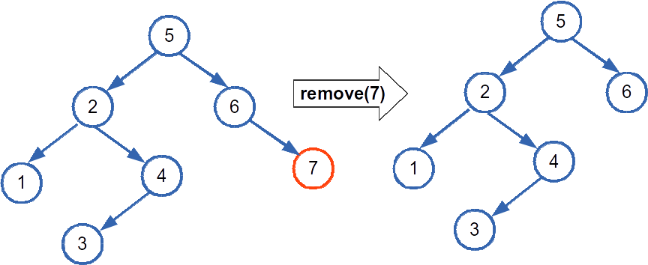
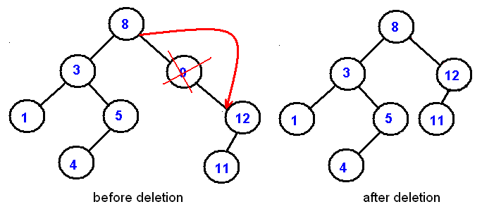
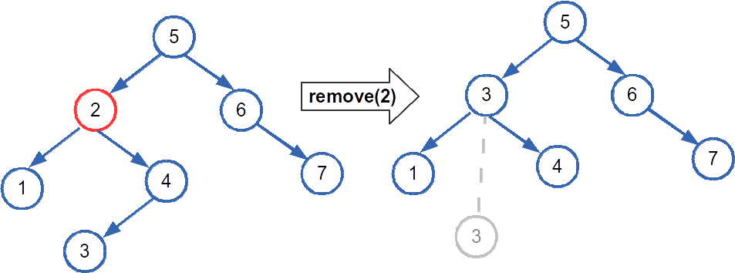
Delete Algorithm
node = findNode(data);
if ( node not in BST )
return;
else if ( node has no subtrees ){
deleteLeaf(node);
}else if ( node has 1 tree ) {
shortCircuit(node);
}else if(node has 2 subtrees){
promotion(node);
}

Slide 30
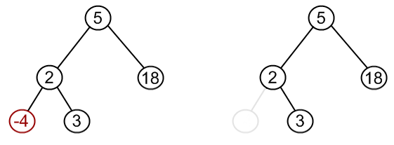
Deleting Leaf Nodes

Slide 31
DeleteLeaf Pseudocode
void removeLeaf(Node * leaf)
if leaf->parent->right == leaf
leaf->parent->right = NULL
else
leaf->parent->left = NULL
delete leaf
What if the leaf is the root?
Delete root
Set root to null to signify an empty tree

Slide 32
Short Circuit Algorithm
The Short Circuit Algorithm sets the child node’s child to be the child of the parent, then deletes the extra leaf node
When deleting a parent node in a BST, you must ensure that the new parent is:
bigger than all the other children in the left tree
smaller than all the other children in the right tree
You must maintain the BST structure

Slide 33
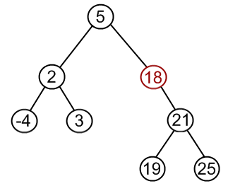
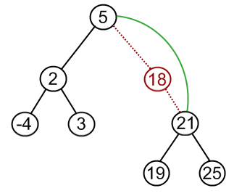
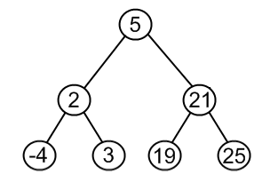
Deleting Single Branch Nodes
Short Circuit Method

Slide 34
Short Circuit Pseudocode
void shortCircuit(Node * node)
if( node->parent->right == node)
if node->right == NULL
parent->right = node->left
node->left->parent = node->parent
else
parent->right = node->right
node->right->parent = node->parent
else
...
delete node
What if the node to be delete is the root?
We have to promote the child node to become the root

Slide 35
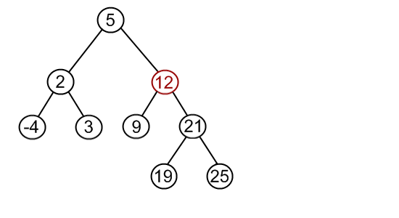
Deleting 2 Child Nodes

Slide 36
Promotion
We must promote a node to a higher space in the tree
There are at most two possible candidates:
the rightmost child of the left subtree
Traverse left once, then right as far as possible
the leftmost child of the right subtree
Traverse right once, then left as far as possible
It doesn't matter which one we pick,
both choices will maintain the BST structure
Successor node
the node in the right subtree that is min value -or-
the node in the left subtree that is max value

Slide 37
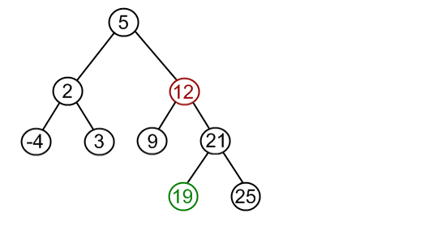
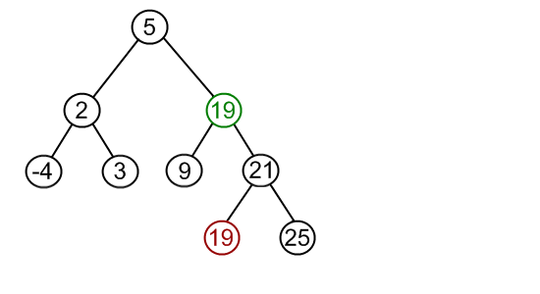
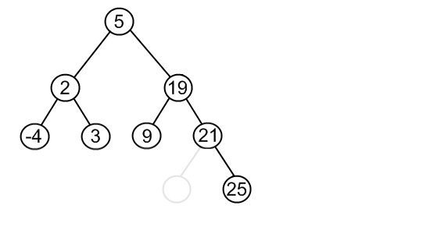
Promote Successor
Find node to delete
2) Find successor
3) Replace value
4) Delete Successor

Slide 38
Promotion Selection
functions needed
Node * getMaxNode(Node * node)
Node * getMinNode(Node * node)
What if the min or max is not a leaf node?
We call our short circuit algorithm
min value has right subtree?
Run single subtree (short-circuit) algorithm
What if the delete node is the root node?
Special case: must promote leftmost max or rightmost min to root node

Slide 39
Promotion Algorithm
void promotion(Node * n){
d_node = searchMin(n->right);
n->data = d_node->data;
//Leaf
if(d_node>left==NULL && d_node->right==NULL){
removeLeaf(d_node);
//one branch
}else{
shortCircuit(d_node);
}
}

Slide 40
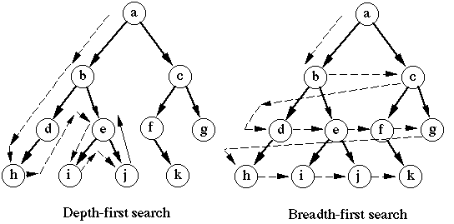
Searching a Tree

Slide 41
Depth First Traverse
Depth First travels down the tree structure to find a value
Basic Algorithm:
Start at the root node,
traverse down the left until finding a leaf
traverse back up until finding a right branch
repeat until no right branch

Slide 42
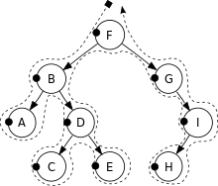
PreOrder
Process each node as you reach it in traversal order
Algorithm:
preorderTraversal(node): process(node) preorderTraversal(node->left) preorderTraversal(node->right)

Slide 43
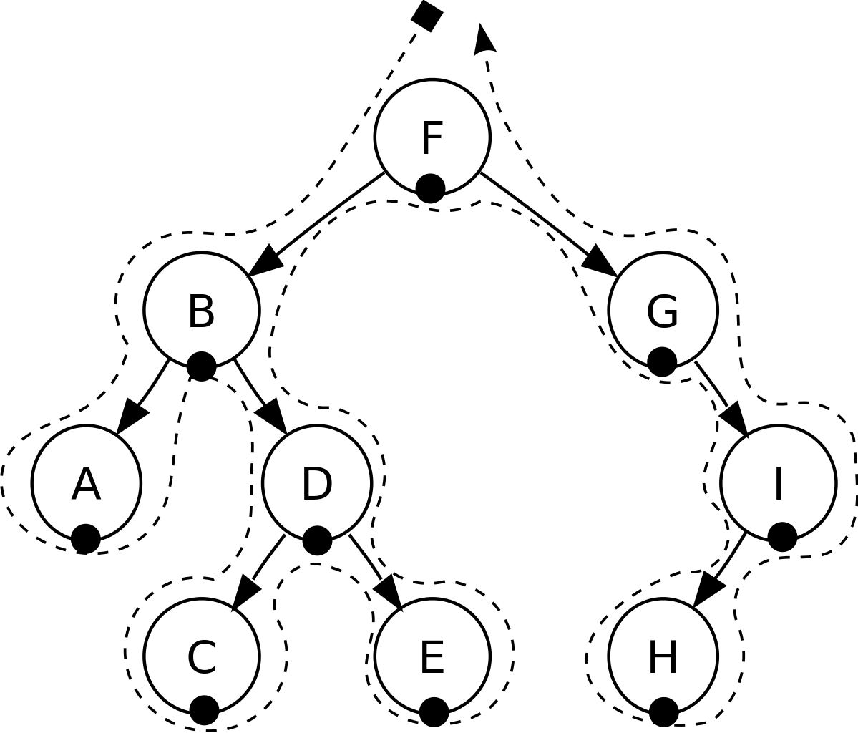
InOrder
Visit each node in ascending order
Algorithm:
inorderTraversal(node): inorderTraversal(node->left) process(node) inorderTraversal(node->right)

Slide 44

PostOrder
Visit each node as you reach it in final traversal order
Algorithm:
postorderTraversal(node): postorderTraversal(node->left) postorderTraversal(node->right) process(node)

Slide 45
Classwork:
Tree Traversal

Slide 46
Use Cases
Basic required Tree operations:
Deep Copy Tree
Delete Tree
Sorted Print
Depth First Search
Traverse as far as possible down a single path
Determine use case for each DFS Operation
PreOrder: copy of the tree
InOrder: gives nodes in non-decreasing order
PostOrder: used to delete the tree

Slide 47
Breadth First Search
So far we have looked at depth first search
We traverse deep into the tree along a single path until we cannot go farther
What is we want to traverse by level
Breadth First Traversal
Also called Level order
Visit every node on a particular level before going to the next level

Slide 48
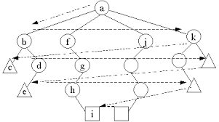
Breadth First Helper ADT
How to Implement?
Not really a recursive algorithm
Can still implement recursively, but not traditionally done with recursion
Use a helper Data Structure to store the next level
Which data structure would work best?
A Queue
Enforces first in first out

Slide 49
Breadth First Search Algorithm
Assume a tree where each node has an unknown number of children
breadthFirstSearch(){ Queue q; q.enqueue(root); while(!q.empty()){ node = q.dequeue(); processNode(node); for(auto child : node.children) //where children is a vector of nodes q.enqueue(child); } }

Slide 50
Balancing a BST
Binary Search Trees use strict ordering
There is only one place an inserted value can go
In order to balance the tree, we will have to restructure it
There are many different variations of BST that ensures a balanced tree (AVL, Red/Black, Splay, etc)
We are going to look at the simplest method of keeping a BST balanced

Slide 51
Creating a Balanced BST
We first need to pull everything out of our tree so we can rebuild it
Use inorder traversal to sort the tree
Store in an array
Divide our sorted array to insert in the optimal order
Remove the middle element of the array and insert into a new tree
Divide remaining array into two parts, left and right
Repeat on both left and right array until the array is empty
Return the new tree

Slide 52
Creating a Balanced BST
42
10 | 14 | 19 | 27 | 35 | 37 | 42
27
35
14
37
10 | 14 | 19 |  | 35 | 37 | 42
19
37
10 |  | 19 |  | 35 |  | 42
10
19
35
42
14
27
10

