Slide 1
Graphs
CS240 - Spring 2019

Slide 2
A New ADT
Trees represent a hierarchy of data. What if we have relational data, similar to a tree, but no hierarchy.
For example, we go the RenFair, and there’s lots of equally great stuff to do (tomato toss, turkey leg, jousting)
Let’s say our RenFair has paved paths that we are not allowed to leave. As good Computer Scientists, we want to come up with an algorithm for planning our day. What information do we need?

Slide 3
RenFair Paths
Let’s call each activity a vertex, and the paths between each activity an edge. What information do we need to determine about our data set before we can form a plan?
Are all vertices connected to every other vertices or are there gaps?
Are all connected vertices the same distance from each other, or do the edges have weight (distance)?
Are the edges directional?
How many vertices are 1 stop away from any particular vertices?

Slide 4
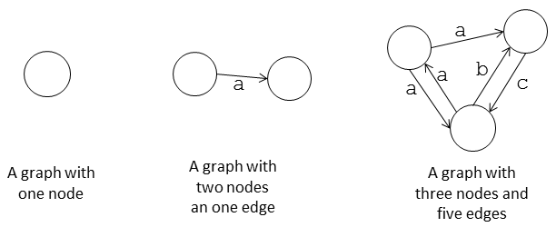
What is a Graph?
A data structure that consists of:
a finite set of vertices (nodes)
a set of edges that relate the vertices to each other
A graph G is defined as follows:
G=(V,E)
The set of edges describes relationships among the vertices
Any subset of a graph’s vertices and edges is a subgraph
Graphs are essential in:
GPS, Database Design, Networks

Slide 5
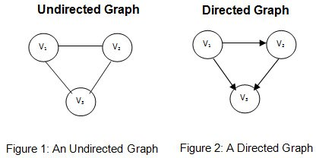
Directed vs. Undirected graphs
When the edges in a graph have no direction, the graph is called undirected
Country roads with no traffic laws
When the edges in a graph have a direction, the graph is called directed (or digraph)
One way streets in a big city

Slide 6
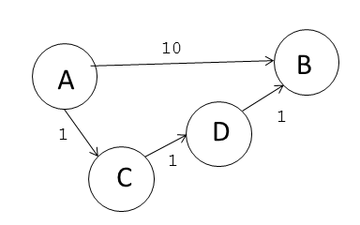
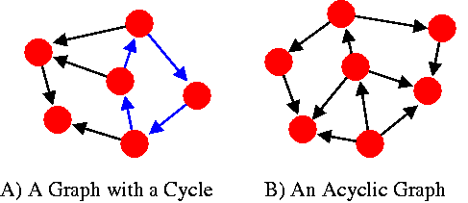
Adjacent Vertices
Connected by a single edge
Degree (of a vertex)
# of adjacent vertices
if directed: Out-Degree vs In-Degree
Path
sequence of vertices v1. . .vk such that consecutive vertices are adjacent.
Simple Path means no repeated v
Cycle
The start and end vertices are the same

Slide 7
Connected vs Disconnected vs Complete
Disconnected
Parts of the Graph are inaccessible from other parts of the graph through any path
Connected
It is possible to build a path to any other part of the graph from any point in the graph
Complete
All vertices of the graph are adjacent to all other vertices in the graph (connected by a single edge)

Slide 8
Kinds of Graphs
Trees
Special cases of graphs
connected graphs without cycles
Simple Graphs
There is only one edge between any two vertices and no self loops
Formal Definition: A simple graph G = (V,E ) consists of a non-empty set V of vertices (or nodes) and a set E (possibly empty) of edges where each edge is a subset of V with cardinality 2 (an unordered pair).
We are only considering simple graphs for this class

Slide 9
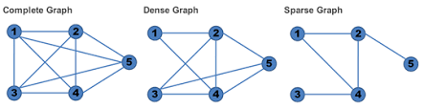
Sparse vs Dense
A graph is sparse if | E | ≈ | V | - 1.
If most V have a cardinality <= 2
A graph is dense if | E | ≈ | V |(|V|-1)/2.
If most V have a cardinality = V-1

Slide 10
ADT Graph Operations
What are some operations we need to perform on graphs?
Test whether graph is empty.
Get number of vertices in a graph.
Get number of edges in a graph.
Determine if an edge exists between two given vertices.
Insert
Insert a new distinct vertex in graph
Insert edge between two given vertices in graph.
Remove
Remove specified vertex from graph and any edges between the vertex and other vertices.
Remove edge between two vertices in graph.
Search for a vertex that contains given value.

Slide 11
How can we implement a graph?
What information will need to be stored for each vertex?
Adjacent vertices
What information do we need to store for each edge?
Weight (if directed)
What vertices it is connecting
What data structure are we going to use to store the graph itself?
array or list

Slide 12
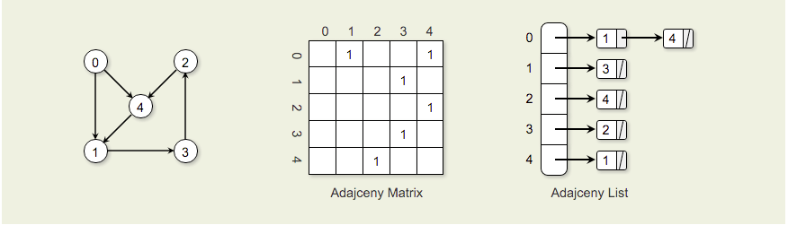
Representing Graphs in Memory
Adjacency Matrix
2 dimensional array contains entries for Vertex v_{i}.
Column j in row i is marked with weight if there is an edge from v_{i} to v_{j}.
Space requirements for the adjacency matrix are V².
Adjacency List
Array of linked lists. The array is |V| items long, with position i storing a pointer to the linked list of edges for Vertex v_{i}.

Slide 13
Stored as Matrix and List
Undirected Graph
Undirected Weighted Graph
Directed Weighted Graph
0
2
0
2
0
2
3
3
3
3
4
2
4
1
2
4
1
1
1
1
3
1
2
3
1
3
2

Slide 14
Classwork
Adjacency Matrix: 50 bytes
50 for edges
5²* 2 bytes
Adjacency List : 120 bytes
80 bytes for pointers
4 bytes * 4 pointers * 5 nodes
40 bytes for edge weights
Adjacency Matrix is good for a full graph,
Adjacency List is good for sparse graph
Implementing Graphs

Slide 15
Pros and Cons of Adjacency List
Advantages:
Saves space for sparse graphs. In practice, most graphs are sparse.
“Visit” edges that start at v
Only need to traverse linked list of v
Size of linked list of v is degree(v)
Disadvantages:
Check for existence of an edge (v, u)
Must traverse linked list of v
Size of linked list of v is degree(v)

Slide 16
Pros and Cons of Adjacency Matrix
Advantage:
Save space on pointers and overhead for dense graphs.
Check for existence of an edge (i, j)
Just check if A[i, j] = 1?
So constant time complexity
Disadvantage:
“Visit” all the edges that start at v
Entire row v of the matrix must be traversed.
So O(n) is best case

Slide 17
Graph Traversal
Breadth First Traversal
Depth First Traversal
Shortest Path
Minimum Spanning Tree
Kruskal
Prim

Slide 18
s-t Connectivity
2 algorithmic questions
Given two nodes s and t, is there a path between s and t?
Called the s-t connectivity problem
Can be modified to ask: is there a path between all nodes?
Given two nodes s and t, what is the length of the shortest path between s and t?
Called the s-t shortest path problem
Can be modified to ask: what is the shortest path between one node and all other nodes?

Slide 19
Search

Slide 20
Classwork
BFS:
If you know a solution is not far from the root of the tree, a breadth first search (BFS) might be better.
finite number of children, but the height of the tree is infinite, DFS might never find the node you're looking for
set of possible player moves in a game can be (effectively) infinite.
DFS:
If the tree is very deep and solutions are rare, depth first search (DFS) is likely to use less memory, and be faster in the average case.
If the tree is very wide, a BFS might need too much memory, so it might be completely impractical.
Searching Graphs

Slide 21
Traversing a Graph
Given a graph G = (V, E) and a source vertex, s, how can we systematically traverse the edges of G to “discover” (visit) vertices of G reachable from s?

Slide 22
Frontiers
Discover all vertices ‘k’ vertices away from s before discovering any vertices k + 1 vertices from s
We expand the frontier between already discovered and undiscovered vertices one step at a time.
Works similar to breadth first search of a tree
Use a First-In-First-Out (FIFO) queue to implement the Frontier.
Need O(1) time to update
Produces a tree that contains all the reachable vertices from s with s as a root.

Slide 23
Breadth First
On an unweighted graph, the algorithm also computes the shortest distance (dist) from s to any reachable node.
We are solving both the s-t connectivity problem and shortest path problem for unweighted graphs
To get O(|V| + |E|), we must use an adjacency list.
If we used an adjacency matrix, the running time would be O(|V|²). Why?
For each node, we have to ‘check’ every other node to see if there is a connection
All single source traversal methods may fail to reach all nodes for directed or unconnected graphs.

Slide 24
Going in Cycles
How can we ensure we don’t go over the same path we already visited?
We tag the nodes to keep track of where we are in the process
We can use colors to tag nodes
Nodes change color in order: White -> Gray -> Red
White are undiscovered nodes
Grey are ‘frontier’ nodes
Red are fully explored nodes

Slide 25
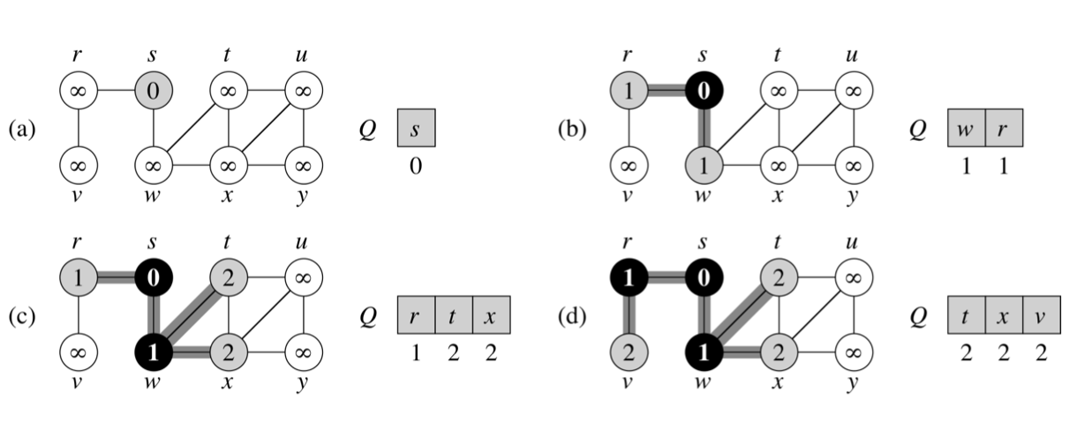
BFS: Example

Slide 26
BFS: Example

Slide 27
BFS: Example

Slide 28
BFS: Example

Slide 29
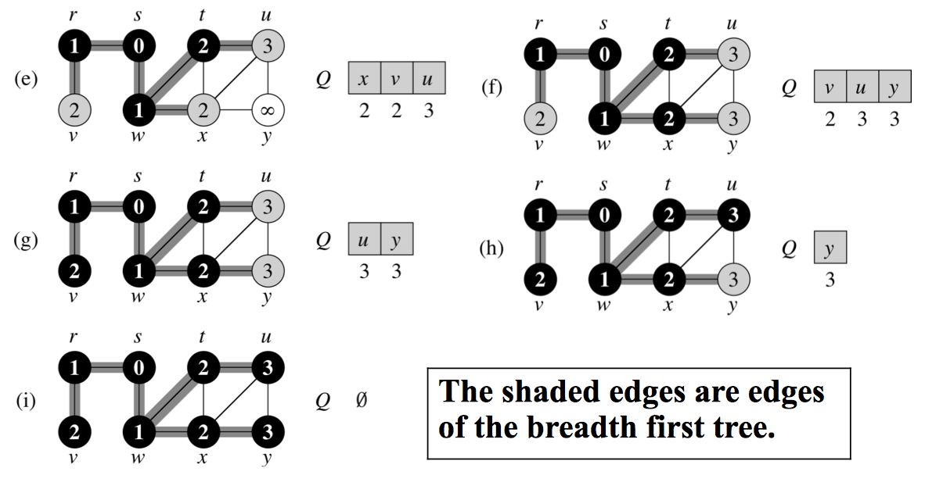
BFS: Example (continued)

Slide 30
BFS: Example (continued)

Slide 31
BFS: Example (continued)

Slide 32
BFS: Example (continued)

Slide 33
BFS: Example (continued)

Slide 34
Implementing the BFS
BFS(G, root) //start the search from node s in graph G
for each vertex u in G.V
u.color = white
u.distance = infinity // holds distance from s to u
u.pre = NIL // u.pre denotes the predecessor of u root.color = gray
root.distance = 0 // distance to itself is 0
root.pre = NIL
Q = // Q is an FIFO queue and it is initially empty Q.enqueue(root)

Slide 35
Implementing the BFS - Part 2
while Q is not empty:
current = Q.dequeue()
for each v adjacent to current:
if v.color == white:
v.color = gray
v.distance = current.distance + n.edge(u)
v.parent = current
Q.enqueue(v)
u.color = black
Notes:
n.edge(w) gets the edge weight between the two vertices

Slide 36
BFS and Connectivity
How can we use the BFS to determine connectivity of our graph?
Once we have completed our BFS, we can check to see if there are any nodes still marked white
If yes, unconnected graph
If no, connected graph

Slide 37
Classwork
A, C, E, B, F, D
C, B, F, D
F
Traversing Graphs with BFS

Slide 38
Depth First Search
Traverse deeper into the graph whenever possible
We can use the same tagging method as the BFS
We still need to guard against cycles
White: Undiscovered Nodes
Gray: Encountered, but not fully explored
Red: fully explored nodes
DFS is useful for
When a tree is very wide, BFS can use too much memory
such as solving a maze because in DFS you explore every possible path before backtracking.

Slide 39
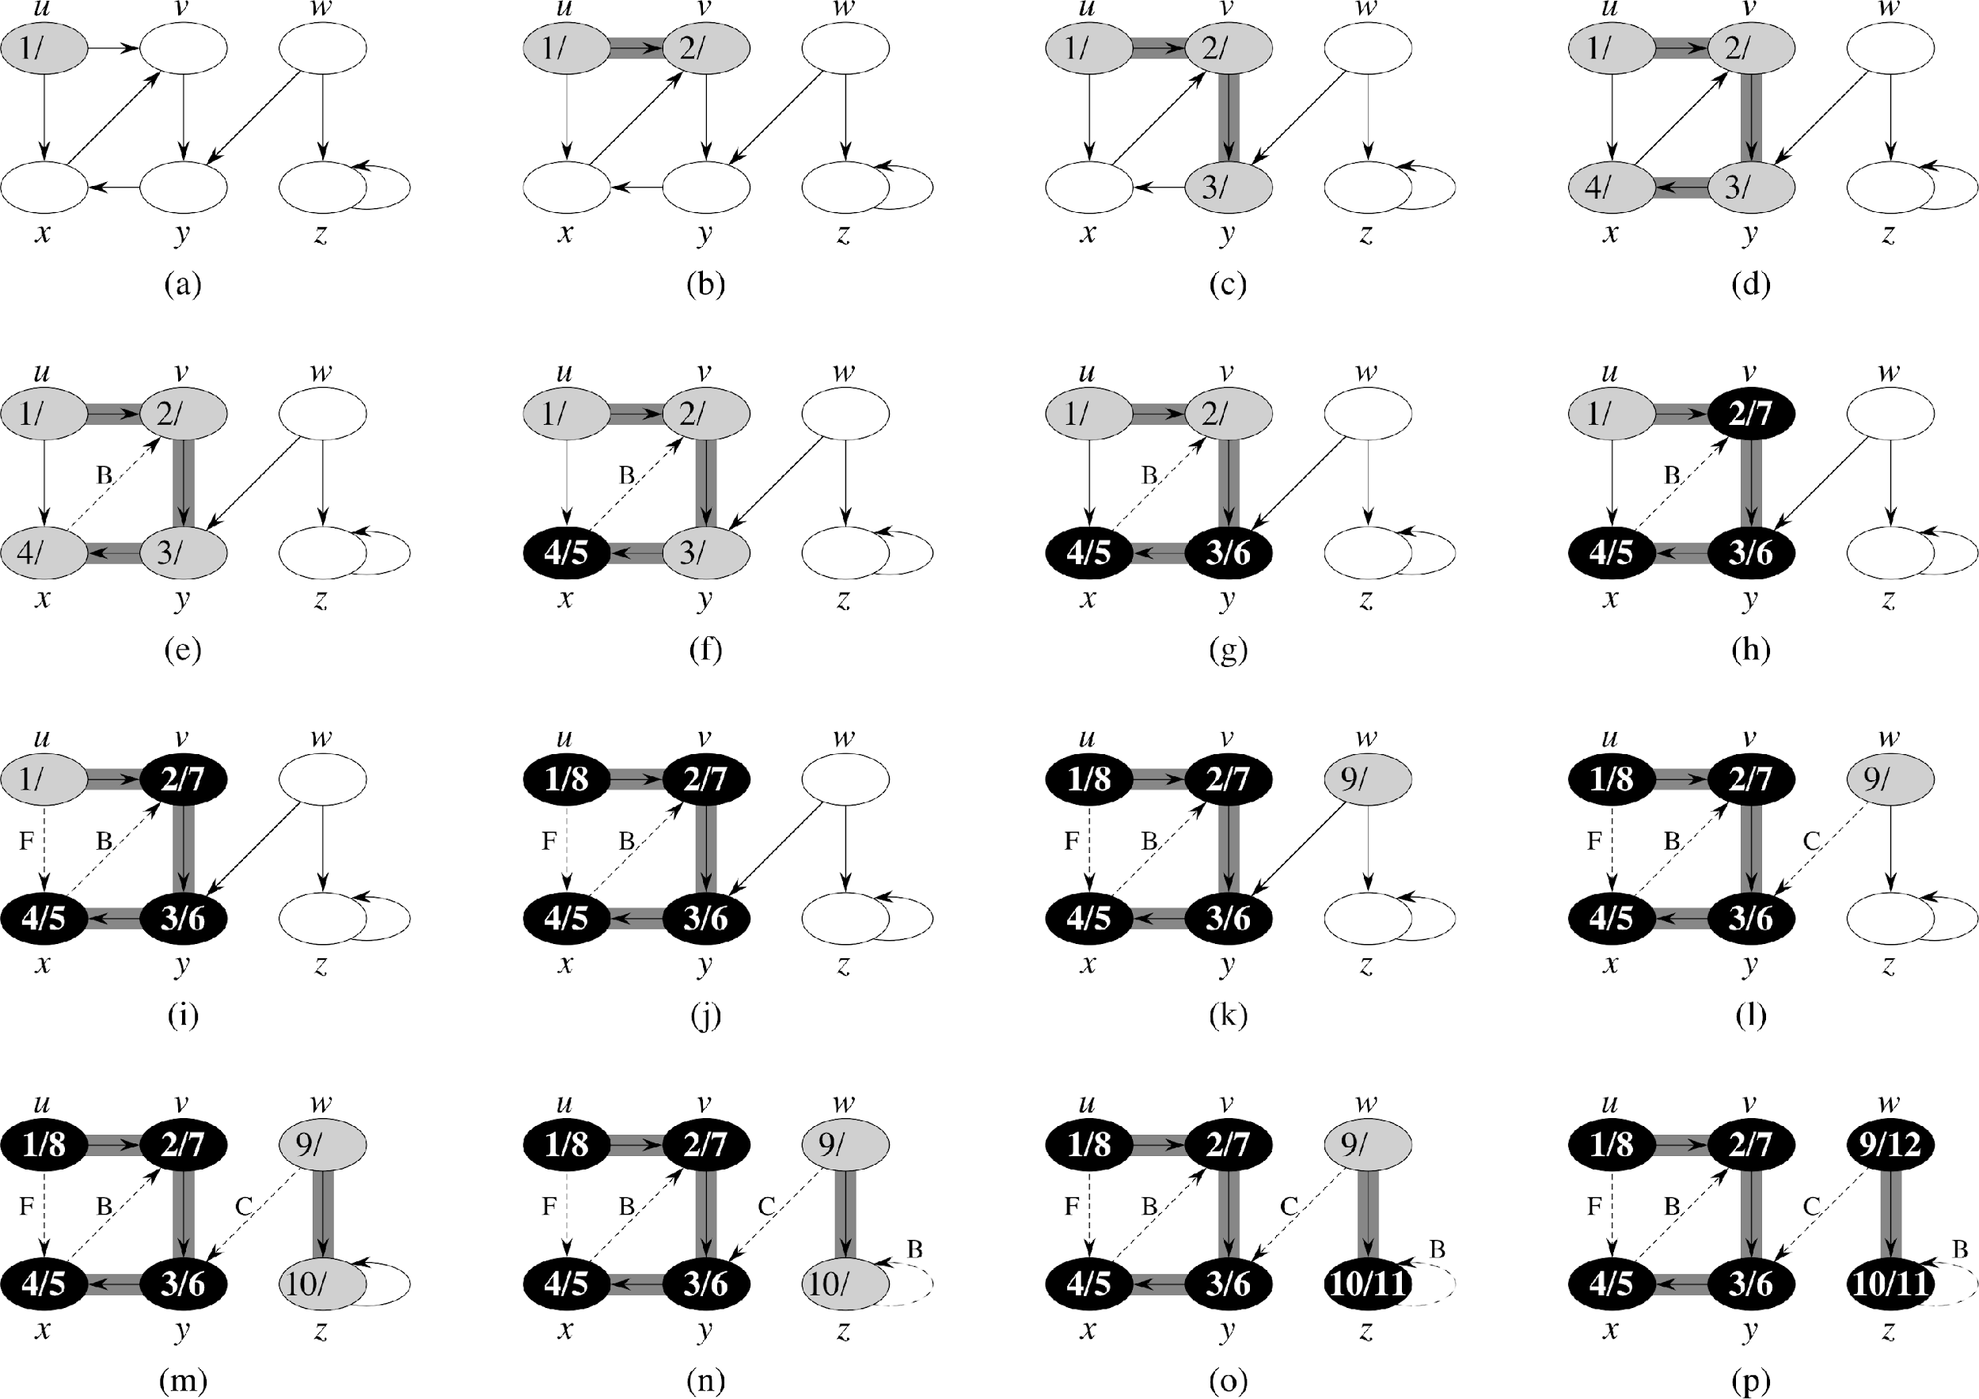
DFS: Example (1)

Slide 40
DFS: Example (2)

Slide 41
DFS: Example (3)
Secondary Data Structure
Will this work with a queue? Why not?

Slide 42
Depth First Algorithm
Basic Algorithm
Start a depth first search from node s by selecting 1 adjacent node.
The search proceeds from the most recently discovered node to the next adjacent node.
When you get to the last discovered node v, backtrack to the last node visited to discover v, and check adjacent.
requires a stack rather than a queue
Eventually, the start node is fully explored.

Slide 43
DFS Implementation
DFS(G, v):
for each u in G.V
u.color = white
u.pre = null
DFSVisit(G, v)
DFSVisit(v)
v.color = gray
for each a in v.adjacent() do
if a.color != gray a.distance = v.distance + v.edge(a)
recursively call DFSVisit(a)
v.color = black

Slide 44
Classwork
ACBFDE
CBFEDA
FBCAED
D can only be reached from F
Traversing Graphs with DFS

Slide 45
Shortest Path

Slide 46
Solutions to Shortest path
BFS finds shortest path on unweighted tree
Why would we want to find the shortest path from a single source within a graph?
GPS, networking, etc.
Why is finding the shortest path between two vertices on a graph hard?
Shortest path may require traversal through intermediate points

Slide 47
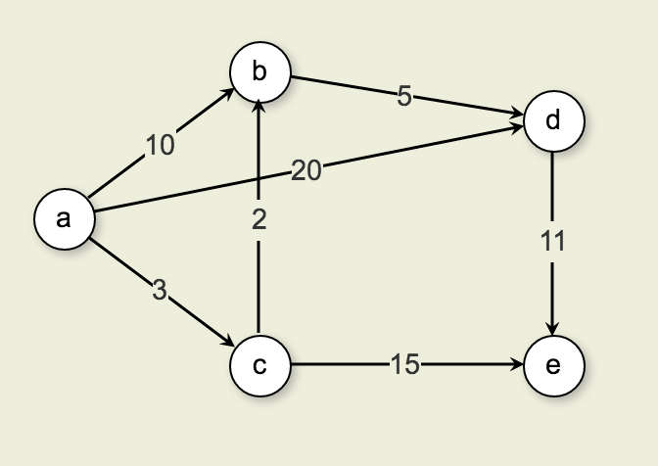
Finding the Shortest Path
Paths from A to D
The cost of the edge directly from A to D is 20.
The cost from A to C to B to D is 10.
Thus, the shortest path from A to D is 10 (rather than along the edge connecting A to D).
On weighted graphs, the brute force solution is to find all possible paths, then select the shortest [ O(n!)].
Goal: How can we find the shortest path without traversing every edge of the graph?

Slide 48
Single source shortest-paths
Given
Weighted digraph, single source s.
Goal:
Find the shortest path from s to every other vertex.
If just looking for a single destination, stop once the destination is found
Note: Shortest paths form a tree
Meaning no cycles

Slide 49
Implementing a faster Shortest Path
Observe: The shortest path from Start (S) to any Destination (D) is the shortest path resulting from the sum of the shortest path that goes from S to any Adjacent to D (A) + the path between A to D
Given the graph to the right, if I have the shortest path between a and d’s adjacents, then I only need to find the shortest path between adj and d to find the shortest path between a and d

Slide 50
Tracking our Path
What variables do we need to keep track of?
G
The graph which contains V and E
dist[]
vertex-indexed array containing distance from start
pred[]
Vertex index array containing the optimal previous node

Slide 51
Edge Relaxation
For all vertices, dist[v] is the length of some path from start (s) to some vertex (v)
Initially all are set to infinity
Relaxation along edge e from v to w.
dist[v] is length of some path from s to v
dist[w] is length of some path from s to w
if v->w gives a shorter path from s to w through v, update dist[w] and pred[w]
Relaxation sets dist[w] to the length of a shorter path from s to w (if v-w gives one)
if (dist[w] > dist[v] + w.weight(v)){ dist[w] = dist[v] + w.weight(v)); pred[w] = v; }

Slide 52
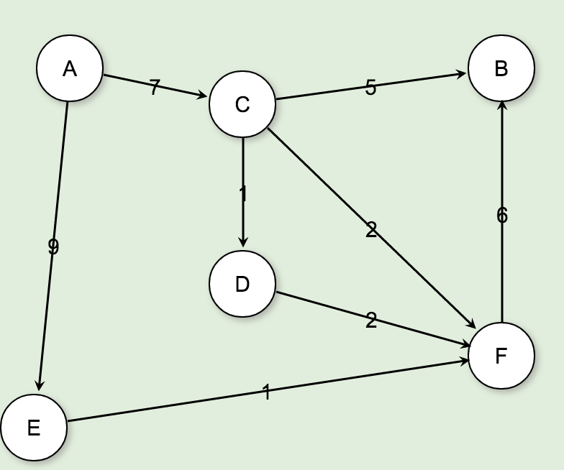
Dijkstra’s Solution
Initialize an array of vertices
Initialize all vertices dist[] to infinity
Initialize all optimal previous to NULL
A
B
C
D
E
F
∞
∞
∞
∞
∞
∞
ø
ø
ø
ø
ø
ø
Vertices
Dist
OptimalPrev

Slide 53
Dijkstra’s Solution
Start at A, mark distance as 0
Leave Optimal Previous Vertex at NULL
Mark distance of each adjacent node to A and optimal previous node
Mark A as a fully explored vertex
A
B
C
D
E
F
0
∞
7
∞
9
∞
ø
ø
A
ø
A
ø
Vertices
Dist
OptimalPrev

Slide 54
Dijkstra’s Solution
Advance to the next unexplored Node with the least distance from A
This would be C
Check all C’s unexplored adjacent nodes
if less than current distance to A, update distance and set optimal previous node
Mark C as Explored
A
B
C
D
E
F
0
12
7
8
9
9
ø
C
A
C
A
C
Vertices
Dist
OptimalPrev

Slide 55
Dijkstra’s Solution
Advance to the next unexplored Node with the least distance from A
This would be D
Check its unexplored nodes to see if less distance
F would be 10, which is greater than 9, so ignore the path
Mark D as Explored
A
B
C
D
E
F
0
12
7
8
9
9
ø
C
A
C
A
C
Vertices
Dist
OptimalPrev

Slide 56
Dijkstra’s Solution
Repeat until all nodes are fully explored
We can now find the shortest path from any node back to a single source by following the optimal previous backward to the source
A
B
C
D
E
F
0
12
7
8
9
9
ø
C
A
C
A
C
Vertices
Dist
OptimalPrev

Slide 57
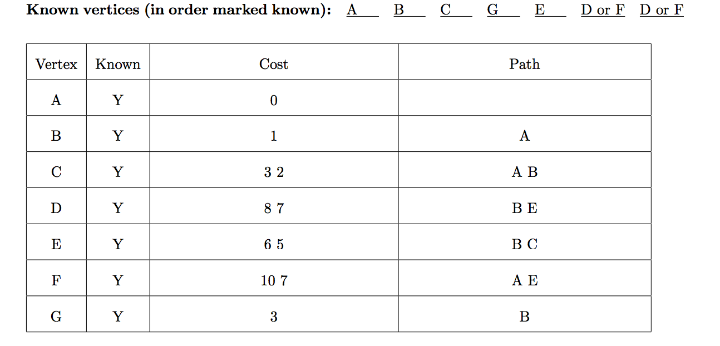
Classwork
No. For example, take the graph with three edges cost(u,v) = -2, cost(v,w) = 2, cost(u, w)=1. The shortest path to w is (u, v, w). But adding 2 to the cost of each edge and then running Dijkstra would give the shortest path as (u, w).
Use a Priority Queue (heap) to get the minimum edge each time
Dijkstra’s Shortest Path

Slide 58
Improving Dijkstra’s Algorithm
We can improve our shortest path implementation with a priority queue
Using a heap, we can produce the minimum unvisited edge in logn time
This gives Dijkstra’s shortest path algorithm an average case nlogn complexity
We explore n nodes once at most, O(n)
Adjacencies:
If we had a dense graph we will go through at most n-1 adjacencies
If we have a sparse graph we will go through approximately O(1)
Worst case for Dense graph is O(n²), average case is O(nlogn)

Slide 59
Implementation
Dijkstra’s shortest path algorithm must keep track of 3 things
explored nodes, distance, and optimal previous
We have used array’s to keep track of these
Can we store this information in the object?
Sure, and it’s more organized too.
Won’t we constantly need to update the object?
Yes, but is this worse than constantly updating an array?
If you are caching previous results, maybe.

Slide 60
Dijkstra’s Algorithm
// Compute shortest path distances from s, store them in D
void Dijkstra(Graph G, int s, int[] D, int[] OP) {
for (int i=0; i<G.nodeCount(); i++) // Initialize
D[i] = INFINITY; OP[i] = NULL
D[s] = 0;
for (int i=0; i<G.nodeCount(); i++) { // Process the vertices
int v = minVertex(G, D); // find next-closest unexplored vertex
G.setExplored(v); //set as fully explored
if (D[v] == INFINITY) return; // Unreachable
int[] adj = G.adjacents(v);
for (int j=0; j<adj.length; j++) {
int w = adj[j];
if (D[w] > (D[v] + G.weight(v, w)))
D[w] = D[v] + G.weight(v, w); OP[w] = v;
}
}
}
}

Slide 61
Minimum Spanning Tree

Slide 62
Problem
You are asked to write software that gives the most efficient path layout to laying fiber optic cable between a set of cities.
How is this a different problem than shortest path?
We are not concerned with a single source. We want to find the smallest connected subgraph in a given graph without regard to any single vertex.

Slide 63
Reaching all the Vertices
The minimal-cost spanning tree (MCST) problem takes as input a connected, undirected graph G, where each edge has a distance or weight measure attached.
Minimum Spanning Tree
has minimum total cost as measured by summing the values for all of the edges in the subset, and
keeps the vertices connected.
contains no cycles

Slide 64
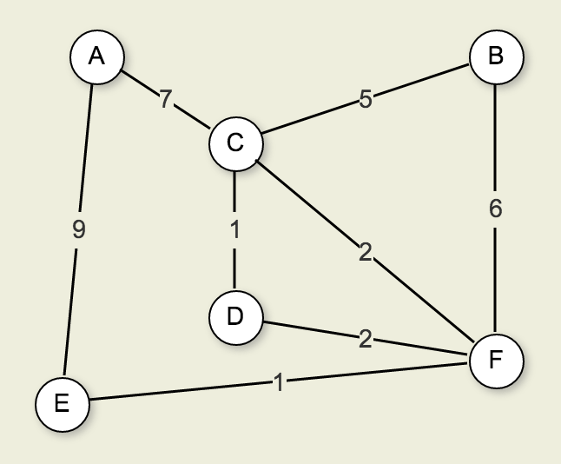
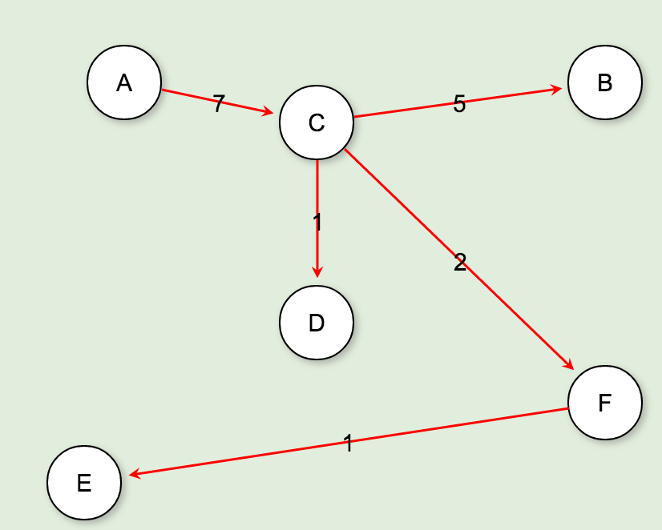
Minimum Cost Spanning Tree
MCST is a free tree with |V|−1 edges.
Free tree has no root

Slide 65
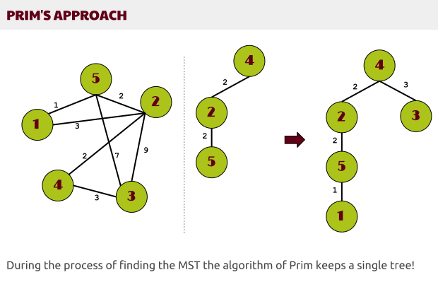
Prim’s Algorithm
Create an array of each vertices and a distance
initialize each distance to infinity
Start with any vertex
For each adjacent vertex not yet in the tree, check the distance
Add the smallest, unvisited edge to the MCST
Review each node in the MCST for adjacent nodes with the smallest edge
repeat

Slide 66
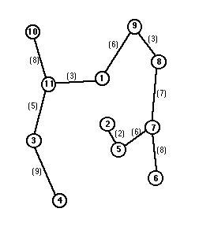
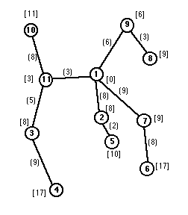
Classwork
MCST
SP
MCST vs Shortest Path

