Slide 1
ADT Lists
CS240 Spring ‘19

Slide 2
Problems with Arrays
Arrays in C/C++ are:
inflexible
wasteful
cumbersome

Slide 3
Example problem
Suppose I have an array: [1,4,10,19,6]
I want to insert a 7 between the 4 and the 10. What do I need to do?

Slide 4
C++ Solution Performance
What is the performance of the C++ solution?
How can we evaluate this array insertion algorithm?
How can we evaluate the effectiveness of any data structure or algorithm?
We need several evaluation tools
growth rate
Growth rate of what? what are we measuring?

Slide 5
Complexity
The efficiency of an algorithm is called its complexity
Memory complexity
Time complexity
The complexity of an algorithm is not exact
Different hardware or languages affect the time and memory usage of an algorithm or data structure
Complexity also does not tell us anything about the merits of two programs where one is "slightly faster".

Slide 6
Big O
We can refer to the complexity of an algorithm using Big O notation.
Why is it called Big O
Best guess is that it stands for Order of Complexity.
Typically, Big O describes the time required for an algorithm and the space required for a data structure.

Slide 7
Factors Requiring Resources
How do we determine the memory complexity of an algorithm or data structure?
How do we determine the time complexity?
Basic Operations
input size

Slide 8
Resource Example
int largest(int A[], int size) {
int currlarge = 0; // Position of largest element seen
for (int i=1; i<size; i++) // For each element
if (A[currlarge] < A[i]) // if A[i] is larger
currlarge = i; // remember its position
return A[currlarge]; // Return largest
}
The memory complexity would be size + 2
(the size of the array, plus the size of the two variables in the function)
The time complexity is ‘size’ (repetition factor) multiplied by the if statement (the operations factor)

Slide 9
Expressing Resource Usage
For a given input size of n we often express the time to run the algorithm as a function of n
written as O(n).
We will always assume O(n) is a non-negative value.

Slide 10
Calculating Time
If ‘c’ = the amount of time required to compare two integers
we only count operations that happen every time
The total time to run largest is therefore approximately ‘cn’

Slide 11
Time Function
We say that function largest() has a running time expressed by the equation O(n) = cn
We do not care right now what the precise value of c might be.
We do not care about the time required to increment variable i
We do not care about the time for the actual assignment when a larger value is found
We do not care about the little bit of extra time taken to initialize currlarge.

Slide 12
Growth Rate
O(n)=cn.
This equation describes the growth rate for the running time of the largest-value sequential search algorithm.
When we discuss Growth rates, we often have several scenarios
best case, average case, and worst case

Slide 13
Constant Time Operations
How many operations to read a value from an array?
1 operation.
c = 1 the amount of time necessary to read a value.
Thus, the equation for this algorithm is simply T(n)=1
This is called a constant running time, or O(1).

Slide 14
Linear Growth Rate
If you have a set of operations, each one running in constant time, but only run once.
Example: Your morning routine
wakeup
brush teeth
shower
make coffee
get dressed
leave house
6 operations, each taking roughly the same amount of time
not really, but close enough
So we have 6 constant time operations performed once per day
A growth rate of c*n (for c any positive constant) is referred to as a linear growth rate
Also referred to as running time.
Our morning routine function is:
T(n) = 6c
As the value of n grows, the running time of the algorithm grows in the same proportion.
Doubling the value of n roughly doubles the running time.
So if you add another task to your morning routine, eat breakfast, the function becomes:
T(n) = 7c

Slide 15
What is the complexity of ‘Largest()’?
O(n) = size * number of operations
size: the size of the array
number of operations: 2
Big O for this code is:
O(n) = 2n
int largest(int A[], int size) {
int currlarge = 0;
for (int i=1; i<size; i++)
if (A[currlarge] < A[i])
currlarge = i;
return currlarge;
}

Slide 16
Simplifying Growth Rates
When working with algorithm complexity, we are concerned with rate of growth
We just want to know how it will grow when the input size grows
When analyzing growth rates, we can simplify the results
Ignore Constants
Higher order term dominates

Slide 17
BogoSort
Simple sorting algorithm
Algorithm
bogoSort(list): while( listSorted(list) == FALSE ) shuffle(list)

Slide 18
Evaluating Bogosort
What is the best case scenario for Bogosort?
Constant Time
How long this sort technique takes grows rapidly with each additional input
Average Case: O((n+1)!)
Worst Case: O(unbounded)

Slide 19
Never Use BogoSort!
Bogosort is an academic sort, used only to illustrate an idea. It is never used in any real world application.

Slide 20
Remember When We Were Talking About C Arrays?
What is the Memory and Time complexity of the following solution:
new_size = old_array.size + 1; allocate new_array[new_size] copy from old_array -> new_array adding the 7 delete old_array
You can assume array allocation and deallocation is 1 operation
Time and Memory: We have to copy over every value in the array, which is O(n) for both

Slide 21
Classwork:
Making a Train

Slide 22
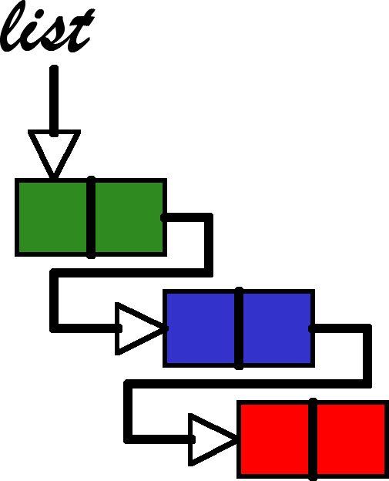
Linked Lists

Slide 23
Linked Lists
What if we need to insert and delete values frequently during runtime?
Arrays would be very slow for these data requirements
What if we could break up each element of the array into its own separate object?

Slide 24
Linked Lists solve Everything
We would need a mechanism to go from one element to the other, but they wouldn’t have to be contiguous in memory
This means insertion and deletion are less cumbersome

Slide 25
Singly Linked List
We can create our own list of objects
we’ll call them nodes
The order of the nodes is determined by the insertion order, called the link, stored in each node
Every node (except the last node) contains the address of the next node

Slide 26
Nodes
Components of a node
Data: stores the relevant information
Link: stores the address of the next node
class Node {
public:
<type> data;
Node * next;
};

Slide 27
List
The List class’s only required instance variable is a pointer to the head of the list
class List{
private: Node * head;
public:
};

Slide 28
Head Node
Only required instance variable for your list
initialized to null
Holds the address of the first node in the list
how can we determine if the list is empty?
Advanced versions of the linked list can have more
size
pointer to the end

Slide 29
Traversal and Iteration
Basic operations of a linked list that require the list to be traversed
Read the list for items
Insert an item in the list
Delete an item from the list

Slide 30
Example of Traversal
Node * current = this->head;
while (current != NULL) {
//Process current
current = this->current->next;
}
What is the time complexity of traversing the linked list?

Slide 31
Traversal and Iteration
How do we traverse the list?
You cannot use the head node to traverse the list
Create a new variable to traverse every time?
Pros: encapsulated, no state
Cons: more complexity in the methods, no state
Add another instance variable of the same type as head, Node * current, to your List class
Pros - can increase efficiency
Cons - more complexity in the class

Slide 32
Current
To allow reading items from the list without exposing implementation, we will need a pointer to the ‘current’ item in the list
We could use current to iterate through the list instead of a temp variable
wrap iteration in methods

Slide 33
Example of Traversal with Iterator
this->current = this->head;
while (this->current != NULL) {
//Process current
this->current = this->current->next;
}
What is the time complexity of traversing the linked list?

Slide 34
Reading from the list
In order to read from the list we need to start at the beginning and iterate through the list with each call
<type> * LList::get(){ if(head == NULL) return NULL; if(current == NULL) { current = head; return NULL; } <type> * temp = current->data; current = current->next; return temp; }

Slide 35
Resetting Current
Internally, we should have a way to set current back to the beginning of the list
bool LList::reset(){ if(head == NULL) return false; else current = head; return true; }
We should use reset anywhere we need to reset current
Prefer method calls over direct manipulation
Notes:
Even though it’s only one line of code, you will be using it in a lot of places. What if you decided you want to start keeping track of the current index as well? Now you need to go through and update every method, or you could just update 1 method.

Slide 36
Next
We could also wrap the iteration itself in a method
bool LList::next(){ if(current != NULL) current = current->next; (current == NULL) ? return false: return true; }
For the same reason reset should be wrapped in a method, we should hide the implementation of our iteration

Slide 37
Updated get() method
<type> * LList::get(){
if(this->next()) return NULL;
return &(current->data);
}
Internally, use reset() and next() to iterate through the list.
This is an example of a design choice that must be documented
The user can only iterate through the list items. No Random Access.

Slide 38
Doubly Linked List

Slide 39
Doubly Linked List
Linked list in which every node has a next pointer and a previous pointer
must add previous pointer to Node class
Must refactor most methods to update/use the previous pointer
A doubly linked list can be traversed in either direction
List class must also contains a pointer to last node

Slide 40
Doubly Linked List Attributes
What needs to be changed?
Add previous pointer
How does this affect the iterator, current
What benefits does this provide?
How can this be detrimental?

Slide 41
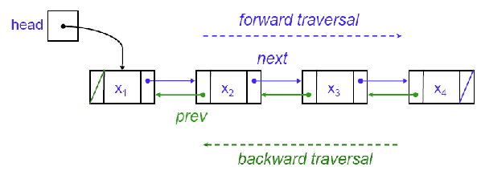
Changes to our CRUD
How does the extra pointer affect our CRUD operations?

Slide 42
Doubly Linked List Insertion
Adds an element to the end of the list
bool insert(<type> data){ Node * new_node = new Node(data); tail->next = new node; return true; }
What is the Big O of appending to the doubly linked list?

Slide 43
Classwork
Two Lists

Slide 44
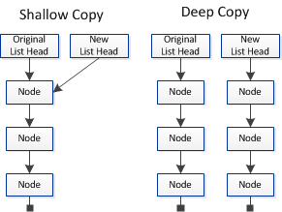
Shallow vs Deep Copy
Shallow Copy
Copies all instance variables into a cloned object
DOES NOT copy pointer reference values
Deep Copy
Copies all instance variables and referenced values into a cloned object
In C++ you must write the code to perform the deep copy

Slide 45
Copy Constructor
Copy Constructors
<Class>(const <Class> &o){ //deep copy object }
3 Scenarios where Copy Constructor is called:
Using the copy constructor explicitly
Both invoke the copy constructor
List copy_list(old_list);
List copy_list = old_list;
Passing parameters by value

Slide 46
Circularly Linked List

Slide 47
Circular Linked List
Linked list in which last node points to the first node
How do we know when we have finished traversing the list?
Eliminates checks for null

Slide 48
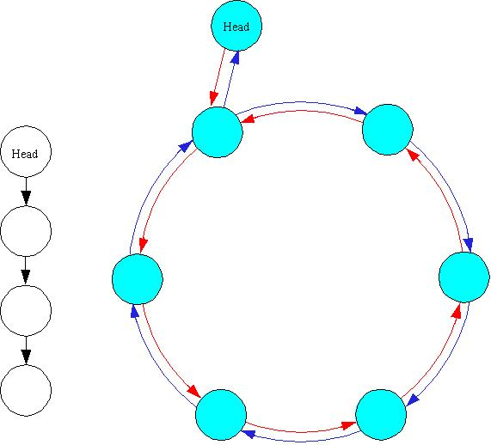
Circular Doubly Linked List

Slide 49
Deletion
Standard Deletion
removes an element from the end of the list
void remove(){ Node * to_delete = tail; tail = tail->previous; //set the new tail //update pointers tail->next = head; head->previous = tail; //remove the tail delete to_delete;
}

Slide 50
Deletion Complexity
What is the Big O of deleting the last item from the circularly linked list?
What about a singly linked list?

Slide 51
Another design
How can we alter our design to remove special cases?
Adding dummy nodes allows you to get rid of the special cases
You never have to worry about an empty list
How does this change your constructor?
You have to allocate space for a head node and a tail node in the constructor

Slide 52
Dummy Nodes
The dummy node is very useful as a “lag” pointer when inserting or removing nodes.
For instance, to remove all the nodes whose data is 0, one can write:
Node lag = head; for (Node p = lag.next; p != null; p = p.next) { if (p.data == 0) { lag.next = p.next; delete p; } else { lag = p; } }

Slide 53
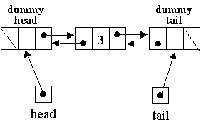
Dummy Nodes
Eliminates the need to check if the head is empty
Eliminates long boolean conditions
if(current != null && current->next != null && current->next->next != null)
How would a dummy node work for a circular doubly linked list?

Slide 54
Linked List Algorithms
Linked List algorithms generally require a well formed linked list.
If a linked list has a cycle:
The malformed linked list has no end
Iterating through the malformed linked list will yield all or some nodes in the loop multiple times

Slide 55
Malformed Lists
A malformed linked list with a loop causes iteration over the list to fail because the iteration will never reach the end of the list.
Solution?

Slide 56
Classwork
Well-Formed Lists

Slide 57
The Two Iterator Algorithm
Simultaneously go through the list by ones (slow iterator) and by twos (fast iterators).
If there is a loop the fast iterators will go around that loop twice as fast as the slow iterator.
The fast iterator will lap the slow iterator within a single pass through the cycle, O(n).
Detecting a loop is detecting that the slow iterator has been lapped by the fast iterator.

Slide 58
Two Iterator Pseudocode
malFormed(List l){
Node slow = l->head, fast1 = l->head, fast2 = l->head;
while (slow && fast1 = fast2->next && fast2 = fast1->next){
if (slow == fast1 || slow == fast2)
return true;
slow = slow->next;
}
return false;
}

