Slide 1
Conventional Commits

Slide 2

Conventional Commits
A specification for adding human and machine readable meaning to commit messages
  https://www.conventionalcommits.org/en/v1.0.0/
  https://github.com/angular/angular/blob/22b96b9/CONTRIBUTING.md#-commit-message-guidelines
Encourages useful commit messages that contain :
  changes that were made
  what was changed
  the motivation for making the changes

Slide 3
Conventional Commits
<type>[optional scope]: <description>
[optional body]
[optional footer]
fix: ABC-123: Caught Promise exception
We did not catch the promise exception thrown by the API call
and therefore we could not show the error message to the user

Slide 4
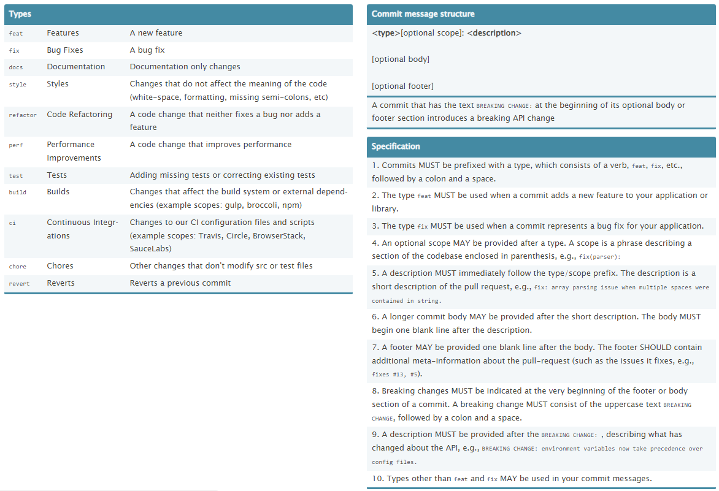
https://cheatography.com/albelop/cheat-sheets/conventional-commits/

Slide 5
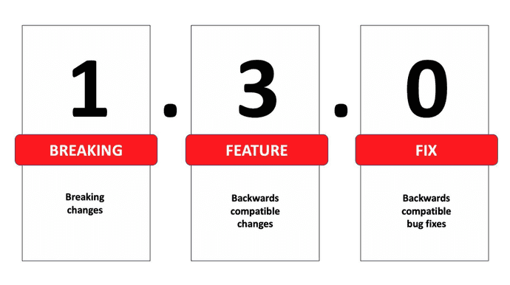
Semantic Versioning
Semantic Versioning (SemVer) is a de facto standard for code versioning. It specifies that a version number always contains these three parts:
MAJOR: is incremented when you add breaking changes, e.g. an incompatible API change
MINOR: is incremented when you add backward compatible functionality
PATCH: is incremented when you add backward compatible bug fixes

Slide 6
Git hooks
We can use git hooks
  Check commits (conventional commit linting)
  Guard (refuse commits that do not respect conventions)

Slide 7
Tools
Cli tools :
  @commitlint/config-conventional
  Github Changelog Generator (https://github.com/github-changelog-generator/github-changelog-generator)
  Git Chglog (https://github.com/git-chglog/git-chglog)
  Auto Changelog (https://github.com/CookPete/auto-changelog)
  Conventional Changelog (https://github.com/conventional-changelog/conventional-changelog)
  Changelog (https://github.com/dylang/changelog)
  etc ...
VS Code extensions
  Build commit messages
  Generate changelog files
Other
  https://github.com/typicode/husky
  https://git-scm.com/docs/githooks

Slide 8
Docs ...
https://eric.swiftzer.net/2020/08/conventional-commits-commitlint/commitlint-config-conventional-cheatsheet.pdf
https://cheatography.com/albelop/cheat-sheets/conventional-commits/
https://cheatography.com/hansuld/cheat-sheets/git-conventional-commit-messages/
https://mokkapps.de/blog/how-to-automatically-generate-a-helpful-changelog-from-your-git-commit-messages/

Slide 9
Examples
https://github.com/vivaxy/vscode-conventional-commits/blob/master/CHANGELOG.md
Angular
  https://github.com/angular/angular
  https://github.com/angular/angular/blob/master/CHANGELOG.md
  https://github.com/angular/angular/pulls

