Slide 1
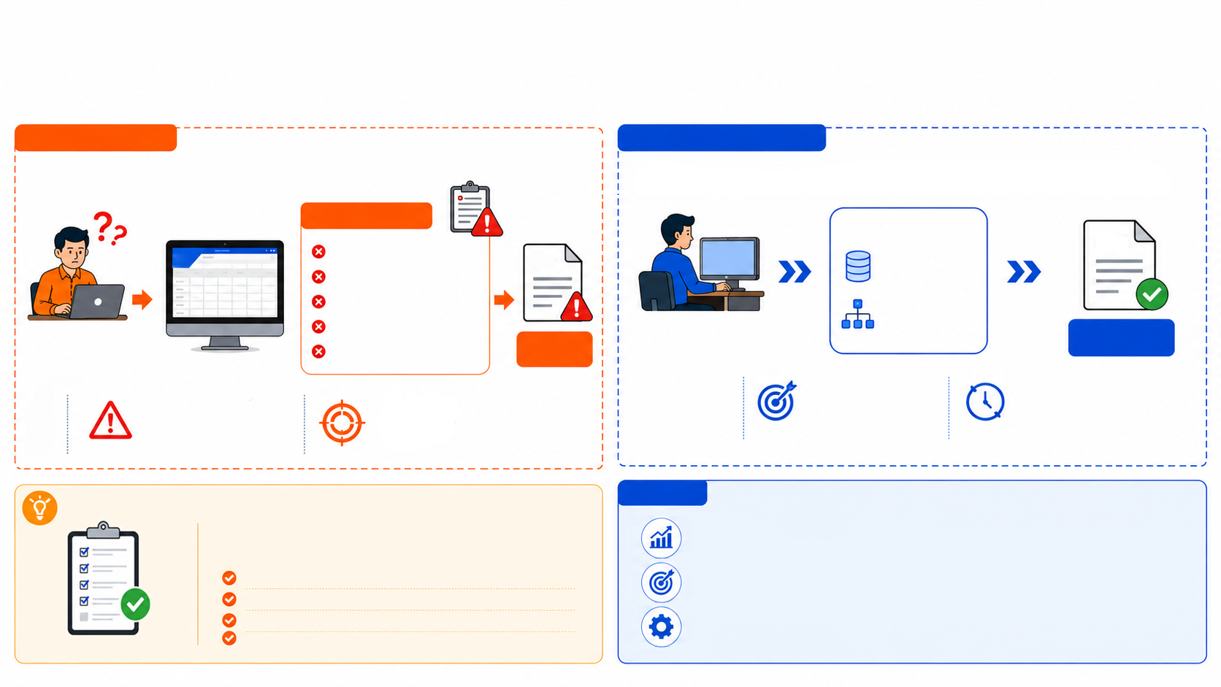
SAP CAPABILITY ENHANCEMENT & SIMPLIFICATION
SAP Enhancement for Streamlined COA Workflow
Streamlining Quality Assurance by Retrieving Data Directly from SAP Result Recording, Significantly Reducing Lead Time and Eliminating Manual Entry Errors
PRESENT STATE
VALUE-DRIVEN RESULTS
Manual Process
Manual copy inspection
COA Automation
COA
Random inspection copying
COA
Dynamic Mapping Matrix (By JR/SR)
Manual QA mapping
Get Data from Result Recording
Manual data entry in COA
COA
COA
QA / Inspector
Manual data entry in COA
Manual
QA / Inspector
Generated
High Accuracy
Real Time Data
High Manual Effort
Data Inconsistency
Updates from Result Recording & Mapping in real time
Multiple manual check and re-checks.
Risk of human error and sample mismatch
Eliminates manual data entry error & inconsistencies
NEW REQUIREMENT
Automate COA generation by pulling data directly from result recording, implement a dynamic QA mapping matrix to link film types with their designated source inspections, and eliminate manual data entry to ensure sample consistency, reduce lead time, and improve data accuracy.
Impact
Faster COA Delivery
Significantly reduces COA lead time.
Create dynamic QA mapping matrix (Film Type ⇔ Source Inspection)
Improved Data Accuracy
Eliminates manual errors and ensures sample consistency.
Pull data automatically from Result Recording
Generate COA automatically (Delivery Order → Inspection → Result → COA)
Operational Efficiency
Reduce manual workload and rework, allowing QA to focus on value-added task.
Eliminate manual copying and manual data entry

Slide 2
SAP CAPABILITY ENHANCEMENT & SIMPLIFICATION
SAP Enhancement for Streamlined COA Workflow
Streamlining Quality Assurance by Retrieving Data Directly from SAP Result Recording, Significantly Reducing Lead Time and Eliminating Manual Entry Errors
Key Accomplishment:
PHASE | ACTIVITIES | DELIVERABLES | START DATE | END DATE | STATUS
PREPARE | Project Initiation | Project Scope & Schedule are Defined | 18-May-26 | 22-May-26 | Done
 | Discovery and Evaluation | Solutions are Discovered and Evaluated | 18-May-26 | 22-May-26 | Done
 | Business Process Map | Business Process Map Defined | 18-May-26 | 29-May-26 | Done
EXPLORE | Business Blueprint Design | Business Blueprint Design is completed and documented | 25-May-26 | 29-May-26 | Done
 | Initial Business Blueprint Confirmation | Baseline process and design approved | 25-May-26 | 5-Jun-26 | Done
 | Enhancement (RICEF) Design | RICEF Design is Documented | 25-May-26 | 5-Jun-26 | Done
 | Authorization Requirement and Design | Authorization Requirements and Design is Completed and Documented | 25-May-26 | 5-Jun-26 | Done
REALIZE | Enhancement (RICEF) Development | RICEF Design is Developed | 1-Jun-26 | 30-Oct-26 | In Progress
 | Run Scenario Test and Integration Test | Scenario and Integration Test are executed and Issues are resolved | 8-Jun-26 | 13-Nov-26 | In Progress
 | Prepare UAT and EUT | UAT and EUT Document are ready | 12-Nov-26 | 13-Nov-26 | Planned
DEPLOY | User Acceptance Test (UAT) | User Acceptance Test is Approved | 16-Nov-26 | 19-Nov-26 | Planned
 | End User Training (EUT) | End-Users are trained | 16-Nov-26 | 20-Nov-26 | Planned
 | Prepare Production System Environment | Production System Environment is Ready | 19-Nov-26 | 20-Nov-26 | Planned
 | Cut-over Strategy | Cut-over Strategy is Documented | 16-Nov-26 | 20-Nov-26 | Planned
RUN | Go Live | Live Production Environment | 23-Nov-26 | 23-Nov-26 | Proposed
 | Support After Go Live | Functional or Technical Issues are Solved | 23-Nov-26 | 4-Dec-26 | Planned

Slide 3
SAP CAPABILITY ENHANCEMENT & SIMPLIFICATION
SAP Enhancement for Streamlined COA Workflow
WHY THE COA SCHEDULE WAS REVISED
Scope agreed early. Detailed rules needed final agreement at
Blueprint Confirmation Final, 25 Sep — before UAT.
01
ORIGINAL SCOPE
COA automation was agreed from the start. IT's initial build was ready on 23 Sep using the specifications then available.
02
MASTER DATA
Master data evolved by film/customer. Final standards were needed for COA templates, Lower/Upper Limits, Barrier MIC and Inspection Plans, outsourced inputs, and four production-stage mappings.
03
MIC vs TRACEABILITY
MIC defines the test and acceptable limits; SAP records the result. Traceability finds its source batch/inspection lot through three levels that vary by film.
04
BATCH LIST & ALIAS
Export/Domestic headers, special customer Batch Lists, DO examples and product aliases needed agreed rules for each variant.
05
SCHEDULE IMPACT
QA confirms rules/data → IT adjusts and tests → UAT approves
Final Blueprint finding
October go-live → proposed 23 Nov 2026, subject to data readiness and UAT.
Management message: the schedule follows completion of business standards and validation.

Slide 4
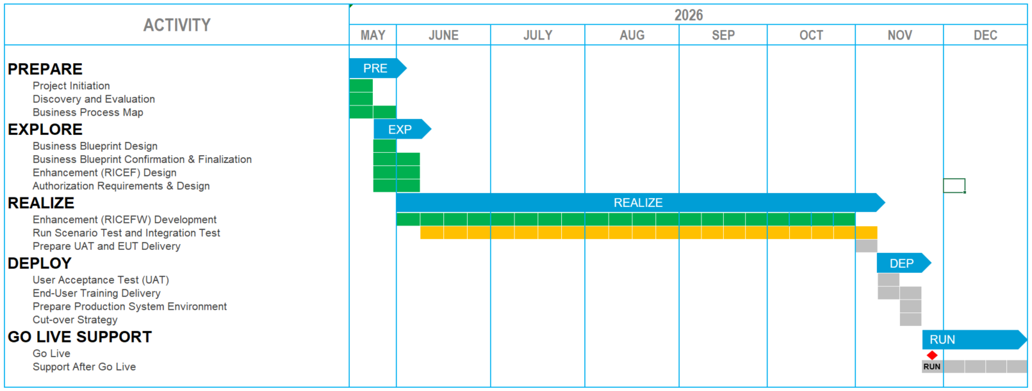
SAP CAPABILITY ENHANCEMENT & SIMPLIFICATION
SAP Enhancement for Streamlined COA Workflow
Streamlining Quality Assurance by Retrieving Data Directly from SAP Result Recording, Significantly Reducing Lead Time and Eliminating Manual Entry Errors
Schedule:
We Are Here
Legend:
Planned
In Progress
Done
Proposed Milestone
Finished Milestone

