Slide 2

Boost Up your projects with PyCharm!

Slide 3
Presenters: Istvan Lazar – DevOps professional, scripting
Bese Bernula – Test Automatization, 3 years in python

Slide 4


Slide 5
PyCharm provides: - code analysis
- a graphical debugger - an integrated unit tester - integration with version control systems - and many more

Slide 6
Be More Productive. Boost Code Quality.
https://www.jetbrains.com/pycharm/download/ Win + Mac + Linux ☺

Slide 7
Basic code completion: - Ctrl + Space
Quick definition: - Ctrl + Shift + I
Insert documentation string stub:
- Alt + Enter

Slide 8
Code -> Inspect code…

Slide 9
Auto Import modules…
- Type a function name from any module, like sleep, or randint
- Ctrl + Space (2x)
- Select from list and import

Slide 10
Help -> Find Action…
Type <something> - which settings you want to change
- Interpreter
- Syntax

Slide 11
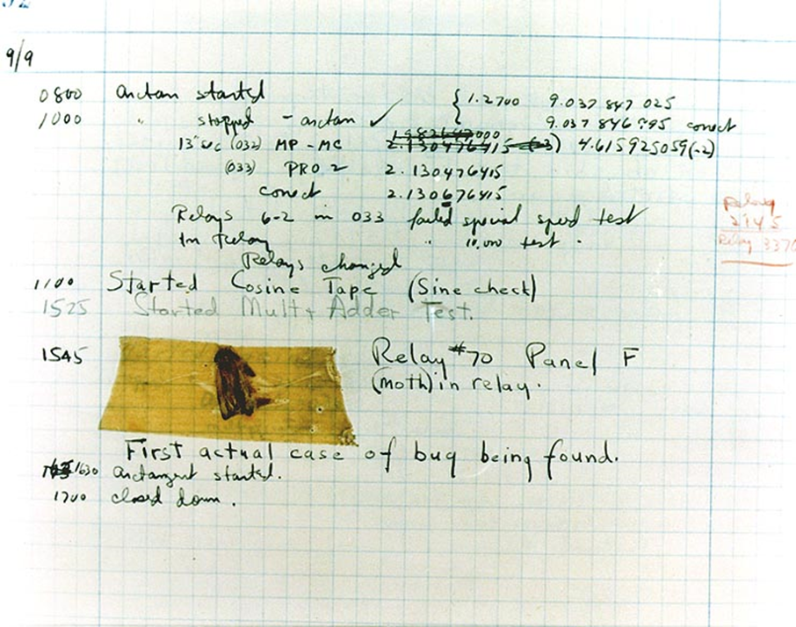
Debugging is the process of finding and resolving defects or problems within a computer program that prevent correct operation of computer software or a system.

Slide 12
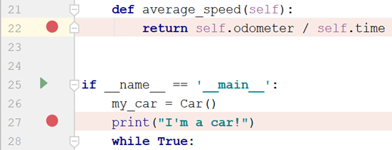

Breakpoints
Breakpoints are source code markers that let you suspend program execution at a specific point and examine its behavior.
Icon | Tooltip and shortcut | Description
 | Step Over F8 | Click this button to execute the program until the next line in the current method or file, skipping the methods referenced at the current execution point (if any). If the current line is the last one in the method, execution steps to the line executed right after this method.
 | Step Into F7 | Click this button to have the debugger step into the method called at the current execution point.
 | Step Out Shift+F8 | Click this button to have the debugger step out of the current method, to the line executed right after it.

