Slide 1
Product Recommendation using feature-level Analysis
Guide: P. Nanda Kishore
Team C3:
B. Pranavi - Y20ACS535
R. Likhitha - L21ACS417
Sk. Gouse - Y20ACS557
R. Mahathi - Y20ACS551

Slide 2
Contents
Abstract
Existing system
Proposed system
Design methodology
Implementation
Results
Conclusion

Slide 3
Abstract
Through our project we want to implement a model which rely solely on features. Through overall feature-level rating using reviews and ratings of features, our system can enhance the relevance of product recommendations as per user preferences.
The methodology involves various processes like Credibility assessment, Feature selection, Feedback collection, Preprocessing, Sentiment analysis and Feature strength categorization which aids in generating recommendation.

Slide 4
Existing System
The existing system studies how we can obtain feature-level ratings of the mobile products from the customer reviews and review votes to influence decision making, both for new customers and manufacturers.
There has always been a need to know which features fall short or are doing well according to the customers perception. Different customers are interested in different features. Thus, feature-level ratings can make buying decisions personalized.

Slide 5
Proposed system
The proposed system is an intelligent platform that leverages customer feedback and sentiment analysis that aids to deliver personalized product suggestions. The system comprises several key components designed to engage customers, analyze their preferences through feature-level analysis.

Slide 6
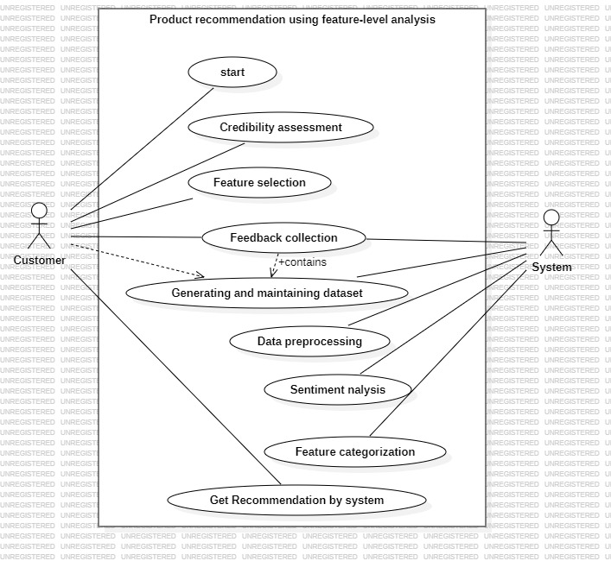
Design
The design can be observed through the following uml diagrams

Slide 7
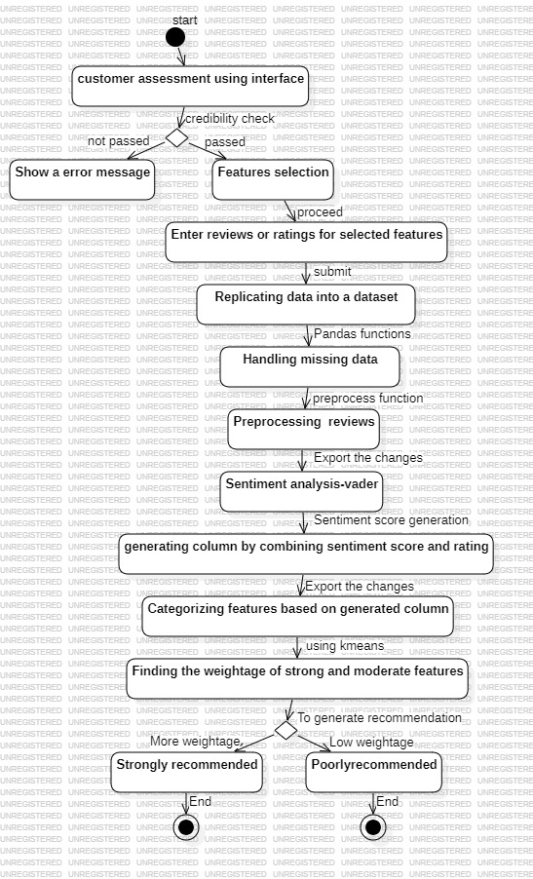
Activity diagram

Slide 8
Implementation
The proposed model can be implemented as following modules:
User Interface and Engagement
Feature Selection and Feedback Collection
Data Processing and Sentiment Analysis
Feature Importance Assessment and Categorization
Recommendation Generation

Slide 9
User Interface and Engagement:
Here, we design and implement an intuitive interface to collect Boolean - type responses from customers to assess their authenticity.
For developing the user interface, we have used tkinter library of python.
2. Feature Selection and Feedback Collection:
Here, Customers will be able to select desired product features from a curated list and then they can provide feedback for selected features through textual reviews or numerical ratings.
Once customer provides his feedback the data is replicated into a new dataset for further analysis.

Slide 10
3. Data Processing and Sentiment Analysis:
In this module, we use pandas library functions and nltk library functions to handle missing data and clean textual inputs (reviews).
Sentiment analysis using the VADER algorithm is applied to derive sentiment scores that reflect customer sentiment towards specific product features.
Feature Importance Assessment and Categorization:
In this module, We create a new column in the dataset representing the combined effect of reviews and ratings for each feature.
Then we categorize features as strong, moderate, or weak based on the newly generated column.
For categorizing, we have used kmeans clustering algorithm.

Slide 11
Recommendation Generation :
The system will generate recommendation utilizing categorized feature groups and customer preferences to generate personalized product recommendations.
Decision rules will be implemented to determine recommendation outcomes (e.g., strong recommendation vs. weak recommendation) based on the balance and strength of categorized features selected by the customer.

Slide 12
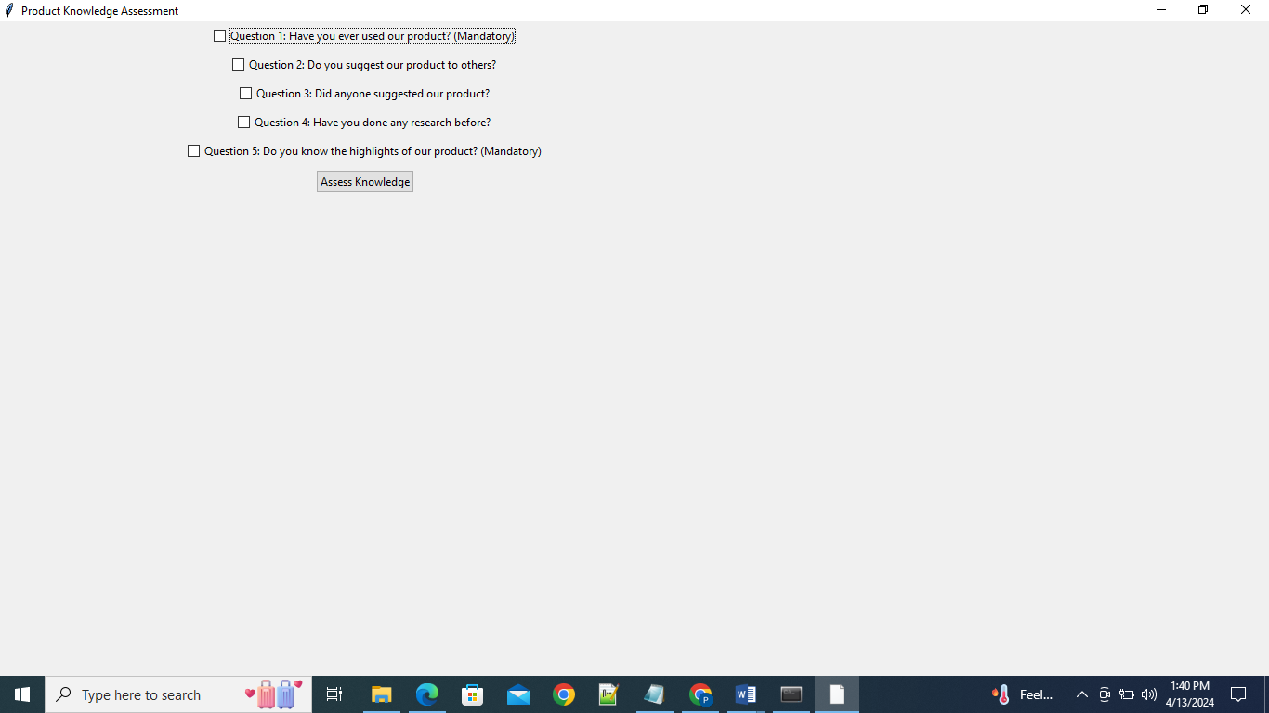
Results
The following are the results after implementing the five modules.
Credibility assessment

Slide 13
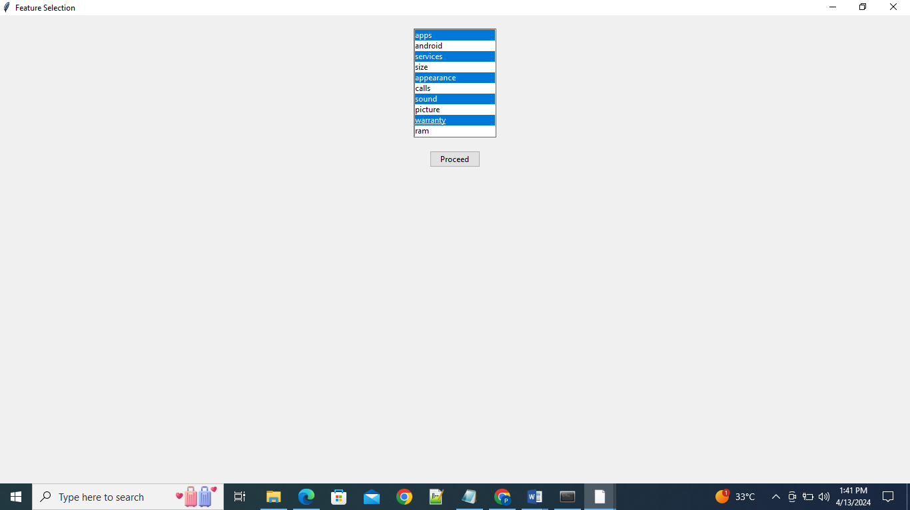
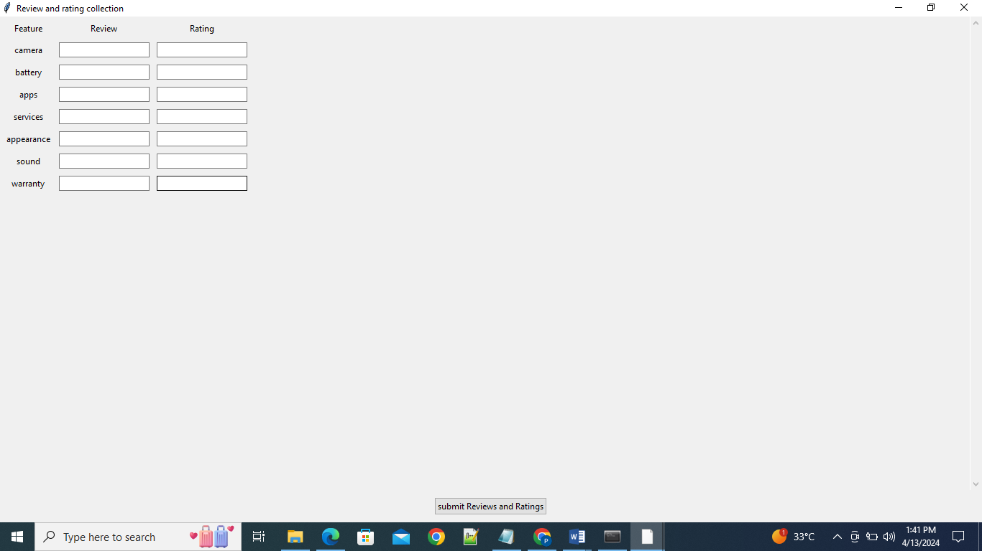
Feature selection
Feedback collection

Slide 14
Feature | Review | Rating
camera |  | 4
battery | takes lot of time to charge. not recommended
screen |  | 5
services |  | 3
sound | Good audio quality
picture |  | 5
ram | High gb ram at this cost
design |  | 5
storage |  | 3
speed | High speed. Best for general use
hardware | Good hardware is used may not get easily damaged.
updates |  | 4
software | Better software compatible for many applications
Generated Dataset

Slide 15
Feature | Review | Rating | preprocessed_review
camera | unknown | 4 | unknown
battery | takes lot of time to change. not recommended | 0 | takes lot time charge not recommended
screen | unknown | 5 | unknown
services | unknown | 3 | unknown
sound | Good audio quality | 0 | good audio quality
picture | unknown | 5 | unknown
ram | High gb ram at this cost | 0 | high gb ram at cost
design | unknown | 5 | unknown
storage | unknown | 3 | unknown
speed | High speed. Best for general use | 0 | high speed best general use
hardware | Good hardware is used may not get easily damaged. | 0 | good hardware used may not get easily damaged
updates | unknown | 4 | unknown
software | Better software compatible for many applications | 0 | better software compatible many applications
Preprocessed Dataset

Slide 16
Feature | Review | Rating | preprocessed_review | Sentiment rating | Final rating
camera | unknown | 4 | unknown | 0 | 4.0
battery | takes lot of time to change. not recommended | 0 | takes lot time charge not recommended | 3 | 3.0
screen | unknown | 5 | unknown | 0 | 5.0
services | unknown | 3 | unknown | 0 | 3.0
sound | Good audio quality | 0 | good audio quality | 4 | 4.0
picture | unknown | 5 | unknown | 0 | 5.0
ram | High gb ram at this cost | 0 | high gb ram at cost | 3 | 3.0
design | unknown | 5 | unknown | 0 | 5.0
storage | unknown | 3 | unknown | 0 | 3.0
speed | High speed. Best for general use | 0 | high speed best general use | 5 | 5.0
hardware | Good hardware is used may not get easily damaged. | 0 | good hardware used may not get easily damaged | 5 | 5.0
updates | unknown | 4 | unknown | 0 | 4.0
software | Better software compatible for many applications | 0 | better software compatible many applications | 4 | 4.0
Dataset after sentiment analysis

Slide 17
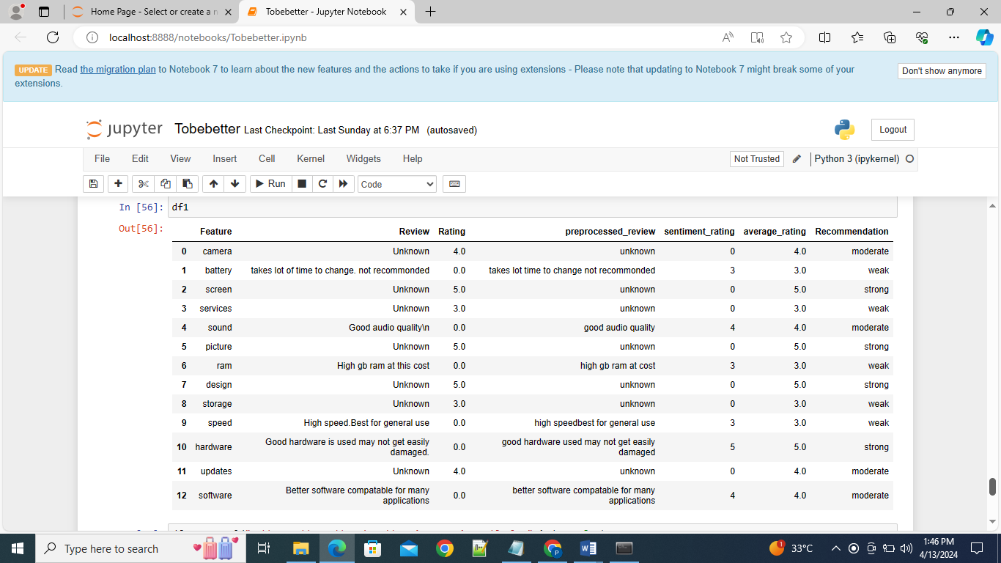
After features categorization

Slide 18
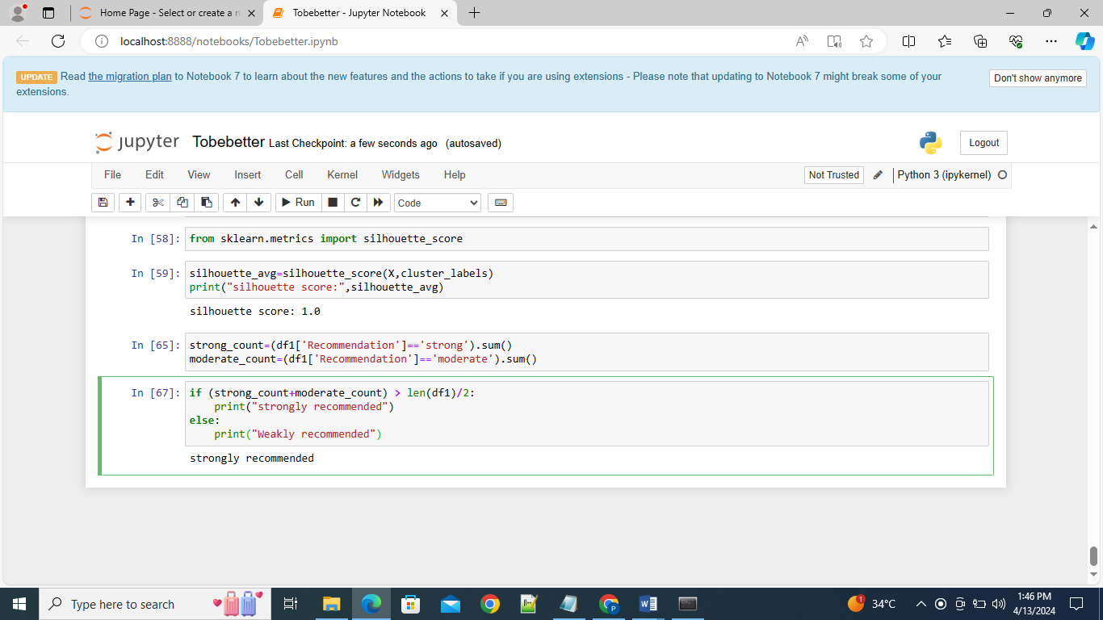
Generating Recommendation

Slide 19
Conclusion
In today’s world, we can observe most of the businesses are running through their own websites. So, it is necessary that consumer opinion need to be considered and their requirements are met. This system provides a deep feature-level analysis by incorporating customer feedback and sentiment analysis through various processes. The system can find its applications in recommendation systems, customer research etc..

Slide 20
Thank you

