Slide 1
Pretty Poison: Health Risks of Toxic Beauty
Presented by:
Dhanumjay Buddabattuni

Slide 2
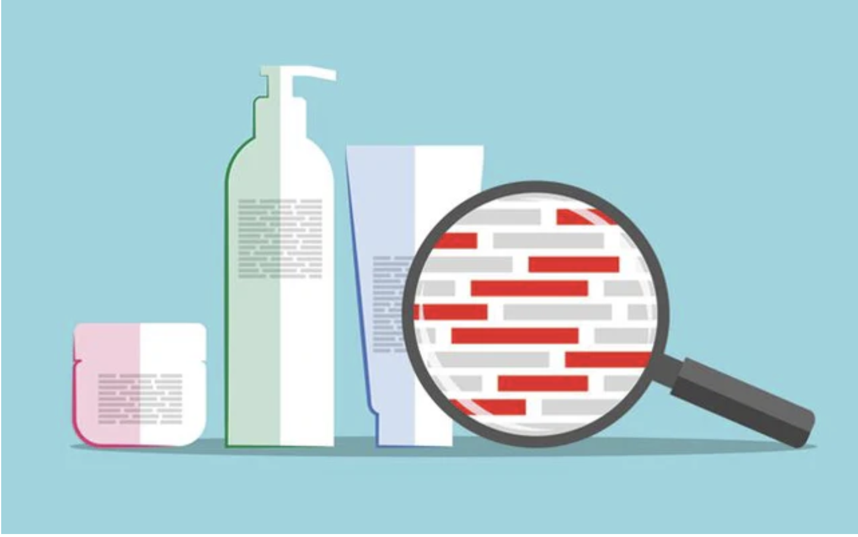
Introduction
The growing cosmetics market uses increasing amounts of chemical ingredients, but only a small portion are considered safe, posing public health concerns.
Common beauty products like makeup and lotions contain chemicals (e.g., parabens, phthalates) that may enter the body and lead to hormone, reproductive issues, and cancer risks.
This project will investigate the health risks of cosmetic chemicals using data from the NHANES (National Health and Nutrition Examination Survey).
Despite the widespread use of these products, there is insufficient research on the long-term health impacts of these chemicals.

Slide 3
Project Objective:
Project Overview: Investigating Chemical Exposure from Cosmetics and Cancer Risk
Objective: To assess if harmful chemicals, commonly found in cosmetics, are present in the body and if they are linked to cancer risk.
Goals:
Prevalence of Chemical Use: Identify the most common cosmetic chemicals and their frequency of use.
Health Implications: Analyze the link between exposure to cosmetic chemicals and health issues (e.g., skin disorders, chronic diseases).
Demographic Patterns: Explore how exposure varies by gender, age, ethnicity, and socioeconomic status.
Promote Awareness: Highlight safer cosmetic alternatives and raise awareness about potential risks.
Impact: This research will enhance understanding of cosmetic chemical exposure and its public health risks, guiding consumers and policymakers towards safer, sustainable choices.

Slide 4
Key Toxic Chemicals in Beauty Products
1) Parabens:
Synthetic preservatives found in cosmetics, personal care products, and some foods.
Common types: methylparaben, propylparaben.
Used to prevent bacterial and mold growth. Concerns about hormone disruption by mimicking estrogen, though generally considered safe by regulatory agencies.
2) Phthalates:
Chemicals used to make plastics flexible and extend fragrance longevity in personal care products.
Found in perfumes, lotions, and plastics. Some types are linked to reproductive health and developmental issues.
3) Triclosans:
Triclosan is an antimicrobial agent found in personal care products, soaps, and toothpaste to prevent bacterial contamination.
It is linked to health and environmental risks, including endocrine disruption, antibiotic resistance, and water pollution.

Slide 5
Exposures add up - Survey results
Survey on Personal Care Product Use and Chemical Exposure
A survey of 2,300+ people by public health organizations found:
Average use: 9 personal care products per day, containing 126 unique chemicals.
High usage: Over 25% of women and 1 in 100 men use at least 15 products daily.
Key Findings:
Carcinogen Exposure: 12.2 million adults (1 in 13 women, 1 in 23 men) are exposed daily to ingredients classified as known or probable human carcinogens.
Reproductive Toxin Exposure: 4.3 million women (1 in 24) are exposed daily to chemicals linked to reproductive or developmental harm.
Note: Phthalates, found in around 75% of personal care products, often go unlisted due to being part of fragrances (EWG et al. 2002).
https://web.archive.org/web/20040809233605/http:/www.ewg.org/reports/skindeep/report/exposure_survey.php

Slide 6
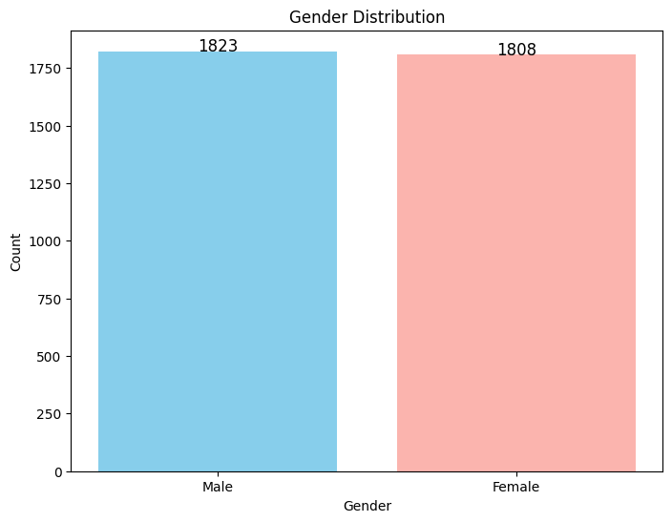
Gender Distribution
Balanced Gender Distribution: There are 3631 rows in the dataset. The chart shows a nearly equal distribution between males and females in the dataset, ensuring that gender representation is not heavily skewed.
Slightly Higher Female Count: While both genders are well-represented, there are slightly more males (1,823) compared to females (1,808). This indicates a small gender imbalance in favor of males, but overall, the dataset maintains a well-balanced gender ratio.

Slide 7
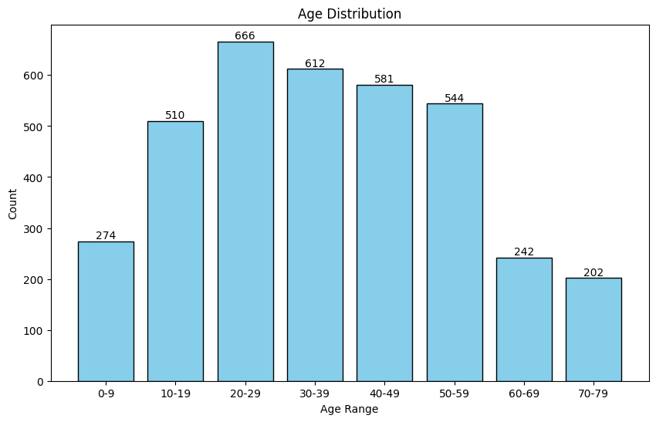
Age Distribution
Majority of Participants are Young: The highest frequency is in the 0-10 age range, indicating a large portion of participants are children or infants.
Gradual Decline in Middle Ages: The number of participants decreases as age increases, with a relatively even but lower distribution for ages 30-50.
Slight Increase in Elderly Participants: A small rise in the number of participants is observed around ages 60-70 and at age 80, showing some representation of older adults.

Slide 8
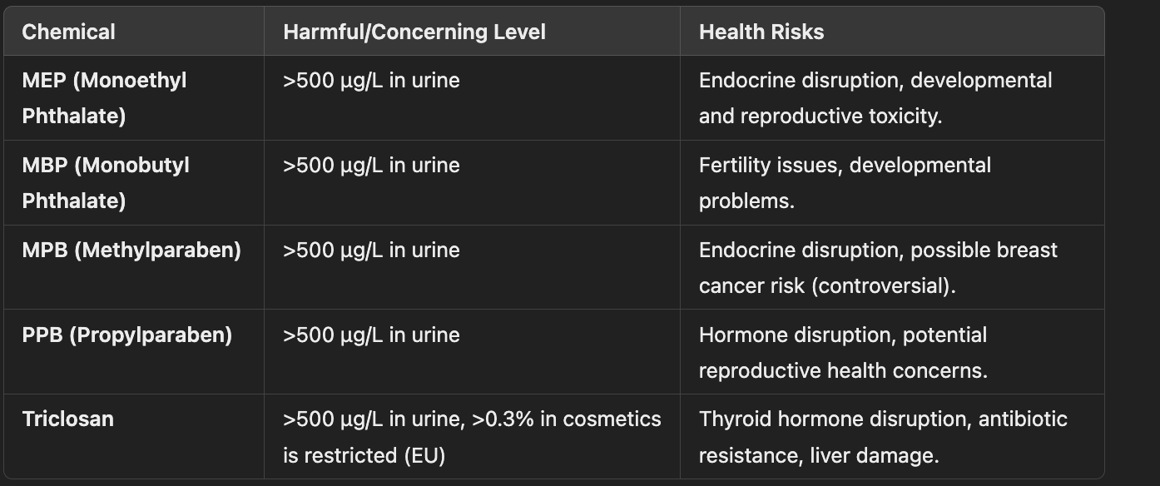
Threshold Levels for the Chemicals
Screenshot 2025-03-14 at 3.47.25 PM
Screenshot 2025-03-14 at 3.47.25 PM

Slide 9
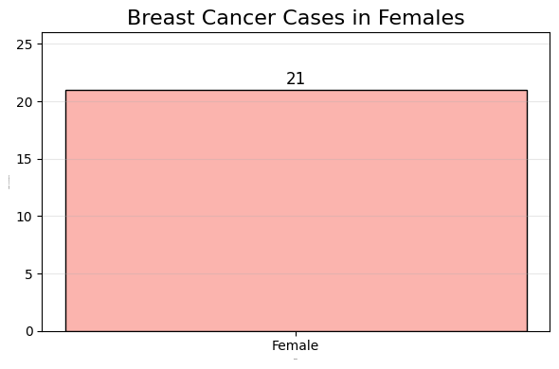
Breast Cancer Cases Distribution among Females

Slide 10
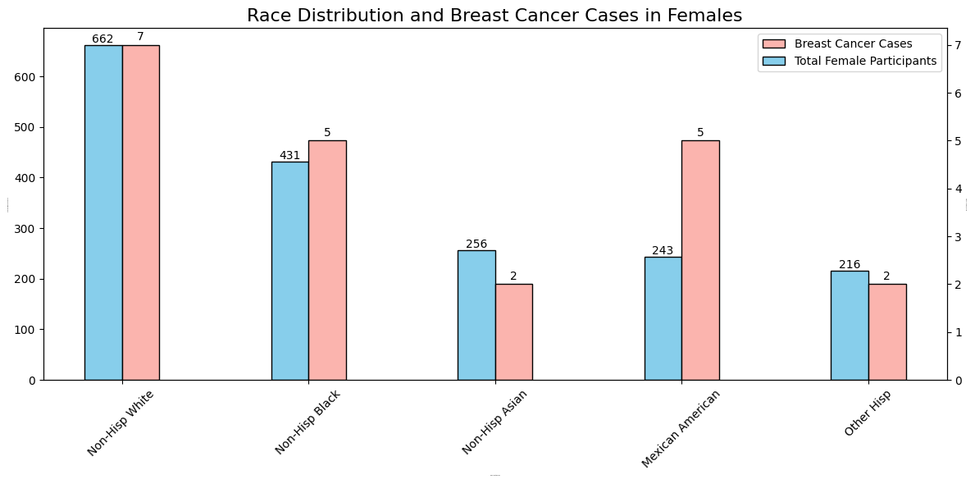
Breast Cancer Distribution by Race

Slide 11
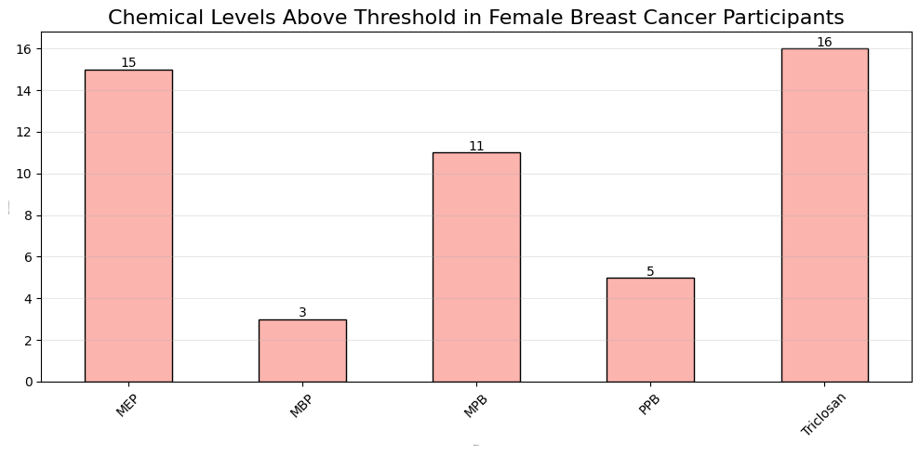
Chemical levels above threshold in Female data

Slide 12
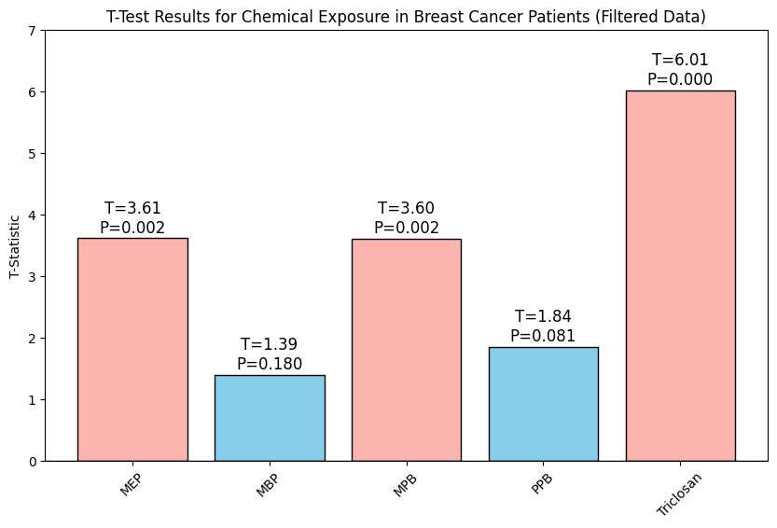
T-test for Chemical Exposure in Breast Cancer Data

Slide 13
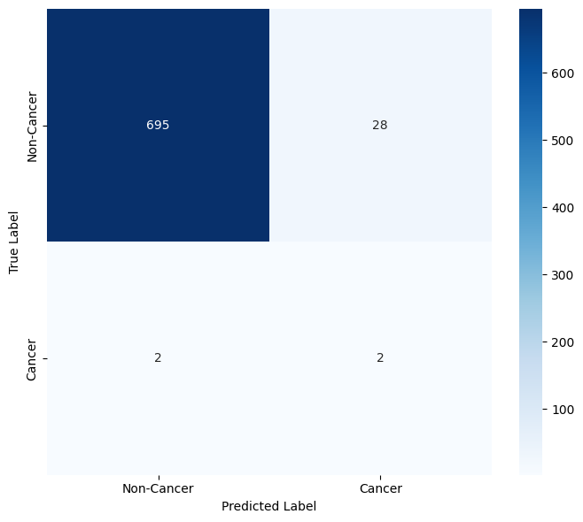
Confusion matrix for XGBoost Machine Learning Model

Slide 14
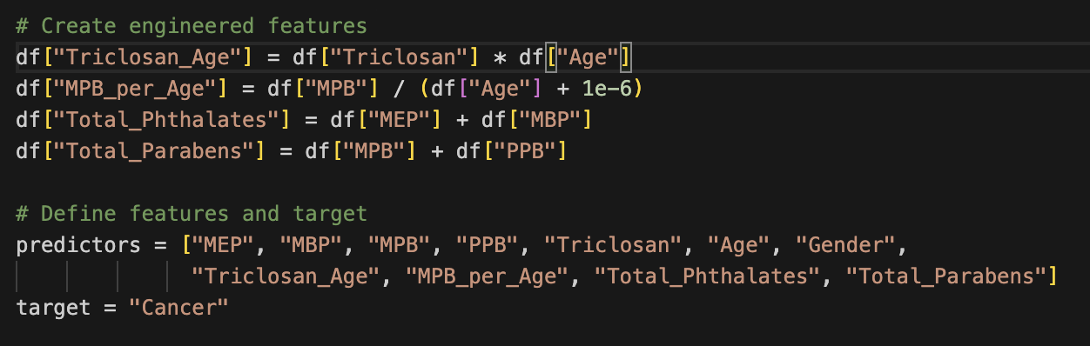
Adding new features
Screenshot 2025-04-05 at 12.26.59 PM
To capture real-world interactions: Some chemical effects may depend on age (e.g., Triclosan x Age), and interaction terms help the model learn these relationships.
To reflect cumulative exposure: Summing similar chemicals (e.g., Total_Parabens, Total_Phthalates) aligns with how exposure is assessed in toxicology and health studies.
To highlight normalized or risk-adjusted patterns: Features like MPB_per_Age help identify individuals with unusually high exposure relative to their age, which may be more relevant than raw values.

Slide 15
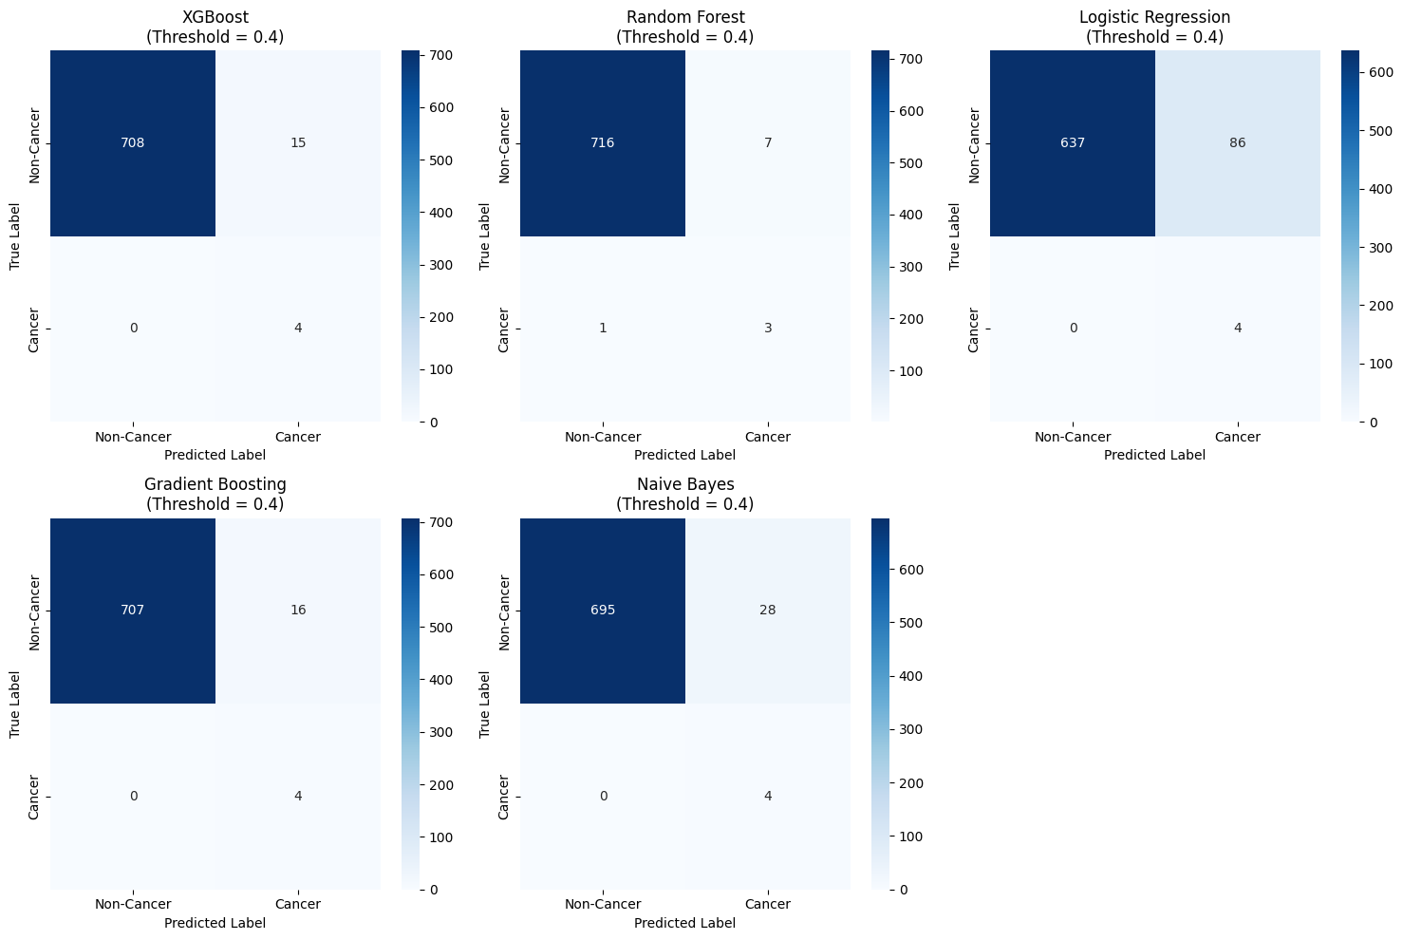
Model-wise Confusion Matrices for Cancer Prediction

Slide 16
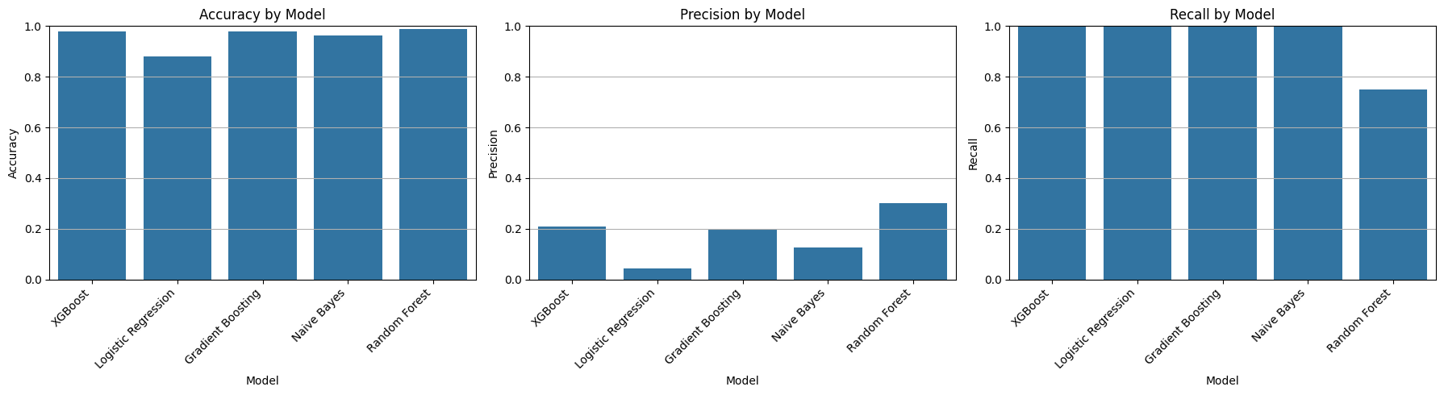
Comparative Analysis of Cancer Prediction Models

Slide 17
Links of Papers
https://journals.plos.org/plosone/article?id=10.1371/journal.pone.0051086
https://doi.org/10.1186/s12915-019-0660-6
Urinary Phthalate

Slide 18
Future Scope
Threshold Optimization Fine-tune the model’s decision threshold to better balance precision and recall, using ROC and Precision-Recall curve analysis.
Model Explainability Apply explainable AI methods like SHAP or LIME to interpret which chemical exposures and demographics drive cancer risk predictions.
Longitudinal Exposure Analysis Study how repeated and cumulative chemical exposures over time affect cancer risk, rather than relying on single-time measurements.
Cross-Population Validation Test the model on new datasets from different countries or ethnic groups to verify generalizability and improve model robustness.

