Slide 1
Medical image enhancement using histogram equalization
Under the guidance of:
Dr. Jyoti Bharti
Submitted by:
Budde Pavan Sai Varma
Vasishtha Kumar Nalla
Chithakindi Manideep Sai

Slide 2
Problem statement
Medical Images generally contain high noise and low contrast, which hinders the ability of accurately scrutinizing the image.
Here comes a need for an system that overcomes the complications specified in the above statement.
The proposed model is an image enhancement technique which uses Histogram equalization followed by noise removal and filtering.
The proposed enhancement algorithm achieves better quality image by either suppressing the noise or increasing the image contrast.

Slide 3
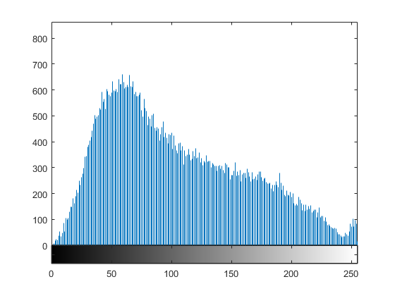
Histograms
Histogram is a graphical representation of the intensity distribution of an image.
It represents the number of pixels for each intensity value considered.
In the below figure, X-axis represents the tonal scale (black at the left and white at the right), and Y-axis represents the number of pixels in an image.

Slide 4
Histogram equalization
Histogram Equalization is a computer image processing technique used to improve contrast in images.
It accomplishes this by effectively spreading out the most frequent intensity values, i.e. stretching out the intensity range of the image.
This method usually increase the global contrast of images when its usable data is represented by close contrast values. This allows for areas of lower local contrast to gain a higher contrast.
S_{k} = G(r_{K}) = ∑ p_{r}(r_{j}) = ∑ n_{j}/n, where S_{k}: processed intensity
r_{k}: input intensity
G is equalization function

Slide 5
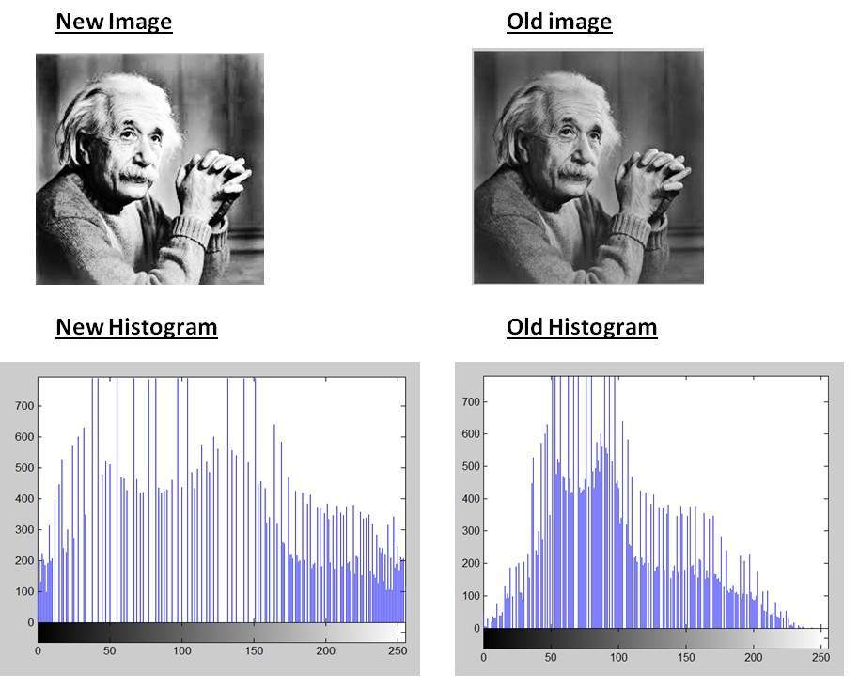
As you can clearly see from the images that the new image contrast has been enhanced and its
Histogram has also been equalized.

Slide 6
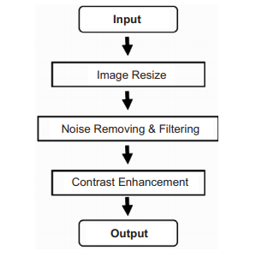
Proposed methodology
The above image depicts the different phases involved in the proposed
medical image enhancement.

Slide 7
Image Enhancement
Image enhancement is a process that focuses on processing an image in such a way that the processed image is more suitable than the original one for the specific application. The word 'specific' has significance. It gives a clue that the results of such an operation are highly application dependent.
g(x, y) = T[f(x, y)]
Where f(x, y) is the input image, g(x, y) is the processed image and T is an operator on f defined over some neighborhood of (x, y).

Slide 8
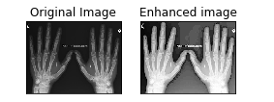
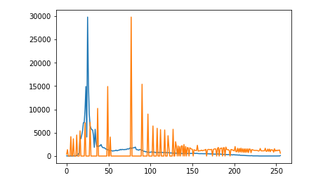
Results after Image Enhancement using Histogram Equalization
Histogram of Original and Enhanced Image

Slide 9
Filtering
Filtering technique is used for modifying or enhancing an image. In image processing, filters are mainly used to suppress either the high frequencies in the image, i.e. smoothing the image, or the low frequencies, i.e. enhancing or detecting edges in the image.
You can filter an image to emphasize certain features or remove other features.
Image filtering is useful in many applications; this technique includes smoothing, removing noise, edge detection, and sharpening. A filter is a small array defined by a kernel, which is applied to each pixel and it’s neighboring within an image.

Slide 10
Different types of filters
Median Filter: The median filter run through each element of the signal (in this case the image) and replace each pixel with the median of its neighboring pixels (located in a square neighborhood around the evaluated pixel).
Bilateral Filter: A bilateral filter is a non-linear, edge-preserving, and noise-reducing smoothing filter for images. It replaces the intensity of each pixel with a weighted average of intensity values from nearby pixels. This weight can be based on a Gaussian distribution.

Slide 11
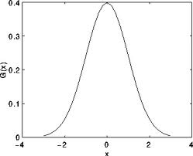
Different types of filters
Gaussian Filter: Gaussian filtering is done by convolving each point in the input array with a Gaussian kernel and then summing them all to produce the output array.
Assuming that an image is 1D, you can notice that the pixel located in the middle would have the biggest weight. The weight of its neighbors decreases as the spatial distance between them and the center pixel increases.

Slide 12

Different types of filters
Power Law Transformation: This operator, also called gamma correction, is another operator we can use to enhance an image. At the pixel (i,j), the operator looks as follows: p(i,j) = I(i,j)^gamma, Where I(i,j) is the Intensity values at location(i,j).
Morphological Opening Filter: Morphological opening is useful for removing small objects from an image while preserving the shape and size of larger objects in the image.
Laplacian Filter: The Laplacian of an image highlights the areas of rapid changes in intensity and can thus be used for edge detection. If we let I(x,y) represent the intensities of an image then the Laplacian of the image is given by the following formula:

Slide 13
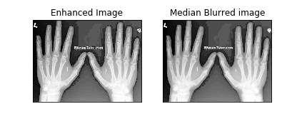
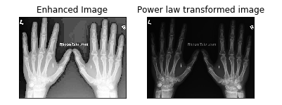
Result
Applying Gaussian Filter:
Applying Power law transformation:

Slide 14
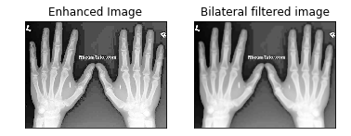
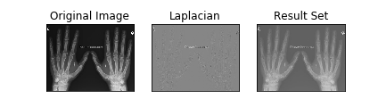
Applying Bilateral filter
Applying Laplacian filter
Applying Median Blur filter
:

Slide 15
Conclusion
We discussed the medical image preprocessing techniques. In the image, noise is detected and also removed from the given mammogram images, applied with different filtering techniques namely Gaussian, Bilateral, Median filters etc.
In This work we have detected that the choice of filters for denoising the medical mammogram images depends vitally on the type of noise and type of filtering, which are selected and used. It is remarkable that techniques save the processing time.
This result in analysis will improve the accuracy of mammogram image. The results, which we have achieved, are more useful and they prove to be helpful for medical practitioners to analyze the symptoms in the patients.

