Slide 1

Q4 2023
ProCogia + Toronto Metropolitan University
Muzz Abdur-Razak, R Developer I, ProCogia

Slide 2
Overview
The Beachwater Quality Dashboard is a pivotal tool designed to offer historical and current data, as well as predictive insights on beach water quality in the Niagara region.
This project involved significant enhancements to the dashboard, focusing on improving data accuracy, user experience, and predictive capabilities. The upgraded dashboard now features comprehensive historical data visualization, advanced predictive models, and customizable user interfaces, making it an indispensable resource for monitoring and decision-making regarding water safety and quality.

Slide 3
Project Background
Initial State and Challenges: The original Beachwater Quality Dashboard, while functional, faced challenges in terms of data integration, user interface design, and predictive accuracy. The data range was not being utilized to its full potential. Users found the dashboard less interactive and informative than desired, and the predictive models lacked precision.
Client Needs: The client sought to revamp the dashboard to make it more user-friendly, data-rich with live data (through APIs), and accurate in its predictions. The goal was to transform the dashboard into a more dynamic and reliable tool for local authorities and researchers, studying water quality trends or making informed decisions.

Slide 4
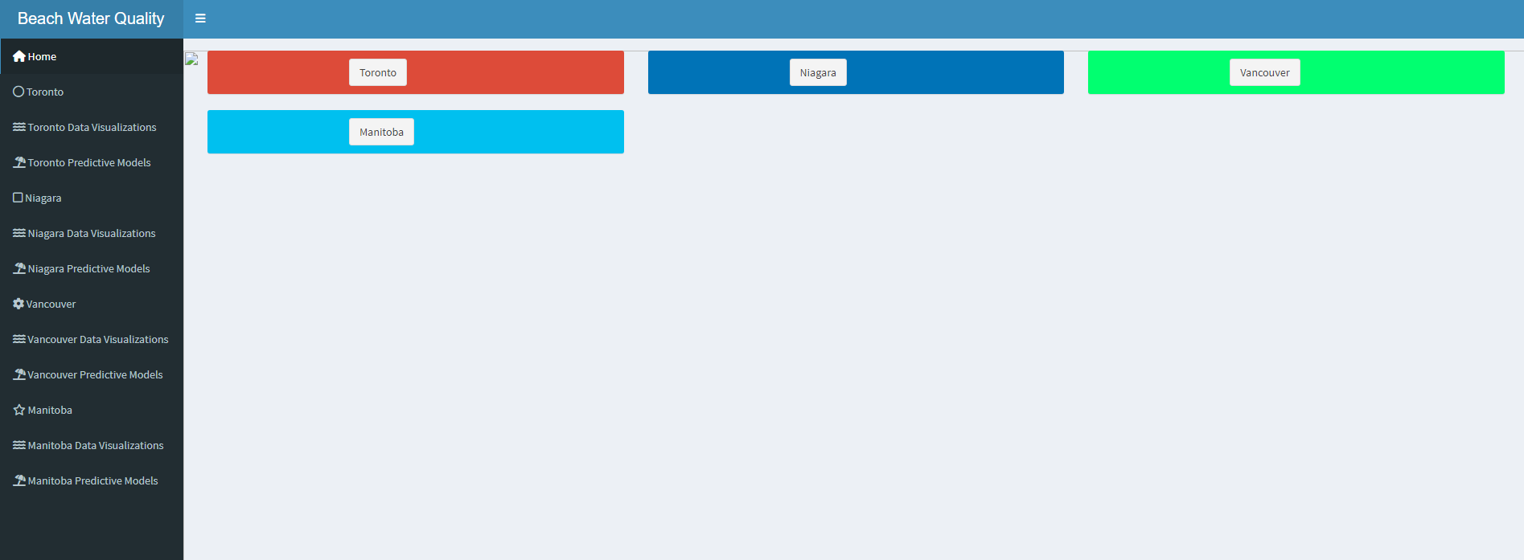
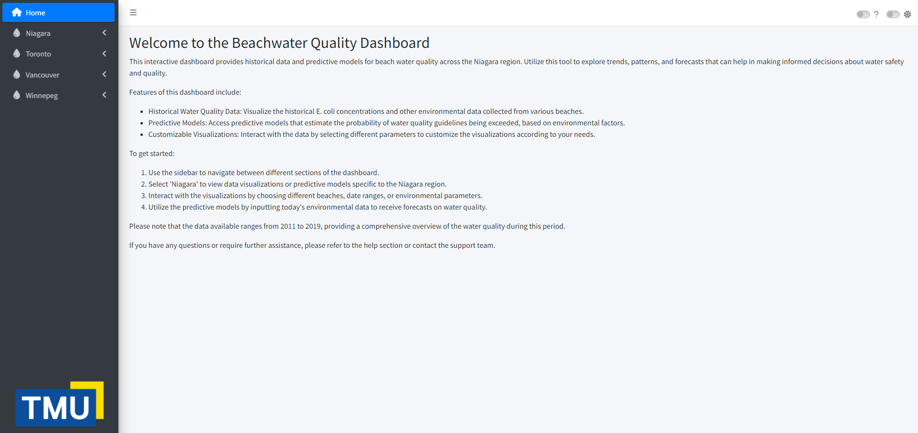
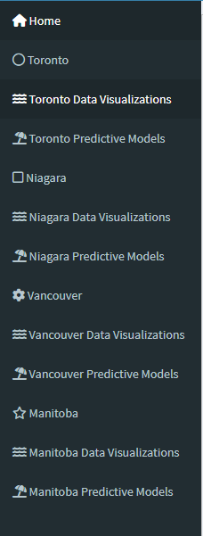
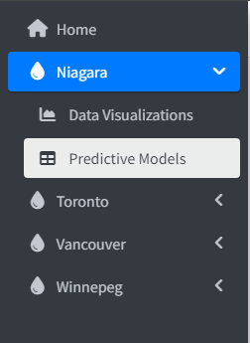
Codebase and Wireframe Restructuring
Original State: The initial codebase and wireframe was cluttered and lacked scalability. It posed challenges in maintenance and feature expansion.
Restructuring Process: The restructuring involved modularizing the code, optimizing data processing algorithms, and enhancing the overall architecture for better performance and scalability.
Improvements: Post-restructuring, the codebase became more maintainable, allowing for easier updates and feature additions. Performance and scalability were significantly improved, facilitating smoother user experiences and faster data processing.

Slide 5
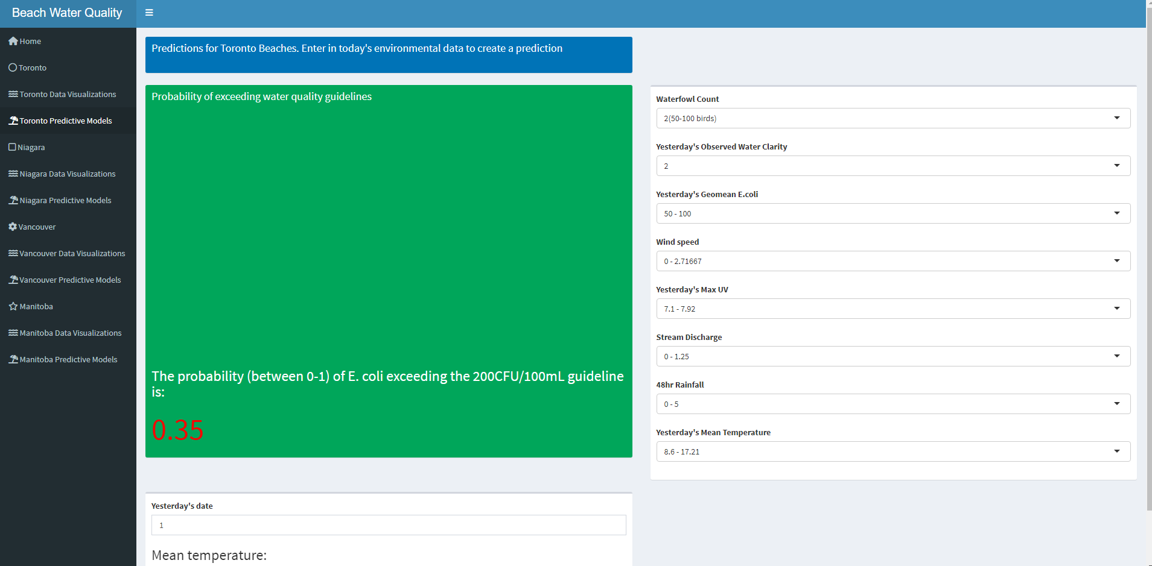
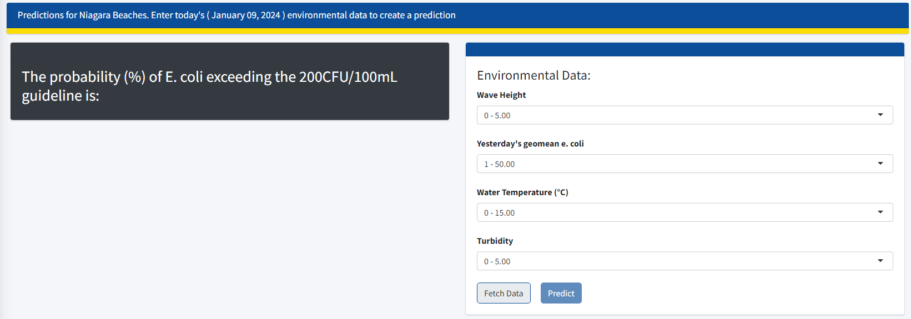
Design Solutions & Fixing Reactivity
Original Limitations: The initial frontend was less interactive and visually appealing, limiting user engagement. The reactive elements of the initial app were broken.
Changes Made: The frontend underwent a complete overhaul with a focus on UI/UX. New features for data interaction and visualization were introduced, making the dashboard more engaging and informative. All reactive elements were overhauled and written from scratch. This introduced better logic to the predictive model.
Impact: These changes significantly enhanced the user experience, making data exploration and interpretation more intuitive and effective.

Slide 6
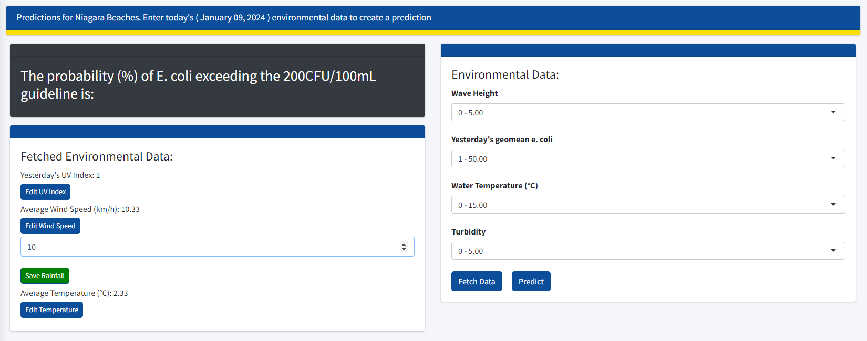
API Integration and Data Fetching
Significance: Integrating APIs for automatic data fetching was crucial for providing real-time, accurate environmental data, which is essential for predictive modeling.
Process: The integration involved setting up API connections, handling data retrieval, processing, and error management efficiently.
Contribution: This feature significantly contributed to the dashboard's effectiveness, offering up-to-date data, and enhancing the accuracy of predictive models.
Allows users to edit API-sourced data,
save it to the backend, and send it to
predictive model

Slide 7
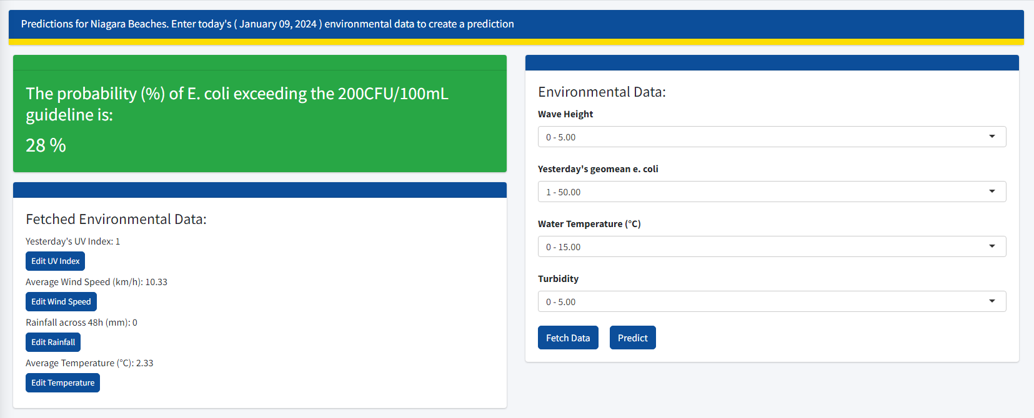
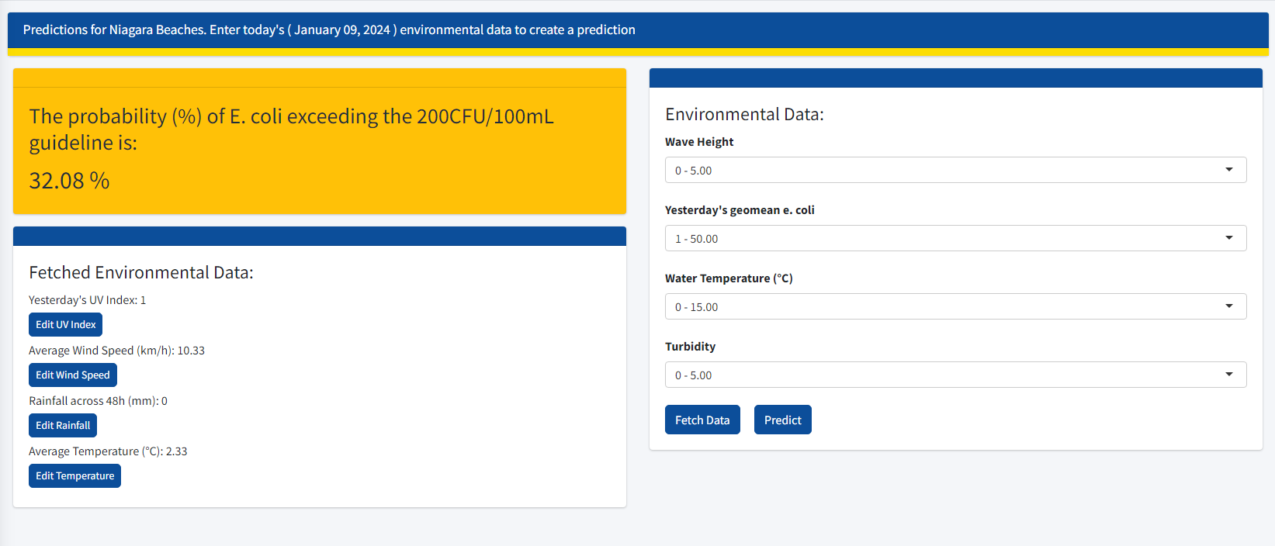
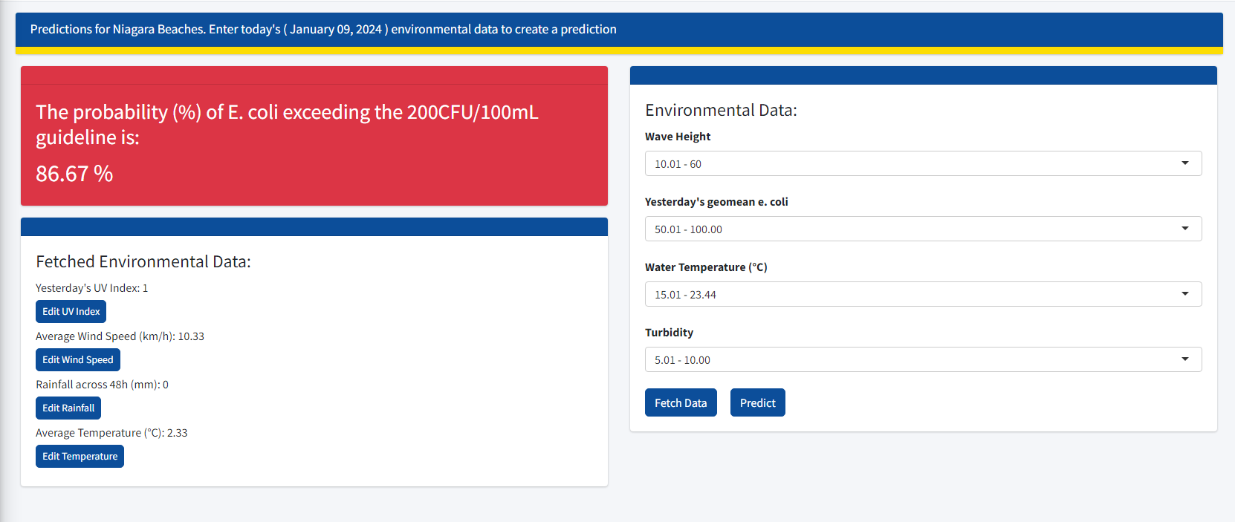
Dynamic UI with Predictive Model
UI changes according to output value of predictive model
7

