Slide 1
Workbench Slurm Integration
Internal Project

Slide 2
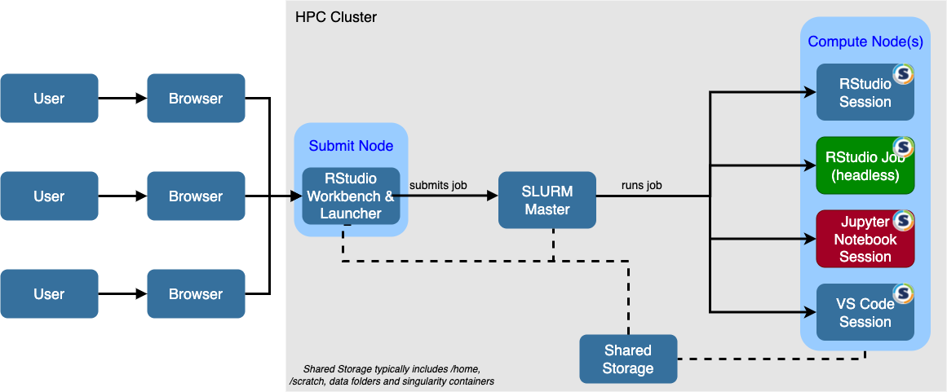
Architecture

Slide 3
Configuration
Spin Up AWS parallel Cluster and install Slurm scheduler.
Parallel Cluster version 3.5.0 and Slurm version 22.05.8
Configure head node and compute nodes
Install workbench on Headnode and activate Procogia Internal License
Install Slurm workers and integrate with Posit workbench on compute nodes.
Configure connection between headnodes and compute nodes.
Verify Scaling is working with workbench.

