Slide 1
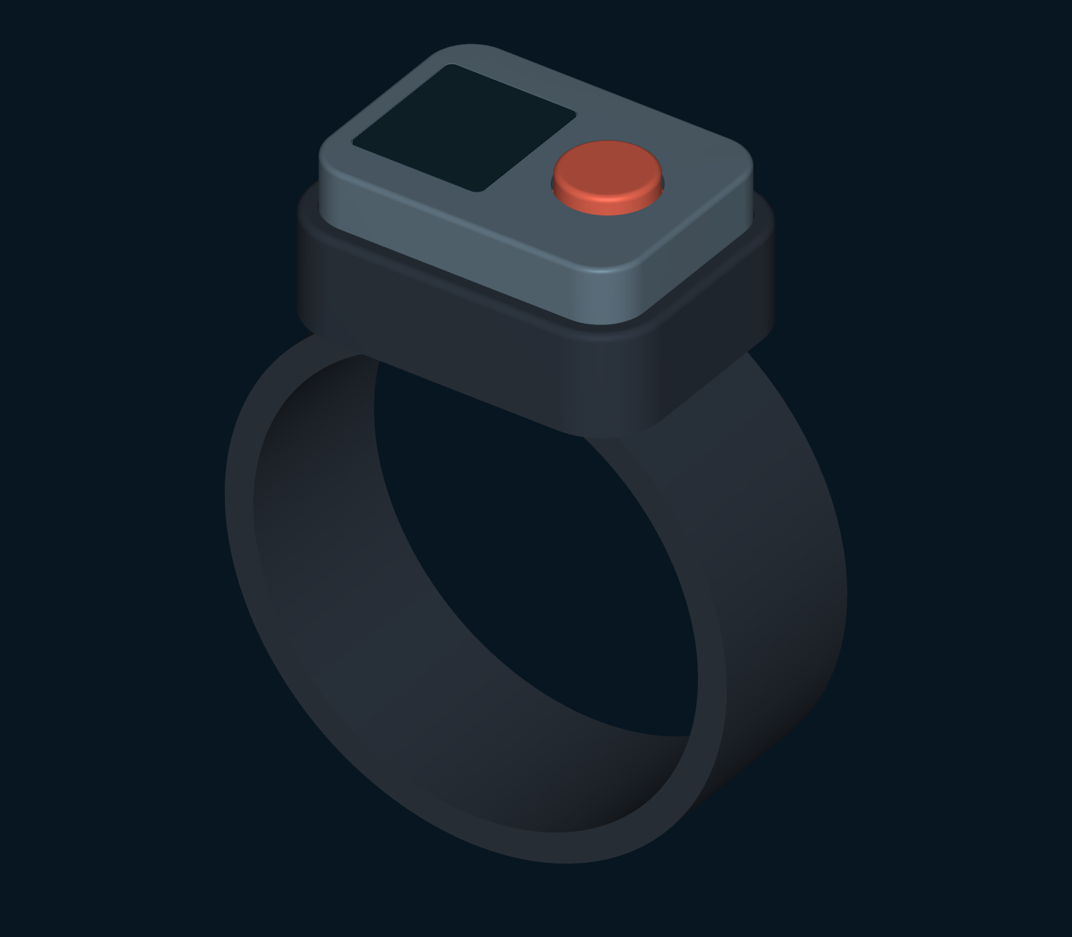
Dive Buddy
Alert Band
Buddy communication
starts with attention.
Concept by Rafael
Presentation Rev E · CAD Rev D
Notes:
Underwater, even a simple message starts with getting the other diver to look. Dive Buddy Alert Band is Rafael’s concept for that first moment: a button calls the paired band, a vibration requests attention, and a display shows the response and available distance. Illustrative dive scenario, not a claimed founder experience, customer testimonial or market result. No market-size, novelty, competitor-superiority or safety claim is added. Rev D CAD remains the geometry authority. Rev A economics remain historical display-free estimates.
Source: presentation/story.json (Presentation Rev E), design-data.json (CAD Rev D), DBA_Design_Package_RevE.pdf and the supplied Rev A package. Concept by Rafael. Interface values are illustrative. CAD defines nominal concept envelopes, not pressure, acoustic or manufacturing performance.

Slide 2
Something to share.
A buddy looking elsewhere
A formation in the reef. A change of plan.
A routine check-in.
The message may be simple, but a hand signal only starts
working when the other diver sees it.
DBA focuses on the step before that exchange:
a direct request for one buddy’s attention.
Notes:
A formation in the reef. A change of plan. A routine check-in. The message may be simple, but a hand signal only starts working when the other diver sees it. DBA focuses on the step before that exchange: a direct request for one buddy’s attention. The intended request is for attention before visual communication. The illustrative situation does not claim an actual founder experience or customer case.
Source: presentation/story.json (Presentation Rev E), design-data.json (CAD Rev D), DBA_Design_Package_RevE.pdf and the supplied Rev A package. Concept by Rafael. Interface values are illustrative. CAD defines nominal concept envelopes, not pressure, acoustic or manufacturing performance.

Slide 3
A call that belongs to your buddy
Before the dive
During the dive
Two bands are paired,
so each diver has a defined
buddy connection.
A deliberate button press
requests a tactile alert
on the other band.
The proposed call uses one physical button and three alert pulses.
Notes:
The idea is a paired connection. Before the dive, two bands are linked. During the dive, a deliberate press requests a tactile alert on the other band. The receiving diver presses to acknowledge, so the caller can distinguish a device reply from a person’s response. This is an addressed attention concept. Pair-code handling, collision avoidance and nearby-pair isolation require firmware definition. It does not assert a guaranteed connection.
Source: presentation/story.json (Presentation Rev E), design-data.json (CAD Rev D), DBA_Design_Package_RevE.pdf and the supplied Rev A package. Concept by Rafael. Interface values are illustrative. CAD defines nominal concept envelopes, not pressure, acoustic or manufacturing performance.

Slide 4
The buddy acknowledges
with a button press
CALLING
DEVICE REPLIED
PERSON RESPONDED
Sent
Received
Acknowledged
Waiting for a reply
The paired band replied
The buddy pressed once
Caller display
Caller display
Caller display
A device reply confirms delivery. The other diver’s button press
communicates their response.
Enlarged proposed interface states
Notes:
The idea is a paired connection. Before the dive, two bands are linked. During the dive, a deliberate press requests a tactile alert on the other band. The receiving diver presses to acknowledge, so the caller can distinguish a device reply from a person’s response. A packet reply confirms device receipt. The receiving diver presses the top button to acknowledge. Only that explicit response changes the caller’s state to Buddy acknowledged. A hold for ranging follows acknowledgement.
Source: presentation/story.json (Presentation Rev E), design-data.json (CAD Rev D), DBA_Design_Package_RevE.pdf and the supplied Rev A package. Concept by Rafael. Interface values are illustrative. CAD defines nominal concept envelopes, not pressure, acoustic or manufacturing performance.

Slide 5
Feel the request.
Understand the response
After the buddy acknowledges,
a hold starts a ranging session.
Both screens show fresh separation
estimates when available.
RANGING
8 m
Getting closer
Synthetic example
If a reading is missing or stale,
the distance and trend clear.
Optional caller pulses follow distance. The screen makes the reading explicit.
Notes:
The vibration is intended to interrupt attention briefly; the screen explains why. It shows an incoming call, a buddy’s acknowledgement, and fresh separation estimates during a ranging session. If a current reading is unavailable, the number clears rather than lingering as if it were still valid. After explicit buddy acknowledgement, a one-second hold requests ranging. Both screens show fresh separation estimates when available. Caller cadence is optional. No current reply means no current distance or trend; proximity pulses stop. The displayed 8 m is synthetic.
Source: presentation/story.json (Presentation Rev E), design-data.json (CAD Rev D), DBA_Design_Package_RevE.pdf and the supplied Rev A package. Concept by Rafael. Interface values are illustrative. CAD defines nominal concept envelopes, not pressure, acoustic or manufacturing performance.

Slide 6
Distance and the limits
of one transducer
8 m
Which way to turn
remains unknown.
Estimated separation
The buddy could be left, right,
above or below the wearer.
A direction-finding feature would need additional sensing and estimation.
Notes:
The approximately 65 kHz single-transducer concept estimates separation from two-way time-of-flight. The same range can place the buddy anywhere around the diver. Relative bearing, heading and depth difference are not measured. Exchanging device headings alone would not establish their relative locations. The band provides no route or guarantee of reunion.
Source: presentation/story.json (Presentation Rev E), design-data.json (CAD Rev D), DBA_Design_Package_RevE.pdf and the supplied Rev A package. Concept by Rafael. Interface values are illustrative. CAD defines nominal concept envelopes, not pressure, acoustic or manufacturing performance.

Slide 7
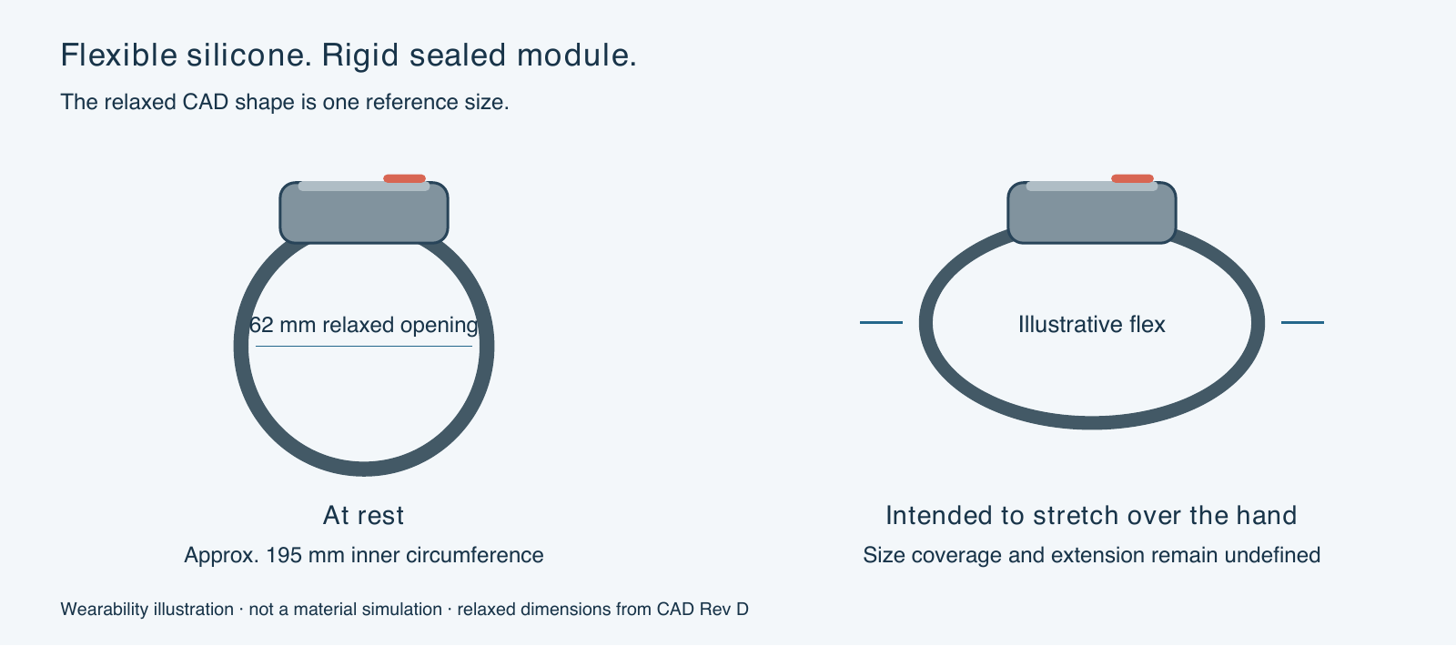
Flexible silicone around a rigid module
Notes:
The band is intended to be flexible silicone: it stretches over the hand, then sits around the wrist or suit cuff. The sealed electronics remain in a rigid, removable module. The circular CAD view shows the band at rest; it does not represent a rigid bracelet. Silicone grade, hardness, force to stretch, recovery and maximum extension remain undefined. The flex view illustrates intended behavior; it is not a material simulation.
Source: presentation/story.json (Presentation Rev E), design-data.json (CAD Rev D), DBA_Design_Package_RevE.pdf and the supplied Rev A package. Concept by Rafael. Interface values are illustrative. CAD defines nominal concept envelopes, not pressure, acoustic or manufacturing performance.

Slide 8
One reference size,
with fit still to define
62 mm
≈ 195 mm
Relaxed inner diameter
Derived inner circumference
Hand passage and worn fit are separate requirements.
Sizing must account for the hand, wrist and suit cuff,
while maintaining comfort and module retention.
CAD reference: 24 mm band width, 4 mm radial wall. No supported size range or maximum extension.
Notes:
The current model represents one reference size, with a 62 mm relaxed opening and approximately 195 mm inner circumference. A finished size range needs to account for wrist and suit-cuff circumference, hand passage, comfort and module retention. No wrist-size coverage or safe extension has been established. Silicone grade, hardness, force to stretch, recovery and maximum extension remain undefined. The flex view illustrates intended behavior; it is not a material simulation. Inner circumference derives from pi times the relaxed 62 mm CAD opening. It does not establish wrist or hand coverage. The 24 mm band width and 4 mm radial wall remain CAD reference dimensions.
Source: presentation/story.json (Presentation Rev E), design-data.json (CAD Rev D), DBA_Design_Package_RevE.pdf and the supplied Rev A package. Concept by Rafael. Interface values are illustrative. CAD defines nominal concept envelopes, not pressure, acoustic or manufacturing performance.

Slide 9
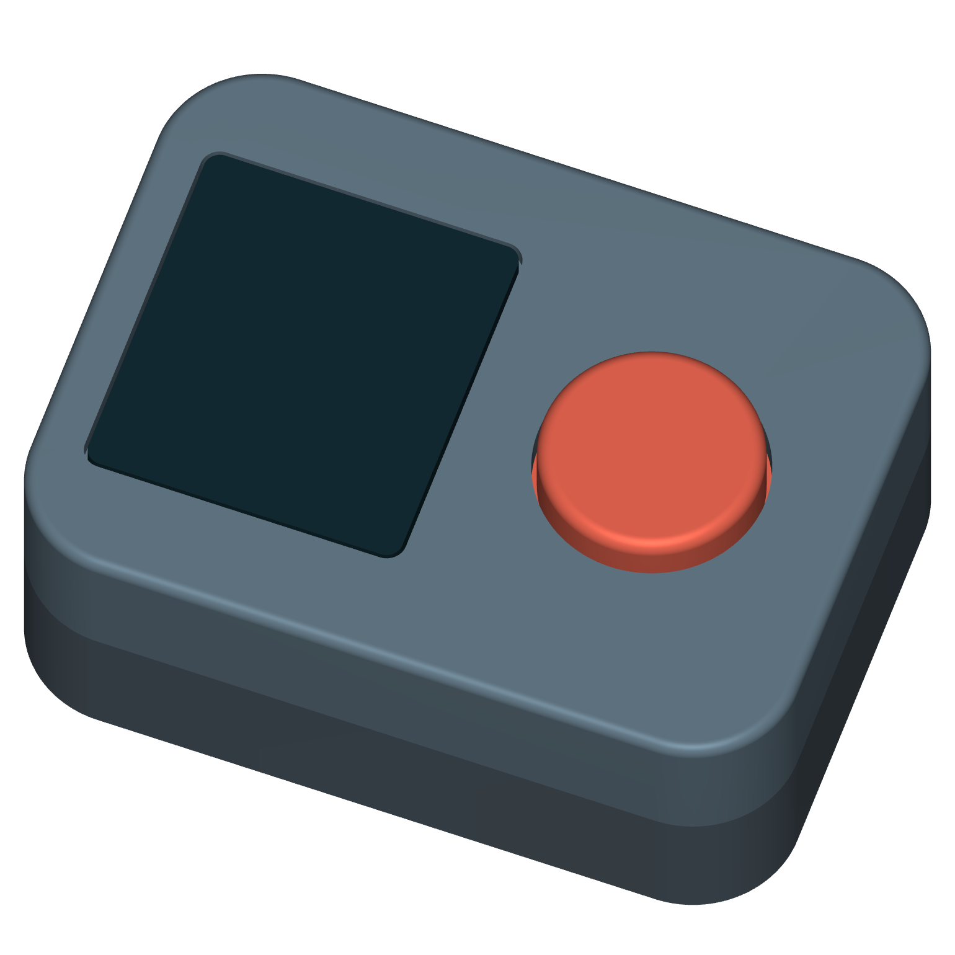
The display and button share a removable module
44 × 32 × 17.5 mm
Nominal housing dimensions
Inductive charging works through
the cap in the proposed design.
There is no charging port
on the band.
Concept geometry. Window sealing, electrical integration and physical performance remain unverified.
Notes:
The silicone band surrounds a rigid sealed-module concept. The 44 × 32 × 17.5 mm housing carries the display window beside the physical top button. A separate plunger passes through the annular receiver coil beneath the opaque button side. The module is removable from the band, but the sealed enclosure is not specified as user-openable. CAD Rev D has fourteen nominal parts. Seals, optical stack, wiring and pressure behavior require engineering definition.
Source: presentation/story.json (Presentation Rev E), design-data.json (CAD Rev D), DBA_Design_Package_RevE.pdf and the supplied Rev A package. Concept by Rafael. Interface values are illustrative. CAD defines nominal concept envelopes, not pressure, acoustic or manufacturing performance.

Slide 10
An acoustic exchange
estimates separation
~65 kHz
20 m
Proposed ultrasonic frequency
Ranging target
Both bands participate in the exchange.
Travel time supplies an estimate of separation.
Range, accuracy, depth performance and display-variant runtime have not been demonstrated.
Notes:
The proposed frequency is approximately 65 kHz. Two-way time-of-flight subtracts an assumed fixed reply delay from round-trip timing before calculating range. The original 20 m range remains a target, not a demonstrated result. Environmental variation, body shadowing, multipath and packet availability remain engineering questions. Timing resolution alone does not establish accuracy.
Source: presentation/story.json (Presentation Rev E), design-data.json (CAD Rev D), DBA_Design_Package_RevE.pdf and the supplied Rev A package. Concept by Rafael. Interface values are illustrative. CAD defines nominal concept envelopes, not pressure, acoustic or manufacturing performance.

Slide 11
Designed around the pair
Two bands with a shared inductive dock
Recreational buddy pairs are the initial audience. Instructors
and dive shops are potential places to introduce the concept.
The commercial question is whether the paired call and visible
separation information earn space on both divers’ wrists.
Customer demand and the display variant’s cost and retail target remain unestablished.
Notes:
A buddy call is useful only when both divers can participate. The proposed product is therefore a pair of bands with one shared inductive charging dock. Recreational buddy pairs are the initial audience; instructors and dive shops are potential places to introduce the concept. The commercial question is whether an addressed tactile call and readable separation information are valuable enough to earn space on both divers’ wrists. The current package defines that proposition; customer demand and the display variant’s cost remain unestablished. Rev A historical display-free estimates were approximately $43 per band / $86 per pair at 5,000 pairs with plus or minus 30 percent uncertainty, and a $179–199 retail target per pair. These are not current display-variant prices or quotes. They exclude tooling, engineering, freight and duty.
Source: presentation/story.json (Presentation Rev E), design-data.json (CAD Rev D), DBA_Design_Package_RevE.pdf and the supplied Rev A package. Concept by Rafael. Interface values are illustrative. CAD defines nominal concept envelopes, not pressure, acoustic or manufacturing performance.

Slide 12
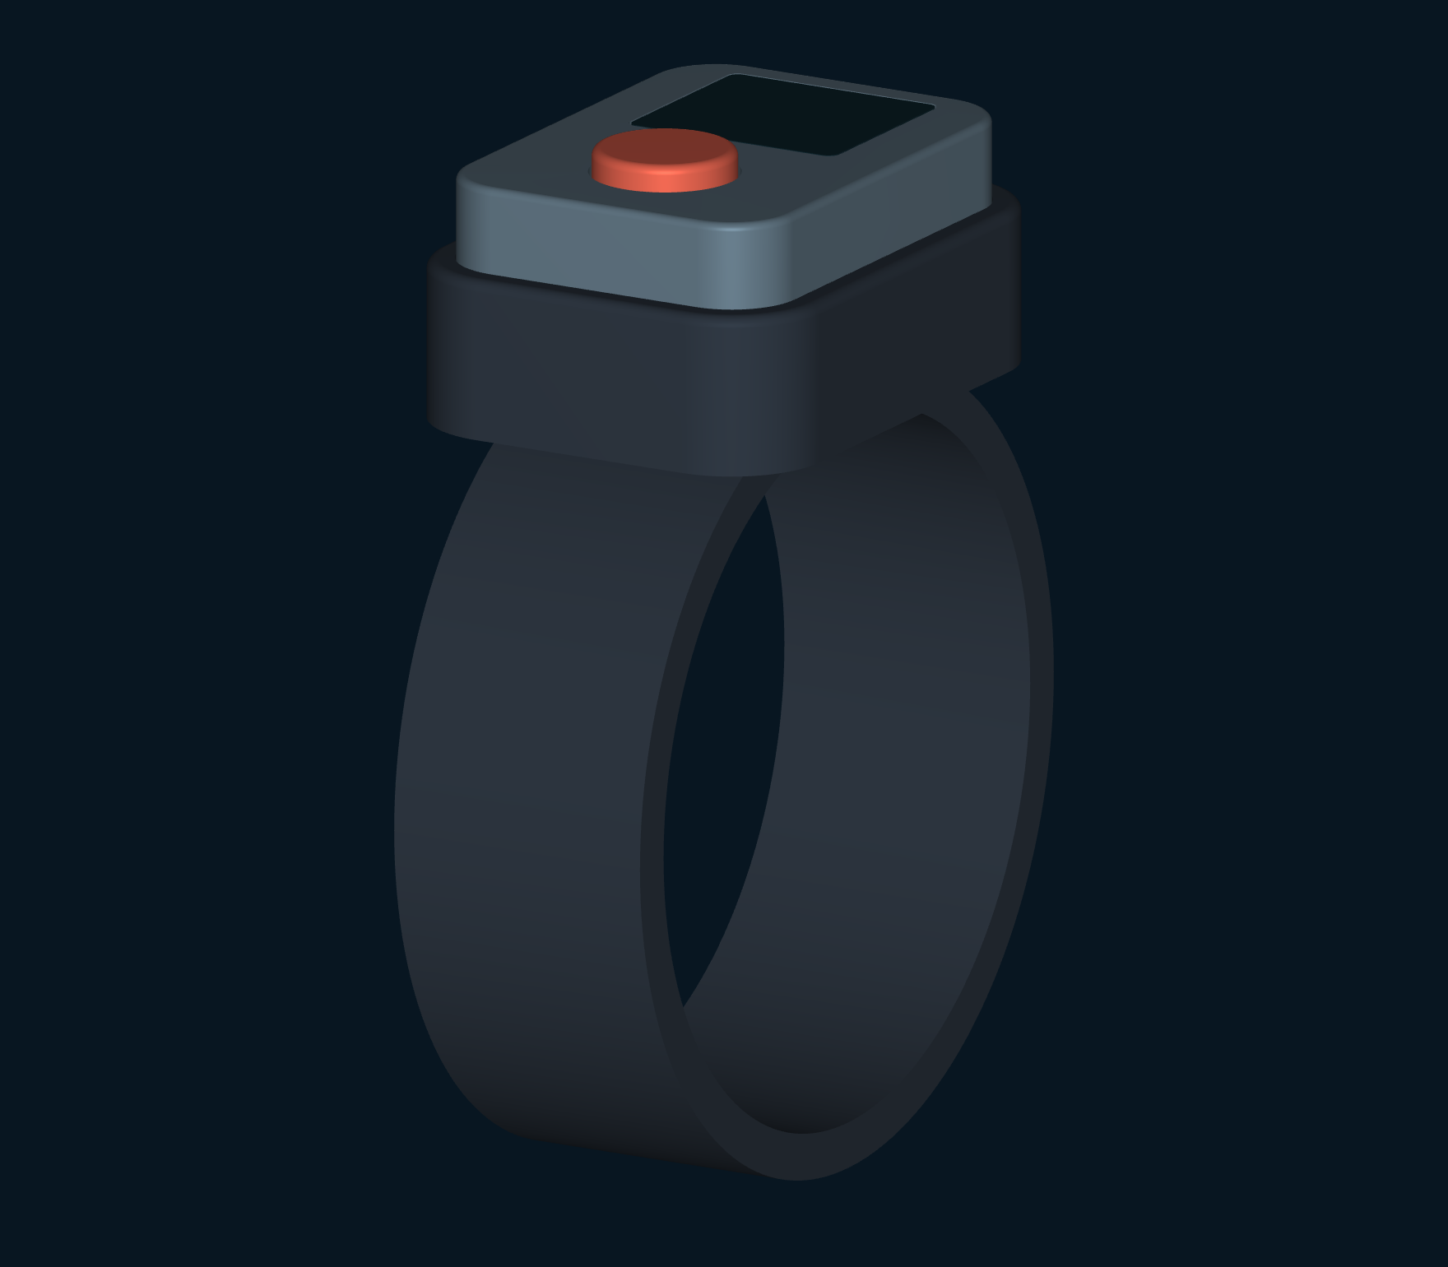
Buddy communication
starts with attention
DBA proposes a paired tactile call
with a clear response on the wrist.
During ranging, the display adds
available separation information
to that exchange.
An aid to buddy procedures. Never a safety guarantee.
Notes:
Underwater, even a simple message starts with getting the other diver to look. Dive Buddy Alert Band is Rafael’s concept for that first moment: a button calls the paired band, a vibration requests attention, and a display shows the response and available distance. This is a communication aid for divers who already use buddy procedures. It does not establish bearing, provide a route, or guarantee reunion. Illustrative dive scenario, not a claimed founder experience, customer testimonial or market result. No market-size, novelty, competitor-superiority or safety claim is added. Rev D CAD remains the geometry authority. Rev A economics remain historical display-free estimates.
Source: presentation/story.json (Presentation Rev E), design-data.json (CAD Rev D), DBA_Design_Package_RevE.pdf and the supplied Rev A package. Concept by Rafael. Interface values are illustrative. CAD defines nominal concept envelopes, not pressure, acoustic or manufacturing performance.

