Slide 1
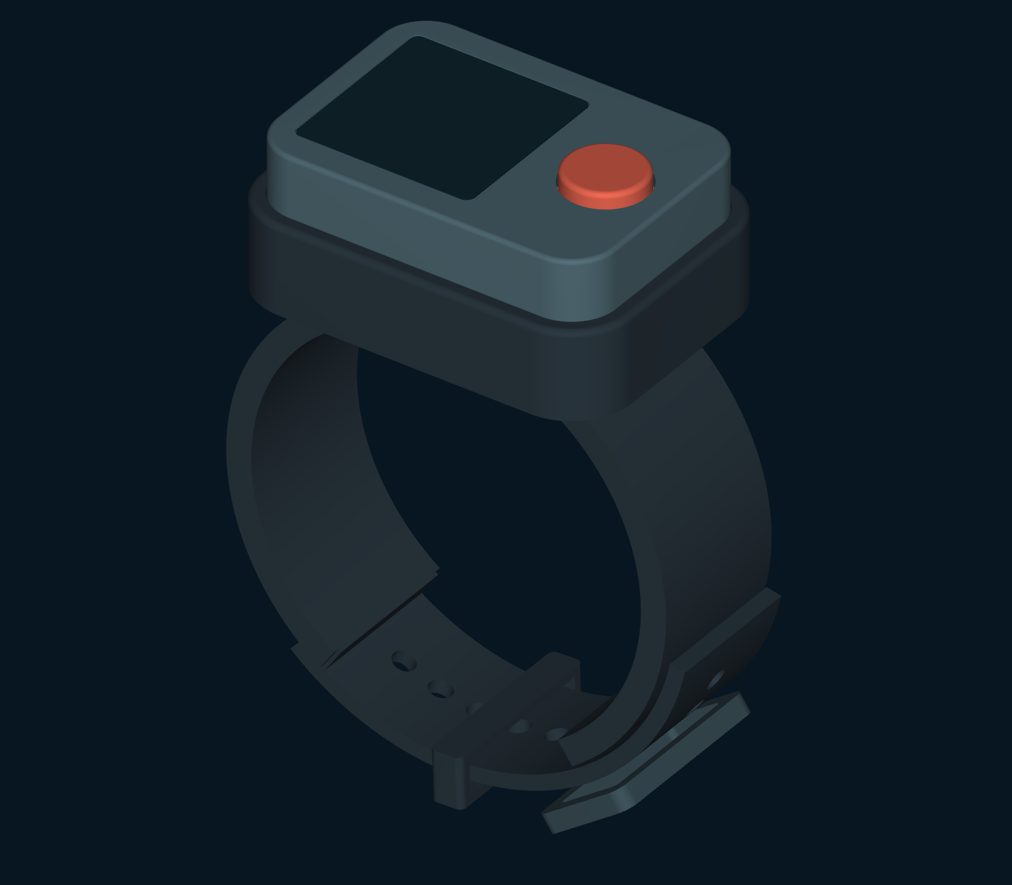
Dive Buddy
Alert Band
Stay in touch.
Know where to look.
Proposed system for
operator-managed boat dives
Concept by Rafael
Presentation Rev G / CAD Rev F
Notes:
A reef draws one diver’s attention. Their buddy turns to share something else. DBA proposes a private call and a clear acknowledgement, with buddy location supplied by a shared acoustic reference. Two bands, reference equipment and sealed charging form a system for operator-managed boat dives. Illustrative use scenario and simulated readings. Presentation Rev G uses CAD Rev F. The proposed first market and feature priorities are recommendations for feasibility review. Rev A economics are historical desk estimates.
Source: presentation/story.json (Presentation Rev G), design-data.json (CAD Rev F), DBA_Design_Package_RevG.pdf and the supplied Rev A package. Concept by Rafael. Interface values are illustrative. CAD defines nominal concept envelopes, not pressure, acoustic or manufacturing performance.

Slide 2
A shared dive.
A moment to reconnect
A hand signal depends on being seen.
A paired call can bring attention back.
A human response confirms acknowledgement.
Valid location data shows where to look.
Proposed first customer: recreational boat-dive operators.
They manage the equipment. Divers wear the paired bands.
Notes:
Underwater, a hand signal depends on being seen. A buddy can be nearby yet outside the other diver’s field of view, above the reef or a few metres deeper. Getting their attention is the first step. Understanding where to look is the next. A boat-based operator could manage the acoustic reference and charging equipment, allocate paired bands before departure and support their use across successive trips. That makes the added equipment part of one managed service. Proposed first market. Customer demand has not been established.
Source: presentation/story.json (Presentation Rev G), design-data.json (CAD Rev F), DBA_Design_Package_RevG.pdf and the supplied Rev A package. Concept by Rafael. Interface values are illustrative. CAD defines nominal concept envelopes, not pressure, acoustic or manufacturing performance.

Slide 3
The complete system
Two paired bands
Acoustic reference
Private call and acknowledgement.
Direct scalar range between divers.
Shared horizontal positions.
Required for bearing and maps.
Inductive dock
Operator-managed equipment
Sealed charging between uses.
Deployment, pairing and turnaround
need a defined working routine.
Reference and dock are proposed system elements. No hardware implementation is validated.
Notes:
Two paired bands: Each diver wears a band with a top button, haptic alert and proposed display. Each band measures direct peer range and would sense depth and wrist heading.
Boat-associated acoustic reference: A proposed spaced receiver array and orientation reference supply shared horizontal positions. Placement, calibration, coverage and supported pair count need definition.
Inductive charging dock: The operator charges the sealed modules between uses. Dock capacity, alignment, charge time and reference power arrangements need definition.
With a current direct peer link: Paired call, device receipt, human acknowledgement and scalar separation. No horizontal bearing follows from range alone.
With current shared reference fixes: Buddy bearing, horizontal map and boat-relative position. Relative depth also needs current exchanged pressure readings. Wrist heading determines display orientation.
When positioning is unavailable: Clear position-dependent arrows and markers. Keep independently valid direct range and local depth/time. Peer-link loss also clears exchanged buddy data.
Source: presentation/story.json (Presentation Rev G), design-data.json (CAD Rev F), DBA_Design_Package_RevG.pdf and the supplied Rev A package. Concept by Rafael. Interface values are illustrative. CAD defines nominal concept envelopes, not pressure, acoustic or manufacturing performance.

Slide 4
A call. A human response
CALLING
DEVICE REPLIED
PERSON RESPONDED
Sent
Received
Acknowledged
Waiting for a reply
The paired band replied
The buddy pressed once
Caller display
Caller display
Caller display
The device reply and the diver’s acknowledgement
have separate meanings.
Proposed interaction. Synthetic screen states.
Notes:
Pair identity, call, explicit human acknowledgement, clear missing-data states, adjustable retention and sealed charging. These define the basic interaction and daily handling. Pair the bands before entering the water. A deliberate press requests a vibration on the paired band. The receiving diver presses to acknowledge. The caller sees that human response separately from the band’s automatic delivery receipt. Proposed control: hold one second to call, short press to acknowledge, hold to cancel.
Source: presentation/story.json (Presentation Rev G), design-data.json (CAD Rev F), DBA_Design_Package_RevG.pdf and the supplied Rev A package. Concept by Rafael. Interface values are illustrative. CAD defines nominal concept envelopes, not pressure, acoustic or manufacturing performance.

Slide 5
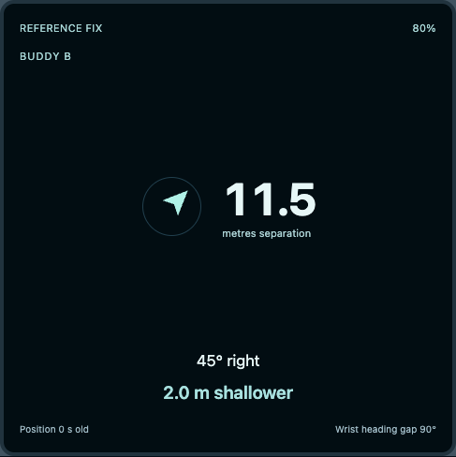
Buddy location, with context
Horizontal bearing
Where to look around the diver.
Relative depth
Whether the buddy is shallower
or deeper.
Requires current reference fixes and sensor data. Missing fixes clear arrows. Readings are simulated.
Notes:
With a current direct peer link: Paired call, device receipt, human acknowledgement and scalar separation. No horizontal bearing follows from range alone.
With current shared reference fixes: Buddy bearing, horizontal map and boat-relative position. Relative depth also needs current exchanged pressure readings. Wrist heading determines display orientation.
When positioning is unavailable: Clear position-dependent arrows and markers. Keep independently valid direct range and local depth/time. Peer-link loss also clears exchanged buddy data. A call-and-range-only product would need a separate commercial decision if reference-assisted navigation proves unsuitable. It is not an automatic substitute for the proposed navigation product.
Source: presentation/story.json (Presentation Rev G), design-data.json (CAD Rev F), DBA_Design_Package_RevG.pdf and the supplied Rev A package. Concept by Rafael. Interface values are illustrative. CAD defines nominal concept envelopes, not pressure, acoustic or manufacturing performance.

Slide 6
First-product priorities
Essential interaction
Pair, call, acknowledge. Clear missing-data states.
Adjustable retention and sealed charging.
Conditional location capability
Buddy bearing and relative depth, subject to
reference feasibility and agreed operating limits.
Later interface options
Map, Boat, additional motion statistics
and orientation comparisons.
The full demonstration remains available. These are proposed development priorities.
Notes:
First-product essentials: Pair identity, call, explicit human acknowledgement, clear missing-data states, adjustable retention and sealed charging. These define the basic interaction and daily handling.
Navigation feasibility decision: Buddy bearing and relative depth are the proposed first-product location view. Include them only if the reference architecture can meet agreed coverage, accuracy, latency, power and setup constraints.
Later interface options: Map, Boat, additional motion statistics and orientation comparisons remain in the full concept demonstration. Their release priority follows the core interaction and location decision.
A call-and-range-only product would need a separate commercial decision if reference-assisted navigation proves unsuitable. It is not an automatic substitute for the proposed navigation product.
Source: presentation/story.json (Presentation Rev G), design-data.json (CAD Rev F), DBA_Design_Package_RevG.pdf and the supplied Rev A package. Concept by Rafael. Interface values are illustrative. CAD defines nominal concept envelopes, not pressure, acoustic or manufacturing performance.

Slide 7
The reason to choose DBA
The proposed advantage
The purchase decision
A private call with readable
spatial context, supported
by the dive operator.
Is that benefit worth the
equipment, setup and price
compared with alternatives?
Published reviews inform the concept. DBA-specific demand, willingness to pay
and operator workload remain unestablished.
Notes:
Existing buddy procedures
DBA supplements visual communication and the pair's established procedures. The product must justify adding equipment to an already essential routine.
The claimed benefit is an addressed prompt before visual contact. No reduction in incidents or separation has been demonstrated.
Paired underwater alert devices
Published Buddy-Watcher reviews provide a relevant comparison for the attention use case.
DBA proposes explicit human acknowledgement and reference-assisted spatial context. Superiority, novelty and purchase preference are unproven.
Integrated underwater communication and positioning
Garmin publishes limitations for its SubWave system, providing a reference for environment and positioning constraints.
A dedicated operator-managed system must justify its equipment burden and total price against integrated alternatives. No compatibility or feature-parity claim is made.
Documented: A reproducible concept model, dimensions, simulated interactions, failure-state behavior and published third-party product commentary.
Still needed for a business decision: DBA-specific diver and operator feedback, frequency and importance of the use case, willingness to pay, equipment-handling burden and comparison with alternatives.
Commercial decision: Proceed only if the intended benefit and acceptable system price justify the operator's setup, turnaround and service obligations. No demand threshold or purchase commitment is established.
Sources: Scuba Diver Life: Buddy-Watcher review https://scubadiverlife.com/gear/gear-review-buddy-watcher/
Different Dive: instructor review https://differentdive.com/week-26-i-test-the-buddy-watcher/
Garmin: SubWave limitations https://www.garmin.com/en-US/legal/subwavedisclaimer/
Source: presentation/story.json (Presentation Rev G), design-data.json (CAD Rev F), DBA_Design_Package_RevG.pdf and the supplied Rev A package. Concept by Rafael. Interface values are illustrative. CAD defines nominal concept envelopes, not pressure, acoustic or manufacturing performance.

Slide 8
Requirements that decide feasibility
Acoustics and position
Accuracy, bearing, coverage, supported pairs and latency.
Energy and deployment
Band/reference runtime, charge time and setup burden.
The worn device
Operating depth, readability, glove use, fit and retention.
Commercial limits
System price, margin, volume, budget and schedule.
20 m remains a direct-range target. Other acceptance limits require agreement. Owners are named in the brief.
Notes:
P0 / Intended use and operating depth / Define the supported dive environment and depth rating in metres, with temperature and salinity bounds. The old 50 m proposal is unverified. / Systems / mechanical / Operating limits agreed before detailed enclosure design.
P0 / Positioning and coverage / Specify horizontal and relative-depth error in metres, bearing error in degrees, usable reference coverage in metres and maximum supported pairs. No current numeric targets. / Underwater acoustics / estimation / A credible reference architecture for the stated use case.
P0 / Message and data quality / Retain 20 m as the direct-range target. Define call delivery and acknowledgement delay in seconds, update interval, stale-data cutoff and missed/false alert limits. Demo timings are illustrative. / Firmware / acoustics / Fresh, stale, unavailable and human-response states remain distinct.
P0 / Energy and turnaround / Define band and reference runtime in hours, reserve, charge time and operator turnaround in minutes. Include display and navigation duty cycles. / Electronics / operations / Energy and charging fit the proposed trip schedule.
P0 / Display and control usability / Define readable distance, light and viewing-angle conditions for the 24 x 24 mm active area, glove actuation and button force in newtons, and perceptible haptic patterns through specified suit thicknesses. / Human factors / industrial design / A diver can identify the call, response and location state with the intended equipment.
P0 / Fit, sealing and materials / Define wrist/cuff coverage in millimetres, adjustment and retention force in newtons, and material/seal durability requirements. Nominal strap layouts do not establish fit ranges. / Mechanical / materials / The wearable meets agreed comfort, retention and saltwater requirements.
P0 / Operator deployment / Define array placement, calibration, reference motion handling, setup time in minutes and pair allocation. The reference's relationship to the boat must remain explicit. / Systems / operations / Reference handling fits an operator's working routine.
P0 / Commercial envelope / Set system selling-price or rental-model assumptions, target margin, order volume, development budget and milestone dates. No current values are approved. / Rafael / commercial lead / Feasibility scope and commercial limits are agreed before a full development commitment.
P1 / Later views and service / Rank map, boat, motion and orientation views. Define battery/module service, replacement strap supply and lifecycle obligations. / Product / service / firmware / Optional features and ongoing support have explicit scope and cost ownership.
P0 decisions define the first-product scope. P1 decisions follow that scope. Units specify how requirements should be expressed; they are not measured results or approved acceptance limits.
Source: presentation/story.json (Presentation Rev G), design-data.json (CAD Rev F), DBA_Design_Package_RevG.pdf and the supplied Rev A package. Concept by Rafael. Interface values are illustrative. CAD defines nominal concept envelopes, not pressure, acoustic or manufacturing performance.

Slide 9
The commercial brief
Proposed offer
Inputs still to agree
Operator-owned equipment.
A possible rental or
included-service model.
System price and margin.
Order volume and budget.
Milestones and schedule.
The complete cost must include reference equipment, charging, development,
production preparation, logistics and service. No current estimate is established.
Notes:
Purchaser and offer: Proposed operator-owned kit: paired bands, acoustic reference and inductive charging. Supported pair count and shared-reference capacity remain open.
Revenue model: Operator equipment purchase with a possible diver rental or included-service model. Proposed options, not established customer preferences.
System price and margin: No current target, quote or margin established. Define the acceptable complete-system price and replacement-band price with the intended purchaser.
Volume: Initial operator count, kits per operator, bands per kit and replacement demand are undecided. Rev A's 5,000-pair assumption is not a forecast.
Development budget: Not supplied. Rafael and the partner must agree a budget for a bounded feasibility/scoping engagement before commissioning development.
Schedule: No launch date or development duration committed. Request proposed milestones, dependencies and decision points with the scope.
Cost coverage: Account for bands, reference, docks, engineering, tooling, applicable compliance work, freight, duty, service and warranty. Current full-system costs are unknown.
Decision owners: Rafael owns the product and investment decisions. The development partner proposes technical scope and estimates. Operator evidence informs workflow and price assumptions. Rev A cost estimates do not price the current navigation system.
Source: presentation/story.json (Presentation Rev G), design-data.json (CAD Rev F), DBA_Design_Package_RevG.pdf and the supplied Rev A package. Concept by Rafael. Interface values are illustrative. CAD defines nominal concept envelopes, not pressure, acoustic or manufacturing performance.

Slide 10
The development-partner request
Recommend a feasible first product
and a priced scope for the next stage.
Product definition and measurable requirements.
Architecture assessment and specialist responsibilities.
Commercial scope, assumptions and milestones.
Decision: proceed, revise or stop, with the reasons.
Feasibility and scoping request. No procurement or physical hardware program is commissioned.
Notes:
Assess the proposed system for operator-managed boat dives and recommend a feasible first product, the essential trade-offs and a priced scope for the next development stage.
Product definition: Recommended first-product capabilities, measurable requirements and explicit exclusions, tied to the intended customer and use case.
Architecture assessment: Acoustic-reference approach, sensing, energy and enclosure constraints, with the largest uncertainties and relevant specialist responsibilities.
Commercial scope: Cost drivers, required customer inputs and a milestone-based proposal identifying deliverables, assumptions, fees and schedule dependencies.
Decision recommendation: Proceed, revise or stop, with the reasons, unresolved evidence and conditions for any subsequent commitment.
Requested next step: feasibility and scope definition. This presentation does not commission procurement, tooling, manufacturing or a physical hardware test program.
Source: presentation/story.json (Presentation Rev G), design-data.json (CAD Rev F), DBA_Design_Package_RevG.pdf and the supplied Rev A package. Concept by Rafael. Interface values are illustrative. CAD defines nominal concept envelopes, not pressure, acoustic or manufacturing performance.

Slide 11
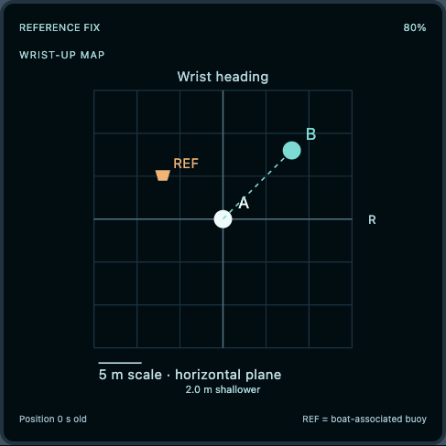
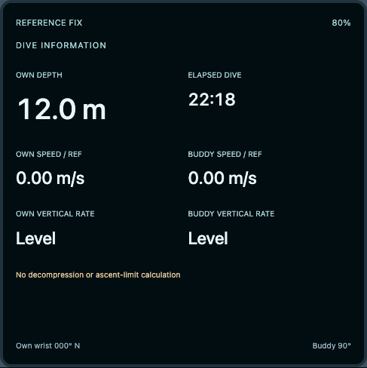
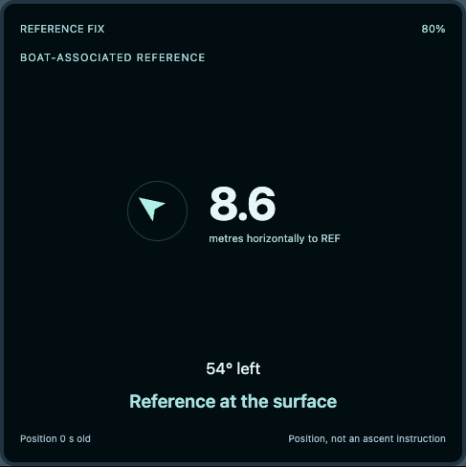
The wider interface concept
Map
Dive information
Boat reference
Supporting detail. Simulated views. DBA is an aid to buddy procedures, not a decompression computer.
Notes:
Supporting detail. Map, Dive and Boat are lower-priority interface options. All readings are synthetic. Reference-assisted positioning is required for map and boat location. Own depth and time can remain independently available. Reference-relative horizontal speed is not speed through water. Vertical rate does not calculate decompression or establish safe ascent limits.
Source: presentation/story.json (Presentation Rev G), design-data.json (CAD Rev F), DBA_Design_Package_RevG.pdf and the supplied Rev A package. Concept by Rafael. Interface values are illustrative. CAD defines nominal concept envelopes, not pressure, acoustic or manufacturing performance.

Slide 12
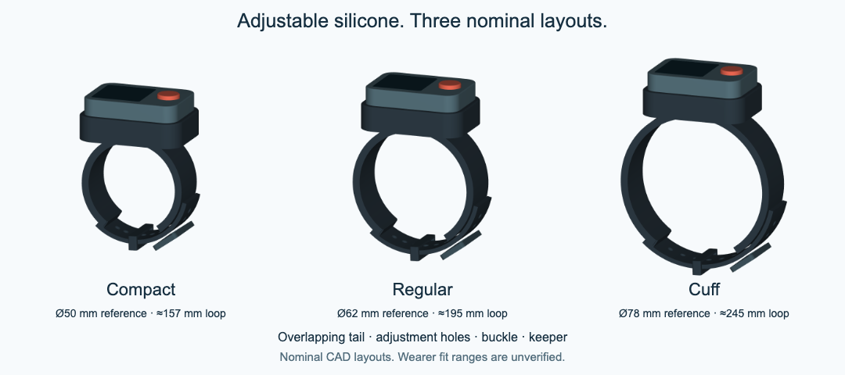
Adjustable fit
Notes:
A split silicone strap wraps around the wrist or suit cuff. Its overlapping tail adjusts through a proposed acetal buckle, with a silicone keeper securing the loose end. The sealed module remains removable when the strap needs replacing. Compact, Regular and Cuff are three modeled layouts, with nominal internal reference diameters of 50, 62 and 78 mm. Their circular reference circumferences are about 157, 195 and 245 mm. These dimensions describe CAD layouts; they are not established wrist-size ranges. Corrosion resistance is a design requirement. The proposed exterior combines silicone, an acetal buckle with nonmetal retention, and a polymer housing and window. No exposed steel pin or charging contacts are specified. Material grades, seal durability, buckle strength and the usable fit range remain unvalidated. Supporting detail. Nominal layouts are not established wearer ranges.
Source: presentation/story.json (Presentation Rev G), design-data.json (CAD Rev F), DBA_Design_Package_RevG.pdf and the supplied Rev A package. Concept by Rafael. Interface values are illustrative. CAD defines nominal concept envelopes, not pressure, acoustic or manufacturing performance.

Slide 13

The removable sealed module
54 × 38 × 19.5 mm
Nominal housing dimensions
24 × 24 mm active display area.
One physical button on top.
Inductive charging through the cap.
Concept geometry. Pressure performance, runtime, actual-scale readability and manufacturing remain unresolved.
Notes:
Supporting detail. CAD Rev F. Housing 54 × 38 × 19.5 mm plus 2.2 mm button protrusion. Define wrist/cuff coverage in millimetres, adjustment and retention force in newtons, and material/seal durability requirements. Nominal strap layouts do not establish fit ranges. Corrosion resistance is a design requirement. The proposed exterior combines silicone, an acetal buckle with nonmetal retention, and a polymer housing and window. No exposed steel pin or charging contacts are specified. Material grades, seal durability, buckle strength and the usable fit range remain unvalidated.
Source: presentation/story.json (Presentation Rev G), design-data.json (CAD Rev F), DBA_Design_Package_RevG.pdf and the supplied Rev A package. Concept by Rafael. Interface values are illustrative. CAD defines nominal concept envelopes, not pressure, acoustic or manufacturing performance.

Slide 14
The project, ready for review
One-page partner brief
Interactive presentation
Engineering brief and source CAD
buddhacoder.github.io/dive-buddy-alert-band
Concept by Rafael. An aid to buddy procedures, never a safety guarantee.
Presentation strategy, design & production by The AI Doc
Prepared for Rafael
Notes:
Assess the proposed system for operator-managed boat dives and recommend a feasible first product, the essential trade-offs and a priced scope for the next development stage. Requested next step: feasibility and scope definition. This presentation does not commission procurement, tooling, manufacturing or a physical hardware test program. Current files: DBA_Partner_Brief_RevG.pdf, DBA_Design_Package_RevG.pdf, DBA_Product_Overview_RevG.pptx, DBA_Annotated_Views_RevF.pdf and DBA_Package_RevG.zip. Live URL: https://buddhacoder.github.io/dive-buddy-alert-band/
Source: presentation/story.json (Presentation Rev G), design-data.json (CAD Rev F), DBA_Design_Package_RevG.pdf and the supplied Rev A package. Concept by Rafael. Interface values are illustrative. CAD defines nominal concept envelopes, not pressure, acoustic or manufacturing performance.

