Slide 1
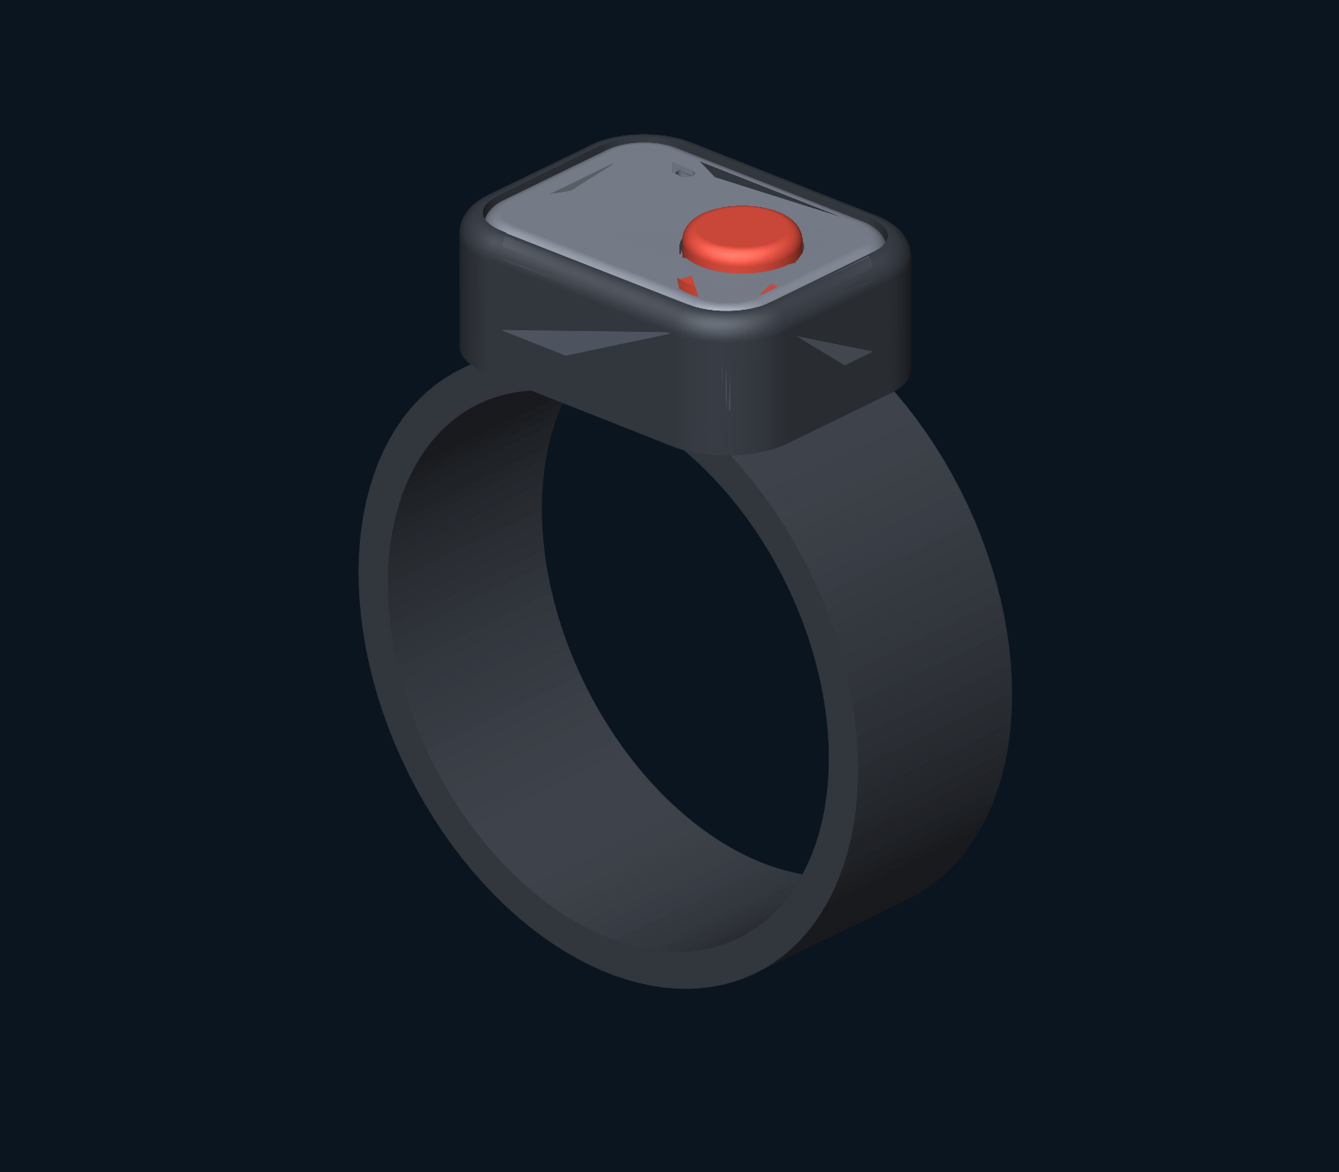
Dive Buddy
Alert Band
Call your buddy.
Feel the distance.
Concept by Rafael
Notes:
Introduce the product as a concept for paired underwater calls and tactile distance feedback. The purpose is attention and distance awareness. It gives no direction and cannot ensure reunion.
Source: supplied DBA_Design_Package_RevA.pdf and reviewed DBA_Design_Package_RevB.pdf; concept by Rafael. Targets and cost estimates remain unverified.

Slide 2
A call on the wrist
Press
Feel
A short press on the caller’s band
requests the buddy’s attention.
The paired band gives
three alert pulses.
Pair on the surface. Hold for ranging. Press once to stop.
Proposed interaction
Notes:
Describe a buddy facing away. A short press requests three buzzes on the paired band. The proposed interface then uses a one-second hold for ranging. Human acknowledgement and delivery feedback remain engineering decisions.
Source: supplied DBA_Design_Package_RevA.pdf and reviewed DBA_Design_Package_RevB.pdf; concept by Rafael. Targets and cost estimates remain unverified.

Slide 3
Distance becomes cadence
12 m
7 m
3 m
One pulse
every 2 seconds
One pulse
every second
Double pulse
every 0.5 seconds
Distance, not direction.
Illustrative cadence. No reply means distance is unknown.
Notes:
Explain the mapping using three valid simulated distances. At 12 m the proposed map gives one pulse every two seconds; at 7 m one each second; at 3 m a double pulse every half second. These are interface assumptions, not measured device performance. No reply means unknown distance, and should not imply a distant buddy.
Source: supplied DBA_Design_Package_RevA.pdf and reviewed DBA_Design_Package_RevB.pdf; concept by Rafael. Targets and cost estimates remain unverified.

Slide 4
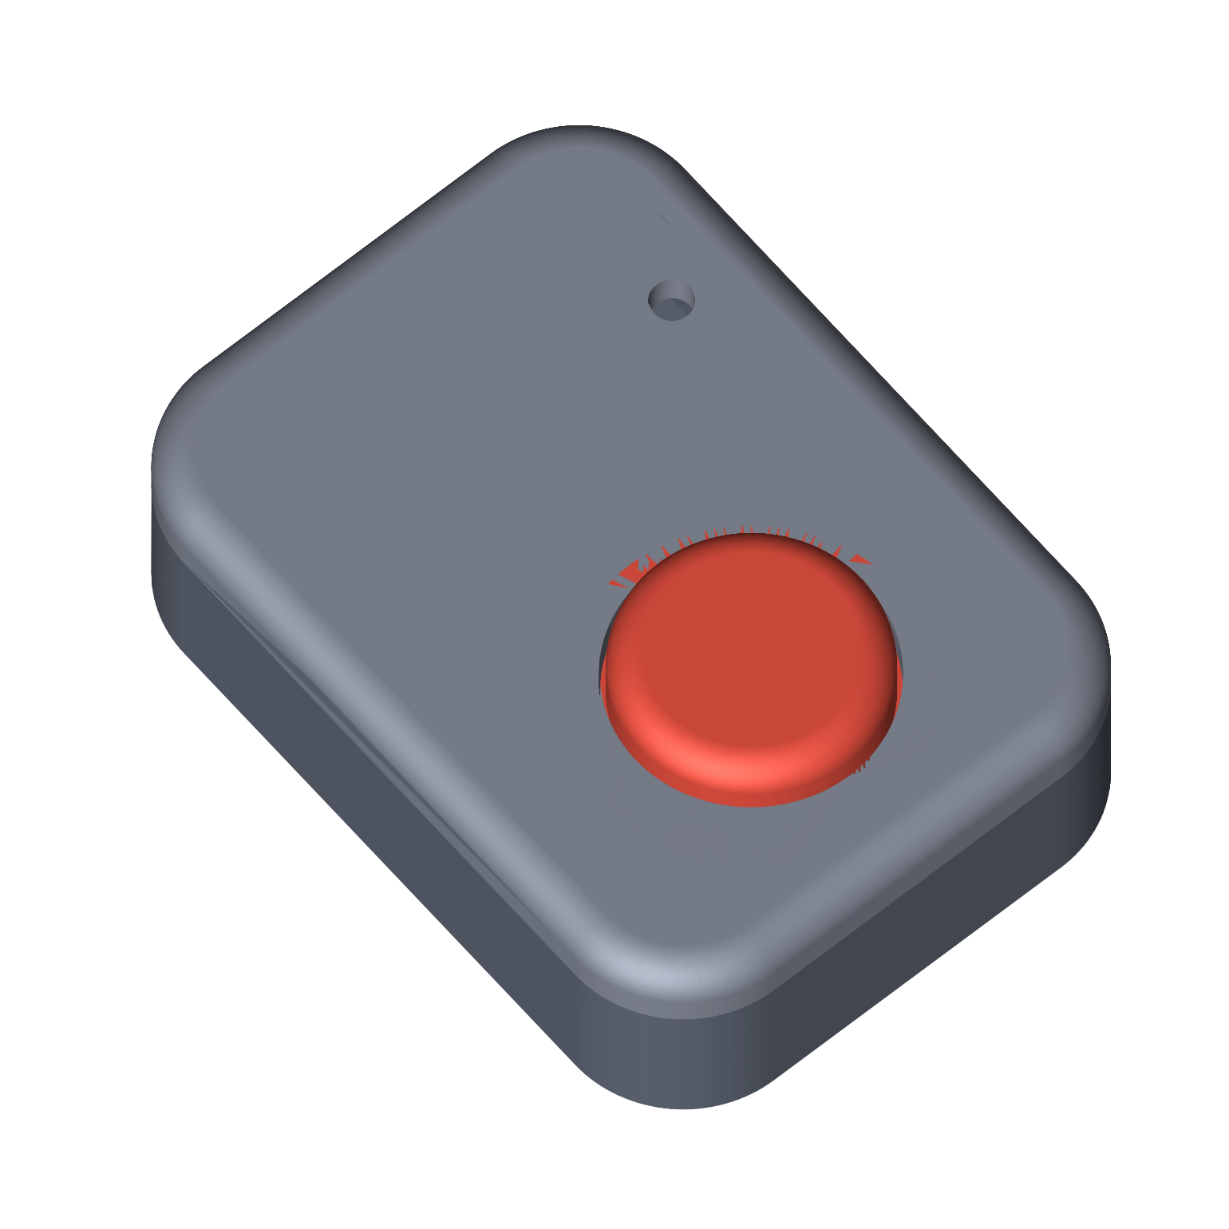
Slip-on form.
Removable module.
38 × 28 × 11.5 mm
Nominal housing dimensions
One button on top.
No charging port on the band.
A shared inductive dock.
Concept geometry; fit, sealing and internal clearances require engineering development.
Notes:
The design intent is a replaceable silicone band with a sealed removable module, a top button and inductive charging. The housing dimensions are nominal and exclude the button protrusion. The fit, seal, retention and internal clearances remain unresolved.
Source: supplied DBA_Design_Package_RevA.pdf and reviewed DBA_Design_Package_RevB.pdf; concept by Rafael. Targets and cost estimates remain unverified.

Slide 5
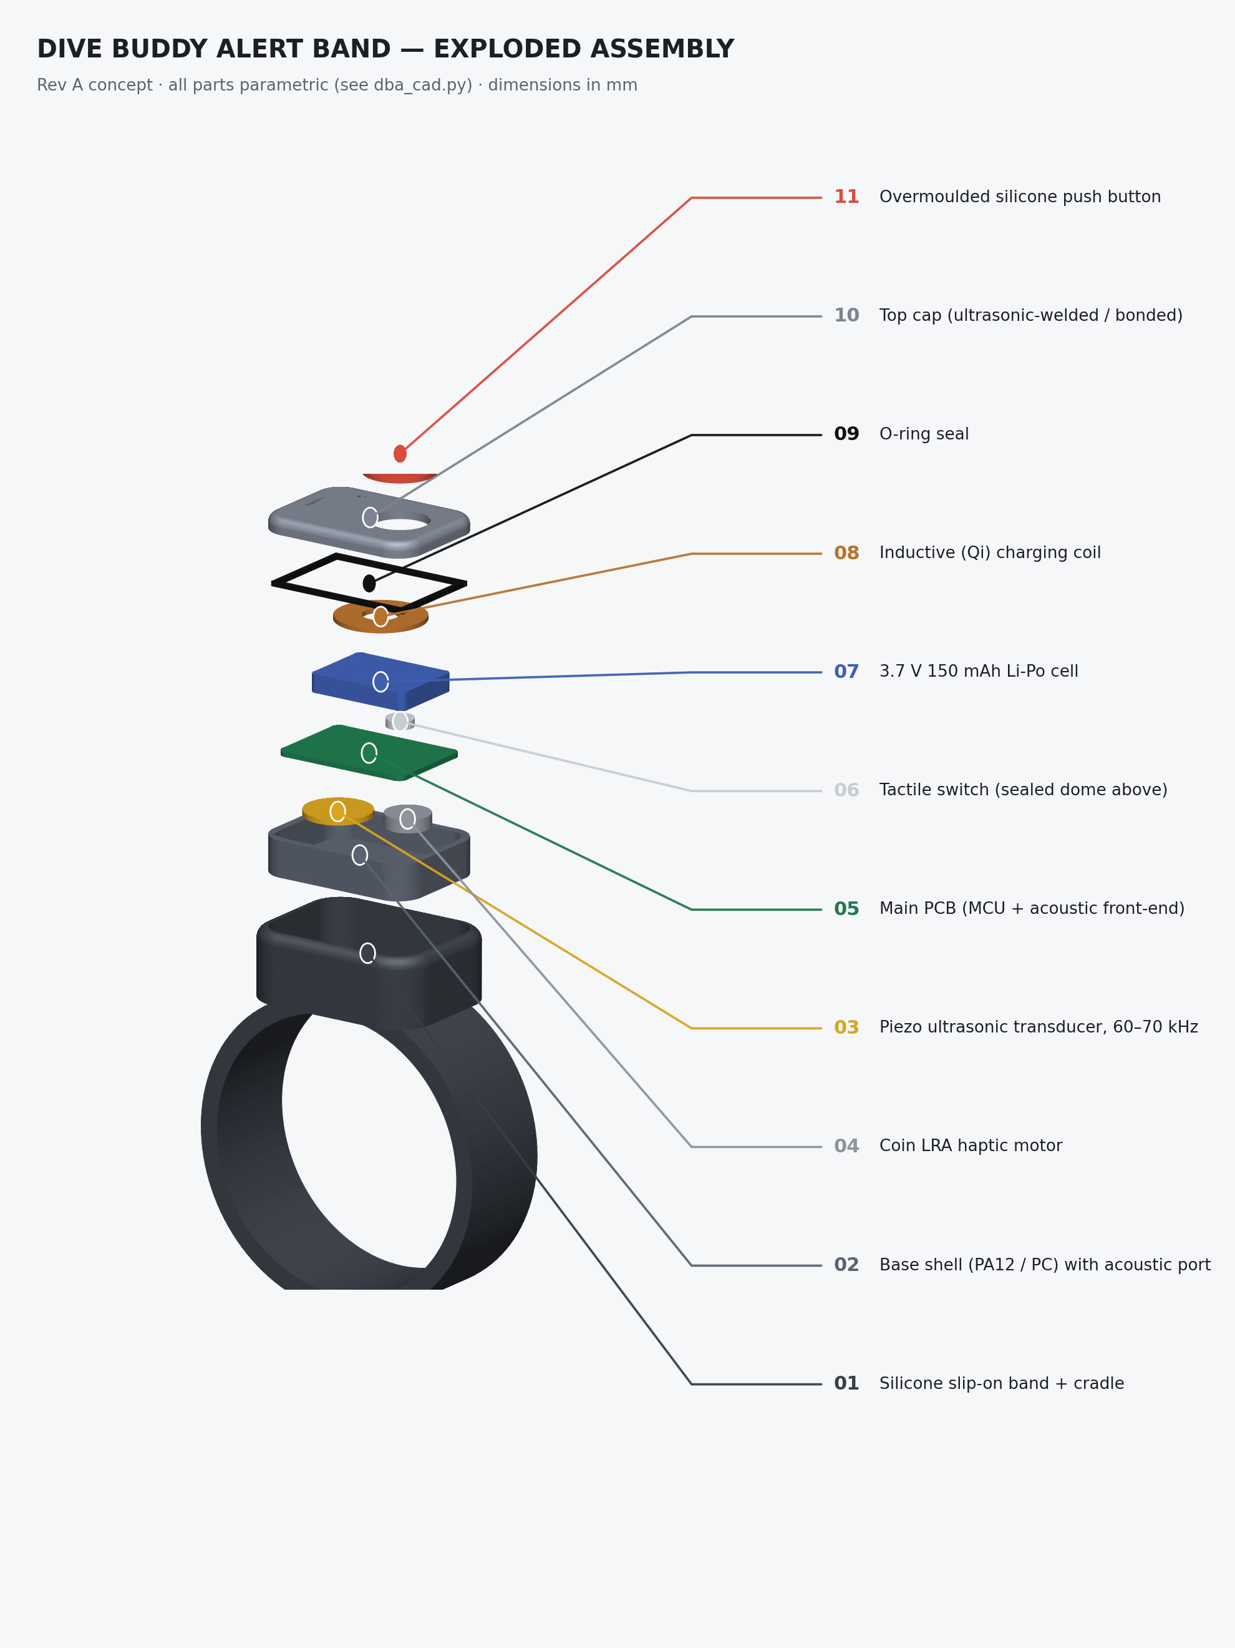
Inside the band
Acoustics
~65 kHz two-way ranging
20 m range target
Power and feedback
Rechargeable cell, receiver coil
and vibration motor.
Concept layout. No validated acoustic or manufacturing performance.
Notes:
Use the assembly to explain the functional blocks rather than claiming the hardware is complete. The full specification records acoustic targets, power assumptions and open mechanical interfaces. Source packaging conflicts and energy arithmetic are recorded in the engineering brief.
Source: supplied DBA_Design_Package_RevA.pdf and reviewed DBA_Design_Package_RevB.pdf; concept by Rafael. Targets and cost estimates remain unverified.

Slide 6
Designed as a pair
$179–199
≈ $86
Retail target per pair
Desk cost estimate per pair
at 5,000 pairs · ±30%
Two bands and one shared charging dock.
Cost excludes tooling, engineering, freight and duty. Supplier quotes and channel economics remain open.
Notes:
Describe the proposed product as two bands with a shared dock for recreational buddies. Instructors and dive shops are potential channels. These price and cost figures are estimates from Rev A, not quotes. No channel margin, customer demand or market validation is established.
Source: supplied DBA_Design_Package_RevA.pdf and reviewed DBA_Design_Package_RevB.pdf; concept by Rafael. Targets and cost estimates remain unverified.

Slide 7
A paired call.
A sense of distance.
Dive Buddy Alert Band
Concept by Rafael
Product interaction, nominal CAD
and technical specification available for review.
An aid to buddy procedures. Never a safety guarantee.
Notes:
Close on the specific proposition: paired tactile attention and distance feedback in a simple wristband. The concept is available for review; engineering performance, customer demand and manufacturing readiness are not demonstrated. Use the full technical brief for the detailed requirements and unresolved items.
Source: supplied DBA_Design_Package_RevA.pdf and reviewed DBA_Design_Package_RevB.pdf; concept by Rafael. Targets and cost estimates remain unverified.

