Slide 1
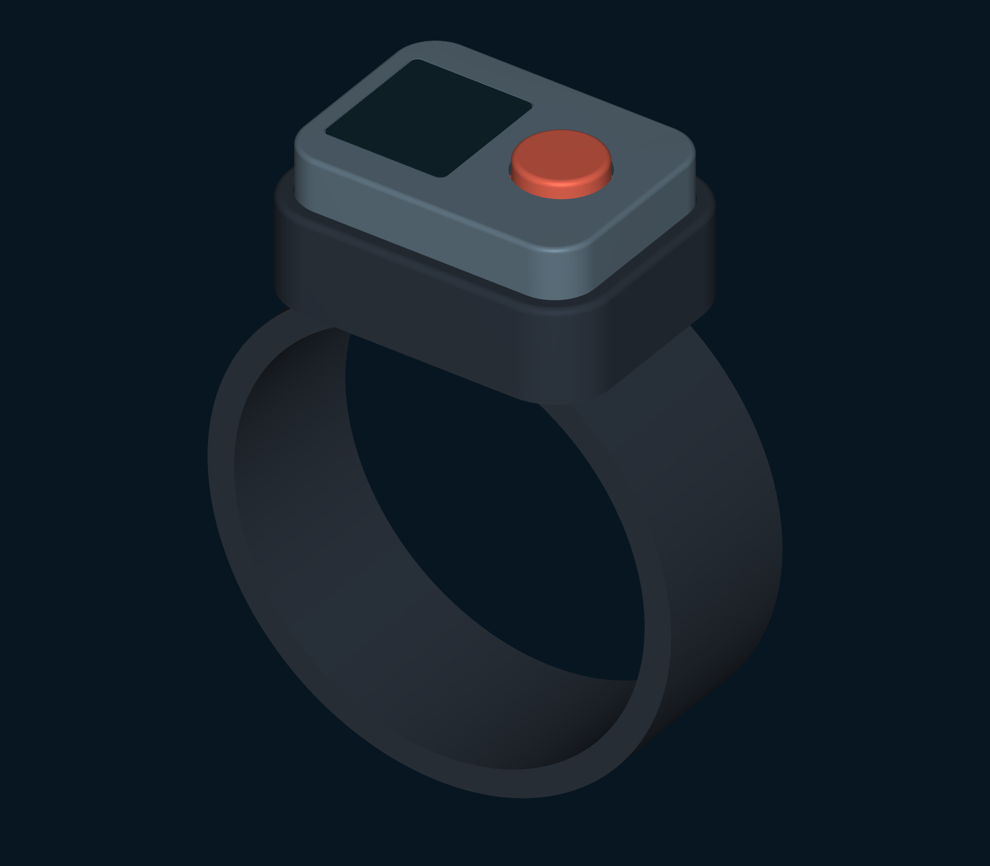
Dive Buddy
Alert Band
Feel the call.
See the distance.
Concept by Rafael
Rev D concept assembly
Notes:
Introduce Rev D as a wristband concept combining a paired tactile call and visible distance feedback. The rendered fourteen-part assembly includes the display body and window alongside the physical top button. This is a parametric concept, with sealing and electrical integration still requiring development. It gives no bearing and cannot ensure reunion.
Source: supplied DBA_Design_Package_RevA.pdf, reviewed DBA_Design_Package_RevD.pdf and presentation/requirements.json. Concept by Rafael. Rev D display behavior is proposed; sample screen values are synthetic. Regenerated CAD defines the concept envelopes only. Pressure sealing, acoustic performance, cost and runtime remain unestablished.

Slide 2
Haptics and a glanceable display
Feel
See
An incoming buddy call.
Optional distance cadence.
Call status. Fresh distance.
A clear unavailable state.
One physical button controls the interaction.
Proposed interface. Underwater readability and haptic performance require definition.
Notes:
Explain the roles of each channel. Haptics provide attention and optional caller cadence. The screen communicates call state, fresh distance and the link state. Both divers get fresh range information during a session. The design retains a physical top button rather than relying on an underwater touchscreen. Underwater readability and haptic perceptibility are not established.
Source: supplied DBA_Design_Package_RevA.pdf, reviewed DBA_Design_Package_RevD.pdf and presentation/requirements.json. Concept by Rafael. Rev D display behavior is proposed; sample screen values are synthetic. Regenerated CAD defines the concept envelopes only. Pressure sealing, acoustic performance, cost and runtime remain unestablished.

Slide 3
Calling and acknowledgement
Received by device
The paired band replied to the message.
Buddy acknowledged
The other diver pressed the button to respond.
A device reply alone does not establish the diver’s acknowledgement.
Notes:
On the surface both users hold three seconds to pair. A short press from Ready calls B, whose band gives three pulses and an incoming-call screen. A packet reply changes A’s display to Received by device. B presses to acknowledge, which then changes A’s display to Buddy acknowledged. These states are distinct. A holds one second for ranging, a short press during ranging stops, and the original five-minute timeout and below-two-metre stop remain proposed. Collision handling, retries and remote-stop confirmation remain firmware decisions.
Source: supplied DBA_Design_Package_RevA.pdf, reviewed DBA_Design_Package_RevD.pdf and presentation/requirements.json. Concept by Rafael. Rev D display behavior is proposed; sample screen values are synthetic. Regenerated CAD defines the concept envelopes only. Pressure sealing, acoustic performance, cost and runtime remain unestablished.

Slide 4
Four display states
READY
CALLING
RANGING
LINK LOST
BUDDY B
Sent
8 m
--
Paired
Waiting for reply
Getting closer
Distance unavailable
Battery 82%
Battery 82%
Fresh reading
No current reading
Fresh readings on both bands. No old distance presented as current.
Enlarged UI studies with synthetic values. Text accompanies status colors.
Notes:
These are enlarged editable interface studies, not physical display dimensions or a proven pixel layout. Ready shows the paired buddy and local battery. Calling is distinct from both device receipt and human acknowledgement. During ranging, the largest content is the latest valid distance. Getting closer requires enough recent valid measurements. Lost or stale data clears distance and trend and suppresses proximity cadence. Both 8 metres and 82 percent are synthetic values.
Source: supplied DBA_Design_Package_RevA.pdf, reviewed DBA_Design_Package_RevD.pdf and presentation/requirements.json. Concept by Rafael. Rev D display behavior is proposed; sample screen values are synthetic. Regenerated CAD defines the concept envelopes only. Pressure sealing, acoustic performance, cost and runtime remain unestablished.

Slide 5
Distance and direction
8 m
Where is the buddy?
Left, right, above or below
remain unknown.
Estimated separation
Relative bearing requires additional sensing.
A screen can display range. Device headings alone cannot provide buddy bearing.
Notes:
The current approximately 65 kHz, single-transducer, two-way time-of-flight proposal measures range. The same measured range could correspond to a buddy anywhere around the wearer, including above or below. A directional arrow needs a separate bearing-capable architecture. Exchanging device headings does not establish the relative location of the two divers. A wrist heading is also not necessarily the swimmer’s heading. No directional arrow, radar or safe-route guidance is promised.
Source: supplied DBA_Design_Package_RevA.pdf, reviewed DBA_Design_Package_RevD.pdf and presentation/requirements.json. Concept by Rafael. Rev D display behavior is proposed; sample screen values are synthetic. Regenerated CAD defines the concept envelopes only. Pressure sealing, acoustic performance, cost and runtime remain unestablished.

Slide 6
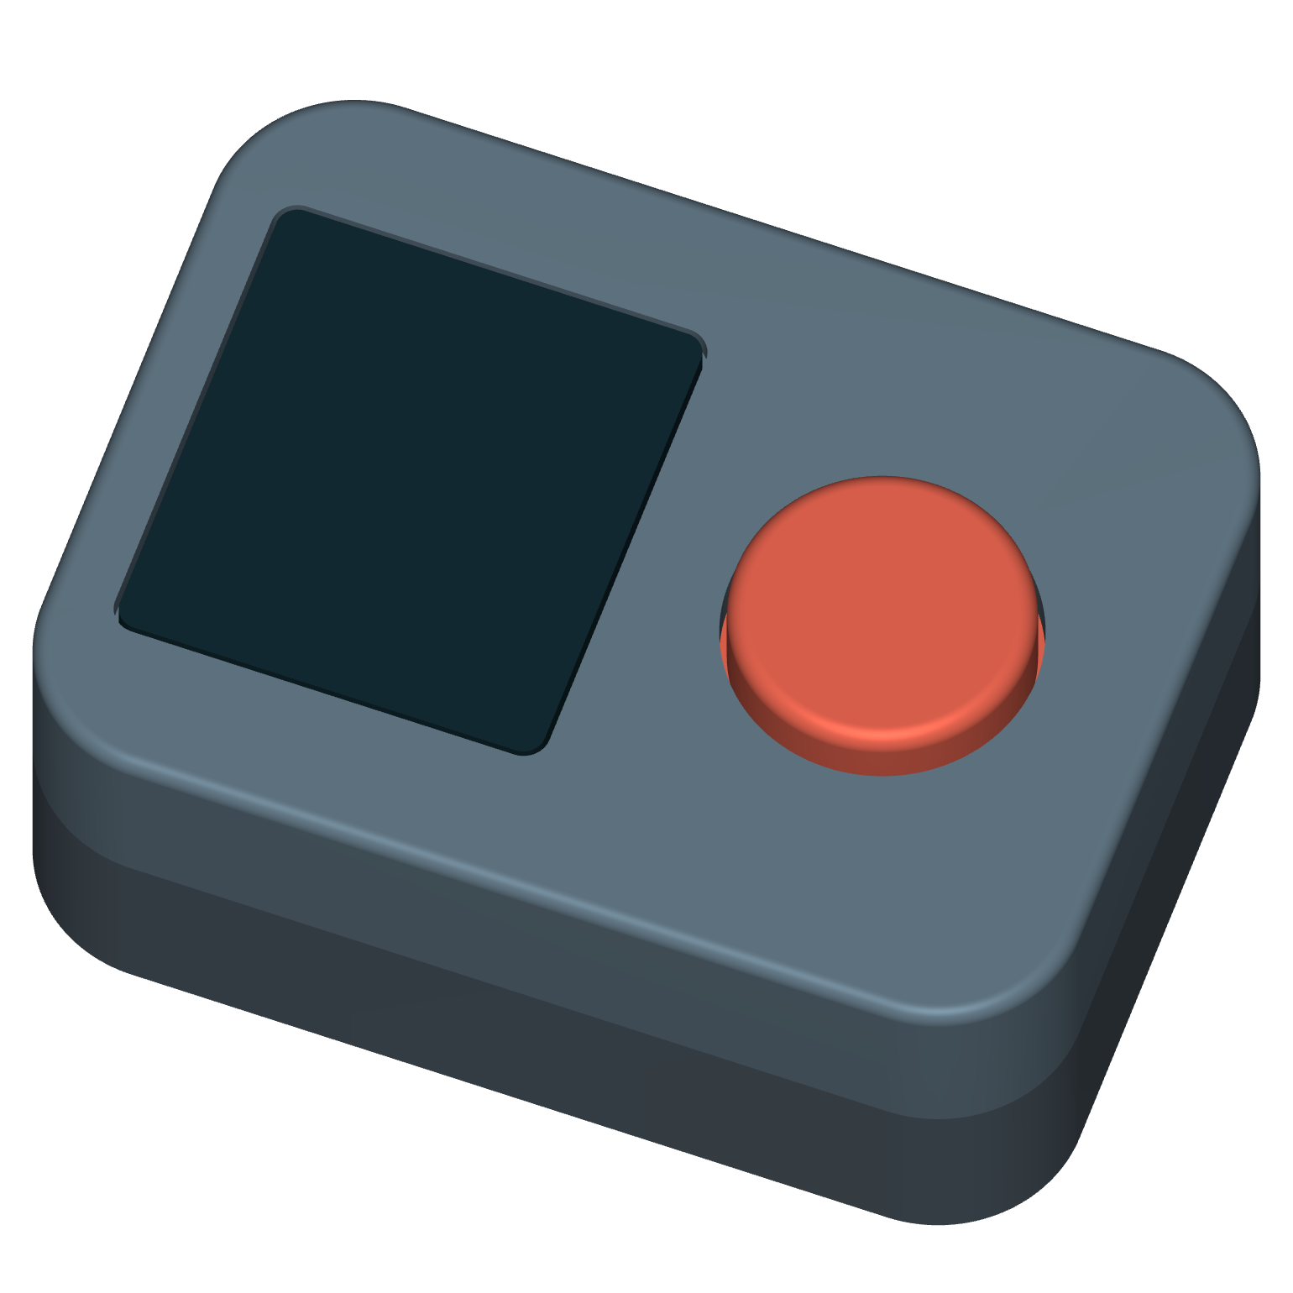
The band and its display
A screen beside the top button
Slip-on silicone band.
Removable sealed module.
Inductive charging through the cap.
Housing: 44 × 32 × 17.5 mm
Nominal concept dimensions. Window sealing and electrical integration require engineering development.
Notes:
The design keeps the slip-on band, removable sealed module, physical top button and inductive charging through the cap. The regenerated Rev D housing is nominally 44 × 32 × 17.5 millimetres, plus 2.2 millimetres of button protrusion. A separate modeled window covers the display body beside the button. The receiver coil sits beneath the opaque button side. CAD clearances do not establish the seal, electrical connections, charging efficiency or physical fit.
Source: supplied DBA_Design_Package_RevA.pdf, reviewed DBA_Design_Package_RevD.pdf and presentation/requirements.json. Concept by Rafael. Rev D display behavior is proposed; sample screen values are synthetic. Regenerated CAD defines the concept envelopes only. Pressure sealing, acoustic performance, cost and runtime remain unestablished.

Slide 7
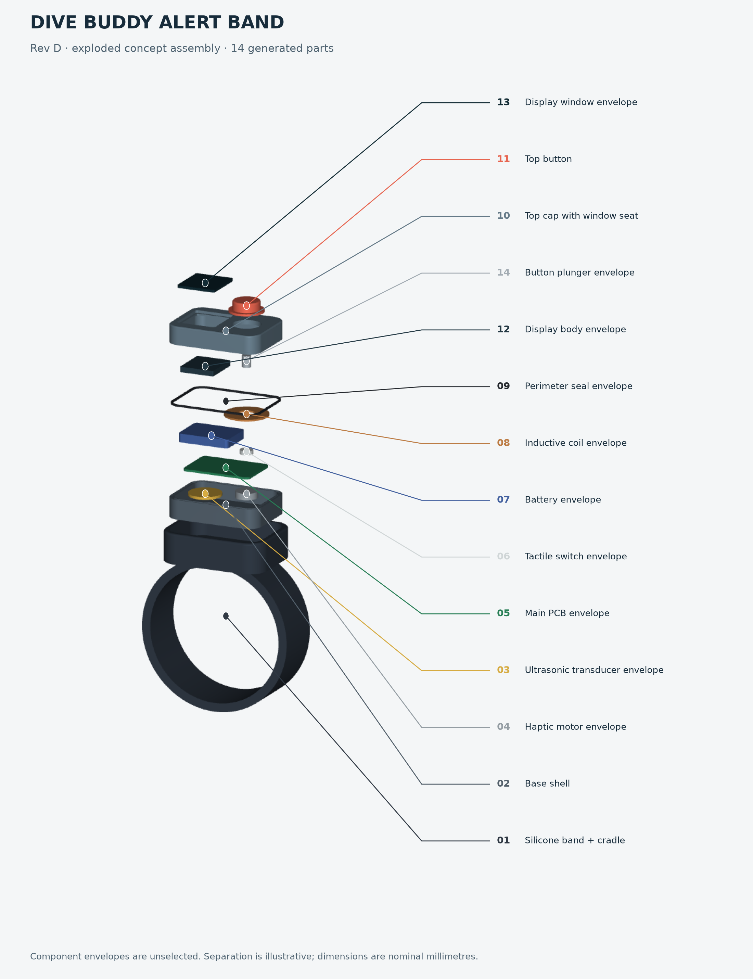
Acoustics and power
~65 kHz
Two-way acoustic ranging
20 m range target
Display integration adds
a window and a power load.
Display-variant runtime and mass remain unestimated. No validated range or pressure rating.
Notes:
The regenerated assembly includes separate display and window components. Its receiver coil sits beneath the opaque button side, with an opening around the modeled plunger. Approximately 65 kHz two-way ranging and a 20 m target remain. No measured range or depth rating is available. The display requires a complete power budget. Rev A runtime and mass figures do not establish the revised design’s performance. Geometric envelope checks do not qualify pressure sealing, charging or acoustic coupling.
Source: supplied DBA_Design_Package_RevA.pdf, reviewed DBA_Design_Package_RevD.pdf and presentation/requirements.json. Concept by Rafael. Rev D display behavior is proposed; sample screen values are synthetic. Regenerated CAD defines the concept envelopes only. Pressure sealing, acoustic performance, cost and runtime remain unestablished.

Slide 8
Paired kit economics
Two bands. One shared dock.
$179–199
≈ $86
Rev A retail target per pair
Rev A desk cost per pair
at 5,000 pairs, ±30%
The display variant has no revised price or cost estimate.
Baseline estimate excludes tooling, engineering, freight and duty.
Notes:
The product proposal remains two bands with one shared inductive charging dock for recreational buddy pairs. Rev A retail and cost numbers apply to the original screenless baseline. Rev D has no revised cost estimate or retail target. The original desk estimate is approximately $43 per band or $86 per pair at 5,000 pairs, plus or minus 30 percent, with dock allocation. It excludes tooling, non-recurring engineering, freight and duty. Supplier quotes, channel margins and customer demand are not established.
Source: supplied DBA_Design_Package_RevA.pdf, reviewed DBA_Design_Package_RevD.pdf and presentation/requirements.json. Concept by Rafael. Rev D display behavior is proposed; sample screen values are synthetic. Regenerated CAD defines the concept envelopes only. Pressure sealing, acoustic performance, cost and runtime remain unestablished.

Slide 9
Dive Buddy Alert Band
Feel the call.
See the distance.
A paired underwater communication concept
Concept by Rafael
An aid to buddy procedures. Never a safety guarantee.
Notes:
Close on the product concept: an addressed tactile call, visible communication state and fresh distance feedback on both bands. The display makes the proposed range information visible but introduces real integration tradeoffs. The current package offers an interactive interface study, the fourteen-part parametric assembly and coordinated engineering specification. It does not establish hardware readiness, direction finding, or safe reunion.
Source: supplied DBA_Design_Package_RevA.pdf, reviewed DBA_Design_Package_RevD.pdf and presentation/requirements.json. Concept by Rafael. Rev D display behavior is proposed; sample screen values are synthetic. Regenerated CAD defines the concept envelopes only. Pressure sealing, acoustic performance, cost and runtime remain unestablished.

