Slide 1
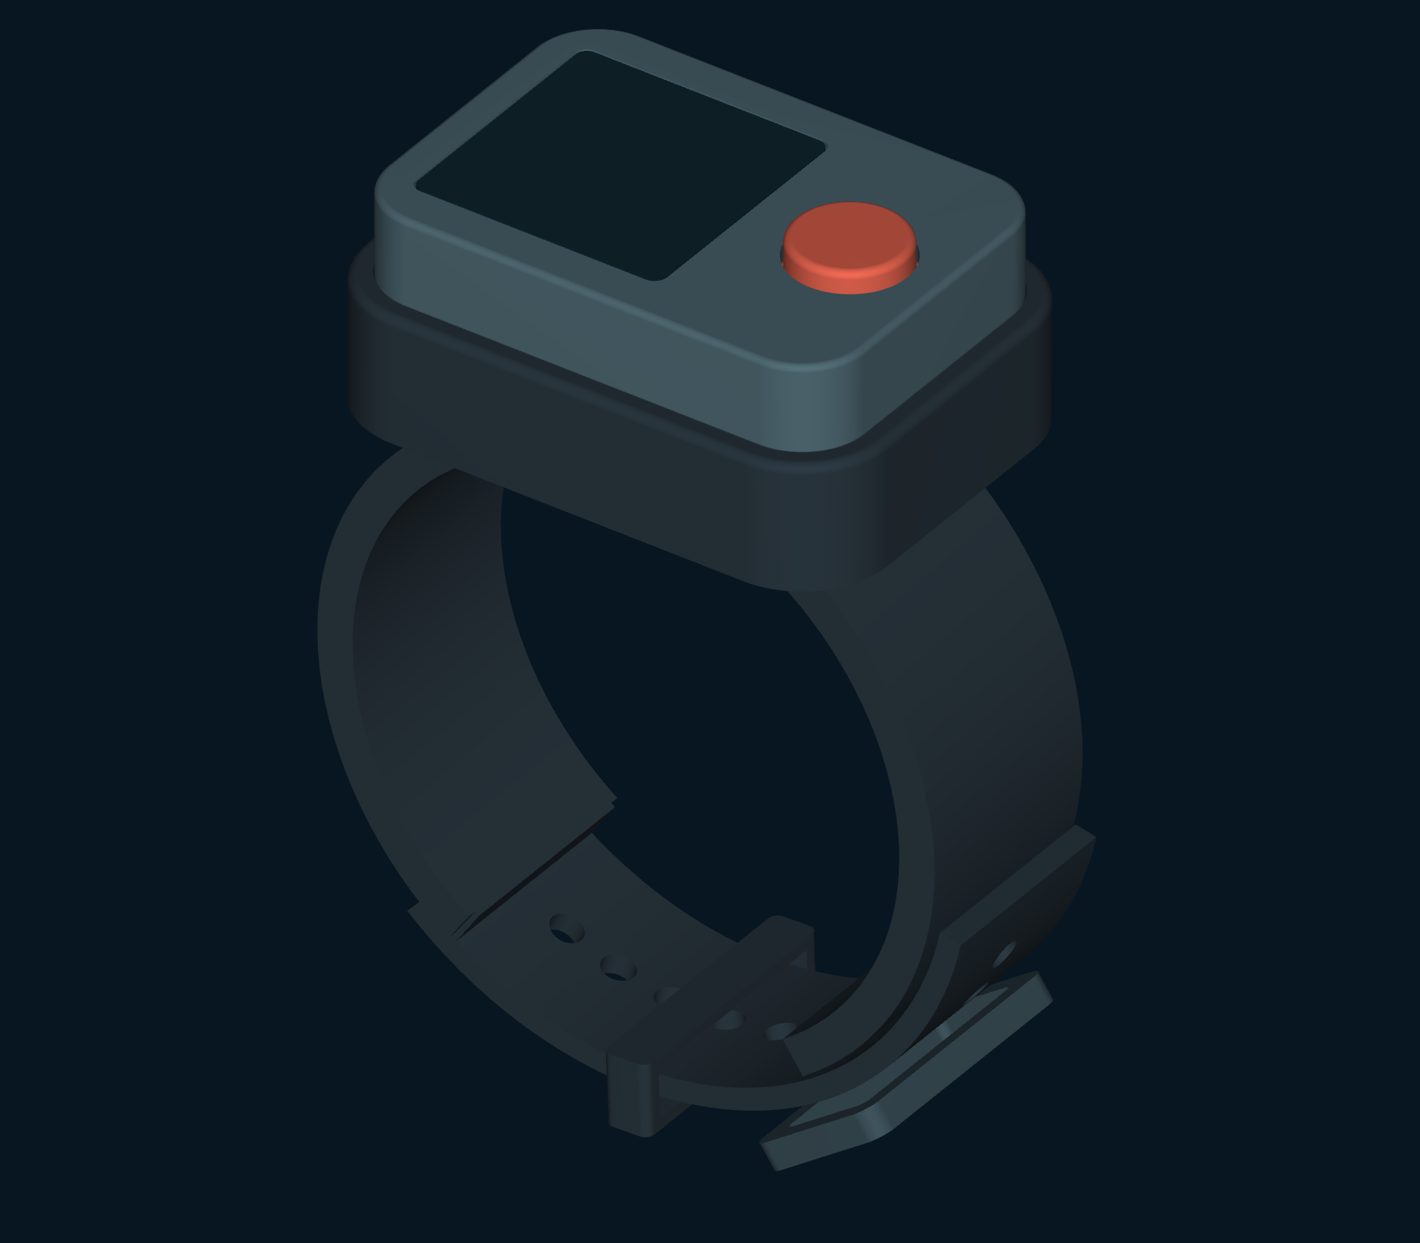
Dive Buddy
Alert Band
Stay in touch.
Know where to look.
Concept by Rafael
Presentation and CAD Rev F
Notes:
A reef draws one diver’s attention. Their buddy turns to share something else. Dive Buddy Alert Band brings that small but important connection to the wrist: a private call, a clear acknowledgement, and a proposed view of where the other diver is. Illustrative use scenario and simulated readings. Rev F is the current concept and CAD revision. Rev A economics are historical desk estimates for the earlier display-free design.
Source: presentation/story.json (Presentation Rev F), design-data.json (CAD Rev F), DBA_Design_Package_RevF.pdf and the supplied Rev A package. Concept by Rafael. Interface values are illustrative. CAD defines nominal concept envelopes, not pressure, acoustic or manufacturing performance.

Slide 2
A shared dive.
Two different points of view
A reef to explore. A change of plan.
A buddy just outside the field of view.
A hand signal needs to be seen.
Getting attention is the first step.
Understanding where to look is the next.
Notes:
Underwater, a hand signal depends on being seen. A buddy can be nearby yet outside the other diver’s field of view, above the reef or a few metres deeper. Getting their attention is the first step. Understanding where to look is the next. Illustrative use scenario and simulated readings. Rev F is the current concept and CAD revision. Rev A economics are historical desk estimates for the earlier display-free design.
Source: presentation/story.json (Presentation Rev F), design-data.json (CAD Rev F), DBA_Design_Package_RevF.pdf and the supplied Rev A package. Concept by Rafael. Interface values are illustrative. CAD defines nominal concept envelopes, not pressure, acoustic or manufacturing performance.

Slide 3
One press starts
the conversation
Before the dive
During the dive
Pair two bands.
Each diver has a defined
buddy connection.
Hold the top button.
Request a tactile alert
on the paired band.
One physical control. An addressed request for attention.
Notes:
Pair the bands before entering the water. A deliberate press requests a vibration on the paired band. The receiving diver presses to acknowledge. The caller sees that human response separately from the band’s automatic delivery receipt. Proposed mapping: at idle, short presses cycle views; a one-second hold calls. An incoming call is acknowledged with a short press. A hold cancels an active call. Surface pairing protocol and gesture arbitration remain undefined.
Source: presentation/story.json (Presentation Rev F), design-data.json (CAD Rev F), DBA_Design_Package_RevF.pdf and the supplied Rev A package. Concept by Rafael. Interface values are illustrative. CAD defines nominal concept envelopes, not pressure, acoustic or manufacturing performance.

Slide 4
The person responds.
The caller knows
CALLING
DEVICE REPLIED
PERSON RESPONDED
Sent
Received
Acknowledged
Waiting for a reply
The paired band replied
The buddy pressed once
Caller display
Caller display
Caller display
Device receipt and a human acknowledgement
remain separate states.
Proposed interaction · synthetic screen states
Notes:
Pair the bands before entering the water. A deliberate press requests a vibration on the paired band. The receiving diver presses to acknowledge. The caller sees that human response separately from the band’s automatic delivery receipt. Transport acknowledgement establishes device receipt only. A separate button press acknowledges the human response. Delayed packets, retries, simultaneous calls and remote cancellation require protocol definition.
Source: presentation/story.json (Presentation Rev F), design-data.json (CAD Rev F), DBA_Design_Package_RevF.pdf and the supplied Rev A package. Concept by Rafael. Interface values are illustrative. CAD defines nominal concept envelopes, not pressure, acoustic or manufacturing performance.

Slide 5
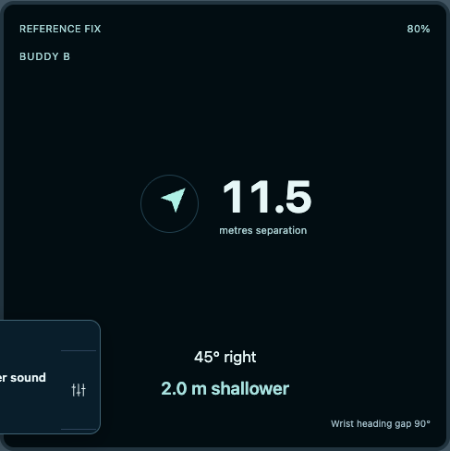
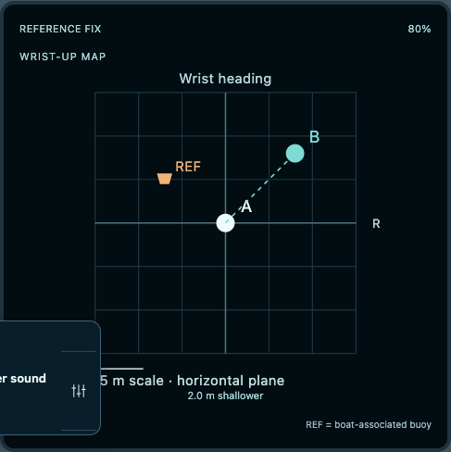
Distance gains context
Bearing + relative depth
Both divers, on one grid
Notes:
The proposed navigation view combines separation with horizontal bearing and a clear shallower-or-deeper cue. A second view places both divers on a horizontal grid. Dive information and the boat-associated reference each have a dedicated screen, so every number has a purpose. Buddy view: synthetic 11.5 m separation, horizontal bearing, and 2 m shallower. Map uses a horizontal grid and separate depth cue. Direction requires the proposed external positioning reference and band depth/heading sensing. Wrist heading is not necessarily swimming direction.
Source: presentation/story.json (Presentation Rev F), design-data.json (CAD Rev F), DBA_Design_Package_RevF.pdf and the supplied Rev A package. Concept by Rafael. Interface values are illustrative. CAD defines nominal concept envelopes, not pressure, acoustic or manufacturing performance.

Slide 6
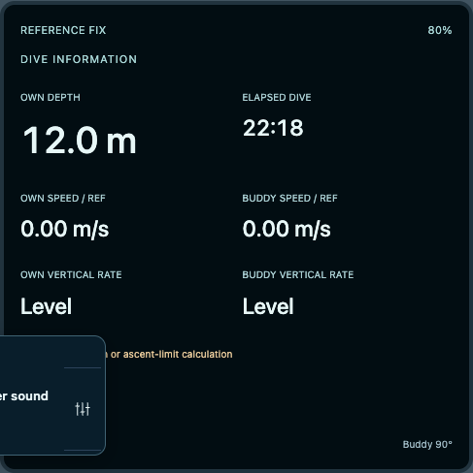
Time, depth and movement.
Each in its own place
Elapsed dive time. Own depth.
Both divers’ horizontal speed.
Both divers’ vertical rate.
Reference-relative motion and
depth change are different measures.
Proposed information display. No decompression or ascent-limit calculation.
Notes:
The Dive view shows elapsed time, own depth, both horizontal speeds relative to the acoustic reference and both vertical rates. Speeds in the moving scenario are synthetic. Reference-relative speed is not speed through water; vertical rate is not decompression protection. No safe ascent limit or bends-prevention claim. DAN source: https://dan.org/alert-diver/article/ascent-rates/
Source: presentation/story.json (Presentation Rev F), design-data.json (CAD Rev F), DBA_Design_Package_RevF.pdf and the supplied Rev A package. Concept by Rafael. Interface values are illustrative. CAD defines nominal concept envelopes, not pressure, acoustic or manufacturing performance.

Slide 7
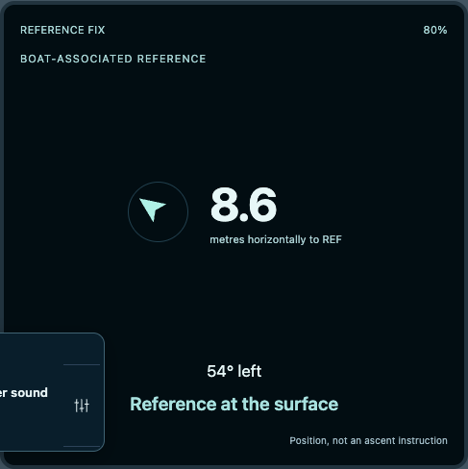
Direction needs
a shared reference
Boat-associated acoustic array
Shared positions for both bands
Band depth + wrist heading
Vertical context + display orientation
Extra equipment, setup and power. Missing fixes clear arrows and map points.
Notes:
Rev F adds a proposed boat-associated spaced acoustic array and orientation reference for shared horizontal positions. Pressure and heading sensing are added to each band. The Boat view shows horizontal distance to the associated reference, not a safe ascent instruction. A reference-to-boat relationship must be established; drift changes it. Array dimensions, synchronization, calibration, coverage, accuracy and runtime remain undefined. There is no reference hardware CAD or claim of existing product compatibility.
Source: presentation/story.json (Presentation Rev F), design-data.json (CAD Rev F), DBA_Design_Package_RevF.pdf and the supplied Rev A package. Concept by Rafael. Interface values are illustrative. CAD defines nominal concept envelopes, not pressure, acoustic or manufacturing performance.

Slide 8
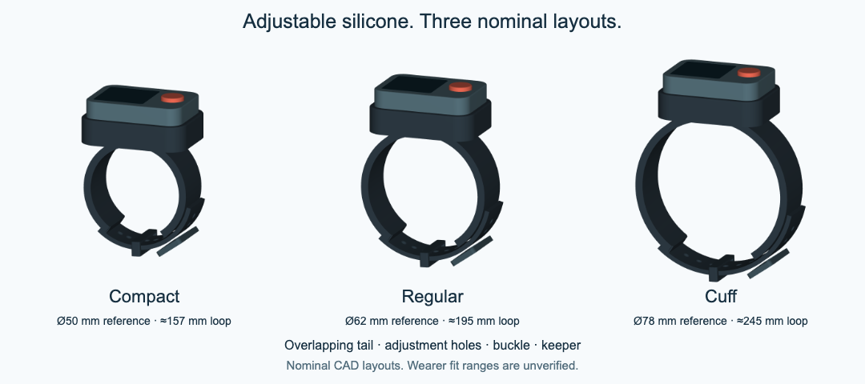
Adjust the fit.
Keep the connection
Notes:
A split silicone strap wraps around the wrist or suit cuff. Its overlapping tail adjusts through a proposed acetal buckle, with a silicone keeper securing the loose end. The sealed module remains removable when the strap needs replacing. Compact, Regular and Cuff are three modeled layouts, with nominal internal reference diameters of 50, 62 and 78 mm. Their circular reference circumferences are about 157, 195 and 245 mm. These dimensions describe CAD layouts; they are not established wrist-size ranges. Corrosion resistance is a design requirement. The proposed exterior combines silicone, an acetal buckle with nonmetal retention, and a polymer housing and window. No exposed steel pin or charging contacts are specified. Material grades, seal durability, buckle strength and the usable fit range remain unvalidated.
Source: presentation/story.json (Presentation Rev F), design-data.json (CAD Rev F), DBA_Design_Package_RevF.pdf and the supplied Rev A package. Concept by Rafael. Interface values are illustrative. CAD defines nominal concept envelopes, not pressure, acoustic or manufacturing performance.

Slide 9
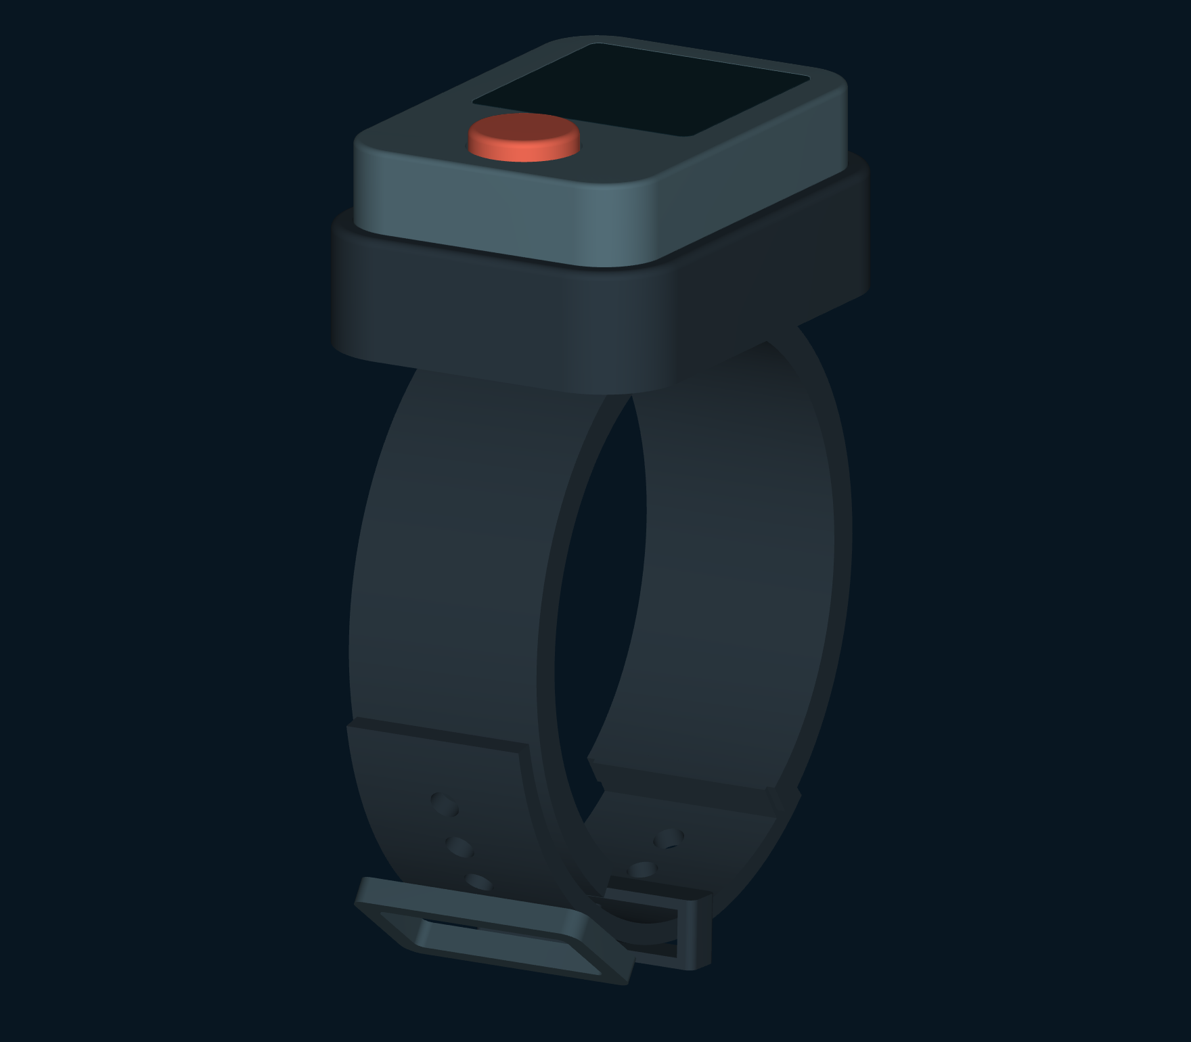
Adjustment has a place
in the actual model
Adjustable silicone strap.
Matte acetal buckle.
Silicone keeper.
Three nominal layouts: 50 / 62 / 78 mm.
Fit ranges still require definition.
Notes:
Compact, Regular and Cuff are three modeled layouts, with nominal internal reference diameters of 50, 62 and 78 mm. Their circular reference circumferences are about 157, 195 and 245 mm. These dimensions describe CAD layouts; they are not established wrist-size ranges. The main strap is 24 mm wide and 4 mm thick; the overlap tail is 22 mm wide and 2.4 mm thick with ten 3.5 mm holes. A matte acetal buckle with nonmetal retention and a silicone keeper are proposed. No exposed steel pin is specified. Corrosion resistance is required; UV-stabilized resin grade, latch strength, creep, attachment and saltwater durability remain unvalidated. Silicone elasticity supplements mechanical adjustment. Supported wearer ranges are not established.
Source: presentation/story.json (Presentation Rev F), design-data.json (CAD Rev F), DBA_Design_Package_RevF.pdf and the supplied Rev A package. Concept by Rafael. Interface values are illustrative. CAD defines nominal concept envelopes, not pressure, acoustic or manufacturing performance.

Slide 10

A larger display.
A removable sealed module
54 × 38 × 19.5 mm
Nominal housing dimensions
24 × 24 mm active display area.
One physical button on top.
Inductive charging through the cap.
Concept geometry. No pressure rating, validated runtime or manufacturing release.
Notes:
The Rev F housing is 54 × 38 × 19.5 mm, excluding 2.2 mm button protrusion. The display body is 26 × 26 × 3 mm with 28 × 28 × 1.2 mm window and 24 × 24 mm active area. Eighteen modeled envelopes include pressure/heading sensors and adjustment hardware. Coil beneath the button side receives inductive charging through the sealed cap. The exterior housing and window are proposed nonmetal materials, with electronics isolated from seawater and no exposed charging contacts. Material grades, wiring, pressure coupling, supports, tolerances and sealing are unestablished.
Source: presentation/story.json (Presentation Rev F), design-data.json (CAD Rev F), DBA_Design_Package_RevF.pdf and the supplied Rev A package. Concept by Rafael. Interface values are illustrative. CAD defines nominal concept envelopes, not pressure, acoustic or manufacturing performance.

Slide 11
A pair of bands.
A shared reference
For buddy pairs and dive operators
The proposition: an addressed call
with useful spatial context on the wrist.
Reference deployment, acoustic performance, wearability,
runtime and complete-system cost remain to be established.
Notes:
The navigation concept adds a boat-associated acoustic positioning reference to the paired bands and inductive dock. A dive operator would deploy that reference; each diver would wear a band. This adds equipment and setup, while making buddy bearing and boat-relative position possible in the proposed system. The value proposition is a private buddy call with readable spatial context. Demand, operator workflow, reference coverage, runtime and the complete system’s price remain unestablished. The presentation defines a product direction for discussion, not a finished underwater navigation instrument. Historical Rev A desk estimate: $86 per pair at 5,000 pairs, ±30%, with a $179–199 retail target. It excluded tooling, engineering, freight and duty. It does not price the current display, sensing or acoustic reference. Published commentary informed requirements but does not establish demand for DBA.
Source: presentation/story.json (Presentation Rev F), design-data.json (CAD Rev F), DBA_Design_Package_RevF.pdf and the supplied Rev A package. Concept by Rafael. Interface values are illustrative. CAD defines nominal concept envelopes, not pressure, acoustic or manufacturing performance.

Slide 12
Stay in touch.
Know where to look
A clear call. A human response.
A proposed view of your buddy.
Explore the interactive concept, then open
the current drawings and editable presentation.
Concept by Rafael. An aid to buddy procedures, never a safety guarantee.
Presentation strategy, design & production by The AI Doc
Prepared for Rafael
Notes:
A reef draws one diver’s attention. Their buddy turns to share something else. Dive Buddy Alert Band brings that small but important connection to the wrist: a private call, a clear acknowledgement, and a proposed view of where the other diver is. Direction and map views require the proposed acoustic positioning reference, plus depth and heading sensing on the bands. All interface readings shown here are simulated. DBA remains an aid to buddy procedures, never a safety guarantee. Illustrative use scenario and simulated readings. Rev F is the current concept and CAD revision. Rev A economics are historical desk estimates for the earlier display-free design.
Source: presentation/story.json (Presentation Rev F), design-data.json (CAD Rev F), DBA_Design_Package_RevF.pdf and the supplied Rev A package. Concept by Rafael. Interface values are illustrative. CAD defines nominal concept envelopes, not pressure, acoustic or manufacturing performance.

