Slide 1
Fact Extraction and Verification
Group - 19
Aditya R Hedge(201IT105)
Buddha Teja(201IT115)
Dhruv N Pai(201IT118)
Bharath C Kulkarni(201IT213)
Guided by
Dr. Anand Kumar

Slide 2
Dataset
Fever Dataset :- https://fever.ai/dataset/fever.html
It contains nearly 145K samples of claims and evidence_ids (which are used to extract evidences related to claims using the wikipedia API), we have considered the samples with verifiability status as non verifiability doesn’t contain any evidences related to their claims.
We then generated our own dataset by combining the evidences into one large evidence text. Our generated dataset will have claim+evidence as one of the attributes and labels as another attribute.

Slide 3
Methodology
Fact Extraction :-
For the train data whose evidences are already collected, the facts for them are extracted using a wikipedia API, In here we improved the computation by eliminating the redundant evidences and replacing the highly correlated evidences.
For the test data whose claims are only known, the evidences are extracted based on all the possible key words,phrases and names that are involved with in the claim.

Slide 4
Methodology
Fact Extraction :
As the average number of evidences per claim is 2.6, For each of the evidence_ids(keywords) that are generated three of the top evidences are selected using the context similarity of the extracted evidence’s content(extracted using the wikipedia API and then cleaned accordingly)

Slide 5
Methodology
Fact Verification :
The Encoded tokens of the Claim+Evidences and the labels related to them are sent as an input to the DeBERTa Model in the batch sizes of 32 and for 10 epochs
We have improved the accuracy of DeBERTa model on the dataset by tuning the hyper parameters and optimizing the test_evidences. As the test accuracy of the data doesn’t change much even there is a change in train data accuracy on the model for epochs higher than 10, we have considered 10 epochs to prevent the overfitting

Slide 6
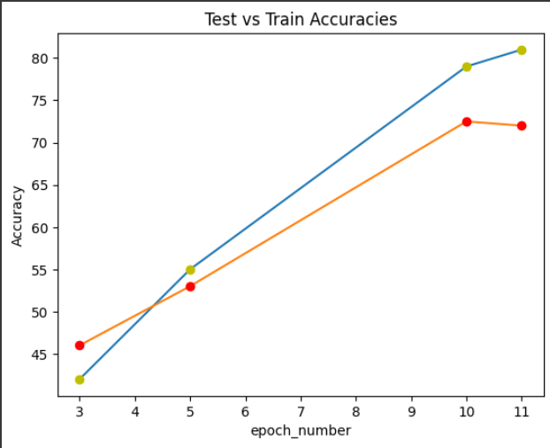
Results
The average accuracy of the model over the 20K samples of the data is 72.3%

Slide 7
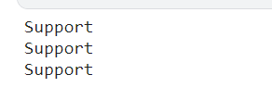
Results
For the considered claim of
The Extracted Evidence_ids along with their rankings are :
And the truthness of the claim according to
These Evidence_ids are :

Slide 8
Literature Survey
https://ieeexplore.ieee.org/document/9415192
An Empirical Comparison of BERT, RoBERTa, and Electra for Fact Verification
In this paper, bert, Roberta and electra are compared for fact verification. According to this paper Roberta shows best accuracy followed by bert and electra.
https://huggingface.co/docs/transformers/model_doc/deberta
From huggingface website we found out that compared to RoBERTa, a DeBERTa model trained on half of the training data performs consistently better on a wide range of NLP tasks.

Slide 9
THANK YOU

Slide 19
Future Work
We are planning to
Implement Fact Extraction for the Claim by generating evidences from the wikipedia using the topic and context similarity techniques
Eliminate the redundant evidences based on their relative correlations
Focus on individual Evidences collected rather than all the evidences combined
Try for different models like the RoBERTa, ELECTRA…

