Slide 1
Heterogeneous Parallel Computing for Efficient Polygon Clipping Computation over Big Spatial Datasets
Buddhi Ashan

Slide 2
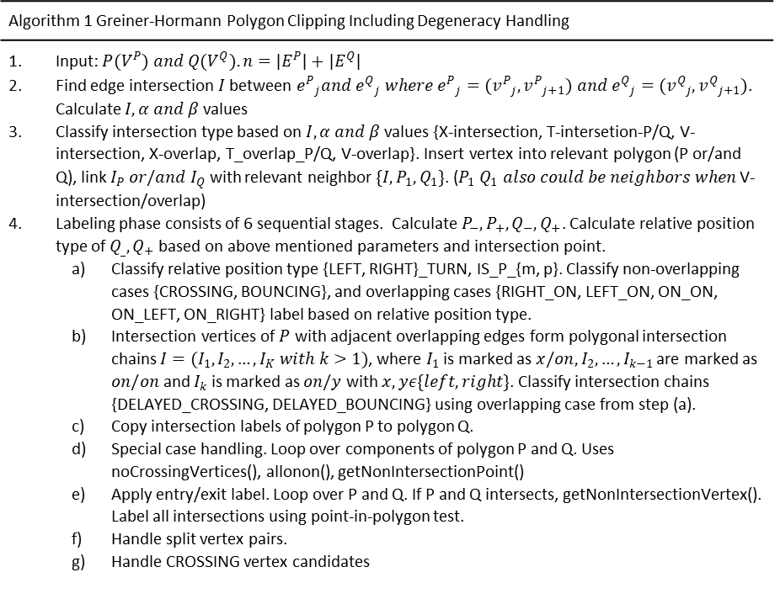
Sequential Algorithm
Algorithm 1 Greiner-Hormann Polygon Clipping Including Degeneracy Handling
Input: $P(V^{P}) and Q(V^{Q}). n=|E^{P}|+|E^{Q}|$ Find edge intersection $I$ between ${e^{P}}_{j}and {e^{Q}}_{j} where {e^{P}}_{j}=({v^{P}}_{j},{v^{P}}_{j+1}) and {e^{Q}}_{j}=({v^{Q}}_{j},{v^{Q}}_{j+1})$. Calculate $I, α and β$values Classify intersection type based on $I, α and β$values {X-intersection, T-intersetion-P/Q, V-intersection, X-overlap, T_overlap_P/Q, V-overlap}. Insert vertex into relevant polygon (P or/and Q), link $I_{P} or/and I_{Q}$ with relevant neighbor $\{I, P_{1}, Q_{1}\}$. ($P_{1} Q_{1} also could be neighbors when$ V-intersection/overlap) Labeling phase consists of 6 sequential stages. Calculate $P_{−}, P_{+}, Q_{−}, Q_{+}$. Calculate relative position type of $Q_{_}, Q_{+}$based on above mentioned parameters and intersection point. Classify relative position type {LEFT, RIGHT}_TURN, IS_P_{m, p}. Classify non-overlapping cases {CROSSING, BOUNCING}, and overlapping cases {RIGHT_ON, LEFT_ON, ON_ON, ON_LEFT, ON_RIGHT} label based on relative position type. Intersection vertices of $P$ with adjacent overlapping edges form polygonal intersection chains $I=(I_{1}, I_{2}, …, I_{K} with k>1)$, where $I_{1}$ is marked as $x/on, I_{2}, …, I_{k−1}$ are marked as $on/on$ and $I_{k}$ is marked as $on/y$ with $x,yε\{left, right\}$. Classify intersection chains {DELAYED_CROSSING, DELAYED_BOUNCING} using overlapping case from step (a). Copy intersection labels of polygon P to polygon Q. Special case handling. Loop over components of polygon P and Q. Uses noCrossingVertices(), allonon(), getNonIntersectionPoint() Apply entry/exit label. Loop over P and Q. If P and Q intersects, getNonIntersectionVertex(). Label all intersections using point-in-polygon test. Handle split vertex pairs. Handle CROSSING vertex candidates

Slide 3
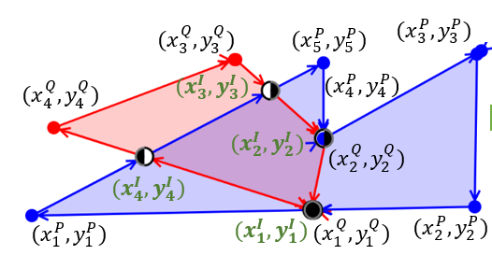
Acquire Intersection Type
P
225 | 550
775 | 500
725 | 200
625 | 350
425 | 175
225 | 550
intersect_type | ep1-x | ep1-y | ep2-x | ep2-y | eq1-x | eq1-y | eq2-x | eq2-y | alpha | beta
3 | 225 | 550 | 775 | 500 | 500 | 525 | 625 | 350 | 0.5 | 0
0 | 225 | 550 | 775 | 500 | 625 | 350 | 300 | 225 | 1.35294 | -1.05882
0 | 225 | 550 | 775 | 500 | 300 | 225 | 150 | 425 | -0.32927 | 1.70732
0 | 225 | 550 | 775 | 500 | 150 | 425 | 500 | 525 | 0.5 | 1
0 | 775 | 500 | 725 | 200 | 500 | 525 | 625 | 350 | 0.972973 | 1.81081
0 | 775 | 500 | 725 | 200 | 625 | 350 | 300 | 225 | 0.328767 | -0.41096
0 | 775 | 500 | 725 | 200 | 300 | 225 | 150 | 425 | 2.47727 | -2.34091
0 | 775 | 500 | 725 | 200 | 150 | 425 | 500 | 525 | -0.3625 | 1.8375
0 | 725 | 200 | 625 | 350 | 500 | 525 | 625 | 350 | 1 | 1
0 | 725 | 200 | 625 | 350 | 625 | 350 | 300 | 225 | 1 | 0
0 | 725 | 200 | 625 | 350 | 300 | 225 | 150 | 425 | -32.5 | -24.5
0 | 725 | 200 | 625 | 350 | 150 | 425 | 500 | 525 | 2.18 | 1.02
0 | 625 | 350 | 425 | 175 | 500 | 525 | 625 | 350 | 0 | 1
4 | 625 | 350 | 425 | 175 | 625 | 350 | 300 | 225 | 0 | 0
0 | 625 | 350 | 425 | 175 | 300 | 225 | 150 | 425 | 1.26415 | -0.48113
0 | 625 | 350 | 425 | 175 | 150 | 425 | 500 | 525 | -1.78788 | 2.37879
0 | 425 | 175 | 225 | 550 | 500 | 525 | 625 | 350 | 4.78947 | -8.26316
1 | 425 | 175 | 225 | 550 | 625 | 350 | 300 | 225 | 0.217021 | 0.748936
0 | 425 | 175 | 225 | 550 | 300 | 225 | 150 | 425 | -1.07692 | -2.26923
1 | 425 | 175 | 225 | 550 | 150 | 425 | 500 | 525 | 0.760331 | 0.35124
Q
500 | 525
625 | 350
300 | 225
150 | 425
500 | 525

Slide 4
Intersection Calculation: Output
s1 | s2 | s3 | relativePositionType |  | Ix | Iy
-23517.6 | -23517.6 | 0 | 1 | RIGHT | 500 | 525
-45000 | -45000 | 0 | 1 | RIGHT | 500 | 525
1250 | -56875 | 47500 | 1 | RIGHT | 625 | 350
45872.3 | -23872.3 | 47500 | 1 | RIGHT | 625 | 350
-23872.3 | -59764 | 3.64E-12 | 1 | RIGHT | 381.596 | 256.383
8002.66 | 20034.5 | 3.64E-12 | 0 | LEFT | 381.596 | 256.383
28863.3 | 12732.4 | -7.28E-12 | 0 | LEFT | 272.934 | 460.124
-53312.2 | -23517.6 | -7.28E-12 | 1 | RIGHT | 272.934 | 460.124

Slide 5
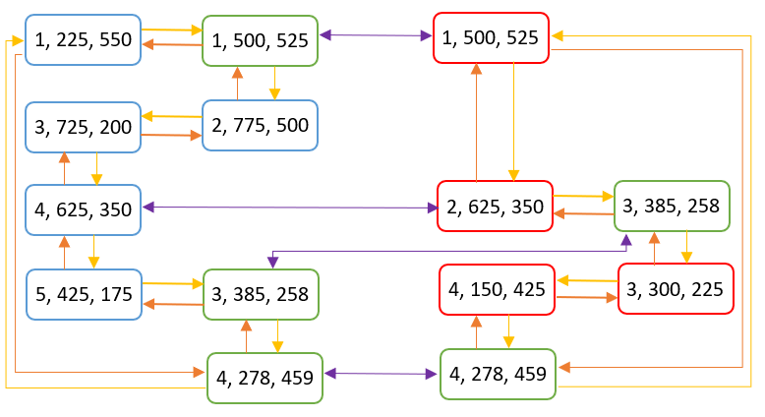
Data Structure From Step 1

Slide 6
1)Initial Classification Label
6 Steps in labeling
Initial classification
Classify intersection chain
Copy labels from P to Q. Check for special cases
Set entry/exit flags
Handle split vertex pairs
Handle CROSSING vertex candidates
500 | 525 | 2 | BOUNCING
625 | 350 | 2 | BOUNCING
381.596 | 256.383 | 1 | CROSSING
272.934 | 460.124 | 1 | CROSSING

Slide 7
2) Classify Intersection Chain
500 | 525 | +2 | BOUNCING
625 | 350 | +2 | BOUNCING
381.596 | 256.383 | +1 | CROSSING
272.934 | 460.124 | +1 | CROSSING

Slide 8
4) Set Entry/Exit Flag
500 | 525 | &2 | NEITHER
625 | 350 | &2 | NEITHER
381.596 | 256.383 | &1 | ENTRY
272.934 | 460.124 | &0 | EXIT
272.934 | 460.124 | &1 | ENTRY
500 | 525 | &2 | NEITHER
625 | 350 | &2 | NEITHER
381.596 | 256.383 | &0 | EXIT

Slide 9
Parallel Algorithm

