Slide 1
Data Parallel DNN Training with Tensorflow
High Performance Machine Learning
CS 5463
Buddhi Ashan M. K.
Spring 2025

Slide 2
Overview
TensorFlow API to distribute training across multiple GPUs, multiple machines, or TPUs
tf.distribute.Strategy
Supports
high-level API methods via Keras
Custom training loops

Slide 3
Class Code Repository
All code files we are using in the class can be found at the following git repo:
https://github.com/buddhi1/pdc-class.git
Clone the repo
git clone https://github.com/buddhi1/pdc-class.git
Or download as a zip file

Slide 4
Types of Strategies
Synchronous
MirroredStrategy
MultiWorkerMirroredStrategy
CentralStorageStrategy
Asynchronous training
ParameterServerStrategy
Support different platforms including multiple GPUs, multiple machines, and TPUs

Slide 5
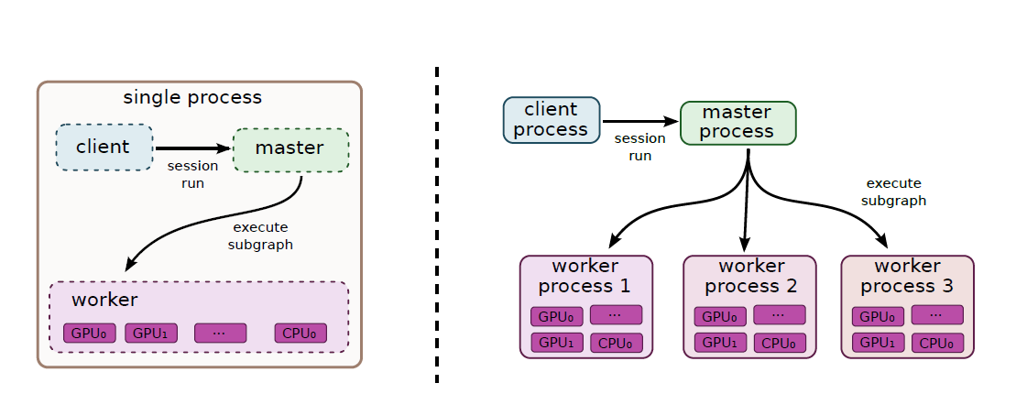
Single node Multi GPU DNN Training
Abadi, Martın, Paul Barham, Jianmin Chen, Zhifeng Chen, Andy Davis, Jeffrey Dean, Matthieu Devin, et al. n.d. “TensorFlow: A System for Large-Scale Machine Learning.”

Slide 6
MirroredStrategy
Synchronous distributed training on multiple GPUs on one machine.
The model replicated across all devices.
Together, these variables form a single conceptual variable called MirroredVariable.
These variables are kept in sync with each other by applying identical updates.

Slide 7
Arc
srun -p gpu2v100 -gres=gpu:2 -N 1 -n 64 -t 0:30:0 --pty bash
ml anaconda3
conda create --name tf-gpu tensorflow-gpu
conda activate tf-gpu
All commands can be found in the commandsForArc.txt

Slide 8
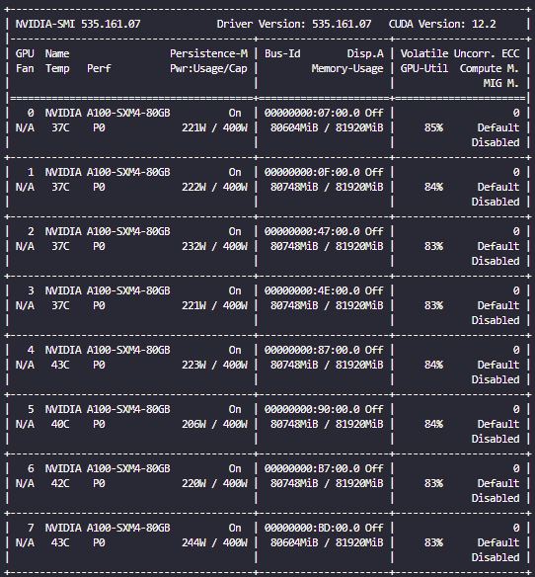
dgx with Eight GPUs

Slide 9
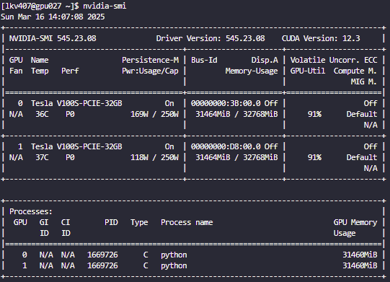
Arc: 1 GPU

Slide 10
Cross Device Communication
tf.distribute.HierarchicalCopyAllReduce
tf.distribute.ReductionToOneDevice
tf.distribute.NcclAllReduce (default)
mirrored_strategy = tf.distribute.MirroredStrategy(
cross_device_ops=tf.distribute.HierarchicalCopyAllReduce())

Slide 11
Distributed DNN Training
Abadi, Martın, Paul Barham, Jianmin Chen, Zhifeng Chen, Andy Davis, Jeffrey Dean, Matthieu Devin, et al. n.d. “TensorFlow: A System for Large-Scale Machine Learning.”

Slide 12
MultiWorkerMirroredStrategy
Synchronous distributed training across multiple workers, each with potentially multiple GPUs.
Creates copies of all variables in the model on each device across all workers

Slide 13
Cross Device Communication
communicationImplementation.RING: RPC-based and supports both CPUs and GPUs.
communicationImplementation.NCCL: NCCL and provides state-of-art performance on GPUs but it doesn't support CPUs.
collectiveCommunication.AUTO: defers the choice to Tensorflow
communication_options = tf.distribute.experimental.CommunicationOptions(
implementation=tf.distribute.experimental.CommunicationImplementation.NCCL)
strategy = tf.distribute.MultiWorkerMirroredStrategy(
communication_options=communication_options)

Slide 14
Google Colab
https://colab.research.google.com/drive/1VBfV3D9Sa4G3o_Uys4egCFLIO-jNlQV4?usp=sharing

Slide 15
Arc
srun -p compute1 -N 2 -n 128 -t 0:30:0 --pty bash
ml anaconda3
conda create --name tf-gpu tensorflow-gpu
conda activate tf-gpu
How to get the list of available nodes:
echo $SLURM_NODELIST
ssh <other node id>
ml anaconda3
conda create --name tf-gpu tensorflow-gpu
conda activate tf-gpu

