Slide 1


eZee Technosys Pvt. Ltd introduces “eZee Absolute” – Web based Hotel Management System which is developed to accommodate needs of various type of properties like hotels, motels, resorts hostel, apartments.
eZee Absolute is a key that ensure the most comprehensive coverage of your venture, integrating every department. It assures that your hotel works efficiently, increases revenue and enhances guest experience.
It is extremely user friendly, effortless, highly reliable, stable
and very secured.
“So, let’s take a glance with feel and comprehend the outline of eZee Absolute”.

Slide 2
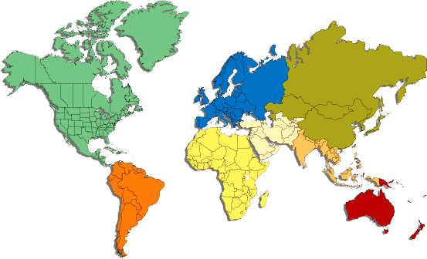
eZee Absolute Worldwide
eZee Hospitality IT solutions is used in more then 87 countries with support centers in 39 countries as on June 2011.
Headquarter
- Support Centers
- Installation
The popular eZee Absolute Hotel Management System is available with SaaS (Software as a Service) Technology and Cloud computing.

Slide 3
Key Features
Here are the Reasons, why eZee Absolute for your Property…
Guest Room Reservation & Group Reservation
Automatic data backup
Audit Trails - who changed, what and when
Foreign Currency Folio
Room Blocking for any transaction
Multiple Language Support
Can Connect on N number of systems & Users
Secure, Solid & Stable.
Powerful yet Flexible.
Easy to use & Easy to maintain
Feature full & Affordable.
Faster, Easier System Configuration
No Installation Required

Slide 4




Comprises
eZee Absolute offers a wide range of integrations to third party systems
and hardware. It integrates with,
Property Management Software (PMS)
Customer Relationship Management (CRM)
Central Reservation System (CRS)
Multiple Channel Management Systems
Internet Booking Engine
Travel Agents & Corporate System Management
Payment Gateway
Authorize.net

Slide 5
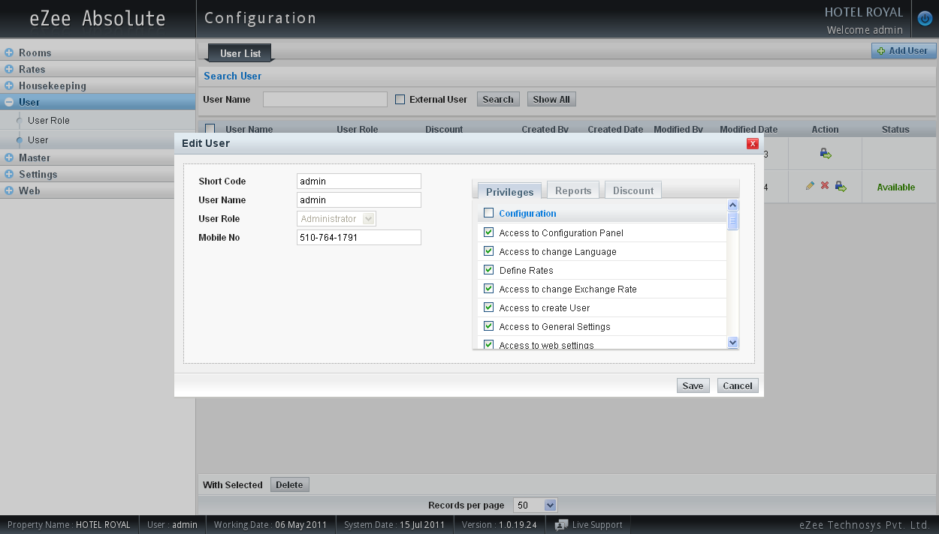
User Configuration
eZee Absolute allows you to configure your user’s privileges accurately. You can grant immunity to your user accessing certain functions and reports. That affix high security to your data and leaves no room for any malpractice.

Slide 6
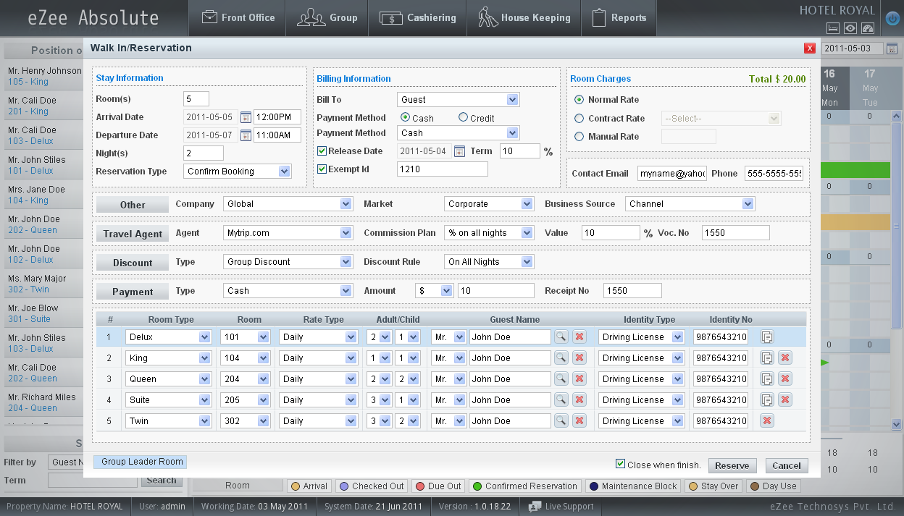
Walk In
eZee Absolute offers easy to use interfaces for Guest Check In, Reservation and Group Management. It’s unique user interface allows you to Check In a guest in just 3 clicks.

Slide 7
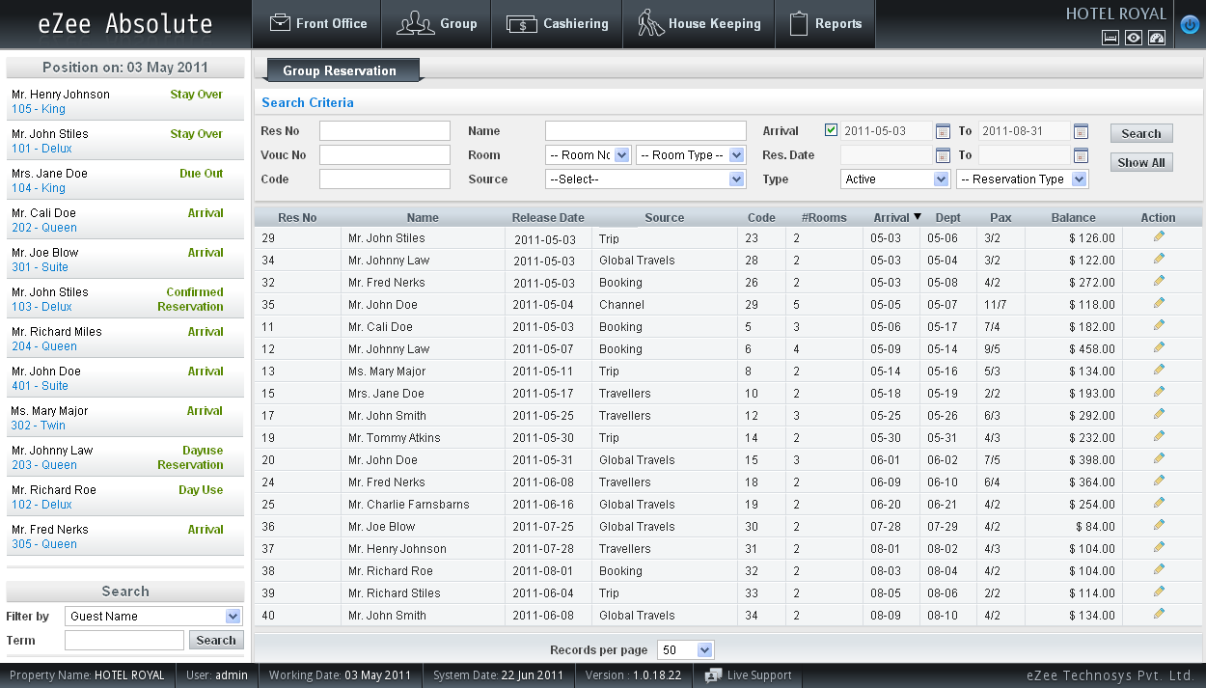
Group Reservation
eZee Absolute offers very flexible Group Management function. A room can be checked in/out individually or in group. Rooms can have different rate types and plans. Individual and Group folios are available.

Slide 8
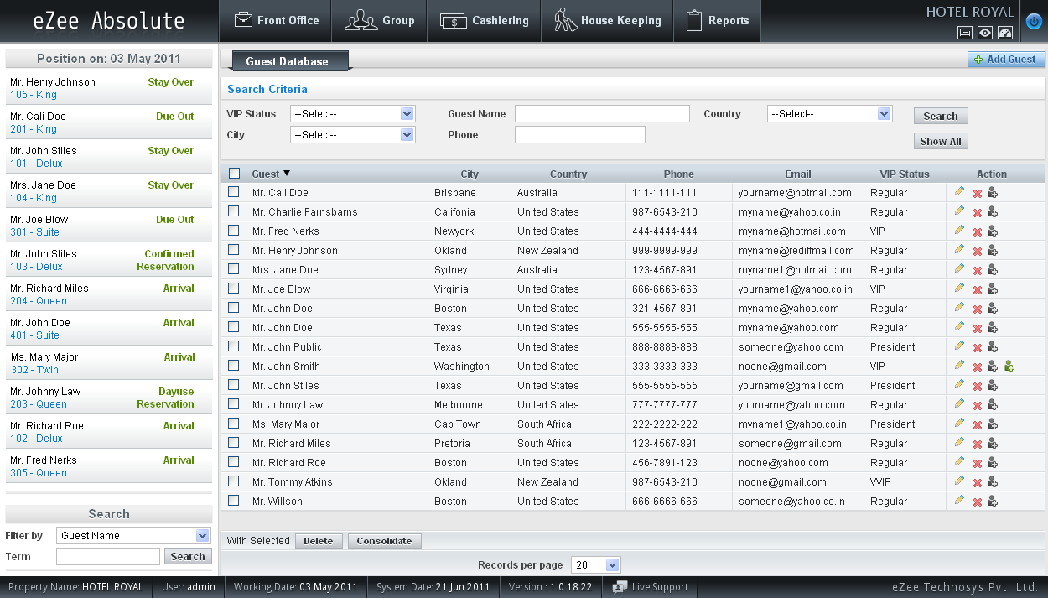
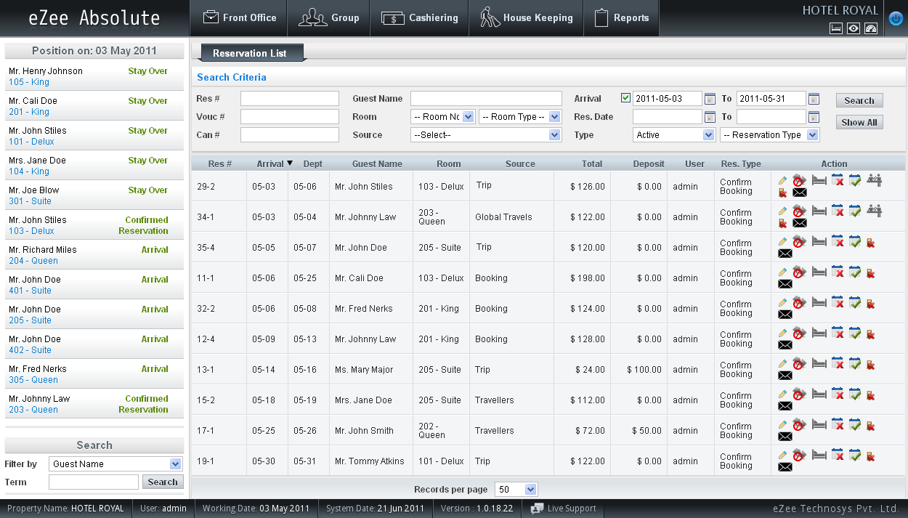
Guest Profile
eZee Absolute enables you to record every single detail about your Guest. You can use historical data for enhanced guest experience and same information can be used for sales and marketing.

Slide 9
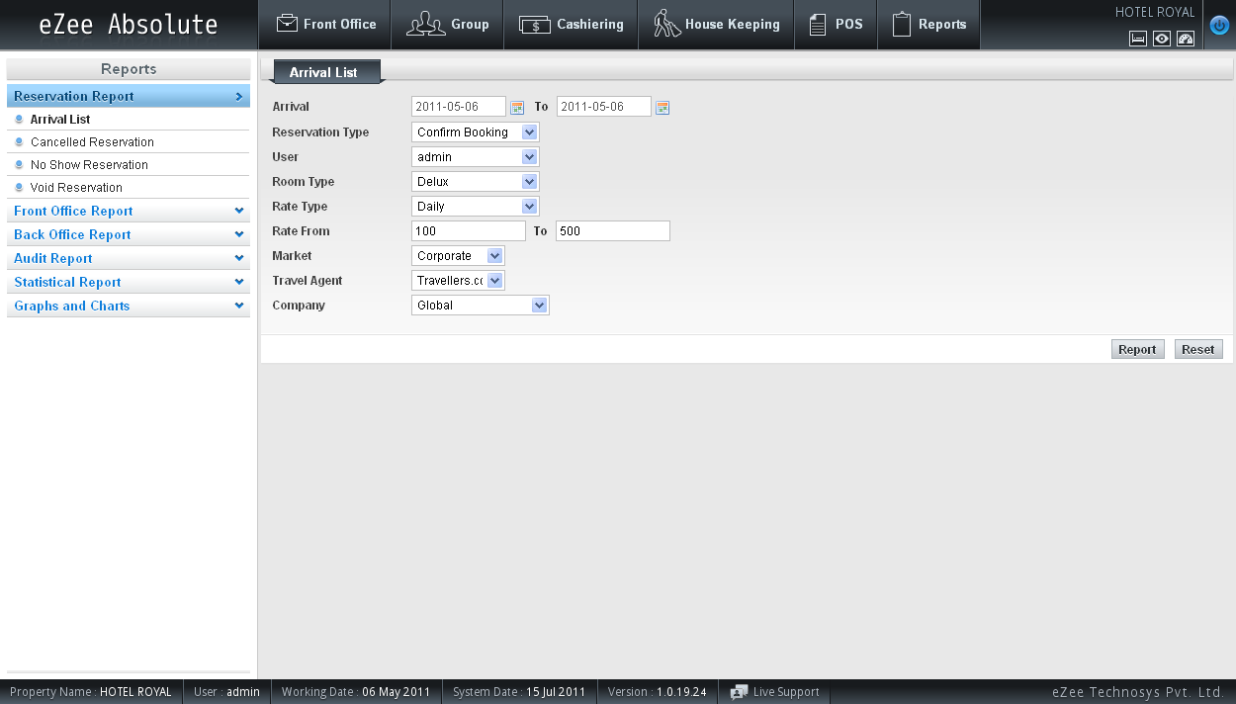
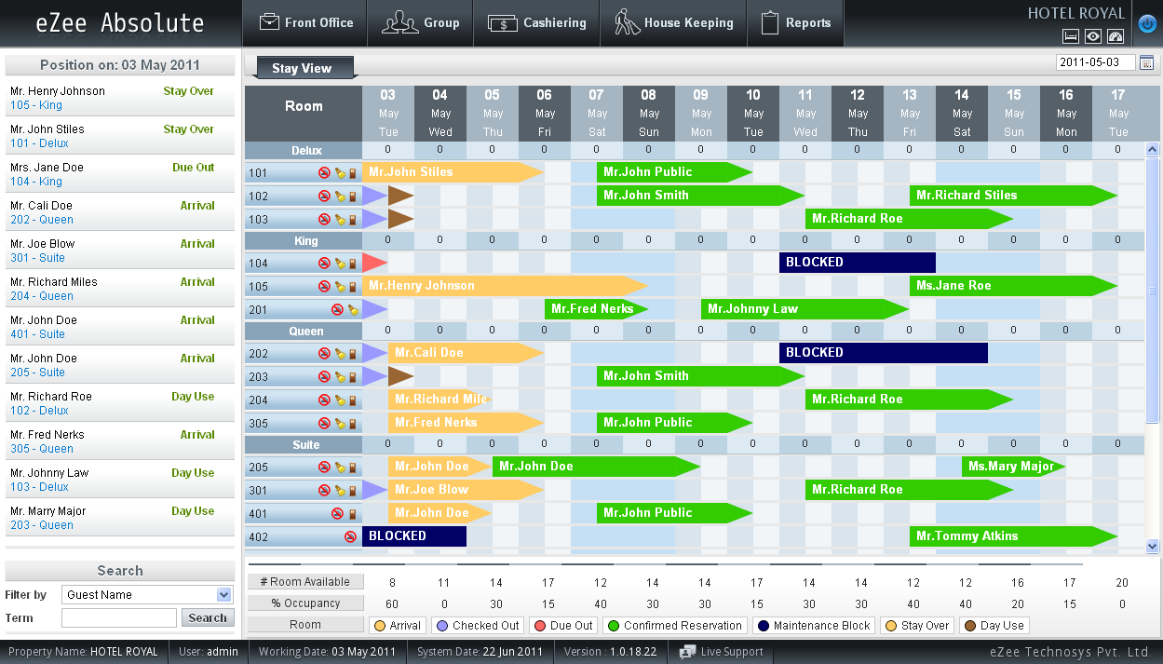
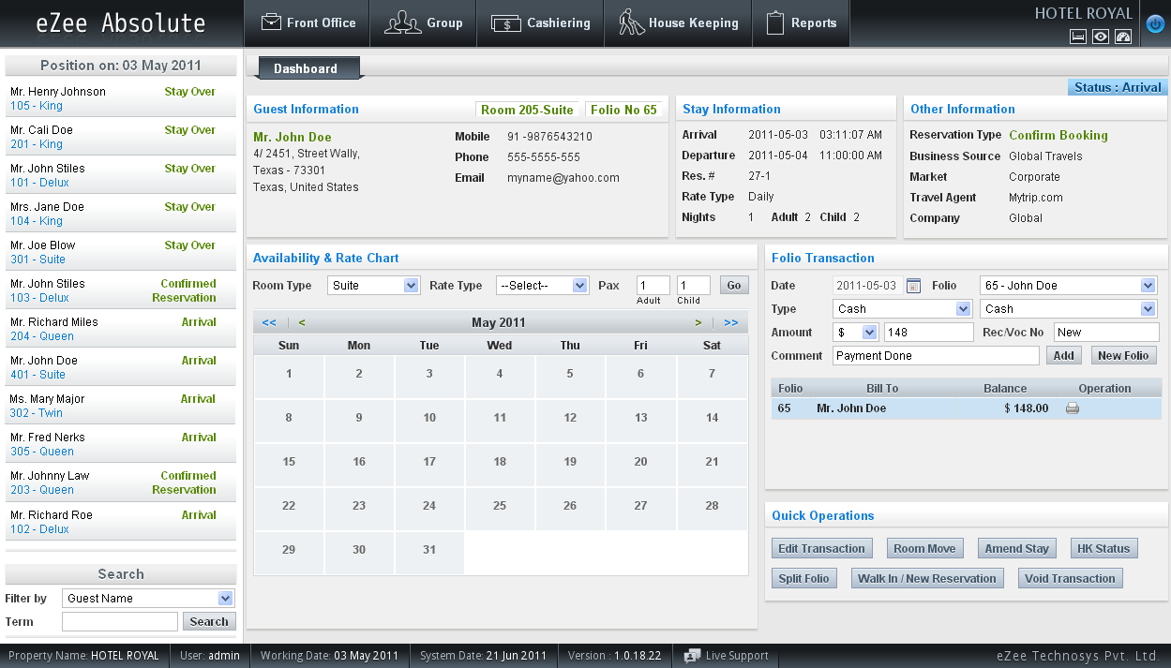
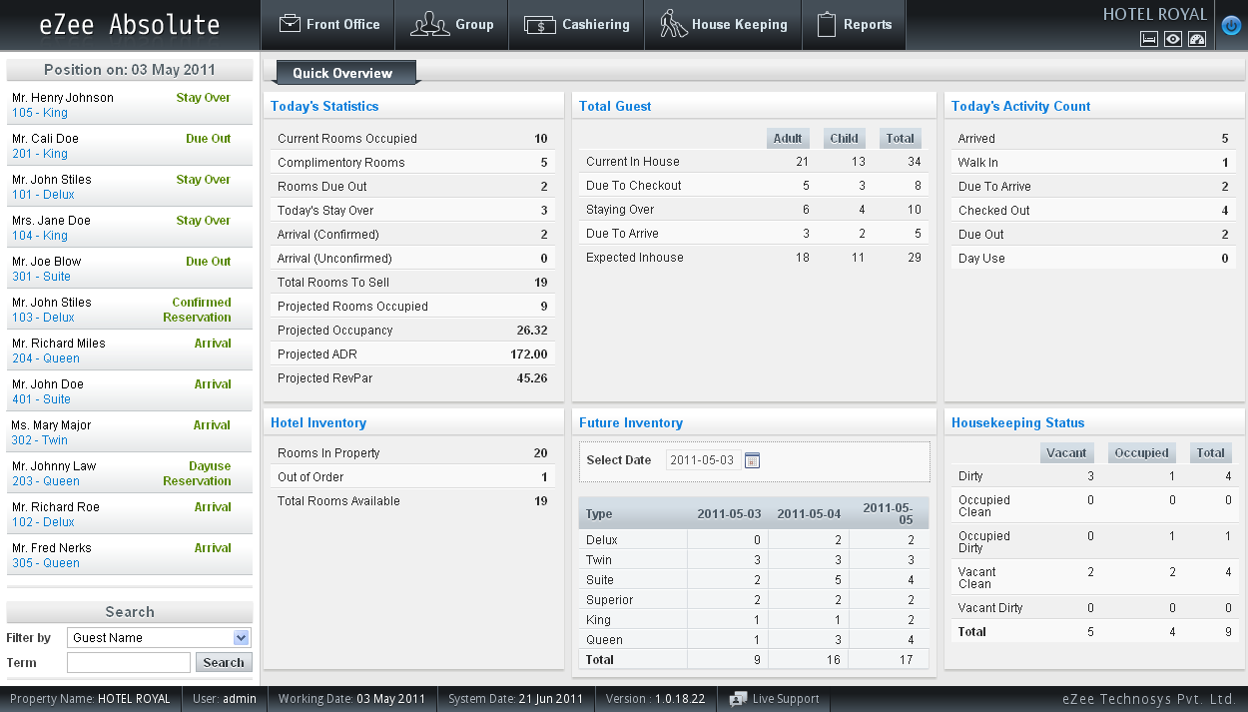
Room Views
Report View
Dashboard View
Stay View
Quick View
eZee Absolute offers variety of System view specially designed for different departments of your property

Slide 10
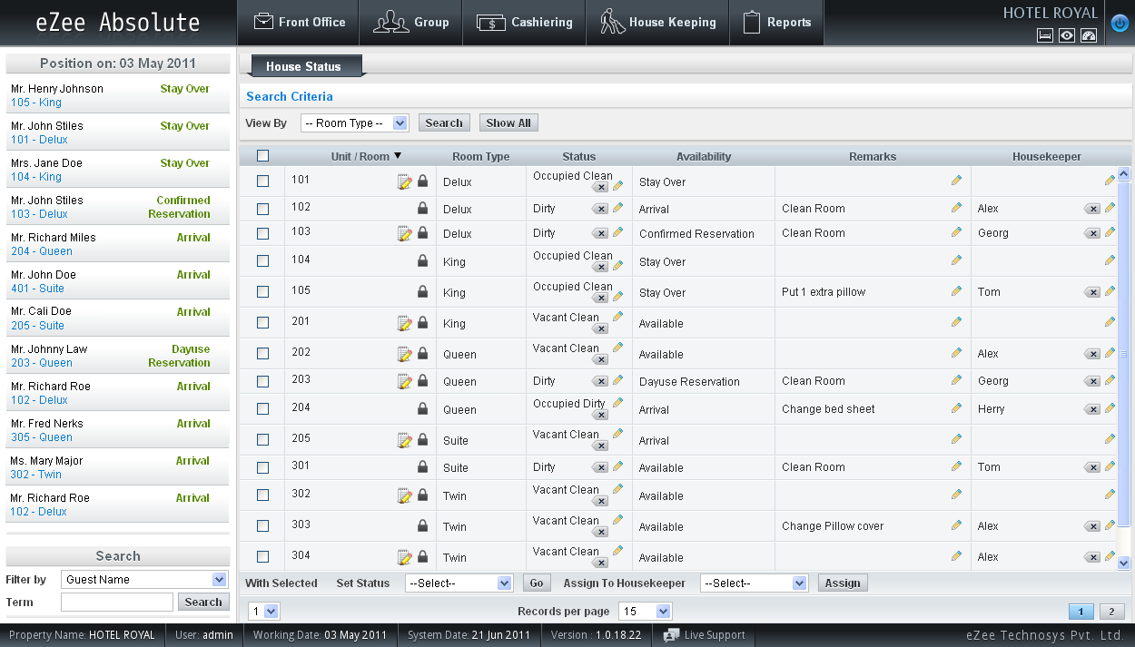
House Keeping
House keeping module facilitates to effectively plan and schedule the house keeper and their schedules depending on current occupancy and forthcoming arrival and departure. House keeping department can use their own codes for room status.

Slide 11
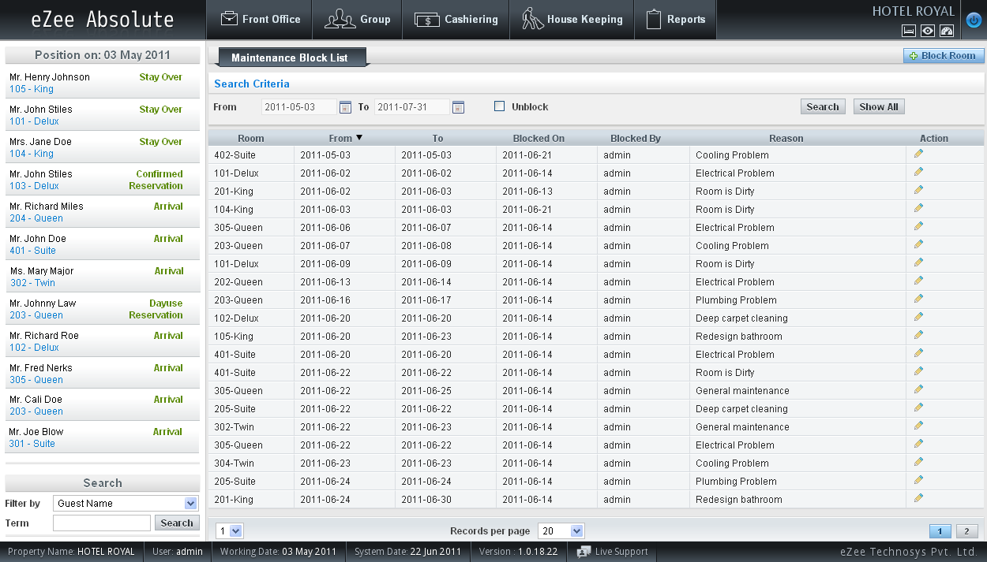
Maintenance module offers functions to manage your proactive and incidental maintenance request. One can add a maintenance order and follow-up its status.
Maintenance
This helps you serve your customer better, keep maintenance block lower and maintain your assets efficiently.

Slide 12
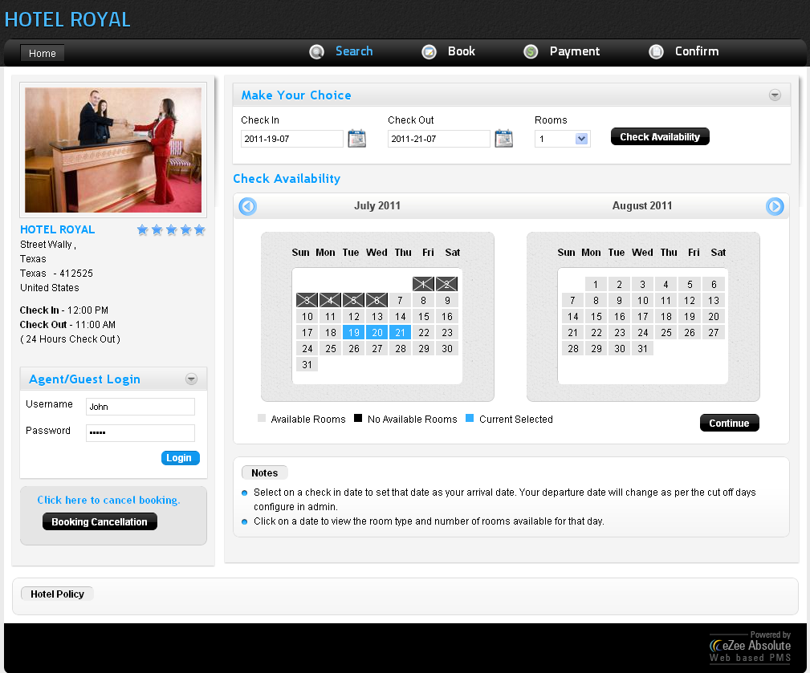
Online Booking
Engine
eZee Absolute has integrated online booking engine that helps any property to provide online booking facility to get reservation through website.

Slide 13
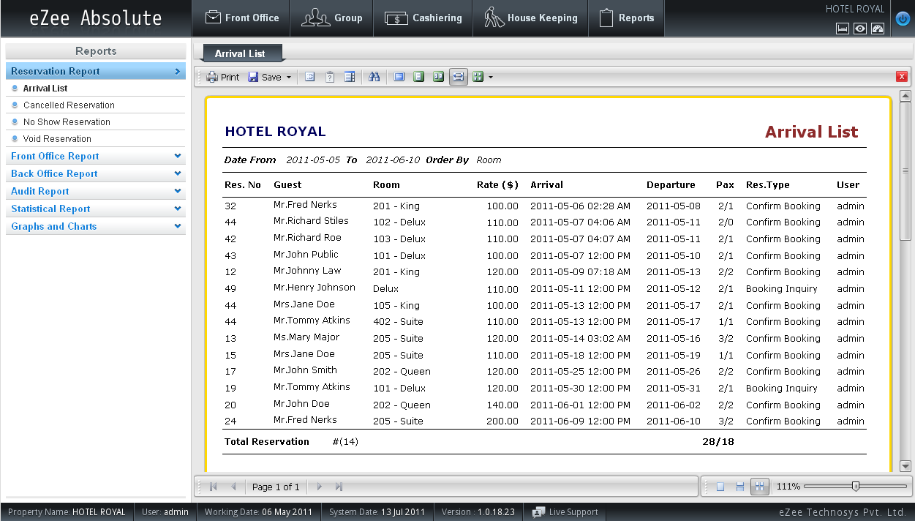
Reports
Industry standard reports to manage your business effectively.

Slide 14
Try before you Subscribe
We offer full functional Live demo of our eZee Absolute. Please visit this link for Live Demonstration – http://www.eZeeAbsolute.com
We do also offer non committal online user training during evaluation period.

Slide 15








































Corporate Headquarter
eZee Technosys Pvt. Ltd.
eZee Technosys Pvt. Ltd.
D-113, ITC, Majuragate, Surat, India.
Sales Phone: +91-97277-09911
Support Phone: +91-261-4004505
Email: support@eZeeTechnosys.com
Web: www.eZeeAbsolute.com
Level 28, Central Plaza, 34 Jalan Sultan Ismail,
Kuala Lumpur, Malaysia.
Phone: + 60-146322789
Email: malaysia@eZeeTechnosys.com
Web: www.eZeeAbsolute.com
Worldwide eZee Sales & Support Centers
New Zealand
Nigeria
Oman
Panama
Papua New Guinea
Philippines
Romania
Russia
Rwanda
Saudi Arabia
Singapore
Tanzania
Thailand
UAE
United Kingdom
United States
Vietnam
Zambia
Zimbabwe
Bahrain
Bhutan
Cambodia
Canada
Costa Rica
Denmark
Egypt
El Salvador
Ghana
Honduras
Iceland
Indonesia
Italy
Jordan
Kenya
Kuwait
Latvia
Lebanon
Malaysia
Maldives

