Slide 1
CFO Command Center
How the AI-built finance model works
Kestrel Ridge Outfitters (fictional) · AI Playground demo · November 2026
Notes:
This deck explains the CFO Command Center I shared in the AI Playground channel. It is a one-page, live finance model for a made-up company, Kestrel Ridge Outfitters. All data is simulated. Claude wrote the page; the maths runs in the browser.

Slide 2
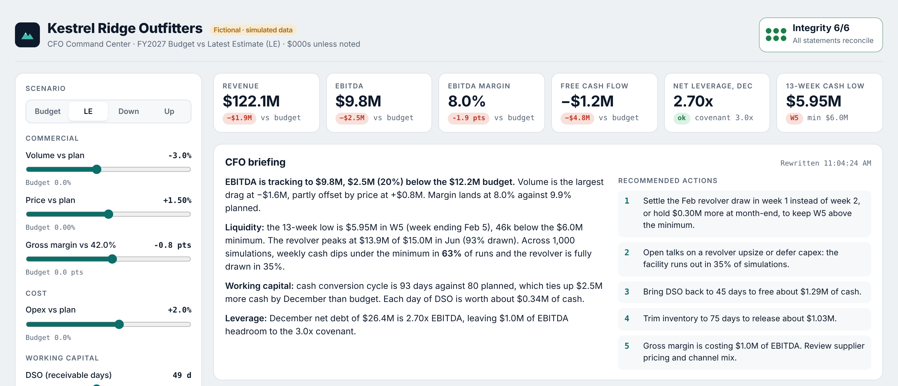
One page holds a full finance model that recalculates live
What you see: scenario sliders on the left, headline KPIs, a self-writing CFO briefing, and the integrity badge (top right). Below the fold: EBITDA bridge, 13-week cash forecast, Monte Carlo, the three statements and the checks.
Notes:
Walk people through the screen top to bottom. Left: the inputs. Top: KPIs compared with budget. Then the briefing, which rewrites itself. Top right: the integrity badge. Scrolling down shows the charts, the statements and the detailed checks.

Slide 3



Nine drivers feed one model, and the model feeds every view
Inputs
The model
Outputs
Sales: volume, price, gross margin
Cost: operating expenses
Working capital: DSO, DIO, DPO
Capital: capex, interest rate
Plus a fixed opening balance sheet
Income statement
Balance sheet
Cash flow statement
Revolver (credit line) policy
12 months in $000s, under 1 ms per run
KPIs vs budget
EBITDA bridge
13-week cash forecast
1,000 Monte Carlo runs
CFO briefing and actions
6 integrity checks
Move any slider and the whole chain reruns instantly. No number on the page is typed in by hand.
Notes:
The key idea: there are only nine inputs. Everything else is calculated from them plus a fixed opening balance sheet. When you move a slider, the browser reruns the full model, the 13-week forecast and 1,000 simulations in a fraction of a second. No AI is called while you use the page.

Slide 4
The nine sliders are the only inputs to the model
Slider | What it means | Budget | Latest estimate
Volume vs plan | How many more or fewer units we sell | 0% | −3.0%
Price vs plan | Average selling price change | 0% | +1.5%
Gross margin | Points above or below the 42% plan | 0 pts | −0.8 pts
Opex vs plan | Change in operating costs | 0% | +2.0%
DSO | Days customers take to pay us | 45 | 49
DIO | Days stock sits before it is sold | 75 | 82
DPO | Days we take to pay suppliers | 40 | 38
Capex vs plan | Capital spending vs the $450k/month plan | 100% | 100%
Interest rate shift | Change to the 7.25% borrowing rate | 0 bps | +50 bps
Presets load a full set at once: Budget, Latest estimate (LE), Downside and Upside.
Notes:
Budget is the plan. The Latest estimate preset is the current view: slightly lower volume, a small price increase, weaker margin, and slower collections. DSO, DIO and DPO are the working-capital levers. One extra day of DSO ties up about one day of revenue in cash, roughly 340 thousand dollars here.

Slide 5
The three statements are linked, so they must agree
Income statement
Cash flow statement
Balance sheet
Revenue = plan × volume × price. Costs follow margin and opex. Ends in net income.
Net income + depreciation − change in working capital − capex − debt repayments and dividends.
Cash, receivables, inventory and fixed assets = payables, debt and equity.
1
Net income → equity
2
Cash flow → cash
3
Days → working capital
Retained earnings go up by net income and down by dividends each month.
Closing cash on the cash flow statement becomes balance-sheet cash.
Receivables = revenue × DSO ÷ 30. Inventory and payables work the same way.
Revolver rule: if month-end cash would fall below the $7.5M target, borrow (up to $15M); any extra cash repays it.
Notes:
This is standard three-statement modelling. The income statement produces net income. Net income flows into the cash flow statement and into retained earnings. The cash flow statement produces closing cash, which is the cash line on the balance sheet. Working-capital balances come from the day counts. The revolver keeps month-end cash at the 7.5 million target, up to a 15 million limit. If any link breaks, the balance sheet stops balancing.

Slide 6

Six automatic checks prove the numbers tie out
Balance sheet balances
Cash ties to balance sheet
Retained earnings roll forward
Assets = liabilities + equity at every month-end
Cash flow closing cash = balance-sheet cash
Opening + net income − dividends = closing
Direct = indirect cash flow
EBITDA bridge reconciles
13-week forecast ties out
Receipts − payments = NI + D&A − working capital
Budget + volume + price + margin + opex = LE
Weeks 4, 8 and 13 equal Jan, Feb, Mar cash
They rerun after every change. The largest difference across all checks is under one cent.
Notes:
These are the same checks a finance reviewer would do by hand. The page computes each one after every recalculation and shows the largest difference it finds. On every preset they all pass, with differences under a cent, which is just computer rounding.

Slide 7
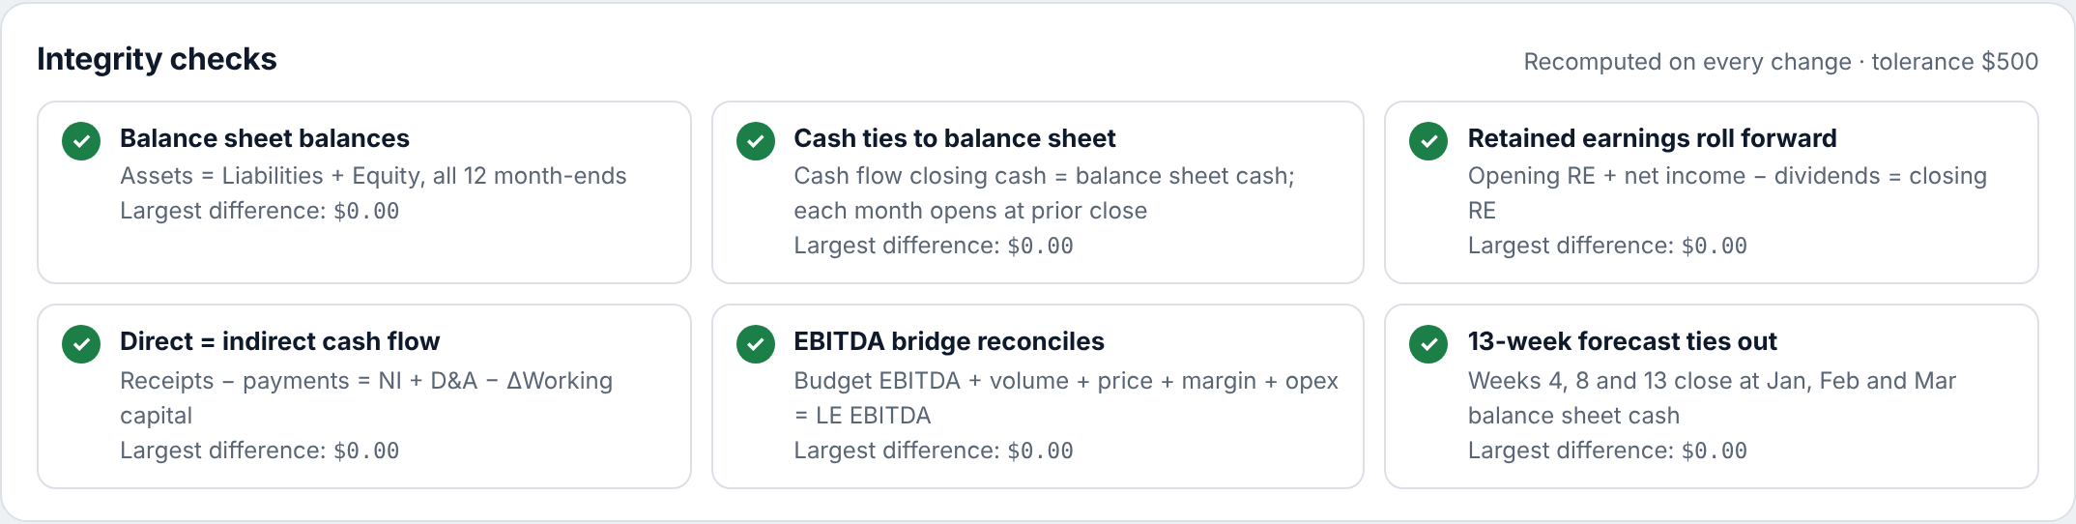
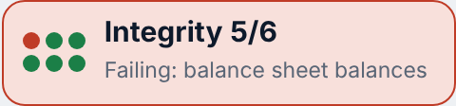
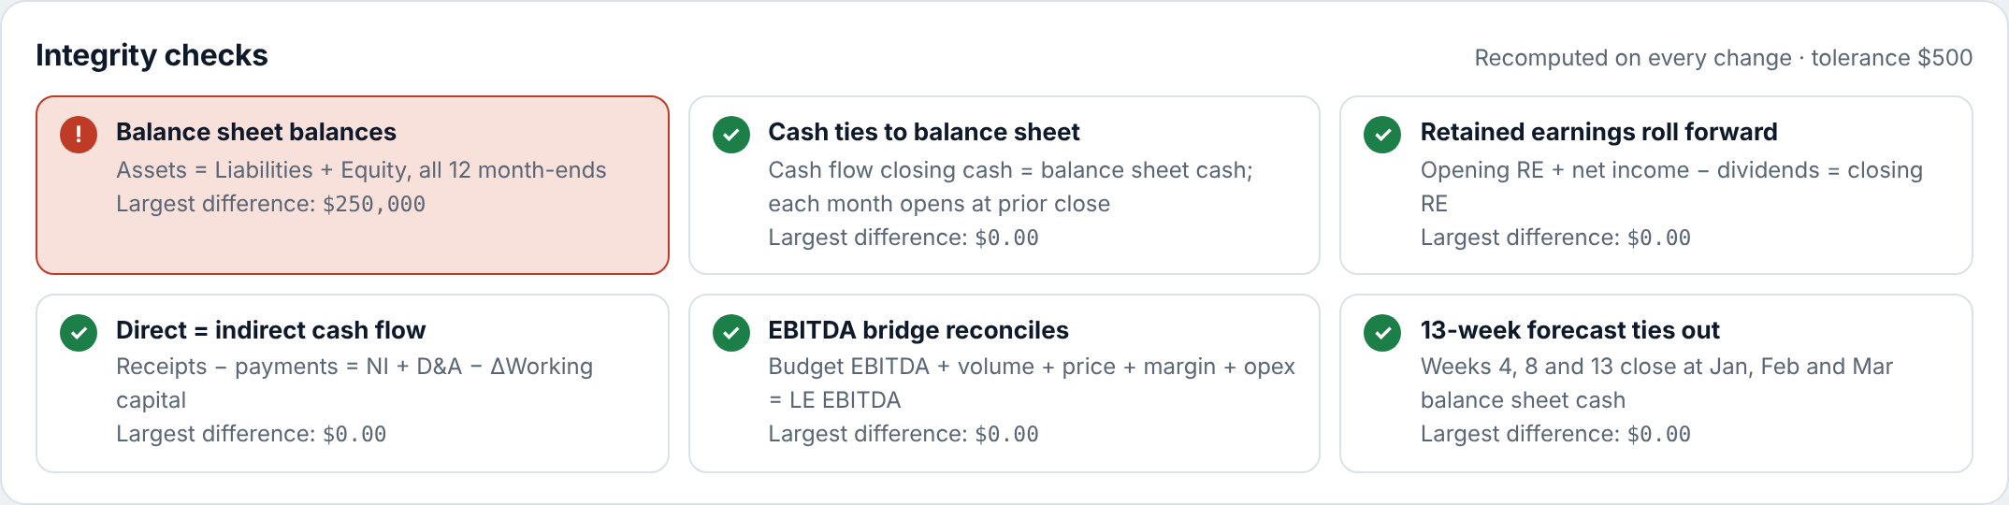
Typing over one number turns the badge red
Before: all six checks pass
What the switch does
Adds $250k to June receivables without flowing it through cash or equity, like a hard-coded cell in Excel.
Why it matters
Typed-over numbers are the most common spreadsheet error. Here the model catches it and the briefing warns the numbers are unreliable.
After: June receivables typed over by +$250k
Notes:
This is the best part to demo live. Tick "Type over a cell" in the left panel. It adds 250 thousand dollars to June receivables without updating anything else, exactly like someone overwriting a formula. The balance sheet check fails, the badge goes red at 5 of 6, the June cell is highlighted, and the briefing shows a warning. The LinkedIn post this is based on made the same point: the value is a model that checks its own work.

Slide 8
Lower volume is the biggest reason EBITDA misses budget
$2.5M
EBITDA shortfall vs budget (−20%)
Volume −3% costs $1.6M of gross profit.
A 1.5% price rise gives back $0.8M.
0.8 pts lower margin costs $1.0M.
Opex 2% over plan costs $0.7M.
Notes:
The bridge walks from budget EBITDA of 12.2 million to the latest estimate of 9.8 million. Each bar is calculated, and the bars must add up exactly; that is check number 5. Volume is valued at the budget margin, price at the budget margin, the margin bar is the margin change times actual revenue, and opex is the cost difference.

Slide 9
Cash dips below the minimum mid-month, not at month-end
$5.95M
Low point, week 5 (w/e Feb 5)
Customers mostly pay late in the month.
Suppliers are paid in weeks 1 and 3; payroll every two weeks.
Revolver cash arrives in week 2, so the first week of each month is the pinch.
Fix: draw in week 1, or hold more cash at month-end.
Notes:
The 13-week forecast splits January to March cash into weeks using realistic timing. The weeks always add back exactly to month-end cash; that is check number 6. Month-ends sit at the 7.5 million target because of the revolver, but in week 5 cash drops to 5.95 million, just under the 6 million minimum. A monthly model would never show this. That is why treasury teams use 13-week forecasts.

Slide 10

1,000 simulations turn one forecast into a range of outcomes
63%
35%
$5.72M
$7.0–12.6M
of runs dip below the $6.0M minimum in some week
of runs fully use the $15M credit line
1-in-10 worst weekly cash low (P10)
FY EBITDA range, P10 to P90
Shake the inputs
Add demand noise
Rerun everything
Each run nudges volume, price, margin, opex and the day counts randomly around your slider values.
Each month gets its own random ±3% wobble in sales.
The full model and 13-week forecast run 1,000 times, in about 30 ms.
Figures shown are for the Latest estimate preset. "Re-run" on the page draws a fresh set of 1,000.
Notes:
A single forecast hides risk. Monte Carlo asks: if the inputs move around a bit, how often do things go wrong? In the latest estimate, 63 percent of runs dip below minimum cash in at least one week, and 35 percent use the full credit line. On the page this shows as the shaded band on the cash chart and the histogram of weekly lows. Try the Downside preset: the credit line is used up in most runs.

Slide 11

The CFO briefing is written by rules, not by a chatbot
How it decides what to say
Example output (LE)
If the biggest bridge bar → becomes the headline driver
"EBITDA is tracking to $9.8M, $2.5M (20%) below the $12.2M budget. Volume is the largest drag at −$1.6M, partly offset by price at +$0.8M."
"Leverage of 2.70x leaves $1.0M of EBITDA headroom to the 3.0x covenant."
If the lowest week is below $6.0M → suggests drawing the revolver earlier
If DSO is above 45 days → shows the cash freed by collecting faster
If DIO is above 75 days → shows the cash freed by cutting stock
If leverage is above 2.75x → flags covenant risk
Notes:
People often assume an AI is writing the commentary live. It is not. Claude wrote the rules into the page. Each sentence is a template filled with the computed numbers, and actions only appear when a rule triggers. That makes the commentary fast, repeatable and auditable: the same inputs always give the same words.

Slide 12
A two-minute live demo
1
2
3
4
5
Start on LE
Click Down
Drag DSO to 60
Tick "Type over a cell"
Untick and click Re-run
Point at the badge (6/6) and read the first briefing sentence.
EBITDA falls, leverage breaches 3.0x, the briefing rewrites itself.
Watch the cash chart and actions update instantly.
The badge turns red at 5/6. This is the money shot.
Fresh 1,000 simulations; the badge is green again.
Tip: open the link in an incognito window first to confirm colleagues can see it.
Notes:
Keep the demo short. Show the green badge, switch to the Downside preset to show everything moving together, drag one slider, then tick the "Type over a cell" box to show the model catching an error. Untick it to show it recovers.

Slide 13

Questions colleagues are likely to ask
Is this real company data?
Is AI running while I use it?
No. Kestrel Ridge is fictional and every number is simulated.
No. Claude wrote the code; the maths is plain JavaScript in the browser.
How long did it take?
Could we use it on our numbers?
A few prompts in one session, plus checking the output.
Yes, with care: swap the drivers and opening balance sheet, then review every formula.
Why trust the numbers?
What are its limits?
Six accounting checks rerun on every change and must all pass.
Simplified tax and debt terms, no prior-year history. It is a demo, not an audited model.
Notes:
Be clear that this is a demo with simulated data. The main message is what AI can build quickly, and that the model is checked by standard accounting logic rather than trusted blindly. For real use, the inputs and formulas would need review by the finance team.

Slide 14
AI built the model. Accounting logic keeps it honest.
Nine inputs · three linked statements · six live checks · 1,000 simulations
Try it: link in #ai-playground
Notes:
Close on the takeaway: AI can build a working finance tool in a few prompts, and the trust comes from building in the same checks a good analyst would. Invite people to try the link and break it.

