Slide 1
Product Presentation
The Furniture Store

Slide 2
FURNITURE
Chairs

Slide 3
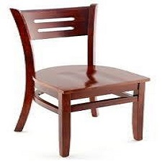
Premium Rome Series Wood Chair
Teak Wood
Polished
Protective Foot Glide Insert
$299.00

Slide 4
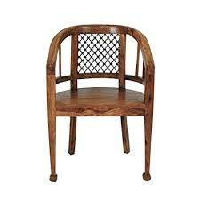
Craftatoz Wooden Chair
100 % Sheesham wood
Finest polishing
Creative curves and contours
$399.00

Slide 5
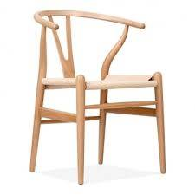
Wish Chair - Beech / Natural
Beech Wood Frame
Paper Rope Seat
Steam Bent Back Rail
$299.00

Slide 6
DECO
Lamp Shades

Slide 7
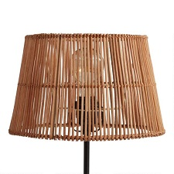
Natural Rattan Accent Lamp Shade
Crafted of natural rattan
10.2"Dia. x 6.7"H
Works with uno socket lamp bases only
$17.00

Slide 8
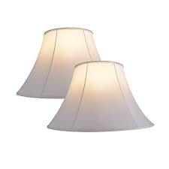
Beige Lamp Shade
2 pack transitional hardback
7" Dia. x 8.6"H
$20.00

Slide 9
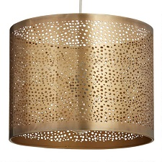
Brass Pierced Table Lamp Shade
Handcrafted of iron with antique brass finish
Works with uno socket lamp bases only
$50.00

Slide 10
DECO
Wall Clocks

Slide 11
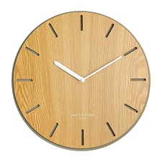
Gabriel Clock
High-quality silent quartz movement
Industry-leading 5-year manufacturer's warranty
$109.00

Slide 12

Fenton Wall Clock
Time Display: Analog
Shape: Round
Material: Plastic
$37.00

Slide 13

Wooden Metal Wall Clock
Classical black metal hands
large roman numerals
Silent non-ticking
$106.00

